Slide 1
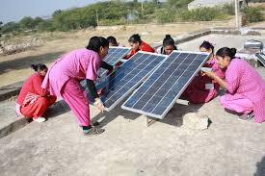

Powered by Women
The benefits of diversity

Slide 2
‘There is such a shortage across the globe of skilled personnel in the mining and engineering disciplines that if we don’t capitalize on diversity we will never make up the shortfall’
‘Rio Tinto, The gender agenda, March 2010, p 19’

Slide 3
Gender Action Plan (GAP)
A GAP has been developed jointly with PPA to encourage a greater representation of women in the utilities;
GAP focusing on not only overall employment of women in the sector, but employment and career paths in technical roles;
Enhanced training and engagement at University level to encourage women to consider less traditional roles;
Specifically, PPA interest in gender mainstreaming in the PICs’ energy sector includes work on the annual Pacific Power Utilities Benchmarking Report, which details job levels by gender across national power utilities.

Slide 4
Data Results – Overall Employment
We must get in front of any downward trend

Slide 5
Data Results – Technical Roles
7% Females in technical roles

Slide 6
Why are Women good for business?
As Employees
In the community
Employment of women creates a company reputation based on sound employment practices and ensures the best and brightest potential candidate consider the company an employer of choice.
Over 70% of potential candidates consider diversity as a major factor in company choice
Women have greater social engagement in their community and can be champions of change.
Women immediately feel the benefit of the change to clean energy.
Women have the potential to accelerate the energy-system change.
Notes:
A growing body of research shows that a broad set of business benefits is associated with gender diversity on corporate boards. These include improved financial performance and shareholder value, increased customer and employee satisfaction, rising investor confidence, and greater market knowledge and reputation (IFC, Women on Boards, 2016)
Copenhagen Uni Stats from 2012
Companies that are not seen as supportive of women’s employment risk being seen as dinosaurs who are not attractive career prospects to the increasingly inclusive mindset of the upcoming generation of workers.

Slide 7


Case Study: Solar Sister
Empowering women and communities through clean energy;
Redefining the role of women in off-grid communities;
Providing opportunities for women to become clean-energy entrepreneurs;
Massive multi-generation community benefits;
Health benefits;
Financially empowering.
Double household income
30% reduction in household expenses when solar replaces kerosene
3 hours more study time for children everyday when solar lamp replaces kerosene
$46 of economic impact generated for every $1 invested in a Solar Sister Entrepreneur

Slide 8


Case Study: GE – The Economic Impact
In 2017 GE launched an to boost female employees in technology roles to 20,000 by 2020 and establish an even gender ratio for all technical entry-level programs. This is a 36% increase for women in technical roles.
GE has found that nearly 40% of women with engineering degrees either leave the profession or never enter the field.
According to the OECD, closing the gender gap could increase GDP by up to 10% by 2030, with OECD studies showing that more gender-diverse companies perform 53% better than less diverse companies.
How do we capture the imagination of girls who are interested in STEM? How do we market to potential employees? How do we bring the potential of a STEM career to life?
“We’ve been collaborating more and more with GE’s university relations department, and doing things on campus that bring the STEM experience to life in a fun way”.

Slide 9

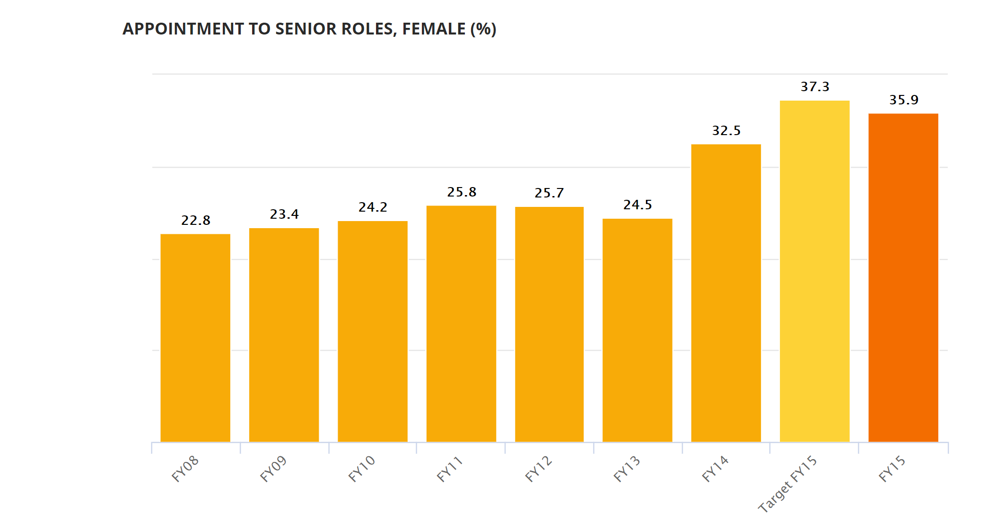
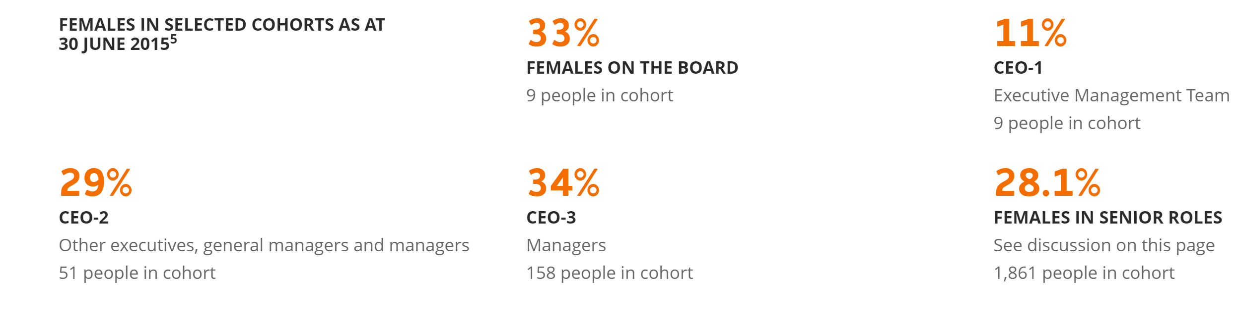
Case Study: Origin Energy
Origin is an integrated energy company encompassing exploration, production, power generation
and retailing
Recognised as a world-leader in providing equal opportunities in the energy sector.

Slide 10
What will I be working on?
Working with PPA until end of Nov 2017
By end of August 2017 proposal regarding the gender dimension of HR Practices of the power utilities associated with PPA
Draft report and recommendations including Human Resource Development policy options by mid October 2017
Final report incorporating feedback from PPA, power utilities, and World Bank by early November 2017

Slide 11
What I need from you to assist your utility reach full potential
Gender data is essential in identifying current issues and ensuring effectiveness of proposed solutions
Establish metrics to track progress
Establish processes to ensure leadership buy in and encourage ongoing momentum and support
Over the coming days let’s talk and see what we can achieve together for your utility!

