Slide 1
AC Bus Hybrid System Workshop

Slide 2
Introduction
Walkthrough of design of AC bus Hybrid system with the following design decisions:
Generator used daily to meet demand
PV array is connected via a PV inverter
Generator design and installation guidance can be found within Hybrid Design and Installation Guideline, however sizing of PV array and battery bank is covered in Off-grid PV system Design Guideline

Slide 3
Hybrid System Overview
Any system that includes two charging sources is a hybrid system.
This overview is only considering hybrid system comprising a fuel generator and PV array.
The generator could just be for back-up when the solar is insufficient to meet the energy demand (e.g. during periods of bad weather) or it could be required to meet some of the energy demand each day.

Slide 4
Scenario Where Generator is Used Daily
A village with 250 households is being powered by a diesel generator operating 24 hours a day, with a second generator onsite for redundancy.
This village is receiving funding via an aid project to build a PV and battery system to supplement its current diesel generator power plant.
The aim of the PV system is to reduce generator operation to 6pm – 11pm nightly.

Slide 5
Customer Requirement
Generator to operate nightly from 6pm to 11pm
Sealed lead-acid batteries to be used.
Batteries to have 3000 cycles with daily depth of discharge (DoD) no greater than 50%.

Slide 6
Site Information
Two 110kVA diesel generators, derated by 10% due to temperature to 99kVA.
Site location: Vanuatu, 15°S
Annual irradiation deficit due to shadowing (horizontal): 0%
Optimal array angle: 15° tilt
Irradiation for design month (May) is 4.59kWh/m² or 4.59PSH
Average temperature of May is 26.8ºC

Slide 7
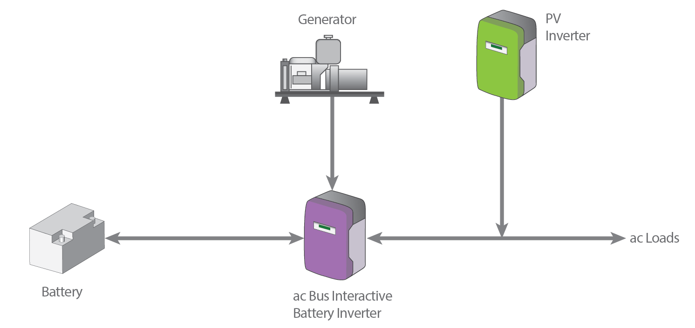
System arrangement: Parallel System- ac Bus
Nominal battery voltage: 48V
Inverter waveform – Pure sine wave for proper operation of all electronic equipment
Inverter type – ac bus interactive inverters from SMA’s Sunny Island Range—3 single phase inverters in a 3-phase arrangement

Slide 8
Site Load Assessment
Peak demand: 40kVA
Average daily energy use: 450kWh
Energy usage between 6pm and 11pm: 100kWh
Percentage of daily use occurring between 6pm and 11pm: 22%
It is assumed that the load is the same all year
The load is the greatest in the daytime due to a number of daytime commercial operations. It then remains high during the evening peak.

Slide 9
Determine battery bank capacity
Given:
Average daily energy use: 450kWh
Energy usage between 6pm and 11pm: 100kWh
i.e. Generator in new system will supply 100kWh daily between 6pm and 11pm
Battery bank capacity = Average energy use – energy used when generator is running

Slide 10
Determine energy provided by PV array and battery bank
Battery bank energy requirement = Average daily energy use – energy used when generator is running
Therefore:
Energy that must be supplied by battery bank daily is 450kWh – 100kWh = 350 kWh

Slide 11
Determining the capacity of the Battery bank
The battery bank must be sized to meet the whole daily load that is being supplied by the PV array and battery bank, as there will be days where the solar irradiation is not available.
The equation used to calculate the energy required at the battery is:
E_{BATT} (Wh) = E_{BATT_DAY} ÷ (DOD× η_{INV})
Where
E_{BATT} = energy required from the battery bank E_{BATT_DAY} = Total daily energy required from the battery η_{INV} = inverter efficiency

Slide 12
Determining the capacity of the Battery bank
Assumptions:
Battery Inverter efficiency 94%
Battery coulombic efficiency 90%
Watt-hour efficiency of the battery 80%
Given:
Client request DOD of 50%
Therefore:
E_{BATT} = E_{BATT_DAY} ÷ (DOD× η_{INV})
E_{BATT} = 350kWh / (0.5 x 0.94)
= 744.68 kWh

Slide 13
Determining the capacity of the Battery bank (Cont’d)
For lead-acid batteries, the amp-hour (Ah) battery capacity is calculate with:
C_{x} = E_{BATT} ÷ (V_{dc} )
Where
C_{x} = capacity rating for given Cx. C₁₀ rating should be used for lead acid battery.
V_{dc} = dc voltage of system

Slide 14
Determining the capacity of the Battery bank (Cont’d)
For lead-acid batteries, the amp-hour (Ah) battery capacity is calculate with:
C_{x} = E_{BATT} ÷ (V_{dc} )
Where
V_{dc} = 48 V (safe voltage)
C₁₀ = 744.63kWh/48V
= 15,514kAh
= 15514 Ah

Slide 15
Selecting the inverter
From site load assessment:
Peak demand = 40kVA but only 35kVA during the times from 6pm to 11pm.
Apply safety factor of 10%
Peak demand = 44kVA
Peak demand required per phase is:
= 44kVA / 3
= 14.6 kVA

Slide 16
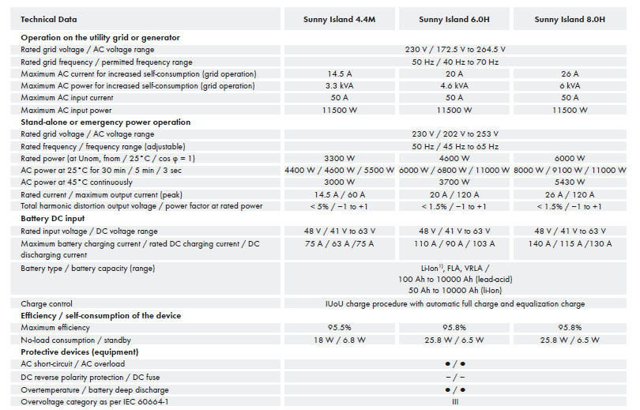
Selecting the inverter
Peak demand required per phase is:
= 14.6 kVA
Two options: 3 x Sunny Island 8.0H(3 x 6 kW = 18kW), or
4 x Sunny Island 6.0H (4 x 4.6kW = 18.4kW)

Slide 17
Selecting the inverter
Sunny Island 8.0H chosen, partitioned into groups (clusters) of 3 inverters to form a 3-phase grid.
3 clusters needed to exceed 14.6kVA per phase
9 inverters needed in total

Slide 18
Selecting a Battery Model
The battery bank will is selected from the Sonnenschein Solar range of batteries due to it meeting the 3000+ cycle at 50% DoD requirement.
The required battery capacity is 15514Ah, the largest battery in this range has a capacity of 3036Ah at C₁₀ , so three parallel banks will be required. (15514/3036 =5.11 (Round up to 6)> 2 )
Therefore each string should have capacity greater than:
= 15514/6 = 2585.6 Ah.

Slide 19
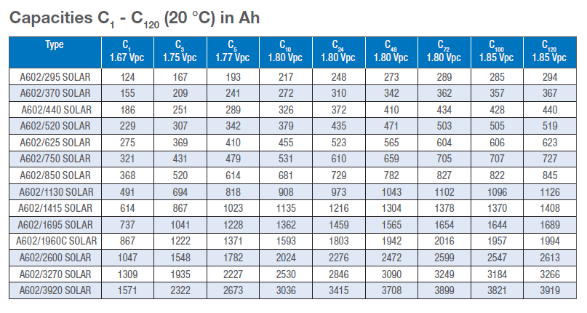
Selecting a Battery Model
From the table below the battery that is greater than 2586 Ah at C₁₀ is the model number A602/3920 with 3036Ah
Six strings (connected to 3 cluster of inverters) would provide a battery bank of 6 x 3036= 18216Ah. 17% greater than required.
Model A602/3270 has a C₁₀ rating of 2530Ah but is smaller and only about 2.2% less than the energy required. (6 x 2530 Ah = 15180Ah, 15180/15514 = 0.978)
In this case, A602/3270 is acceptable, but in other situations final decision may come down to undertake full life cycle analysis in real life events

Slide 20
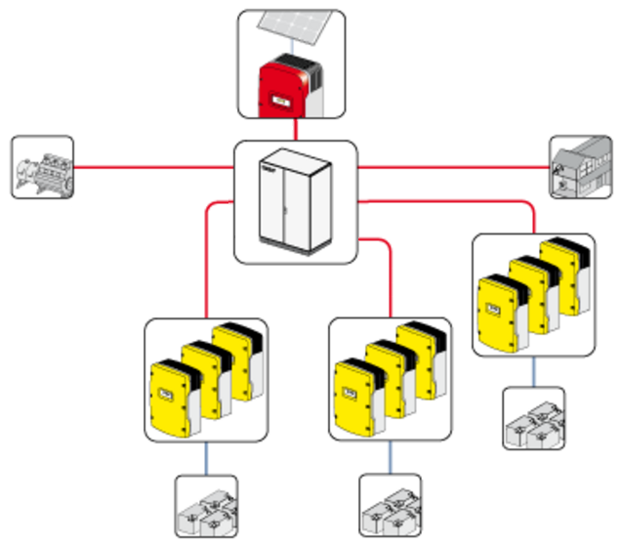
Battery arrangement
6 strings of battery bank, 2530 Ah and 48V each, need to be connected to 3 clusters of 3-phase inverter.
Battery capacity to be spread as evenly across inverters as possible
Each inverter clusters connected to 2 x 2530 Ah banks in parallel

Slide 21
Sizing the Battery Charger
Check Generator availability
Each night the generator will operate for 5 hours. The generator is derated to 99kVA while the maximum (peak demand) during the hours that the generator operates is 35kVA.
Therefore, the minimum available capacity available for charging the batteries
= 99kVA-35kVA = 63kVA
Nameplate capacity of system inverters
= 9 x 6kVA = 54kVA < 63kVA

Slide 22
Sizing the Battery Charger
Calculate maximum charge current
The chosen inverter, SMA Sunny Island 8.0H has a maximum charge current of 140A at full rating of 6kW. Three inverters making three phases gives the maximum charge current of
= 3 x 140A = 420A

Slide 23
Sizing the Battery Charger
The maximum charging current for a battery is 0.1x C10 capacity rating. The maximum charge current for the selected battery bank is
= 0.1 x 5060
= 506A each for two parallel strings connected to an inverter cluster
Notes:
Maximum charge rate notes:
the maximum charge rate is generally less than the maximum discharge rate,
the batteries have to be capable of providing the maximum demand drawn from them by the inverter.

Slide 24
Sizing the Battery Charger
Each inverter clusters’ maximum charge current is 420A;
The battery bank can accept up to 506A of charge current.
As 506A > 420A, the battery can accept the inverter’s maximum charge current.
Notes:
Maximum charge rate notes:
the maximum charge rate is generally less than the maximum discharge rate,
the batteries have to be capable of providing the maximum demand drawn from them by the inverter.

Slide 25
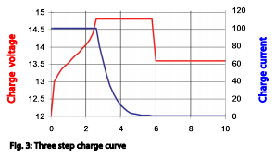
Daily energy charged by generator
Estimate charging current
Sunny Island 8.0H has a maximum charge current of 140A, at 1.8V per cell for 24 cells, this gives 6048kVA.
However as the battery voltage rises the current will decrease.
To be conservative we assume that the average charging current while the genset is operating is 110A per inverter.
The estimated charge current for the whole system would be:
= 110A x 9
= 990A

Slide 26
Daily energy charged by generator
Calculate charge capacity
The charge capacity = charge current x charging duration. Therefore the charge capacity of the battery bank if it is charged for 5 hours is
= 5h x 990Ah = 4950Ah

Slide 27
Daily energy charged by generator
Calculate energy supplied by generator via battery
With a battery columbic efficiency of 90%, DC interactive inverter efficiency of 94% and battery system voltage of 48V, the daily energy that will be supplied by the batteries which is charged by the generator is
E_{GEN_BATT}= (4950 x 0.9 x 0.94 x 48)/1000
= 201.009 kWh
= 201 kWh

Slide 28
Determine the portion of energy that is to be supplied by the PV array
For a hybrid system where the generator is operating daily, the total daily energy requirement is determined as follows:
E_{LOAD}= E_{GEN} + E_{GEN-BATT}+ E_{PV-DIR} + E_{PV-BATT}
Where
E_{LOAD} = Total daily energy
E_{GEN} = Portion of daily energy being supplied directly by generator
E_{BATT_GEN} = Portion of daily energy being provided by battery bank being charged by generator.
E_{PV_DIR} = Portion of daily energy that will be provided by the PV array
E_{PV_BATT} = Portion of daily energy being provided by battery bank being charged by PV array

Slide 29
Determine the portion of energy that is to be supplied by the PV array
Rearrange the equation, the portion of daily energy that will be provided by the PV array is
E_{PV} = E_{PV-DIR} + E_{PV_BATT} = E_{LOAD} – E_{GEN} – E_{GEN_BATT}
We know that
E_{LOAD} = 450kWh
E_{GEN} = 100kWh
E_{GEN_BATT} = 201kWh
Therefore
E_{PV} = 450 – 100 –201
= 149 kWh

Slide 30
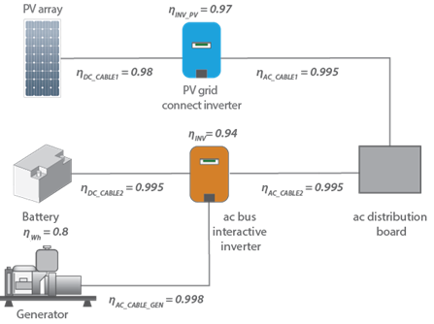
Determining Size of PV Array
The AC load to be supplied by the PV array is 149kWh
The irradiation is 4.59 kWh/m²/day.
A block diagram is useful to show all major losses.
Many principles in this section are covered in grid-connect and off-grid PV systems design guidelines

Slide 31
System Information
System efficiencies
Battery coulombic efficiency (η_{COUL}) 90%
Watt-hour efficiency of the battery (η_{WH}) 80%
Inverter efficiency(η_{INV}) 94%
Inverter efficiency when acting as charger (η_{INV_CHG}) 94%
PV inverter efficienc (η_{PV}) 97%
Oversize coefficient (f_{o}) 1
Dirt de-rating(f_{DIRT}) 95%
Ambient Temperature 26.8°C
System characteristics
Nominal power rating (P_{STC}) 290W_{p}
Power tolerance (f_{MAN}) +0W to 5W Equivalent to
P_{max} Temp Co-efficient(γ) -0.39% / °C

Slide 32
Calculate PV Module Derated Power
PV module power is effected by temperature
To calculate temperature derating factor:
𝐹_{TEMP}=1+[𝛾×(𝑇_{CELL−EFF}−𝑇_{𝑆𝑇𝐶} )]
Where
𝑇_{CELL−EFF} = ambient temperature + 25 ℃
= 26.8 ℃ + 25 ℃
Therefore
F_{TEMP} = 1+[-0.39/100×(26.8℃+25 ℃−25℃)]
= 0.896

Slide 33
Calculate PV Module Derated Power
PV Module power, derated for local condition, is calculated by the equation:
P_{MOD} = P_{STC}×F_{MAN}×F_{TEMP}×F_{DIRT}
P_{MOD} = 290 W × 1 × 0.896 × 0.95
= 246.7 W
= 247W

Slide 34
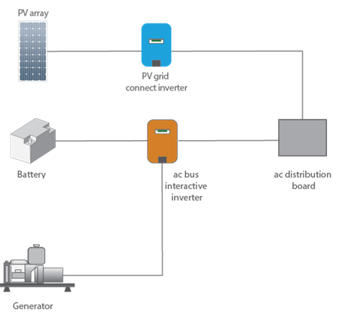
Calculate PV Array Required
PV direct energy path
The PV array need to provide 149kWh/day. There are two ways this can happen:
Provide energy directly to loads during the day
Provide extra energy to battery during the day, to discharge from battery during the night
Energy losses is greater for charging battery for later use, therefore the PV array requirement needs to be separately calculated.
Energy path for
stored energy

Slide 35
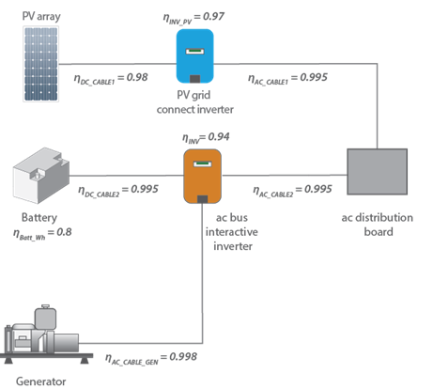
Calculate Number of Modules Needed for Energy from PV Directly
PV direct energy path

Slide 36
Calculate Number of Modules Needed for Energy from PV Directly
The energy directly supplied by the PV array is calculated by:
E_{PV_DIR} = E_{ac5} = P_{MOD} × N × H_{TILT} × η_{PV} × η_{PV-Load}
where:
E_{ac5} = ac energy directly supplied by PV Array (Wh)
P_{MOD} = derated power from a module (W)
N = number of modules in the array (Dimensionless)
H_{ILT} = daily irradiation (in PSH) for the specified tilt angle and orientation (hour)
η_{PV} = PV Inverter efficiency (dimensionless)
η_{PV-Load} = cable (transmission) efficiency (dimensionless)

Slide 37
Calculate Number of Modules Needed for Energy from PV Directly
Rearrange the equation, The number of solar modules required in the arrays is determined as follows:
𝑁_{𝑃𝑉_DIR}=𝐸_{PV_DIR}/(𝑃_{MOD}×𝐻_{TILT}× 𝜂_{PV} × 𝜂_{PV _LOAD} )
where:
P_{MOD} = 247W
H_{TILT} = 4.59 PSH
Ƞ_{PV} = 0.97
Ƞ_{PV_LOAD}
= Ƞ_{ac_cable1} x Ƞ_{dc_cable1}
= 0.995 x 0.98
= 0.9751
PV direct energy path

Slide 38
Calculate Number of Modules Needed for Energy from PV Directly
Assume that 100% of the remaining load can be met directly with PV
i.e. E_{PV_DIR} = 149kW = 149,000W
Number of modules required would be:
N_{PV_DIR} = 𝐸_{PV}/(𝑃_{MOD}×𝐻_{TILT}× 𝜂_{PV} × 𝜂_{PV _Subsys} )
=149000/(247 ×4.59 × 0.97 × 0.9751)
= 138.95
= 139 modules

Slide 39
Calculate Number of Modules Needed for Energy from PV Directly
Assume that 100% of the remaining load can be met directly with PV
Array Size would be
139 modules × 290W
= 40310Wp
= 40.31 kWp

Slide 40
Calculate Number of Modules Needed for Energy from PV via Battery
Energy path for
stored energy

Slide 41
Calculate Number of Modules Needed for Energy from PV via Battery
The energy supplied by the PV array via the battery is calculated by:
E_{PV_BATT} = E_{ac6} = P_{MOD} × N × H_{TILT} × η_{PVINV} × η_{INV-CHG} × η_{WH} × η_{INV} × η_{PV-Load}
where:
E_{ac6} = ac energy directly supplied by battery bank charged by PV Array (Wh)
P_{MOD} = derated power from a module (W)
N = number of modules in the array (Dimensionless)
H_{TILT} = daily irradiation (in PSH) for the specified tilt angle and orientation (hour)
η_{WH} = Watt-Hour efficiency of the battery (dimensionless)
η_{PV} = PV Inverter efficiency (dimensionless)
η_{INV_CHG} = Inverter efficiency acting as battery charger (dimensionless)
η_{INV} = Inverter efficiency (dimensionless)
η_{PV-Load} = cable (transmission) efficiency (dimensionless)

Slide 42
Calculate Number of Modules Needed for Energy from PV via Battery
Rearrange the equation, The number of solar modules required in the arrays is determined as follows:
$N_{PV}=$𝐸_{PV}/(𝑃_{MOD}×𝐻_{TILT} × η_{PV} × η_{INV-CHG} × η_{WH} × η_{INV} × 𝜂_{PV _LOAD} )
where:
P_{MOD} = 247W
H_{TILT} = 4.59 PSH
Ƞ_{PV} = 0.97
Ƞ_{INV-CHG} = 0.94
Ƞ_{WH} = 0.8
Ƞ_{INV} = 0.94
Ƞ_{PV_LOAD} = Ƞ_{dc_cable1} x Ƞ_{ac_cable1} x Ƞ_{ac_cable2}
x Ƞ_{dc_cable2} x Ƞ_{dc_cable2} x Ƞ_{ac_cable2}
= 0.98 x 0.995^5
= 0.9557
Energy path for
stored energy

Slide 43
Calculate Number of Modules Needed for Energy from PV via Battery
Assume that 100% of the remaining load will be met with stored battery energy charged from the PV array
i.e. E_{PV_BATT} = 149kW = 149,000W
Number of modules required would be:
N_{PV_BATT} = 𝐸_{PV_BATT}/(𝑃_{MOD}×𝐻_{TILT} × η_{PV} × η_{INV-CHG} × η_{WH} × η_{INV} × 𝜂_{PV _LOAD} )
= 149000/(247 × 4.59 × 0.97 × 0.94 × 0.8 × 0.94 × 0.9751)
= 196.57
= 197 modules

Slide 44
Calculate Number of Modules Needed for Daytime load
Assume that 100% of the remaining load will be met with stored battery energy charged from the PV array
Array Size would be
197 modules × 290W
= 57130 Wp
= 57.13 kWp

Slide 45
PV Array Size Summary
If 100% of the remaining load will be met by the PV array, required PV array size is:
40.31 kWp
If 100% of the remaining load will be met with stored battery energy charged from the PV array, required PV array size is:
57.13 kWp

Slide 46
PV Array Sizing
What if we assume 50% of PV array energy will directly supply load and 50% of PV array energy will be supplied via battery?
N_{PV_DIR} = 69.475
N_{PV_BATT} = 98.25
Total number of modules required would be:
N_{PV_DIR} + N_{PV_BATT} = 167.725
= 168 modules
Array size would be
= 168 x 290Wp
= 48720 Wp
= 48.72 kWp

Slide 47
System Summary
Generator run time: 6-11pm
Spare capacity from generator during run-time is used to charge battery
Inverter model: SMA Sunny Island 8.0H
Inverter arrangement: 3 clusters of inverter, each cluster consisting of one inverter in each phase
Battery bank capacity: three 5060 Ah banks, one connected to each 3-phase inverter cluster
Battery bank arrangement: 2 x 48V strings
Minimum PV array size: 48.72kW_{P} (Assumes 50% of PV energy is directly consumed)

Slide 48
Discussion: Ratio of PV array providing direct energy and PV array charging battery
ac bus PV array suffer more efficiency losses to store energy in battery than to deliver energy directly.
A sizing program can be used to compare PV array size and genset run times to optimise the system.
Site requirements could be anywhere between readily available CAPEX and low OPEX, which favours PV, to low availability of CAPEX and somewhat higher OPEX, which favours a genset.
Notes:
Note in this example we don’t know about surge, but max demand is OK – C5 rating can provide 42768VA and max demand is only 40kVA

Slide 49
Discussion: System dc Voltage, Maximum Demand, Battery Capacity and Configuration
The appropriate system voltage
depends on the maximum charge or discharge rate that the batteries will experience, which
depends on the size and type of inverter chosen, which in turn
depends on the system load and also
depends on the system configuration (ac vs dc bus)
Note: Typically the d.c. voltage range of the chosen inverter could dictate the battery voltage.

Slide 50
Questions?

Slide 51
The End

