Slide 1
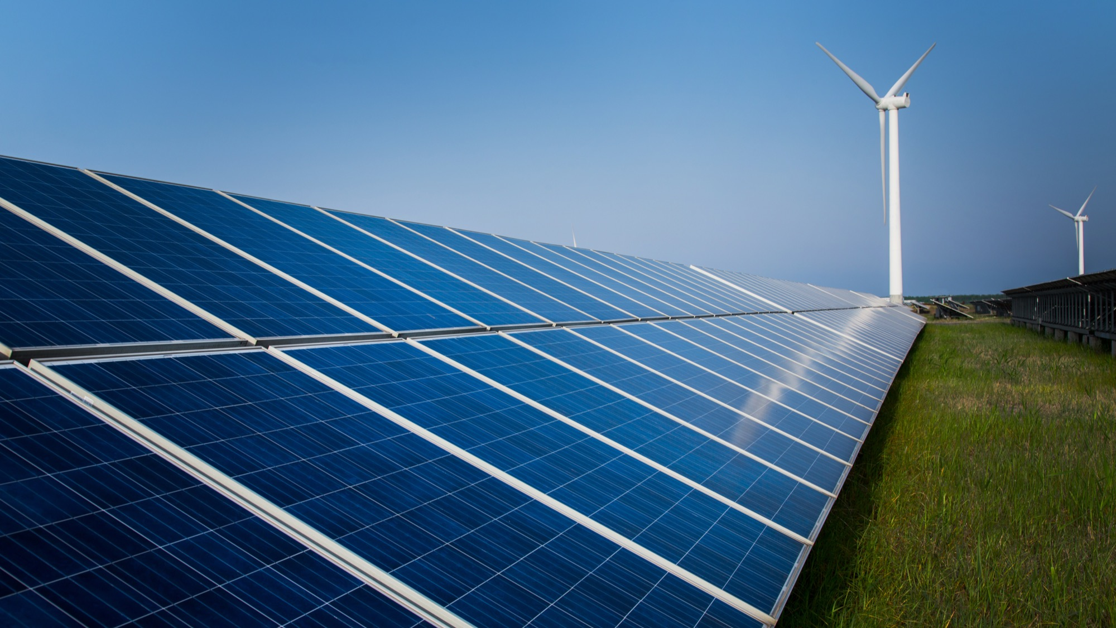


Intelligent Integration of Energy Storage Systems in the South Pacific Region
Pacific Power Association Conference 2018
Koror | Palau
July/August 2018
Wilhelm van Butselaar | Area Manager Energy Storage & Integration
Wärtsilä Singapore Pte Ltd

Slide 2

Remember?

Slide 3

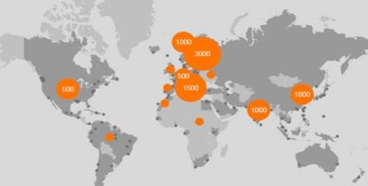

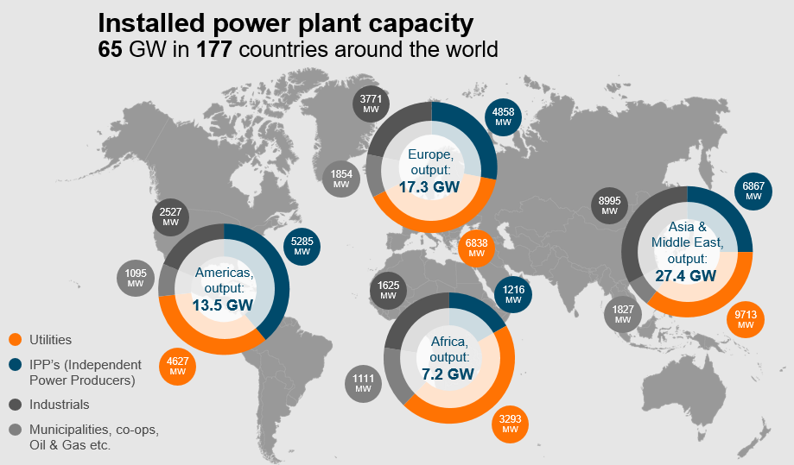
Wärtsilä corporation - introduction
SERVICES
SOLUTIONS FOR
MARINE/
OFFSHORE
POWER GENERATION
18,800 PROFESSIONALS
WÄRTSILÄ POWERING THE WORLD
Net sales
by business
2017
Services
43%
Marine
Solutions
34%
Listed in Helsinki
4,9 billion € turnover
2,6% or 136M€ in R&D
27,400 MW Installed Base in Asia & Middles East
Energy
Solutions
22%

Slide 4
Market share, <500 MW market
17.0 GW
17.4 GW
Source: McCoy Power Report
Includes GT-based gas and liquid-fuelled, <500 MW power plants with prime movers above 5 MW
Includes estimated output of steam turbines for combined cycles (factor 0.5 for industrial turbines, 0.25 for aeros)
Oil & Gas projects not included. Other combustion engines not included.

Slide 5


Introduction
+
+
+
Greensmith
A Wärtsilä Company
On July 3, 2017 Wärtsilä completed its acquisition of Greensmith
Wärtsilä
Leading systems integrator for ultra-flexible internal combustion engine based power plants, solar PV and LNG
Over 63 GW deployed in 176 countries; Strong market share in Caribbean
Global EPC capabilities
Experienced in electrically-islanded systems
Greensmith
Established energy storage leader – unparalleled experience, rapid deployment and proven performance and safety
Deployed over 150MW energy storage – including largest indoor system in North America
Leading energy storage management software controls to optimize and monetize solar + PV
Technology-neutral for best of breed and future-proofing

Slide 6
The Modern Power System in the South pacific is facing Many Challenges
The Case for Energy Storage
Renewables Penetration rates
Ramp rates and Curtailment
Less Visibility / Fluctuating Demand
Peaks shifting into evening
Aging equipment
© Wärtsilä
confidential

Slide 7

Markets for Ancillary Services are Developing Worldwide
Monetizing Energy Storage
NorthAmerica
Bilateral Agreements with various integrated utilities
CAISO
Reg Up/Reg Down
Merchant Market
Thailand
Bilateral Agreement
Philippines
Bilateral Agreement
ERCOT
REM: 60MW
Demo Market
United Kingdom
EFR 201MW
FFR > 1GW
4,2 year contracts
PJM
Reg A: >2GW
Reg D: > 250MW
Merchant Market
Germany/EU
PRC > 1GW
Weekly Auction
India
Bilateral Agreement
Puerto Rico
MTR: RRC -> FR
All solar
Hawaii
Ramping/Duck Curve
Bilateral Agreements
Australia
FCAS: >1GW
Merchant

Slide 8
Key Markets by Region
Markets Overview
  UK
    Continued EFR/FFR & capacity deployments
  Germany
    German market led by solar self-consumption -> not our strength
    PCR market has low prices
  France
    Island tenders
  Middle East
    Solar + storage applications
  Africa
    Mining/Off-grid hybrid engine opportunities
    Solar + storage applications
  USA
    Vertically integrated utilities including storage in procurement plans for FR and T&D deferral
  Caribbean Islands
    Mining/Off-grid hybrid engine opportunities
    Solar + storage applications
  Chile, Argentina
    Mining/Off-grid hybrid engine opportunities
    Solar + storage applications
  Australia
    Grid-tied market is policy-driven at state level
    Mining/Off-grid hybrid engine opportunities
  Philippines
    Hybrid engine opportunities
    Solar + storage applications
    Frequency and Voltage regulation
Thailand
Utility drives storage test systems
South Pacific Islands
Mini Grids, Increased RE
Reactive Power & f/U stabilisation

Slide 9
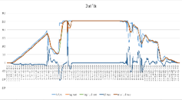
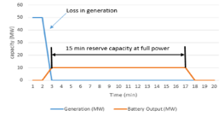
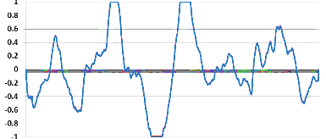
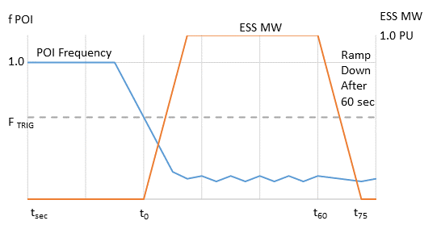
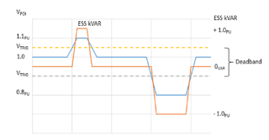
Balancing the Grid
Energy storage solves multiple problems for utilities
Frequency Response
Frequency Regulation via AGC
Bulk Capacity
10
MW
2.5
0
-2.5
⟵ Charging Capability (MW) Discharging ⟶
-10
49.95
f_{n1}
50
f_{n2}
50.2
49.8
50.05
⟵∆f (–) Frequency (Hz) ∆f (+) ⟶
Voltage Control
Storage +
Renewables
System Load Leveling
Power use cases
Energy use cases

Slide 10
Balancing the Grid
Frequency regulation services has many forms
MW
f POI
ESS MW
ESS MW
10
POI Frequency
1.0 PU
1.0
Ramp Down
After 60 sec
2.5
⟵ Charging Capability (MW) Discharging ⟶
0
F _{TRIG}
-2.5
-10
49.95
f_{n1}
50
f_{n2}
50.2
49.8
50.05
t_{sec}
t₀
t₆₀
t₇₅
⟵∆f (–) Frequency (Hz) ∆f (+) ⟶
Regulation via AGC Signal
Autonomous Response at POI
Frequency Droop Control
Frequency services | Description | GS examples
Regulation via AGC Signal | GEMS responds to an automated generator control signal to manage grid frequency deviations. Usually measured by accuracy and energy neutrality varies by market. | Frontier, Meyersdale, Beckjord, Pomona
Autonomous Response at POI | GEMS measures frequency locally and responds proportionally according to a predetermined response envelope | Texas Waves, German PCR
Frequency Droop Control/RRC | Provide near-instant reserve power in the case of a grid fault. GEMS measures frequency locally and can either dispatch centrally from a control room or autonomously from site. | Iron Horse, PRANG

Slide 11
Storage Opportunity
Renewables + Storage: A spectrum of benefits
Energy storage enhances value of PV output through multiple paths
Frequency Response
Ramp Rate Control
Renewables Smoothing
Renewables Firming
Renewables Shifting
Power-centric application
ESS Application | Description | ESS Sizing
Frequency Response | Corrects over and under frequency | 15-30 minutes
Ramp Rate Control | Mitigates ramping at generation source | 30-45 minutes
Renewables Smoothing | Maintains approximate solar curve | 1 hour +
Renewables Firming | Creates Firm committed load shape | 2 hours +
Renewables Shifting | Shifts solar to evening hours w/ or w/o commit | 4 hours +

Slide 12
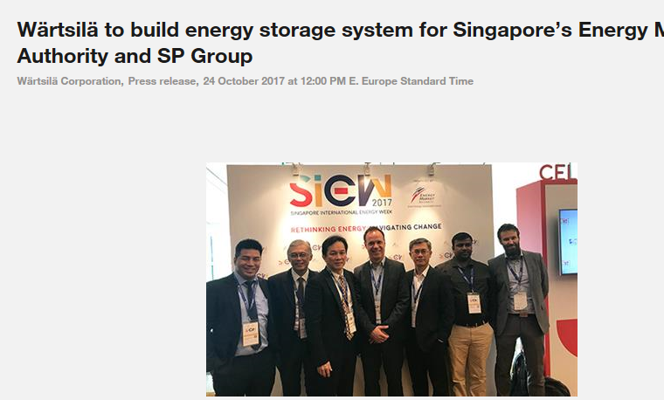
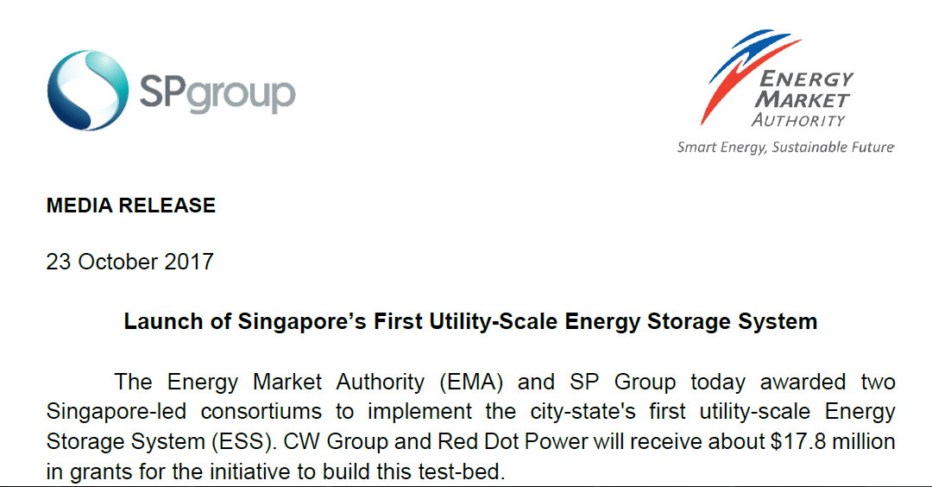
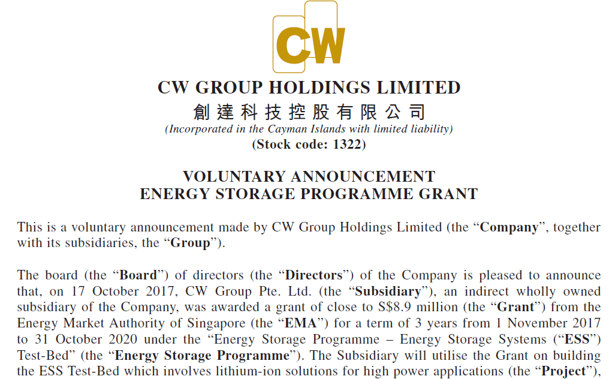
Award of 2.4MW/2.4MWh ESS Test Bed for EMA and SP Group announced in Singapore International Energy Week (SIEW) 2017 – 23 October 2017
Singapore - ESS Test Bed Project

Slide 13
Project Overview
Singapore - ESS Test Bed Project
Project | Singapore’s First Utility-Scale Energy Storage System
System Size | 2.4MW / 2.4MWh
Location | Site A - SP Group Punggol substation next to 206A Punggol Place, S(821206)
Battery Chemistry | Lithium Iron Phosphate
Use Cases | Ancillary Services
Scope | Full Turnkey EPC by Wärtsilä / Greensmith

Slide 14

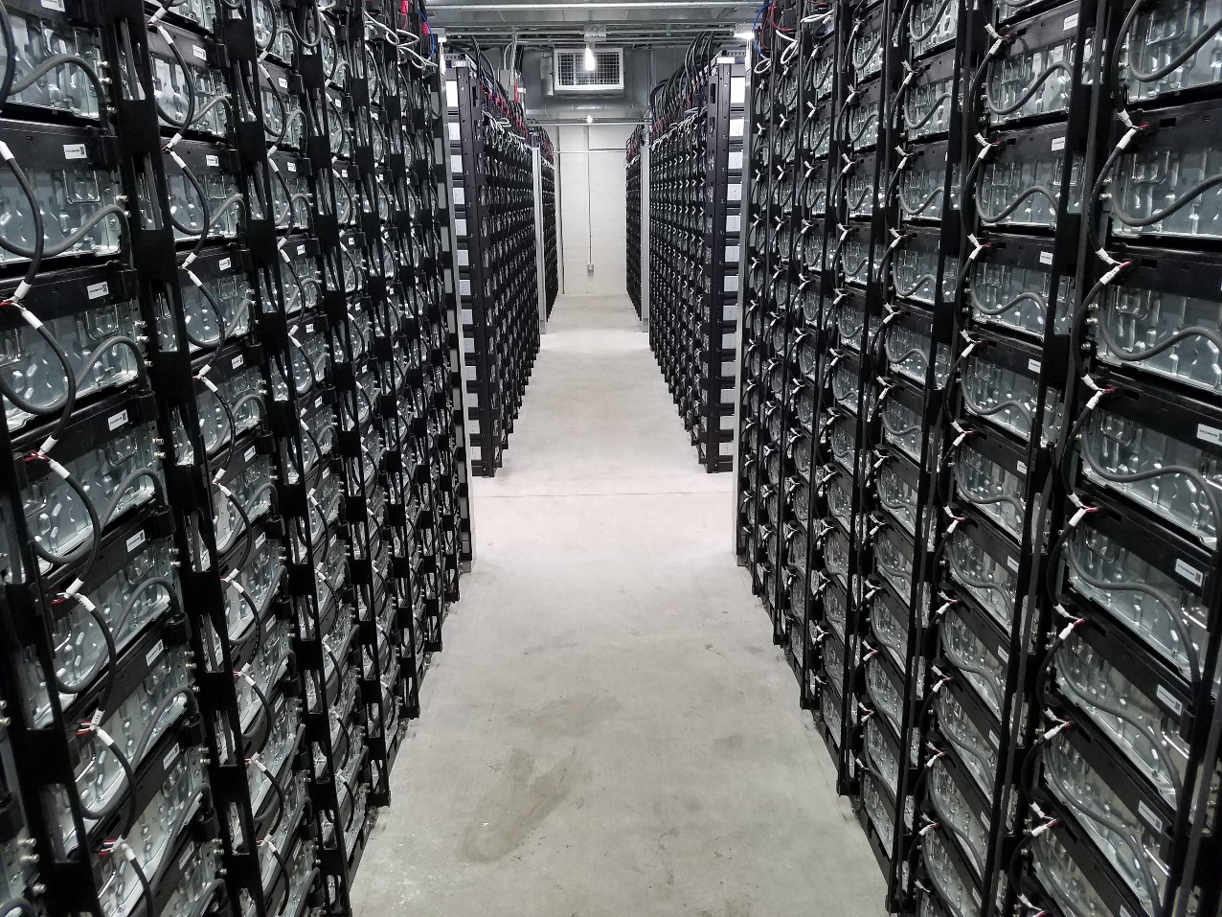
Case Study – California (US) – Multiple Revenue Models
20MW/80MWh RESOURCE ADEQUACY / FREQ. REGULATION
Customer: AltaGas, California, USA
Type: Energy Storage System (Li-Ion)
Operating mode: Resource Adequacy
Frequency Regulation
Inverters: 20MW, Parker
Batteries: 80MWh, Samsung
Energy Management System: GEMS5
Delivered: 2016

Slide 15

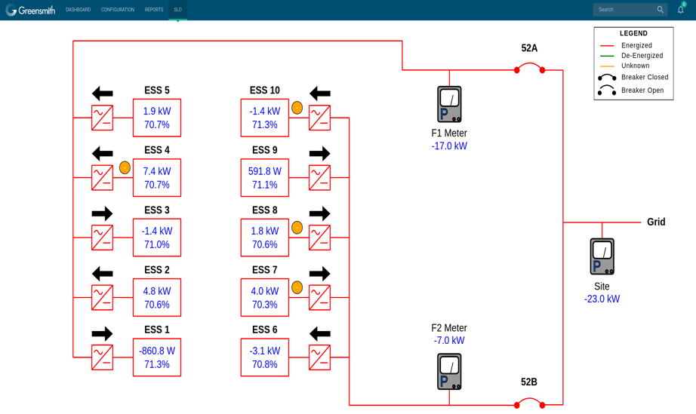
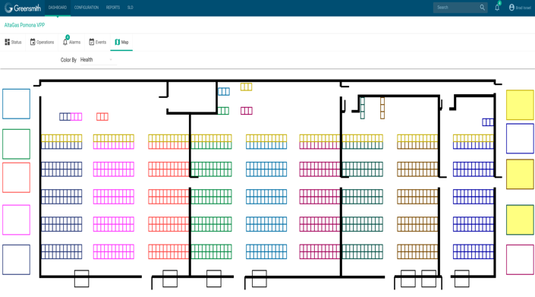

+
CASE STUDY
+
+
Pomona Energy Center 20MW/80MWh
+
CLIENT PARTNER
Alta Gas
DEPLOYMENT
20MW/80Mwh ESS
SOLUTION
Renewables integration
KEY TAKEAWAY
5 months NTP to COD!
20MW/80MWh ESS constructed in record time

Slide 16
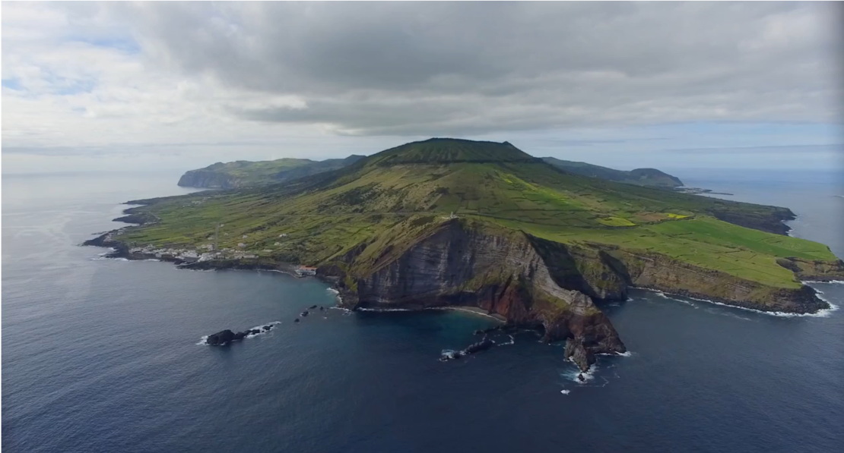
Graciosa (Azores) Microgrid
Deployment details
EU funding >$20M for wind turbines, battery, & solar
5 Enercon 900 KW Wind Turbines
1 MW Solar
6MW/2.6MWh Battery
Greensmith as overall integrator
PPA based on fuel savings
Goal of 65% renewables
Renewables complete
Battery Inverters and System commissioning

Slide 17

Revenue Models
GEMS turns batteries
to Revenue
External
Grid Reliability
Renewable Integration
Micro Grids
Hybrid Engine Optimization
Solutions
SCADA
GEMS OS
Weather Forecasts
Intelligence
Operation Scheduling • Peer-to-Peer Group Control • Real-time Equipment Control • Local HMI
Batteries
Solar
Engines
Sensors
Energy Market Data
Equipment

Slide 18
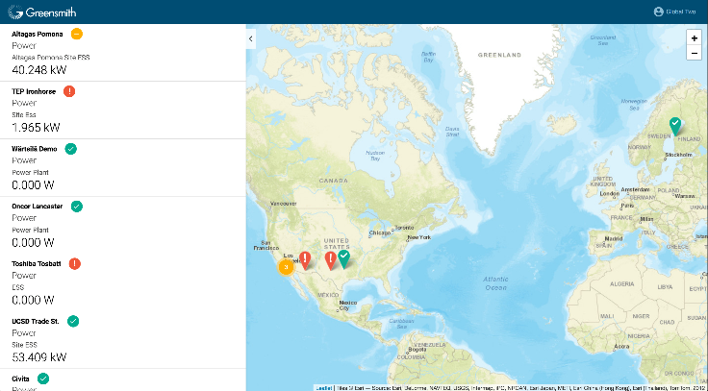
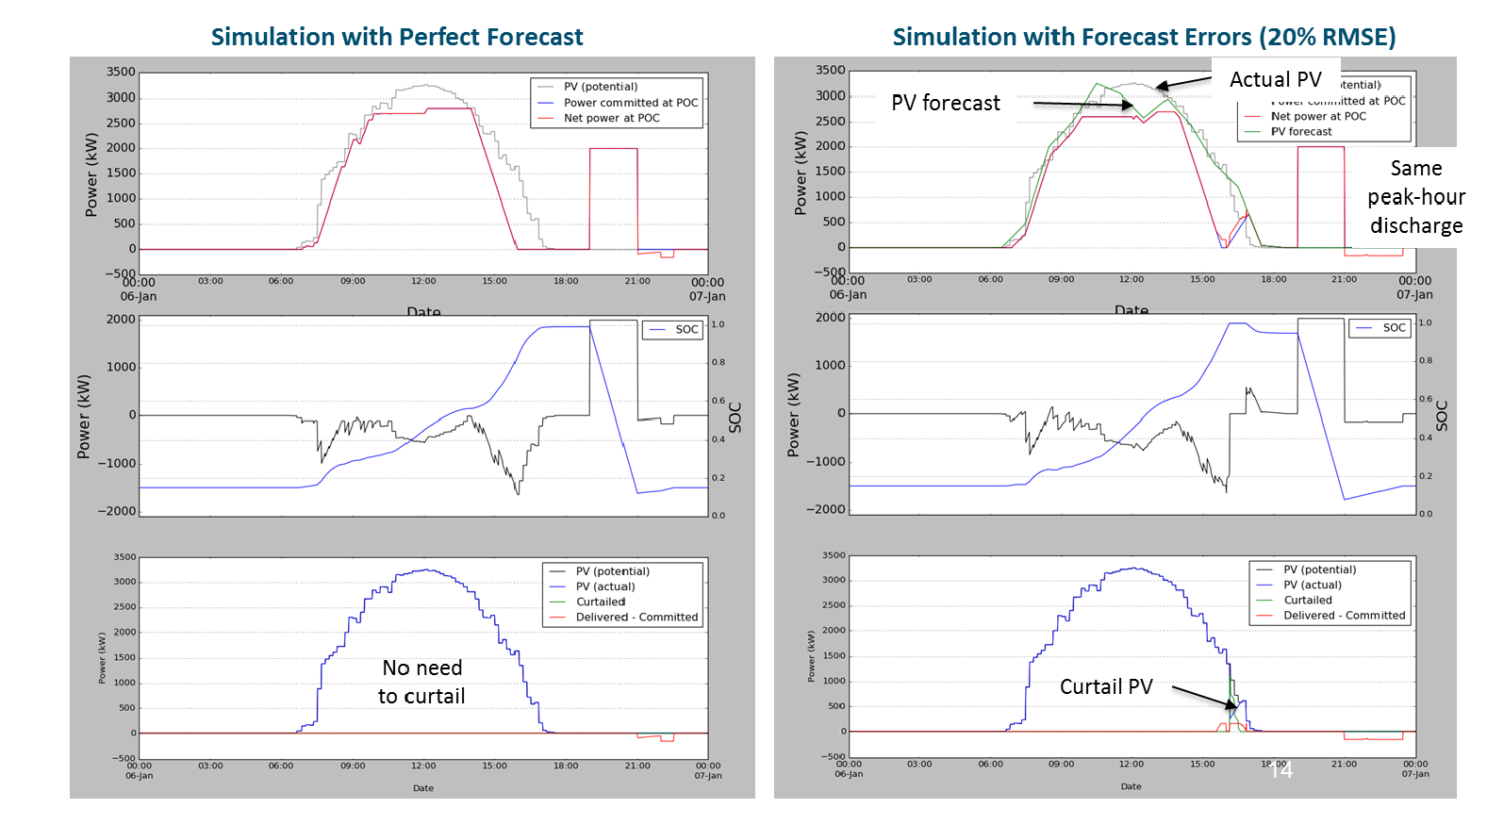
GREENSMITH EMS - GEMS
Site Controller
Fleet manager
Analyzer
Simulator
Virtual Site
APPS
APPS
APPS
Device Adaptor
Device Adaptor
Device Adaptor
Simulator
Server

Slide 19

GEMS - ALL REVENUE MODELS
+
Grid Reliability
Frequency controls
Volt/VAR control
1^{ary} and 2^{ary} Reserves
Distribution deferral
Peak Shifting
Load Leveling
Thermal generation optimization
Power to grid time
Spinning reserve
Grid forming capability
O&M optimization
Applications for
Greensmith solutions
+
Renewable Integration
PV Ramp Control
PV Smoothing
PV Firming and Shifting
Curtailment Capture
Capacity-based Solar PPAs
Micro grid
On grid/off grid seamless transfer
Renewables integration/ grid forming
Renewables integration
Black start
+

Slide 20
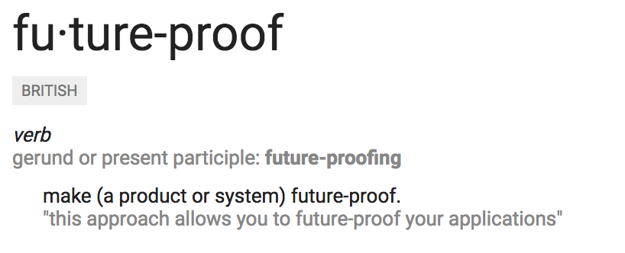
FUTURE-PROOF

Slide 21
















Overview
Technology neutral.
Total flexibility.
Batteries
Power electronics

Slide 22
Battery Chemistry for Every Application
OVERVIEW
UPS
Grid Support
Energy Management
Load Shifting
Bridging Power
Renewables
-- Wind
-- Solar
Load Leveling
Ramping
Energy Arbitrage
Power Quality
Bulk Power Management
Hours
Metal Air Battery
Flow Batteries
ZrBr VRB PSB Novel Systems
Pumped Hydro
Lithium-ion Battery
NaS Battery
CAES
Hi Energy Super Caps
Peak Shaving
T&D Deferral
Advanced Lead Acid Battery
Energy Discharge Time at Rated Power
ZEBRA Battery
Spinning
Reserve
Minutes
Frequency Regulation
Lead Acid Battery
Ni-Cd Battery
Ni-MH Battery
Seconds
High Power Fly Wheels
High Power Super Caps
SMES
1 kW
10 kW
100 kW
1 MW
10 MW
100 MW
1,000 MW
System Power Rating (MW)
Source: EPRI and Greensmith

Slide 23
Sizing Strategy Impact on ROI
Energy Storage System DImensioning
 |  | Oversize |  | Augmentation
Year | Battery Price per kWh | MWh Deployed | Cash Cost | MWh Deployed | Cash Cost
2018 | $225 | 72.6 | $16,335,000 | 51.0 | $11,475,000
2019 | $170 | 0 | $0 | 0 | $0
2020 | $163 | 0 | $0 | 0 | $0
2021 | $157 | 0 | $0 | 0 | $0
2022 | $151 | 0 | $0 | 9.0 | $1,359,000
2023 | $150 | 0 | $0 | 0 | $0
2024 | $150 | 0 | $0 | 0 | $0
2025 | $150 | 0 | $0 | 0 | $0
2026 | $150 | 0 | $0 | 0 | $0
2027 | $150 | 0 | $0 | 7.0 | $1,050,000
2028 | $150 | 0 | $0 | 0 | $0
2029 | $150 | 0 | $0 | 0 | $0
2030 | $150 | 0 | $0 | 0 | $0
2031 | $150 | 0 | $0 | 0 | $0
2032 | $150 | 57.0 | $8,550,000 | 40.0 | $6,000,000
2033 | $150 | 0 | $0 | 0 | $0
2034 | $150 | 0 | $0 | 0 | $0
2035 | $150 | 0 | $0 | 0 | $0
2036 | $150 | 0 | $0 | 0 | $0
2037 | $150 | 0 | $0 | 13.0 | $1,950,000
2038 | $150 | 0 | $0 | 0 | $0
2039 | $150 | 0 | $0 | 0 | $0
2040 | $150 | 0 | $0 | 0 | $0
2041 | $150 | 0 | $0 | 0 | $0
2042 | $150 | 0 | $0 | 0 | $0
NPV @ 7% |  |  | $19,650,837 |  | $15,949,000
NPV savings from Augmentation |  |  |  | 19% | $3,701,837
Rapidly declining cost curves needs creative deployment strategies
Augmentation strategy allows IPP to benefit from declining cost curves and TVM
Results in 19% savings

Slide 24
Thank YOU
Wilhelm van Butselaar
Area Manager Energy Storage & Integration
Wärtsilä Energy Solutions
Wilhelm.vB@wartsila.com
+65 9836 3205
Thomas Hellmich
Sales Manager Australia & Oceania
Wärtsilä Energy Solutions
Thomas.Hellmich@wartsila.com
+61 2 8822 2902

