Slide 1
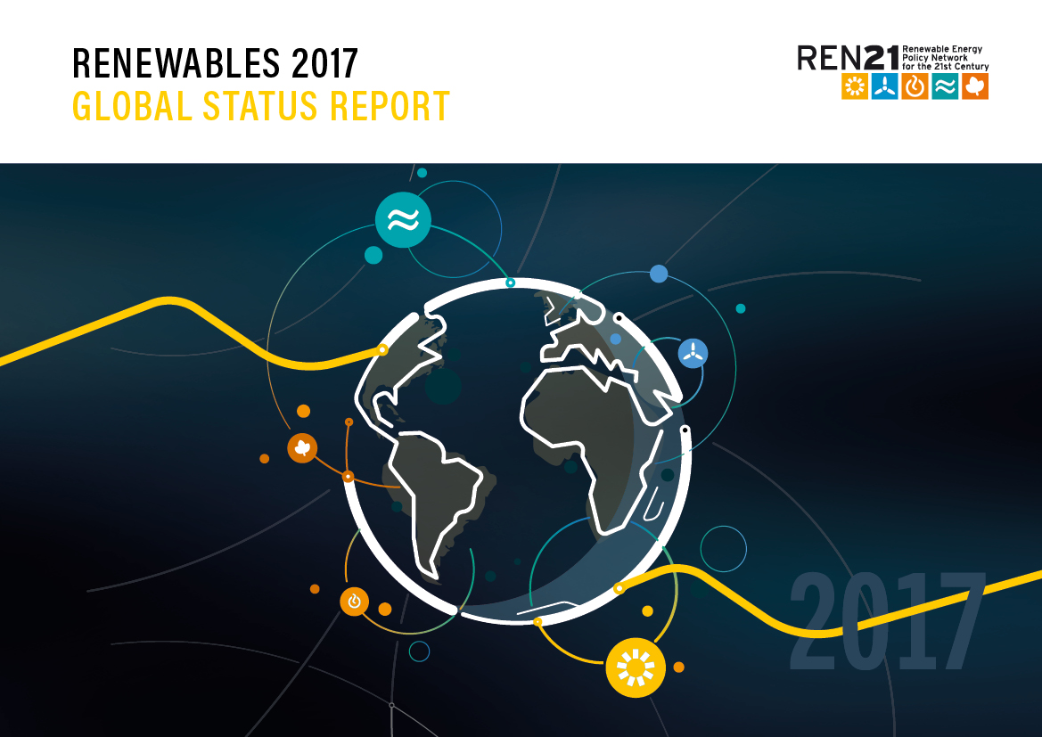
Renewables 2017
REN 21 Global Status Report
http://www.ren21.net/wpcontent/uploads/2017/06/178399_GSR_2017_Full_Report_0621_Opt.pdf
7 June 2017
Notes:
REN 21 -

Slide 2

REN21 is a global multi stakeholder network dedicated to the rapid uptake of renewable energy worldwide.
Science & Academia:
Fundacion Bariloche, IIASA, ISES, NREL, SANEDI, TERI,
International Organisations:
ADB, APERC, ECREEE, EC, GEF, IEA, IRENA, RCREEE, UNDP, UNEP, UNIDO, World Bank
      NGOs:
      CAN, CEEW, FER, GACC, GFSE, Greenpeace International, ICLEI, ISEP, MFC, SLoCaT, REI, WCRE, WFC, WRI, WWF
Industry Associations:
ACORE, ALER, APREN, ARE, CREIA, CEC, EREF, GOGLA, GSC, GWEC, IGA, IHA, IREF, RES4MED, WBA, WWEA
National Governments:
Afghanistan, Brazil, Denmark, Germany, India, Norway, South Africa, Spain, UAE, UK, USA
Notes:
REN21 is the global renewable energy policy multi-stakeholder network that connects a wide range of key actors. REN21’s goal is to facilitate knowledge
exchange, policy development, and joint action towards a rapid global transition to renewable energy.
REN21 brings together governments, nongovernmental organisations, research and academic institutions, international organisations, and industry to learn from
one another and build on successes that advance renewable energy.
The REN21 network is supported by a lean Secretariat based at United Nations Environment in Paris, France.

Slide 3
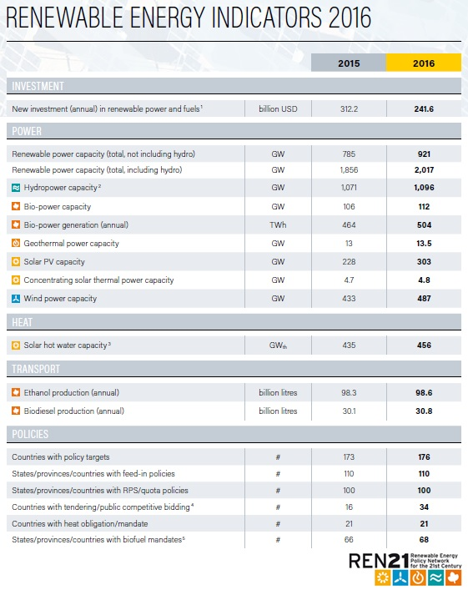
Another extraordinary year for renewable energy
Total global capacity was up 9% compared to 2015, to more than 2,016 GW at year’s end (920 GW not including hydro)
Solar PV - 47% of newly installed renewable power capacity in 2016
Wind - 34%
Hydropower - 15.5%
Notes:
Total global capacity was up 9% compared to 2015, to more than 2,016 GW at year’s end (920 GW not including hydro). Solar PV saw record additions and, for the first time, accounted for more additional power capacity than any other generating technology. Solar PV represented about 47% of newly installed renewable power capacity in 2016, and wind and hydropower accounted for most of the remainder, contributing 34% and 15.5%, respectively.

Slide 4
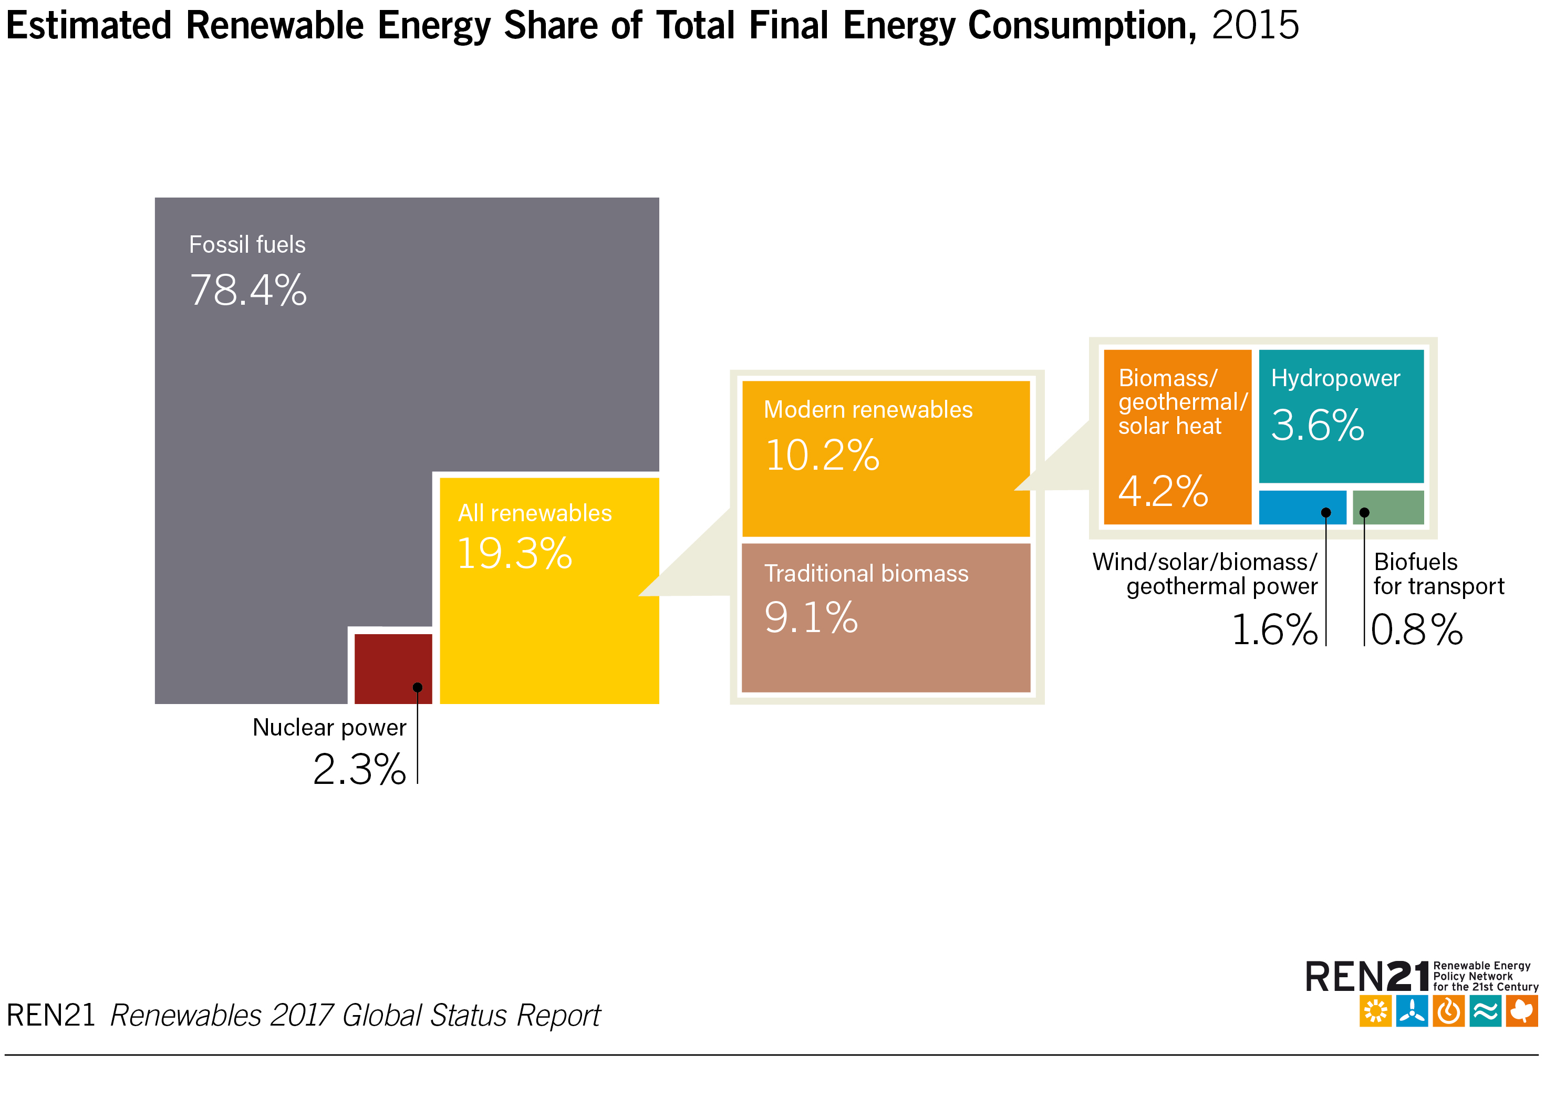
Renewable Energy in the World
As of 2015, renewable energy provided an estimated 19.3% of global final energy consumption
Notes:
As of 2015, renewable energy provided an estimated 19.3% of global final energy consumption.
Of this total share, traditional biomass, used primarily for cooking and heating in remote and rural areas of developing countries, accounted for about 9.1%, and modern renewables (not including traditional biomass) increased their share relative to 2014 to approximately 10.2%.
In 2015, hydropower accounted for an estimated 3.6% of total final energy consumption, other renewable power sources comprised 1.6%, renewable heat energy accounted for approximately 4.2%, and transport biofuels provided about 0.8%.

Slide 5
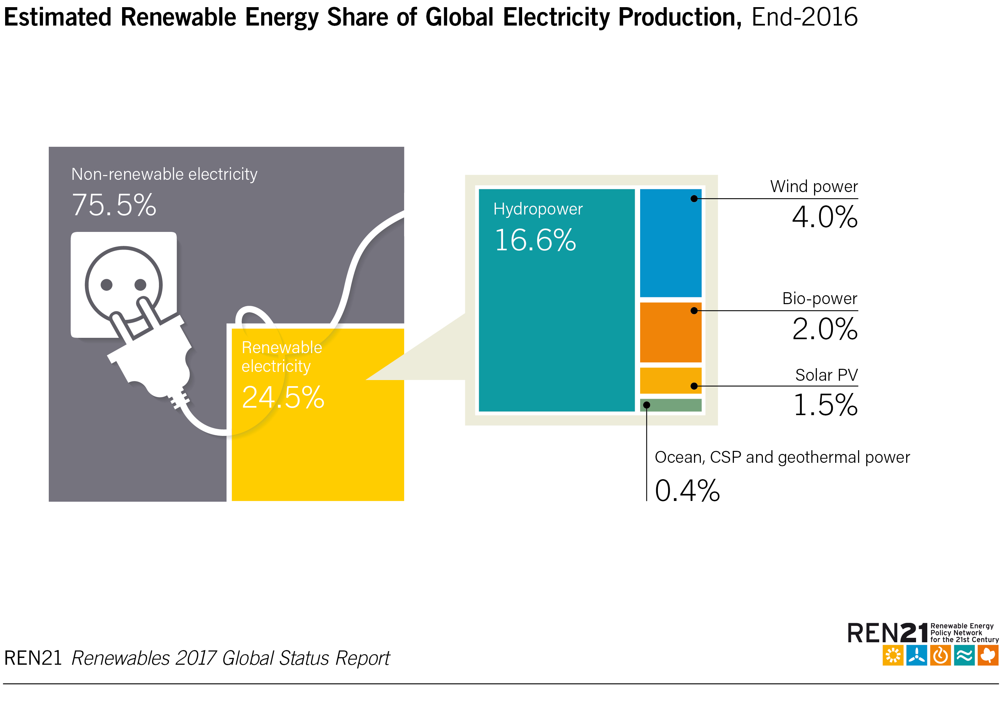
Power Sector
By year’s end, renewables comprised an estimated 30% of the world’s power generating capacity and 24.5% of global electricity demand
Notes:
The world now adds more renewable power capacity annually than it adds (net) capacity from all fossil fuels combined.
In 2016, renewables accounted for an estimated nearly 62% of net additions to global power generating capacity, and represented far higher shares of capacity added in several countries around the world.
By year’s end, renewables comprised an estimated 30% of the world’s power generating capacity – enough to supply an estimated 24.5% of global electricity (up from 23.7 the year before), with hydropower providing about 16.6%.

Slide 6
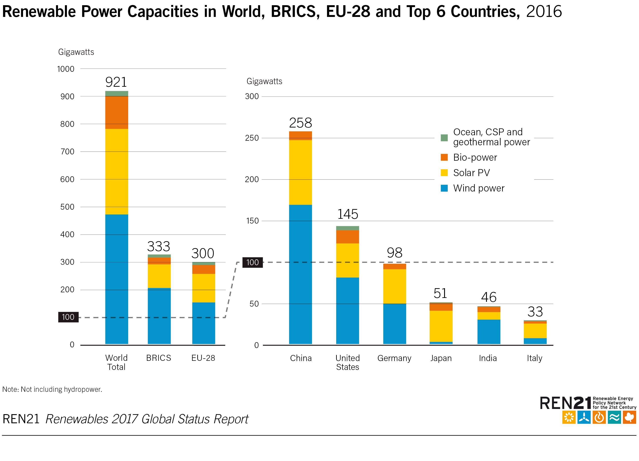
Power Sector
By the end of 2016, China was home to more than one-quarter of the world’s renewable power capacity
Notes:
By the end of 2016, the top countries for total installed renewable electric capacity continued to be China, the United States, Brazil, Germany and Canada.
China was home to more than one-quarter of the world’s renewable power capacity – totalling approximately 564 GW, including about 305 GW of hydropower.
Considering only non-hydro capacity, the top countries were China, the United States and Germany; they were followed by Japan, India and Italy, and by Spain and the United Kingdom (with about equal amounts of capacity by year’s end).

Slide 7
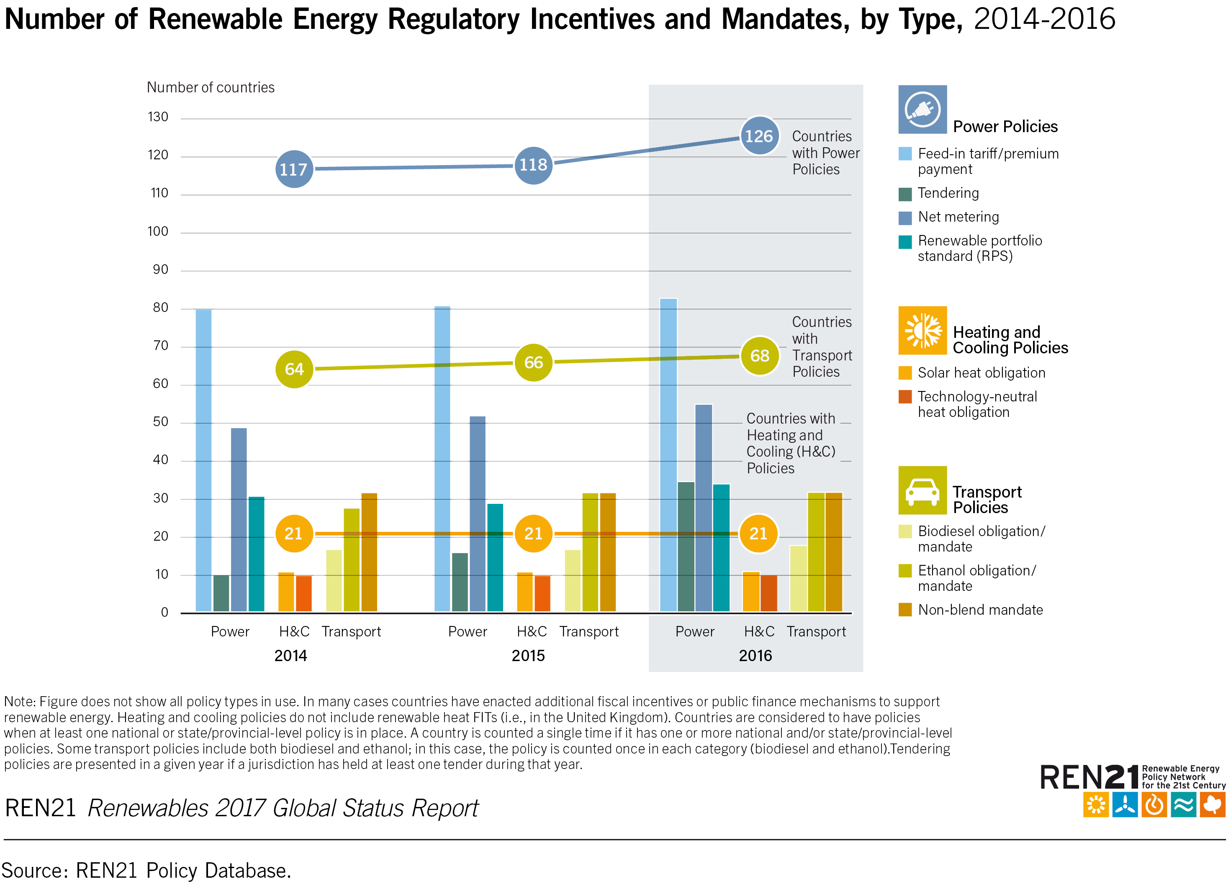
Renewable Energy Policy Landscape
176 countries had renewable energy targets
126 countries had power policies
68 countries
had transport policies
21 countries
had heating and cooling policies
Notes:
Policy support specifically for renewable energy in 2016, as in past years, was focused mostly on power generation, whereas support for renewable technologies in the heating and cooling and transport sectors developed at a slower pace.
As of year-end 2016, 126 countries had enacted power policies.
68 countries worldwide had policy frameworks for renewable energy in the transport sector in place – an increase of only 2 countries from the previous year
21 countries for renewable heating or cooling policies – the third year in a row that not a single new country has adopted a renewable heat obligation

Slide 8
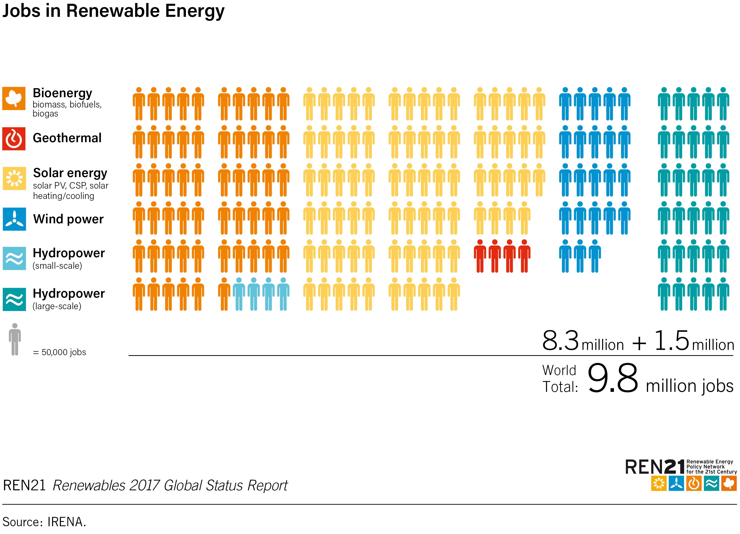
Jobs in Renewable Energy
The renewable energy sector employed
9.8 million people in 2016 - a 1.1% increase over 2015
Notes:
The renewable energy sector employed 9.8 million people in 2016 - a 1.1% increase over 2015.
Jobs in renewables, excluding large-scale hydropower, increased 2.8% to 8.3 million in 2016.
In some major markets, job losses followed policy changes, a decrease in investment and rising automation.
Even so, global employment numbers continued to rise due to record deployment of renewables, driven by falling prices and supportive policies in several markets. Solar PV was the largest employer, followed by biofuels, large-scale hydropower, wind energy and solar heating and cooling.

Slide 9
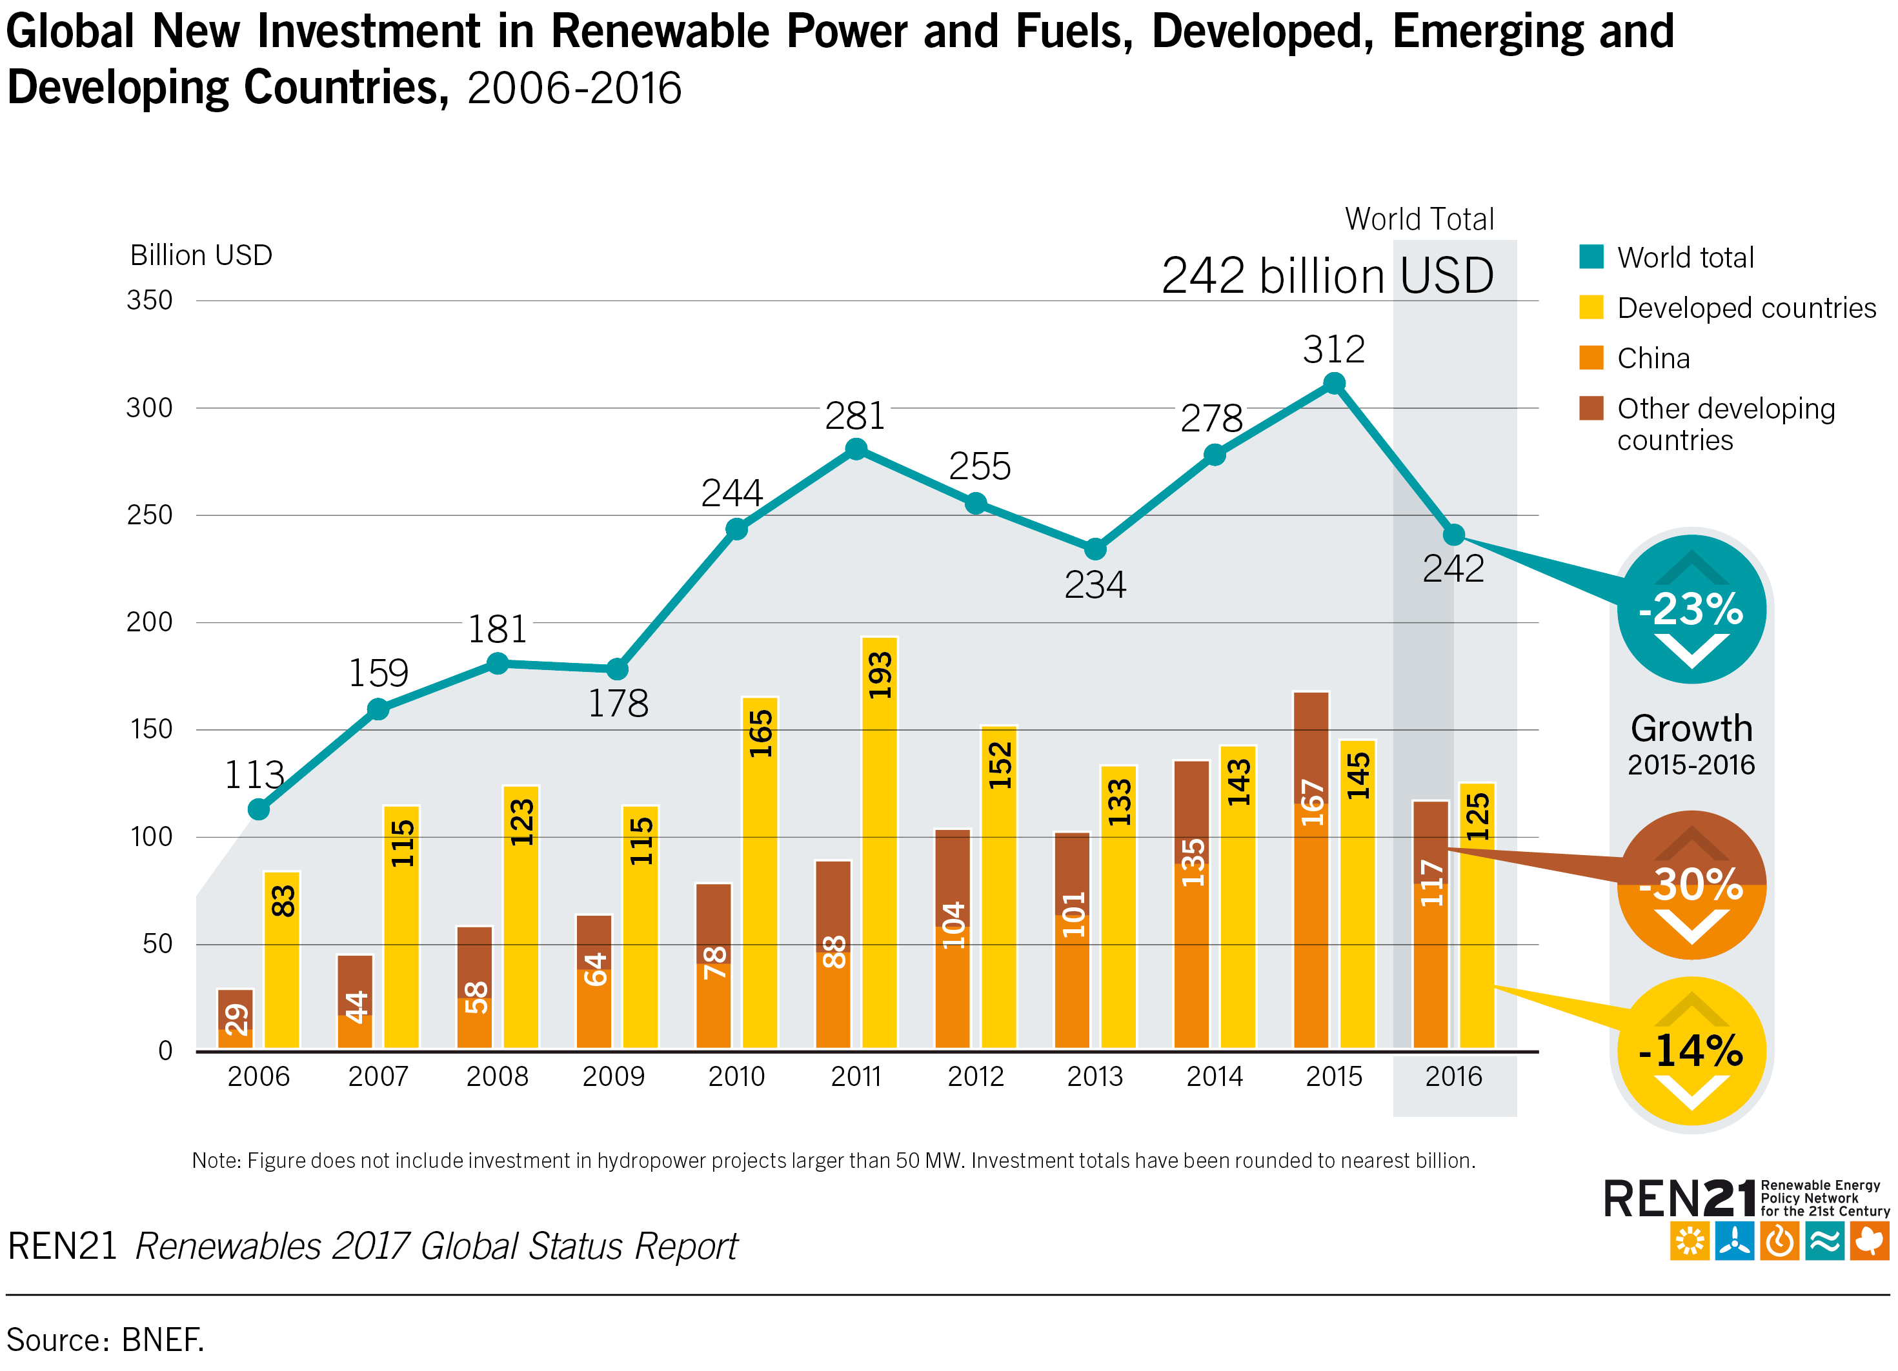
Global Investment in Renewable Energy
Global new investment in renewables was USD 241.6 billion in 2016
For the fifth consecutive year, investment in new renewable power capacity was roughly double that in fossil fuel capacity.
Notes:
Global new investment in renewable power and fuels (not including hydropower projects larger than 50 MW) was USD 241.6 billion in 2016, as estimated by Bloomberg New Energy Finance (BNEF) .
Although this represents a decrease of 23% compared to the previous year, the decline accompanied a record installation of renewable power capacity worldwide in 2016 .
Investment in renewable power and fuels has exceeded USD 200 billion per year for the past seven years.
Developing and emerging economies overtook developed countries in renewable energy investment for the first time in 2015, but developed countries retook the lead in 2016.

Slide 10
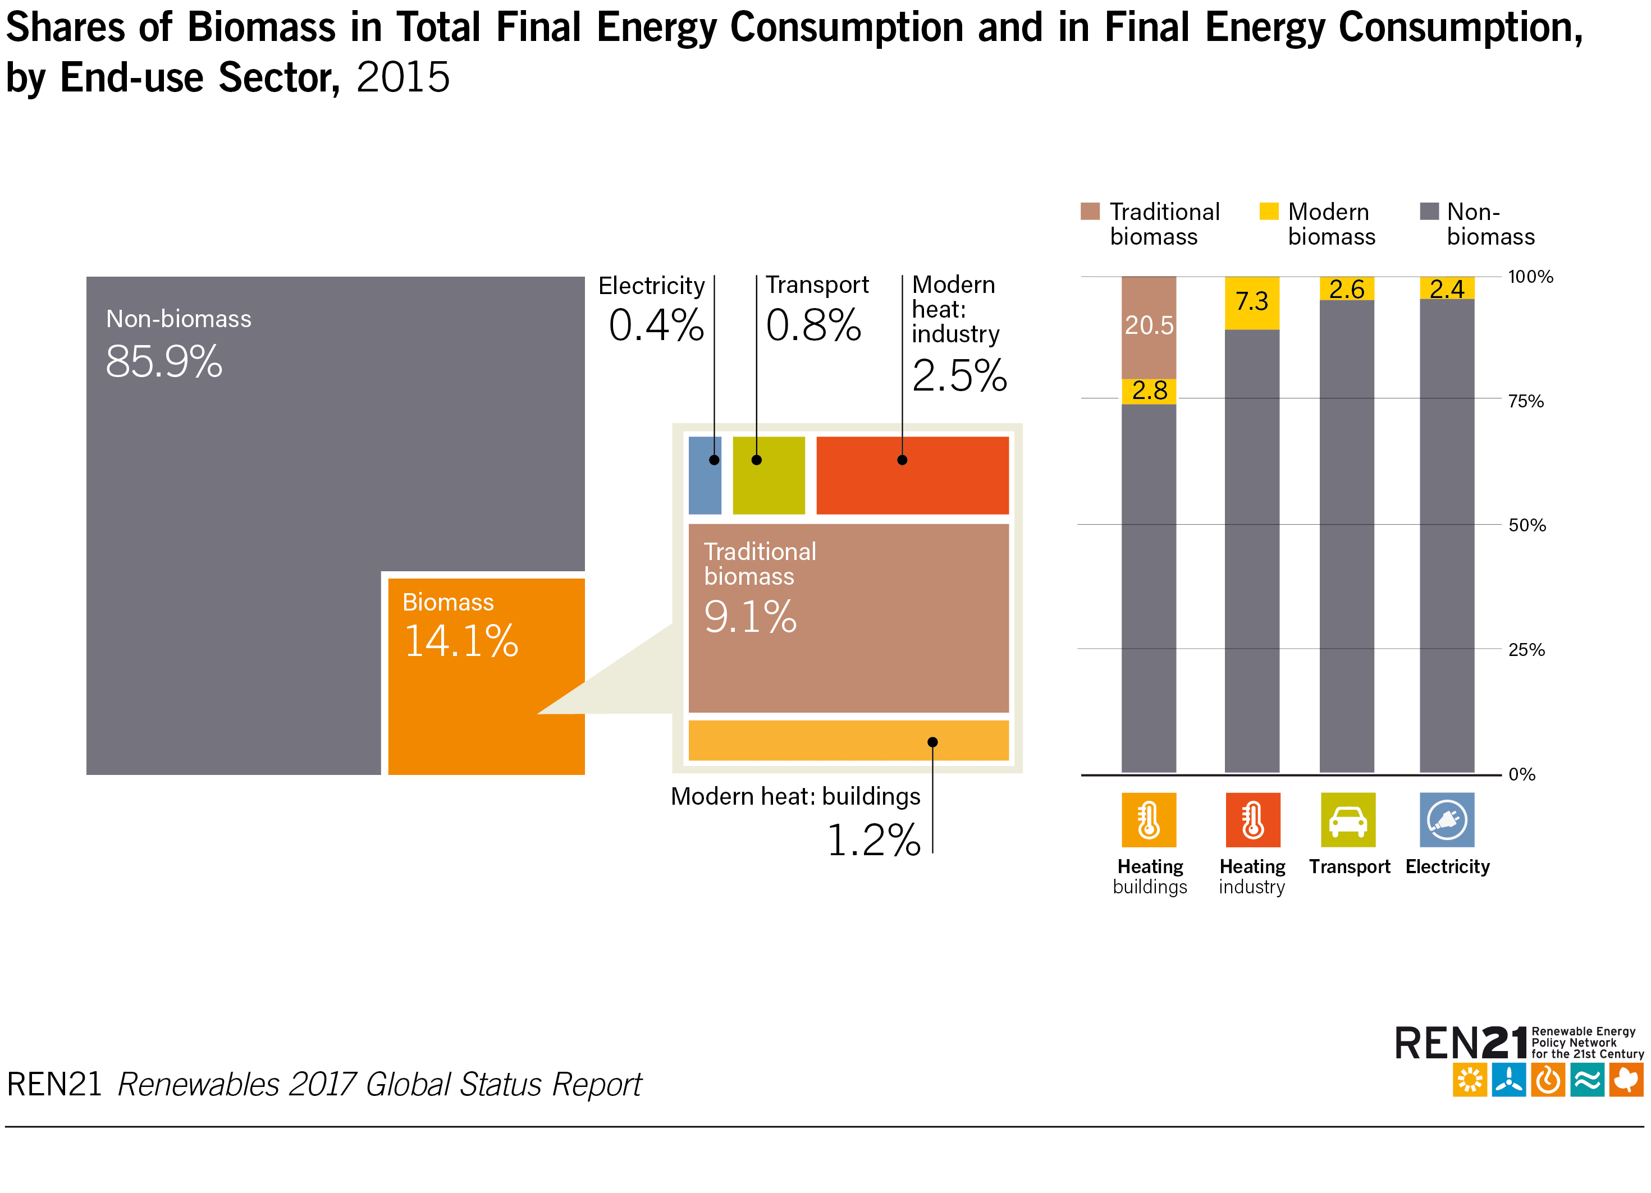
Biomass Energy
Biomass accounted for 14.1% of total final energy consumption
Notes:
The contribution of bioenergy to final energy demand for heat in buildings and industry far outweighs its use for electricity and transport combined.
Biomass accounted for 14.1% of total final energy consumption, up only slightly from the previous year (14%).
Traditional biomass continues to make up the majority of biomass consumption.

Slide 11
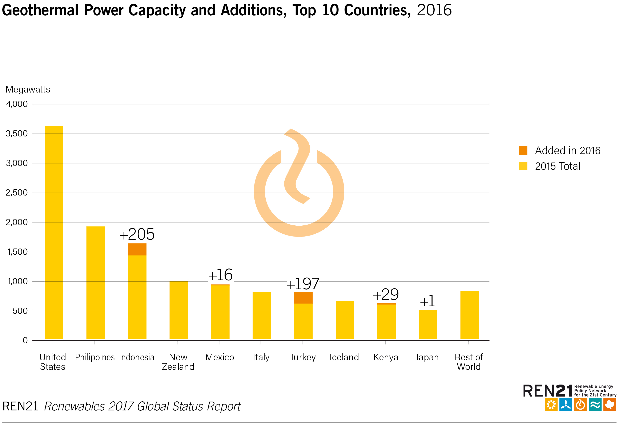
Geothermal Power and Heat
The United States had the most geothermal power generating capacity at the end of 2016 with 3.6 GW
Notes:
The countries with the largest amounts of geothermal power generating capacity at the end of 2016 were the United States (3.6 GW), the Philippines (1.9 GW), Indonesia (1.6 GW), New Zealand (1.0 GW), Mexico (0.9 GW), Italy (0.8 GW), Turkey (0.8 GW), Iceland (0.7 GW), Kenya (0.6 GW) and Japan (0.5 GW).

Slide 12
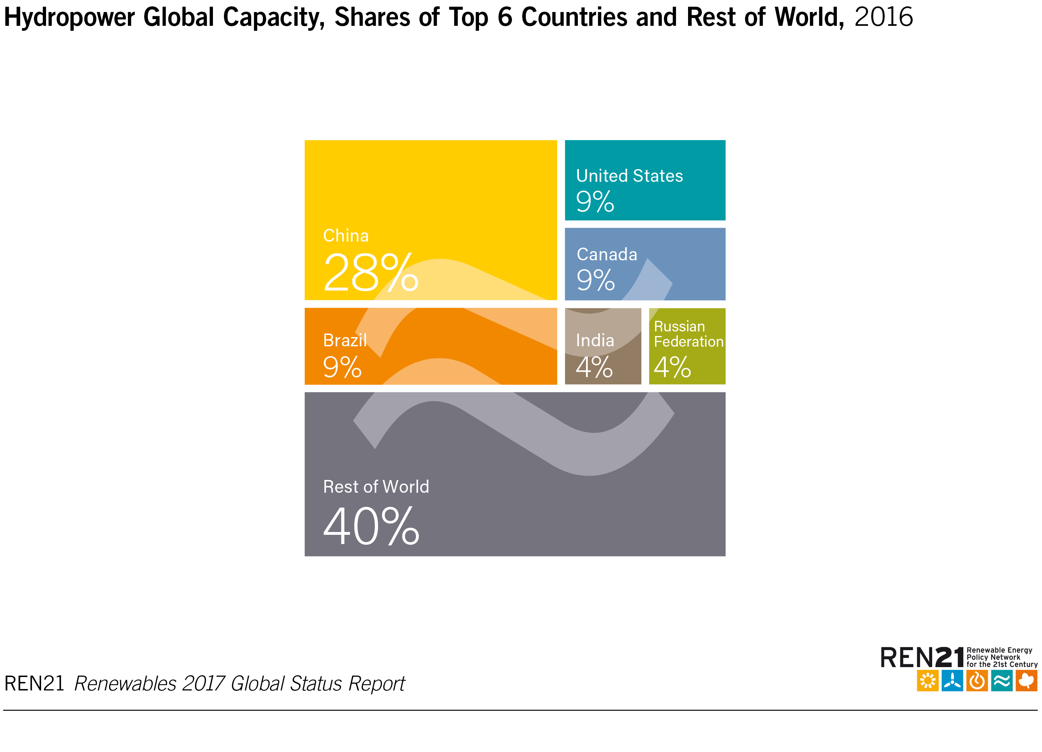
Hydropower
Total global hydropower capacity increased to 1,096 GW
Global hydropower generation reached 4,102 TWh – up by 3.2% over 2015
Notes:
Global hydropower capacity additions in 2016 are estimated to be at least 25 GW, with total capacity reaching approximately 1,096 GW.
The top countries for hydropower capacity are China, Brazil, the United States, Canada, Russia, India and Norway, which together accounted for about 62% of installed capacity at the end of 2016.
Global hydropower generation was estimated to be 4,102 TWh in 2016, up by about 3.2% over 2015.
Global pumped storage capacity (which is counted separately) was an estimated 150 GW at year's end, with about 6.4 GW added in 2016.

Slide 13
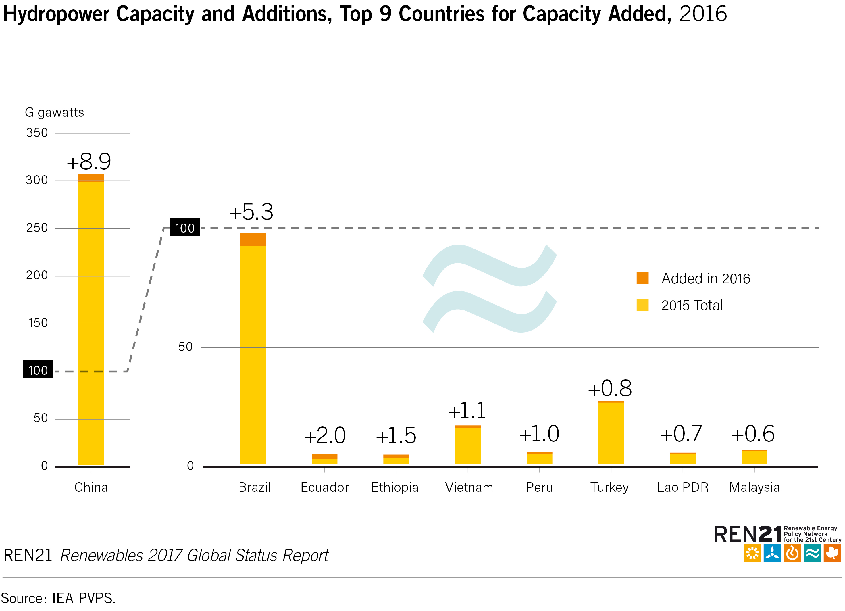
Hydropower
25 GW of new hydropower capacity was commissioned in 2016
More than one-third of new capacity commissioned in China
Notes:
At least 25 GW of new hydropower capacity was commissioned in 2016.
More than one-third of new hydropower capacity was commissioned in China. After China, the countries adding the most capacity in 2016 were Brazil, Ecuador, Ethiopia, Vietnam, Peru, Turkey, Laos, Malaysia and India.
China also was the leading installer of pumped storage capability during the year, followed by South Africa, Switzerland, Portugal and the Russian Federation.

Slide 14
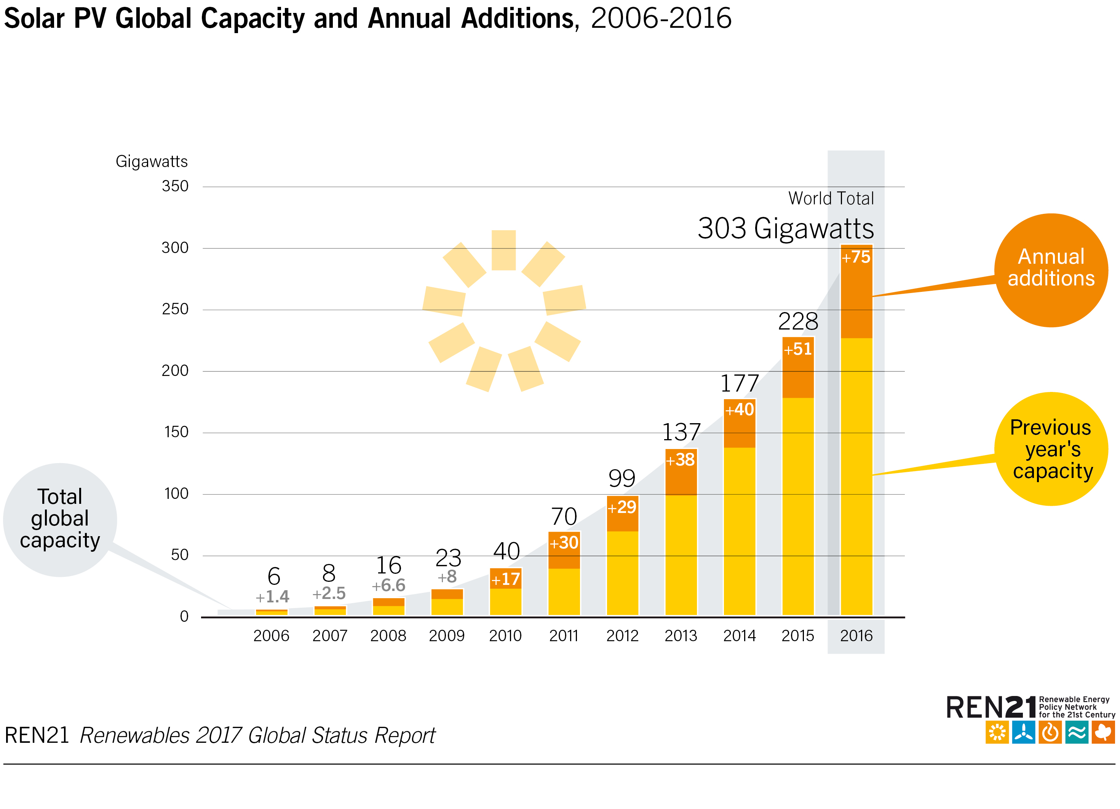
Solar PV
75 GW of solar PV capacity was added worldwide
Global solar PV capacity totaled
303 GW
Notes:
During 2016, at least 75 GWdc of solar PV capacity was added worldwide - equivalent to the installation of more than 31,000 solar panels every hour.
More solar PV capacity was installed in 2016 (up 48% over 2015) than the cumulative world capacity five years earlier.
By year's end, global solar PV capacity totalled at least 303 GW.

Slide 15
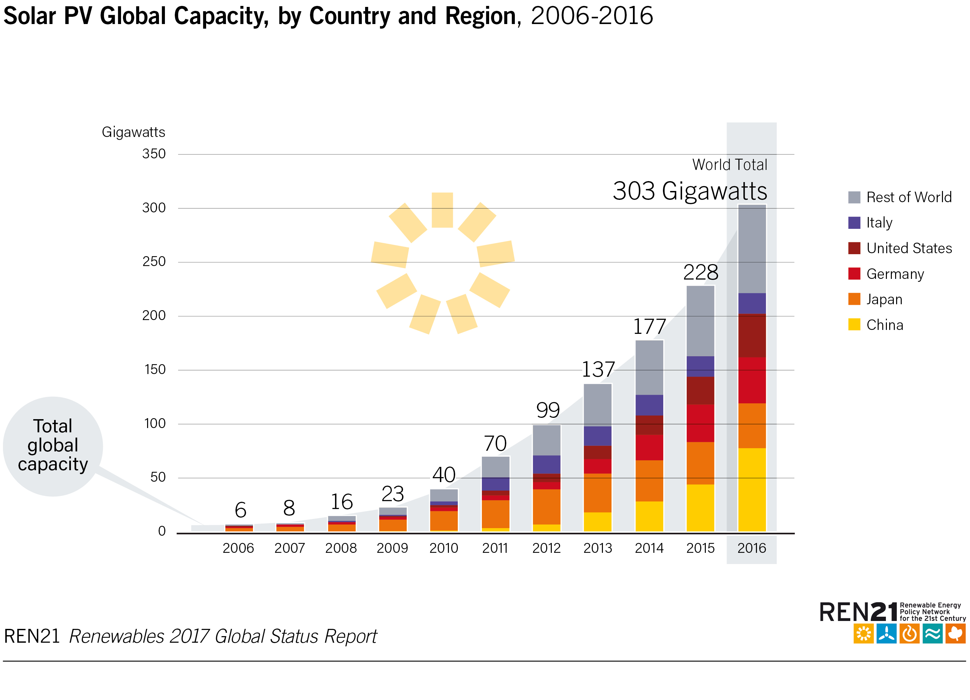
Solar PV
By end-2016:
Every continent had installed at least 1 GW
At least 24 countries had
1 GW or more of capacity
At least 114 countries had more than
10 MW
Notes:
For the fourth consecutive year, Asia eclipsed all other markets, accounting for about two-thirds of global additions.
The top five markets - China, United States, Japan, India and the United Kingdom - accounted for about 85% of additions; others in the top 10 for additions were Germany, the Republic of Korea, Australia, the Philippines and Chile.
For cumulative capacity, the top countries were China, Japan (which passed Germany) and the United States, with Italy a distant fifth.
While China continued to dominate both the use and manufacturing of solar PV, emerging markets on all continents have begun to contribute significantly to global growth.
By end-2016, every continent had installed at least 1 GW, at least 24 countries had 1 GW or more of capacity, and at least 114 countries had more than 10 MW.
The leaders for solar PV capacity per inhabitant were Germany, Japan, Italy, Belgium and Australia.

Slide 16
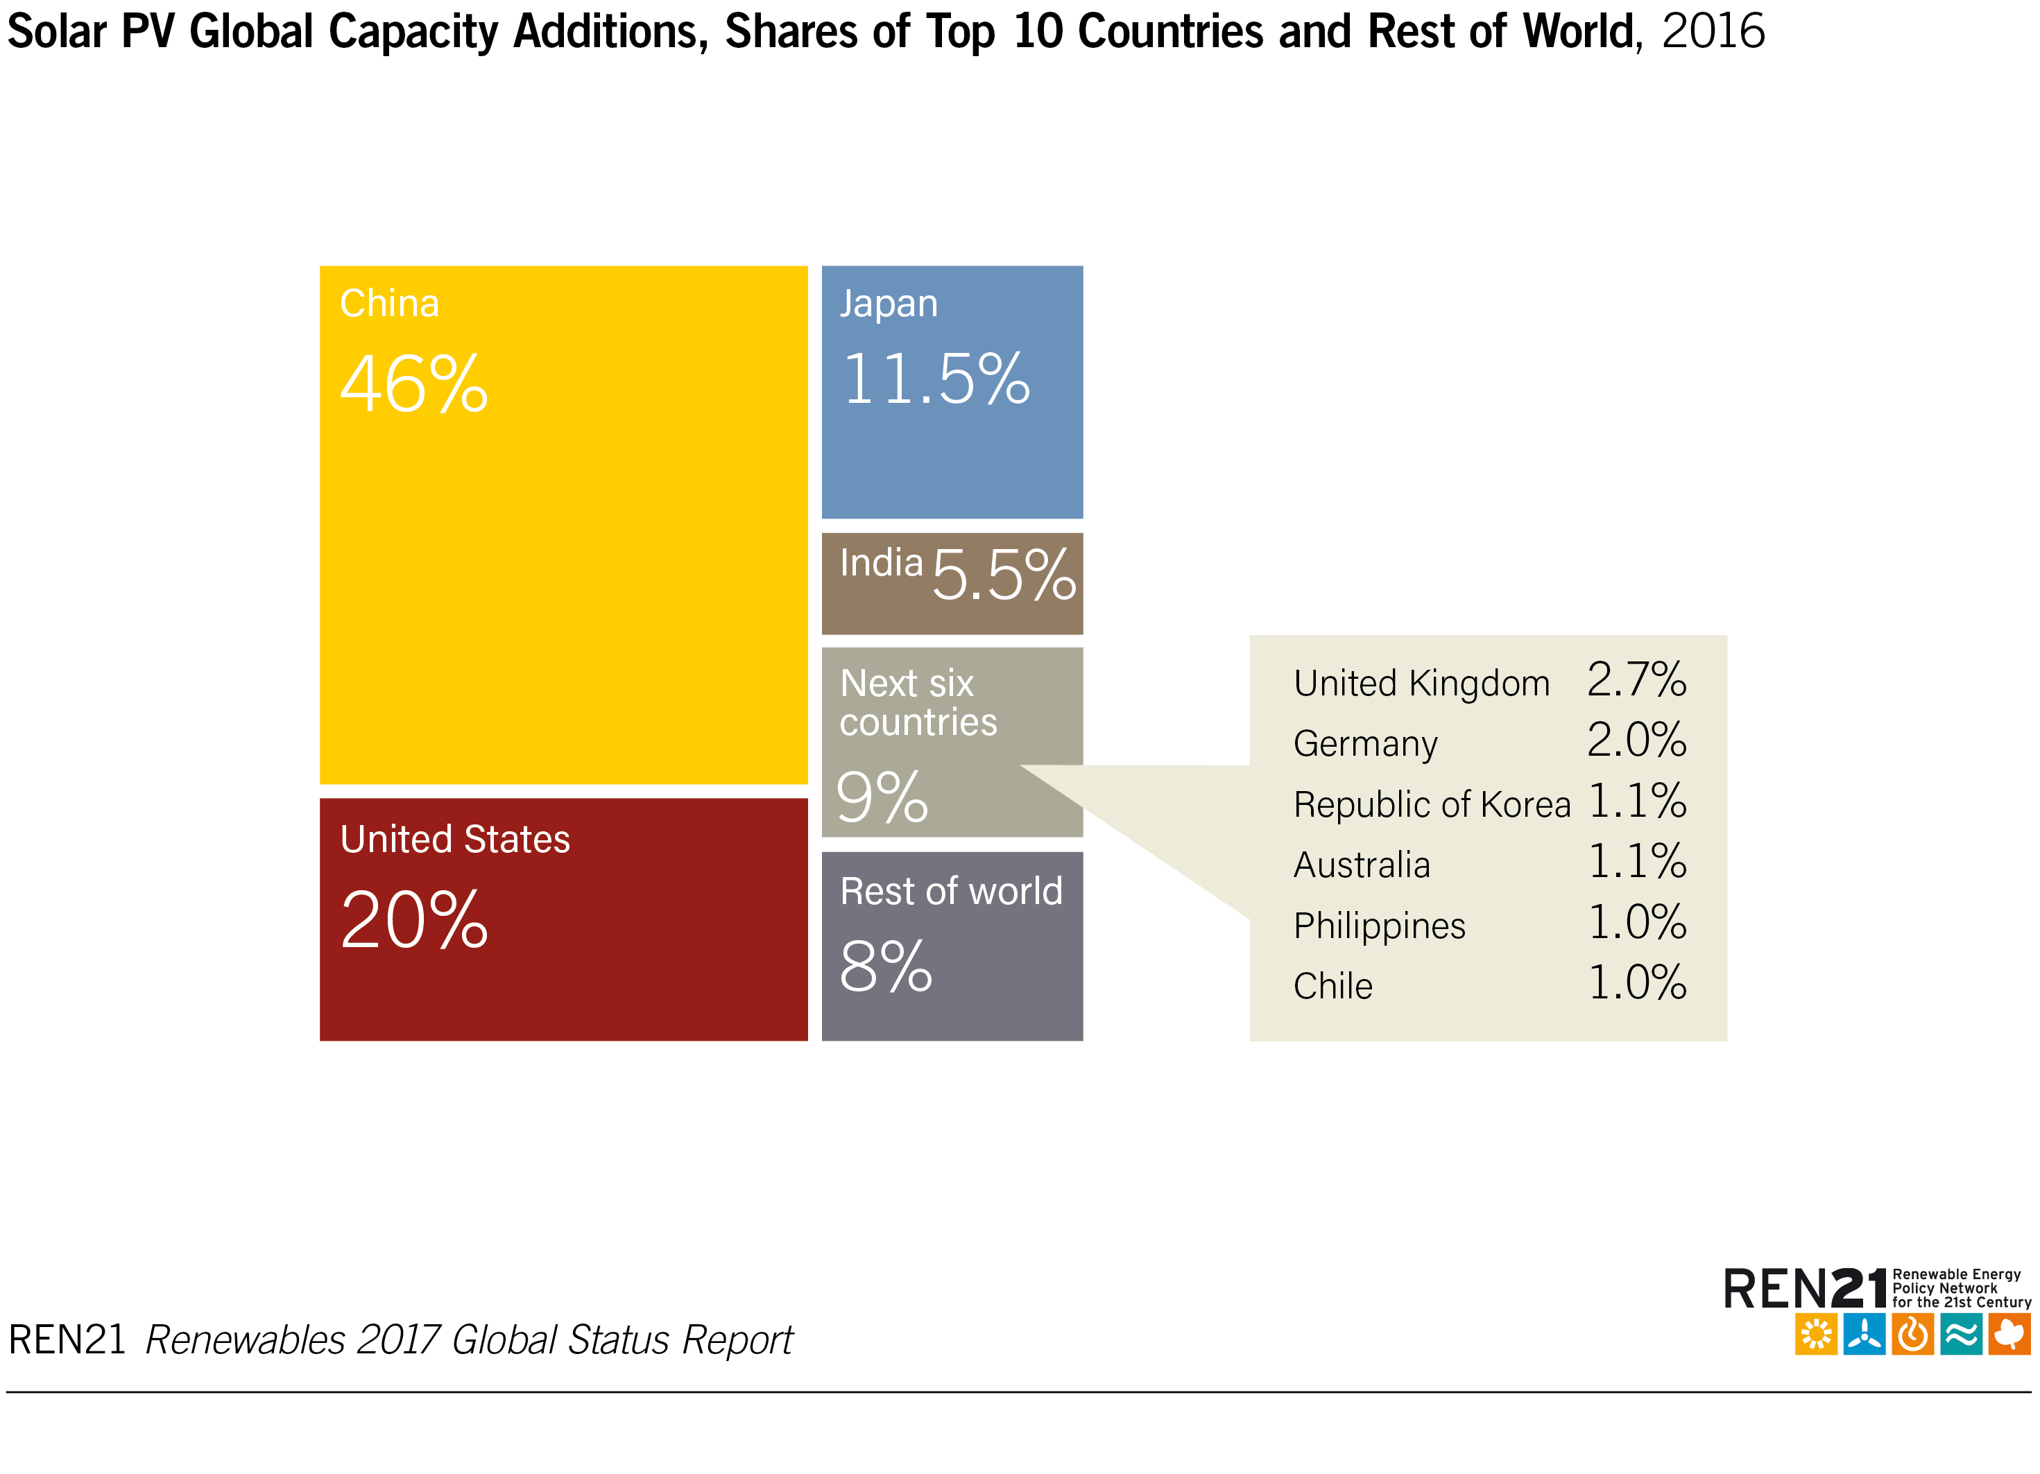
Solar PV
Top 5 markets for solar PV accounted for about 85% of additions
China
United States
Japan
India
United Kingdom
Notes:
In 2016, China added 34.5 GW (up 126% over 2015), increasing its total solar PV capacity 45% to 77.4 GW, far more than that of any other country.
The record increase came despite a downwards adjustment in China's target for 2020, made in response to a slowdown in the growth of electricity demand.
A rush of installations (an estimated 20 GW) came online in advance of a mid-year cut-off date for approved projects to receive the 2015 FIT rate.
Following a brief dip, the market picked up again and continued strongly into 2017, in anticipation of the next cut-off deadline (June).
Solar PV is playing an important role in providing energy access in Latin America and the Caribbean, although the vast majority of capacity installed to date has been in large-scale projects.
Chile was the region's top installer and ranked tenth globally for newly added capacity, thanks to a booming mining industry that has pushed rapid development in the north.
The country added over 0.7 GW in 2016 for a year-end total of 1.6 GW.

Slide 17
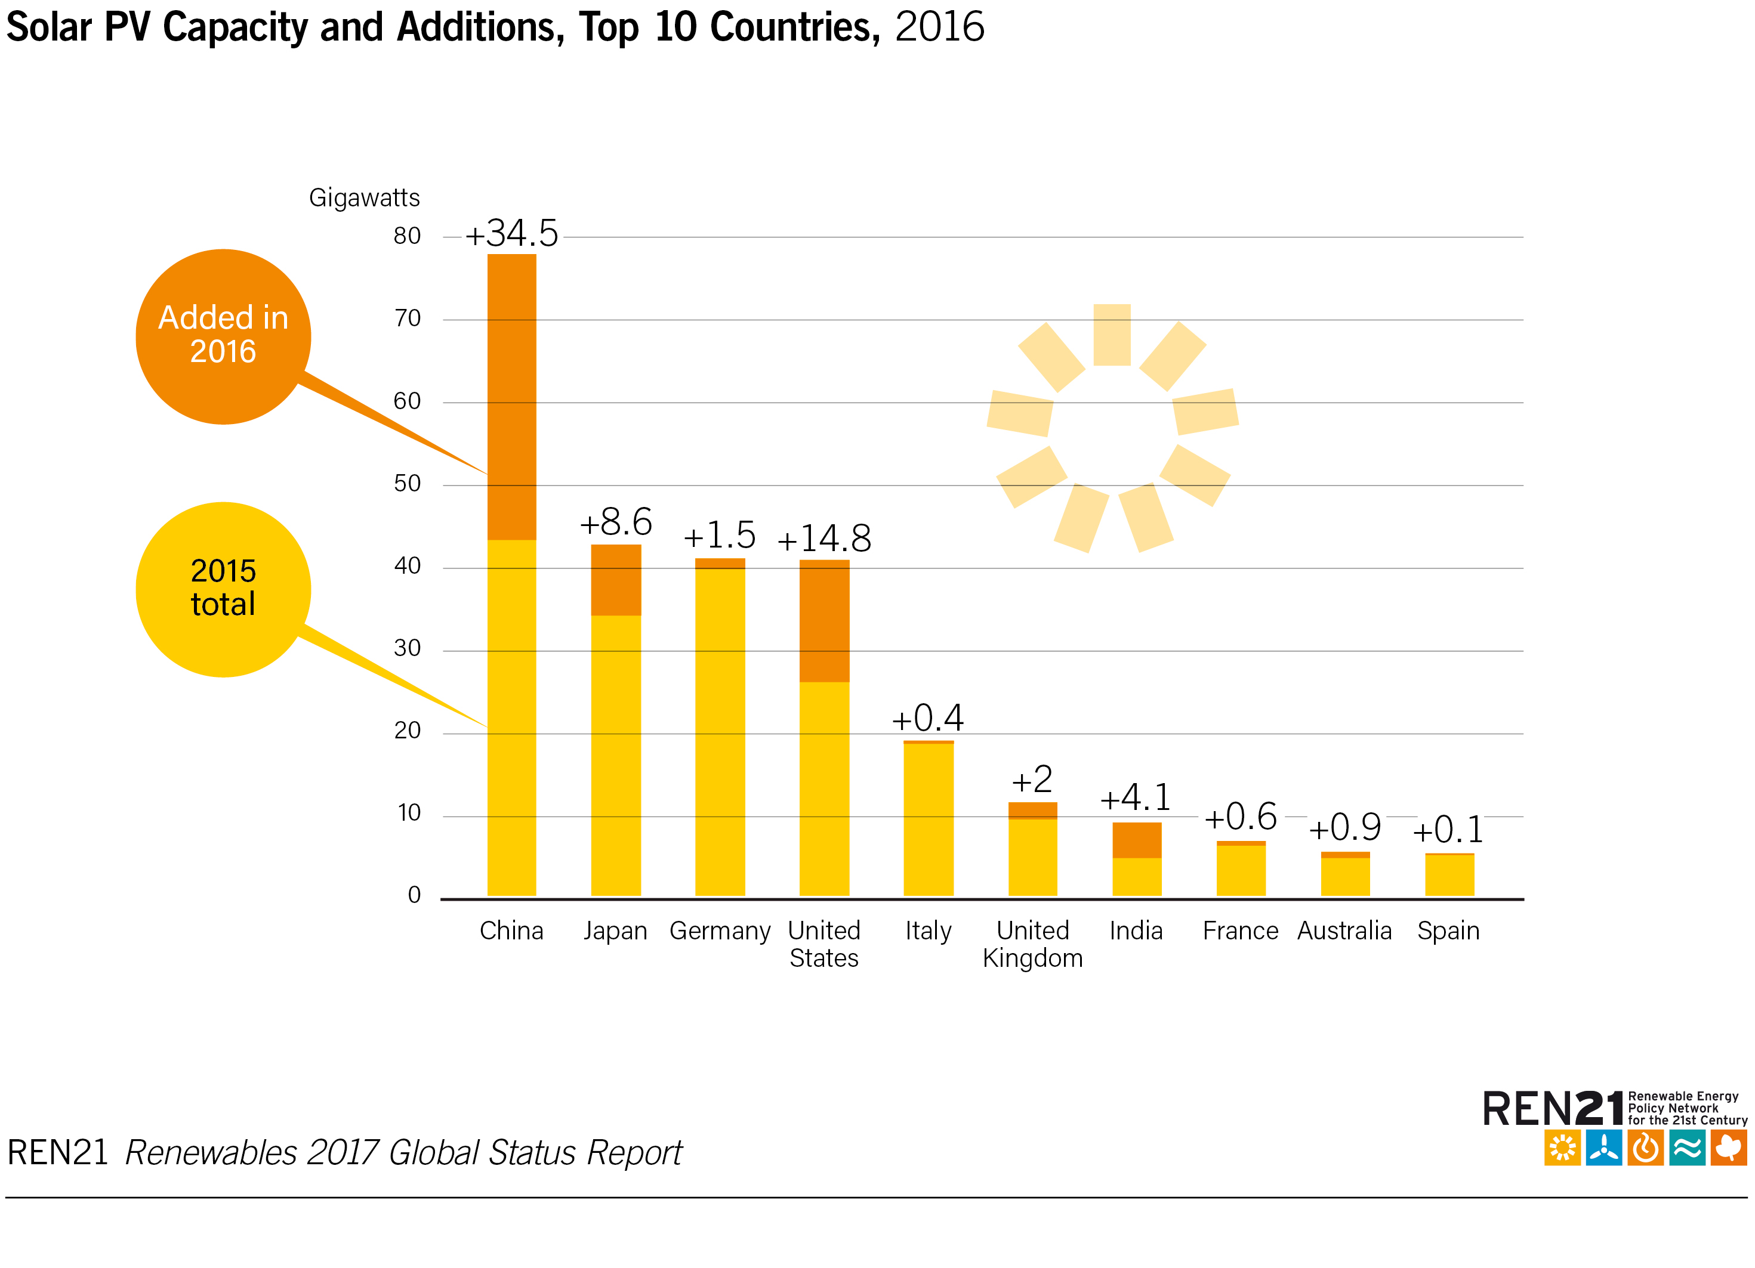
Solar PV
China added
34.5 GW (up 126% over 2015), increasing its total solar PV capacity 45% to 77.4 GW, far more than that of any other country
Notes:
In 2016, China added 34.5 GW (up 126% over 2015), increasing its total solar PV capacity 45% to 77.4 GW, far more than that of any other country.
The record increase came despite a downwards adjustment in China's target for 2020, made in response to a slowdown in the growth of electricity demand.
A rush of installations (an estimated 20 GW) came online in advance of a mid-year cut-off date for approved projects to receive the 2015 FIT rate.
Following a brief dip, the market picked up again and continued strongly into 2017, in anticipation of the next cut-off deadline (June).
Solar PV is playing an important role in providing energy access in Latin America and the Caribbean, although the vast majority of capacity installed to date has been in large-scale projects.
Chile was the region's top installer and ranked tenth globally for newly added capacity, thanks to a booming mining industry that has pushed rapid development in the north.
The country added over 0.7 GW in 2016 for a year-end total of 1.6 GW.

Slide 18
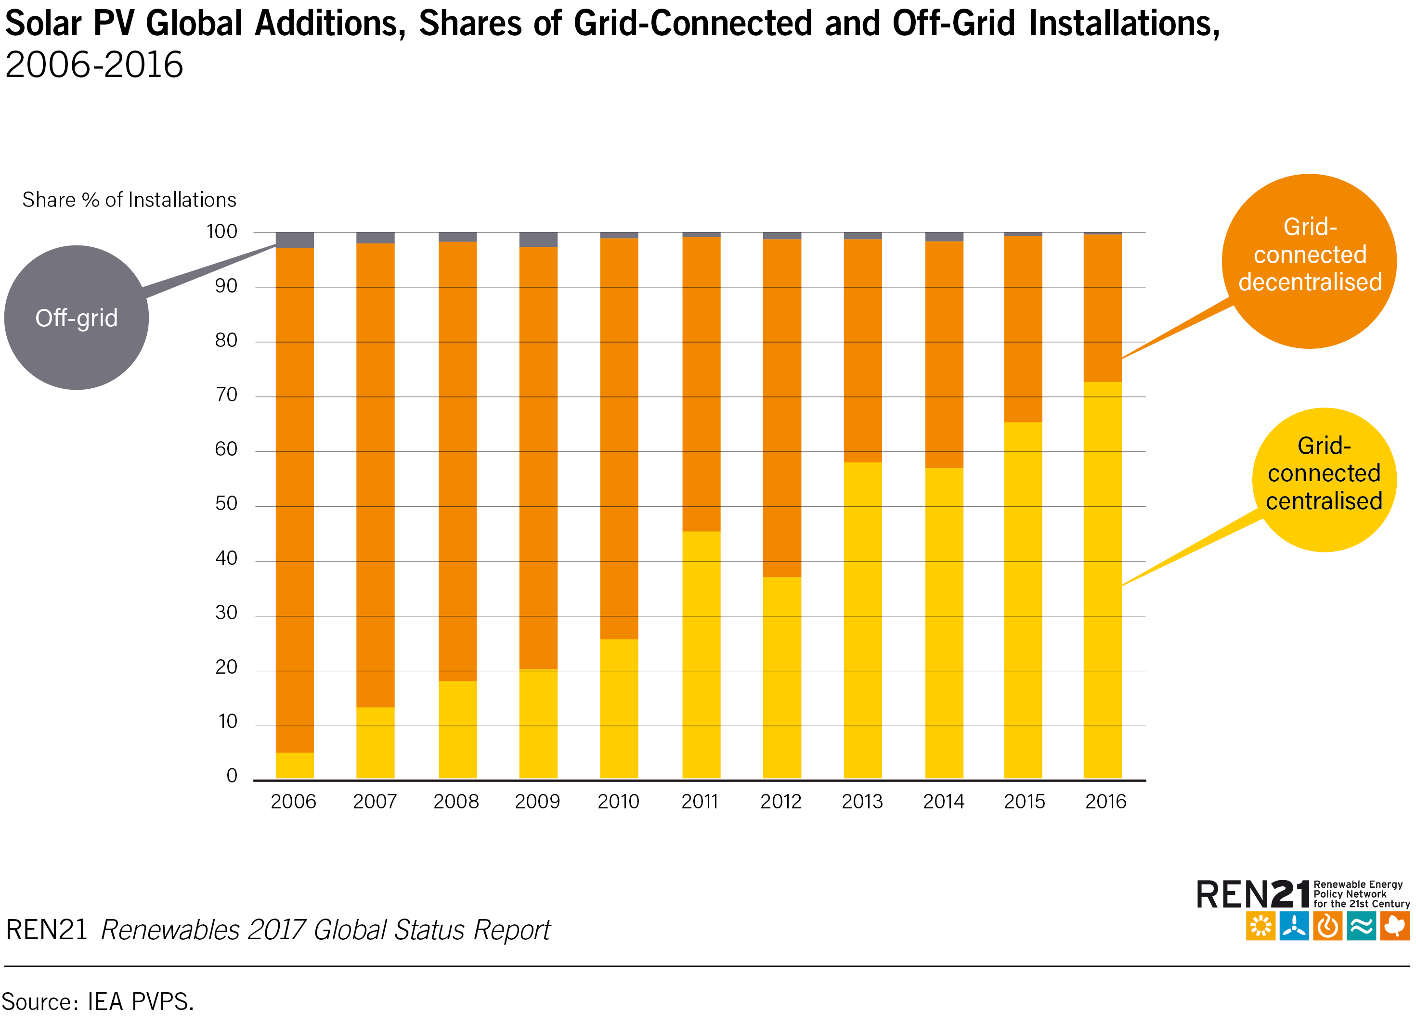
Solar PV
Demand is expanding rapidly for off-grid solar PV, but capacity of grid-connected systems is rising more quickly
Notes:
While demand is expanding rapidly for off-grid solar PV, the capacity of grid-connected systems is rising more quickly and continues to account for the vast majority of solar PV installations worldwide.
Decentralised (residential, commercial and industrial rooftop systems) grid-connected applications have struggled to maintain a roughly stable global market (in terms of capacity added annually) since 2011, particularly with the transition from FITs and net metering to self-consumption.
Centralised large-scale projects, by contrast, have comprised a rising share of annual installations - particularly in emerging markets - despite grid connection challenges, and now represent the majority of annual installations.

Slide 19
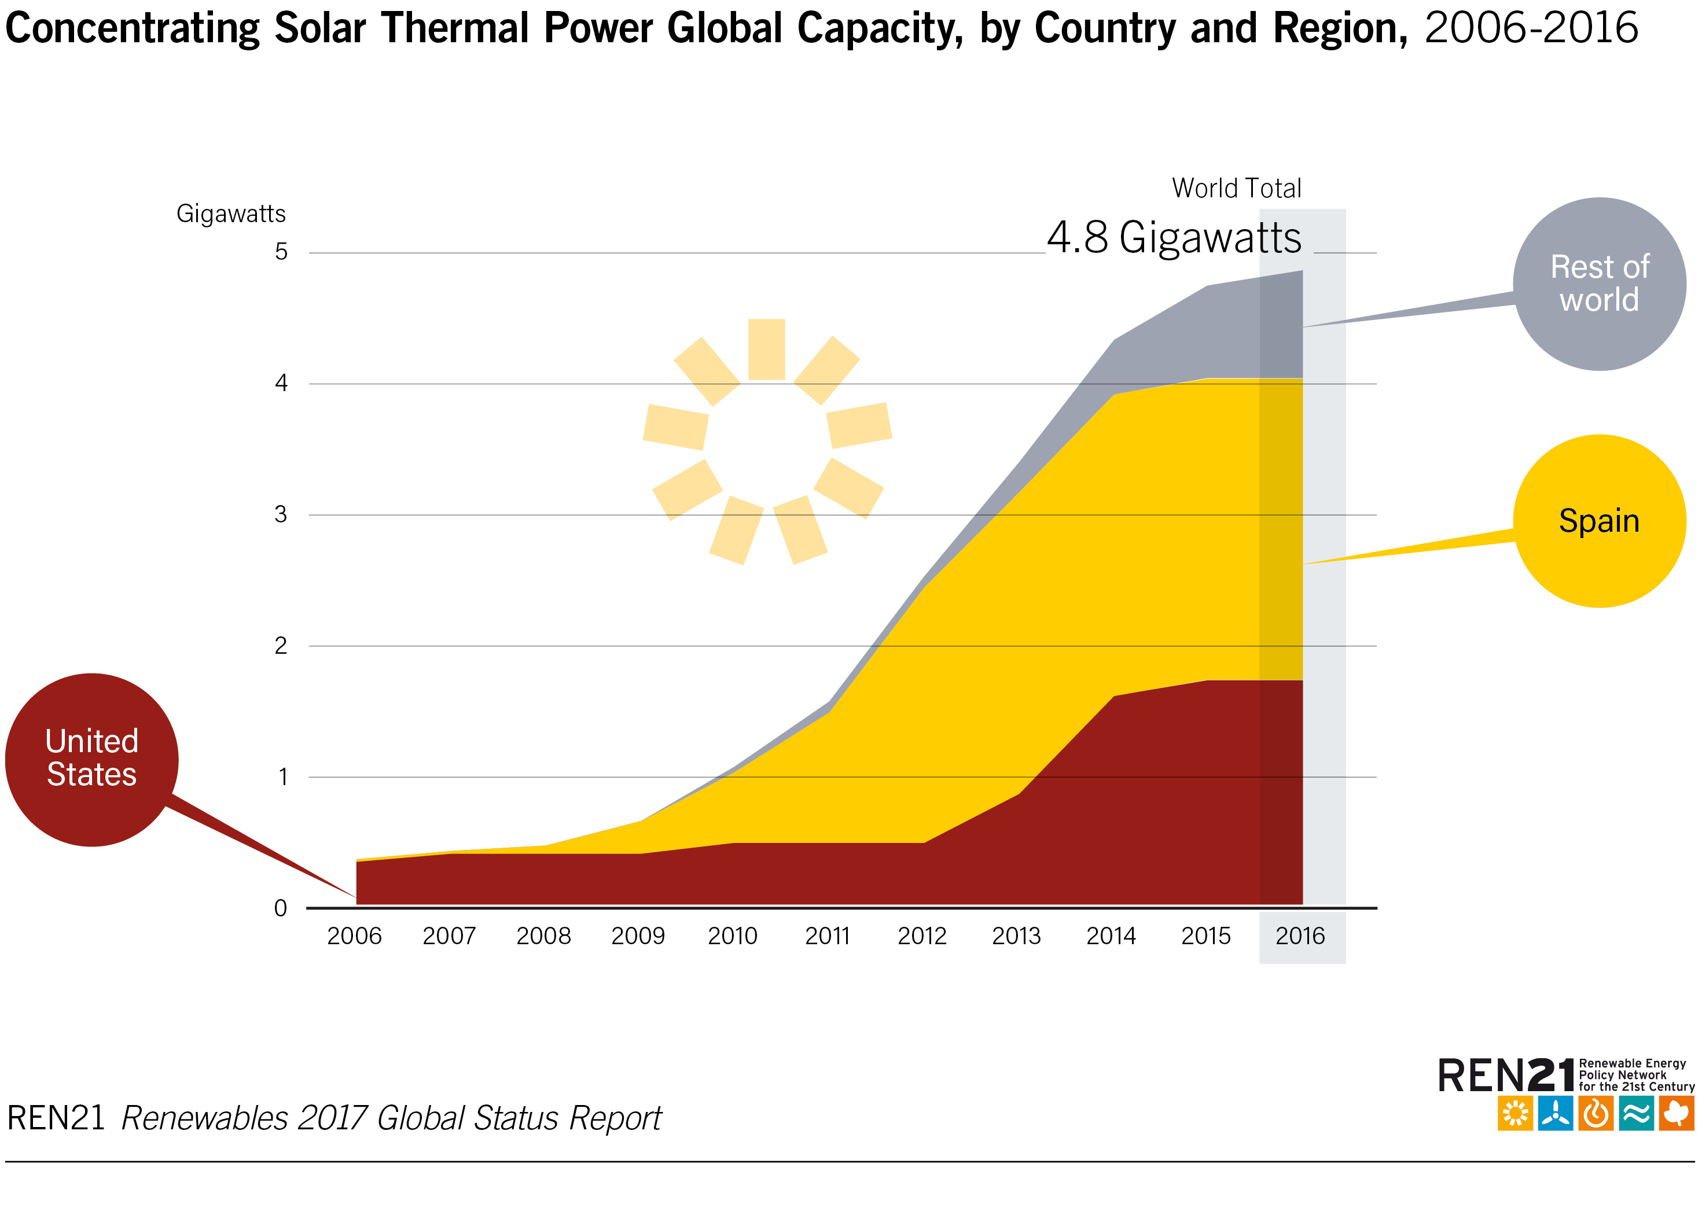
Concentrating Solar Thermal Power (CSP)
110 MW of capacity came online in 2016
Total global capacity: 4.8 GW
900 MW expected to enter operation during the course of 2017
Notes:
Concentrating solar thermal power (CSP), also known as solar thermal electricity (STE), saw 110 MW of capacity come online in 2016, bringing global capacity to slightly below 4.9 GW by year's end.
This was the lowest annual increase in total global capacity in 10 years, at just over 2%.
Even so, CSP remains on a strong growth trajectory, with as much as 900 MW expected to enter operation during the course of 2017.

Slide 20
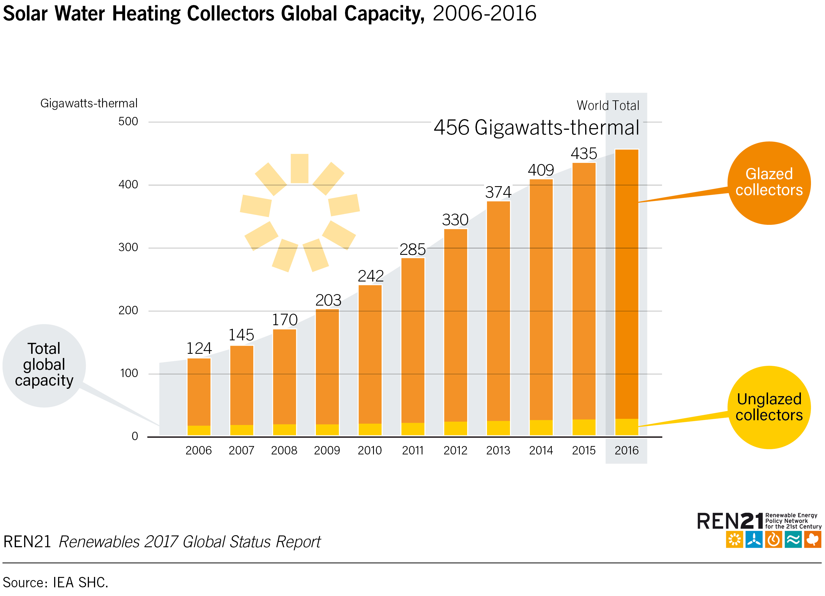
Solar Thermal Heating and Cooling
Total capacity of water collectors increased by 5% to 456 GWth
Solar heating and cooling technologies have been sold in at least 127 countries
Notes:
Solar thermal technology is used extensively in all regions of the world to provide hot water, to heat and cool space, to dry products and to provide heat, steam or refrigeration for industrial processes or commercial cooking.
By the end of 2016, solar heating and cooling technologies had been sold in at least 127 countries.
The cumulative capacity of glazed (flat plate and vacuum tube technology) and unglazed collectors in operation increased to a year-end total of 456 GWth, up from 435 GWth a year earlier.

Slide 21
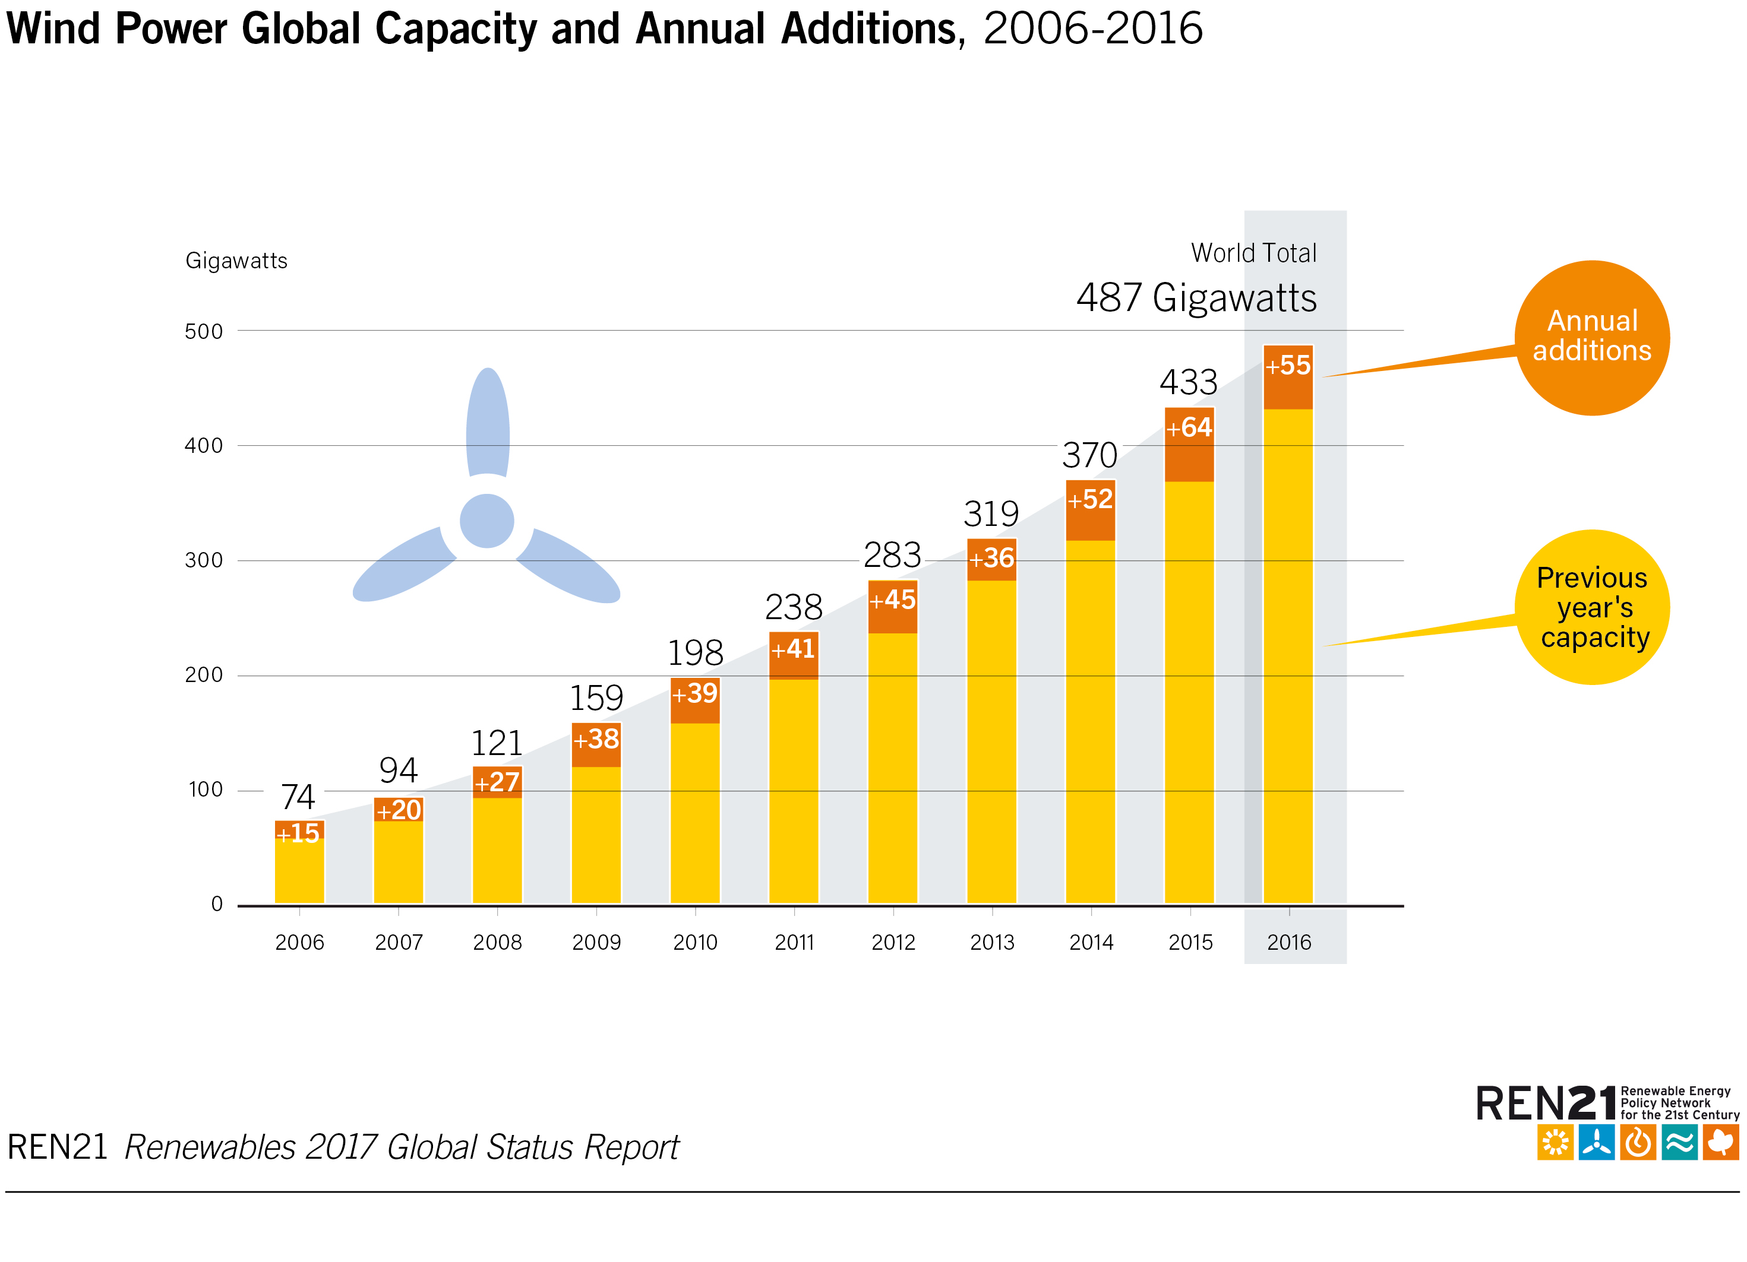
Wind Power
55 GW of wind power capacity added
Global total increased 12% to 487 GW
Notes:
Almost 55 GW of wind power capacity was added during 2016, increasing the global total about 12% to nearly 487 GW.
Gross additions were 14% below the record high in 2015, but they represented the second largest annual market to date.
By the end of 2016, over 90 countries had seen commercial wind power activity, and 29 countries - representing every region - had mroe than 1 GW in operation.

Slide 22
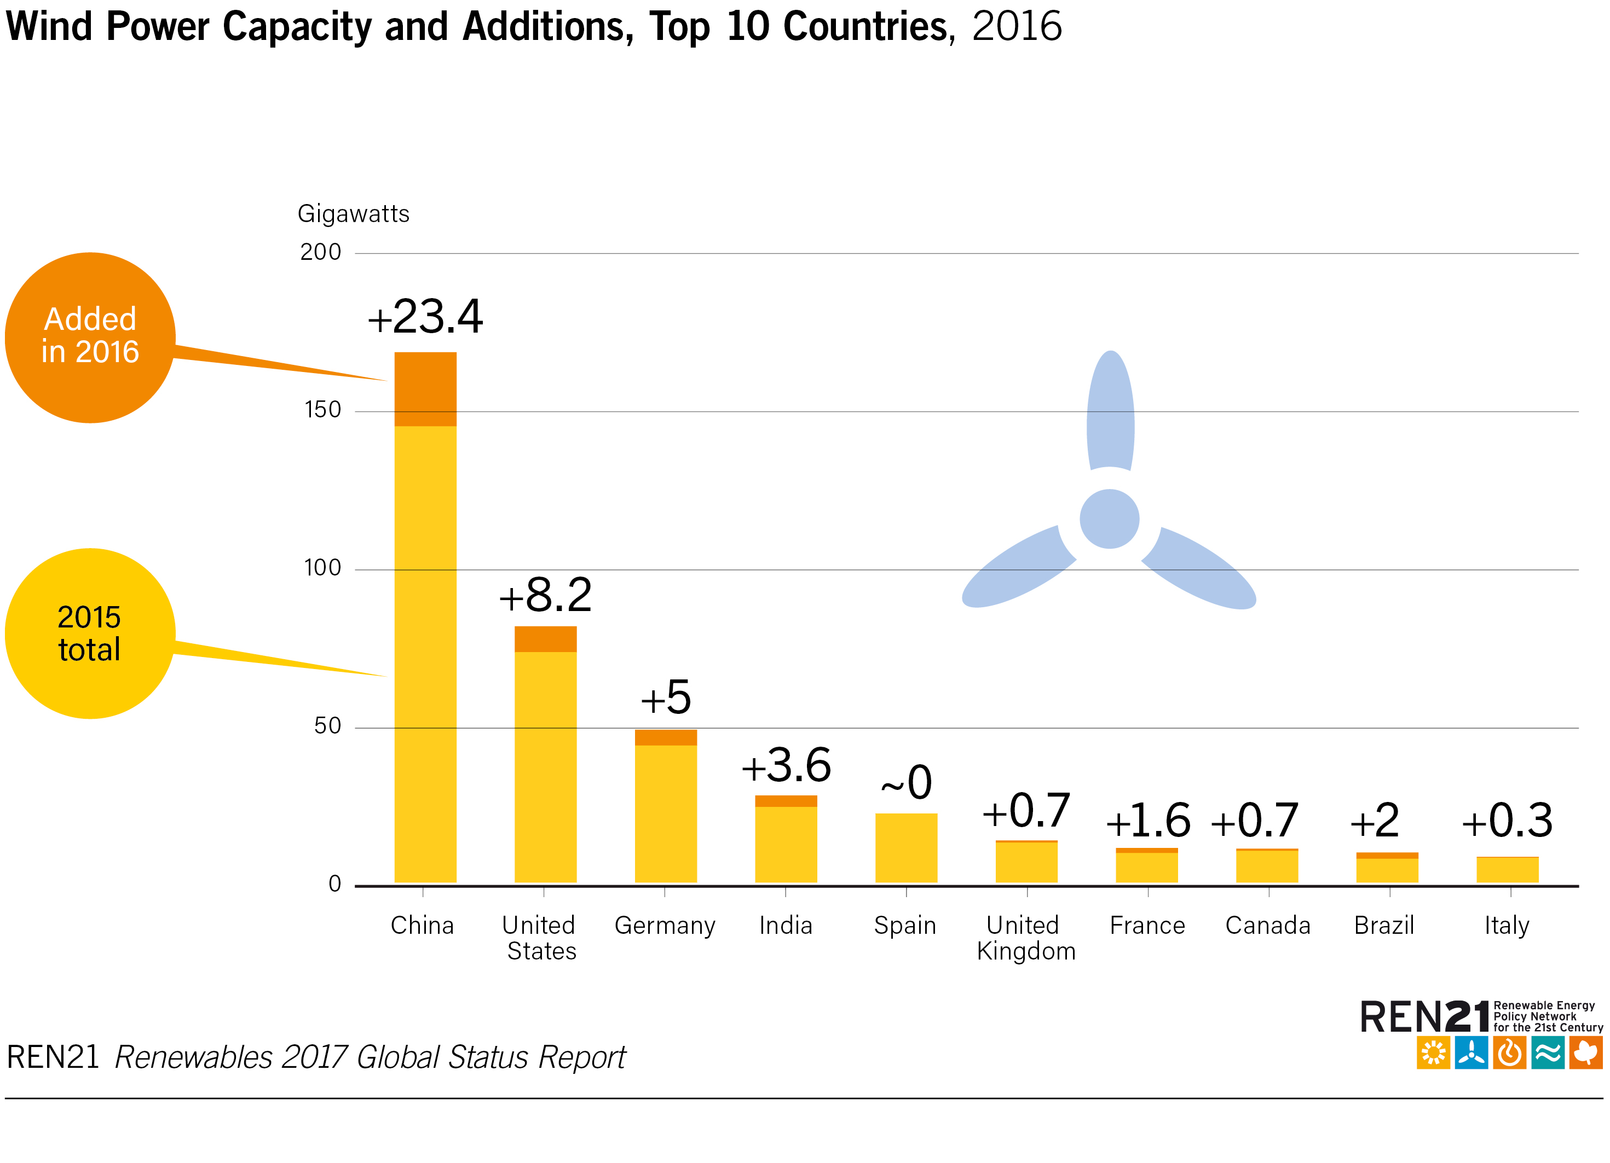
Wind Power
The global wind power market contracted in 2016
China added most new installations: 23.4 GW
Notes:
A significant decline in the Chinese market (following a very strong 2015) was responsible for most of the market contraction.
Even so, China retained its lead for new installations, followed distantly by the United States and Germany, with India passing Brazil to rank fourth.
Others in the top 10 additions were France, Turkey, the Netherlands, the United Kingdom and Canada.

Slide 23
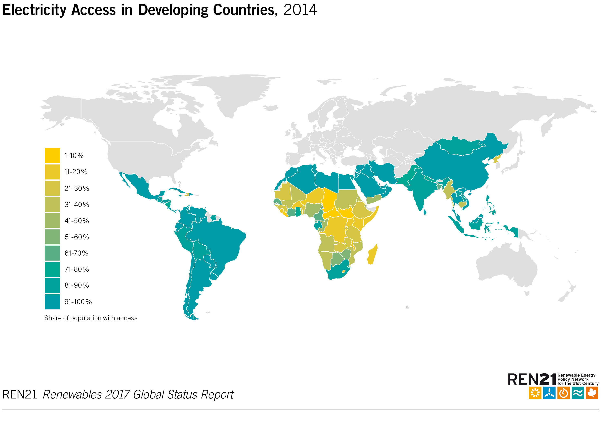
Distributed Renewable Energy for Energy Access
16% of the global population lived without electricity - approx. 1.19 billion people
Notes:
Approximately 1.19 billion people (about 16% of the global population) lived without electricity in 2014, about 15 million people fewer than in 2013.
Numbers and trends differ greatly by region.
The vast majority of people without access to electricity and clean cooking are in sub-Saharan Africa and the Asia-Pacific region, and most of them live in rural areas.

Slide 24
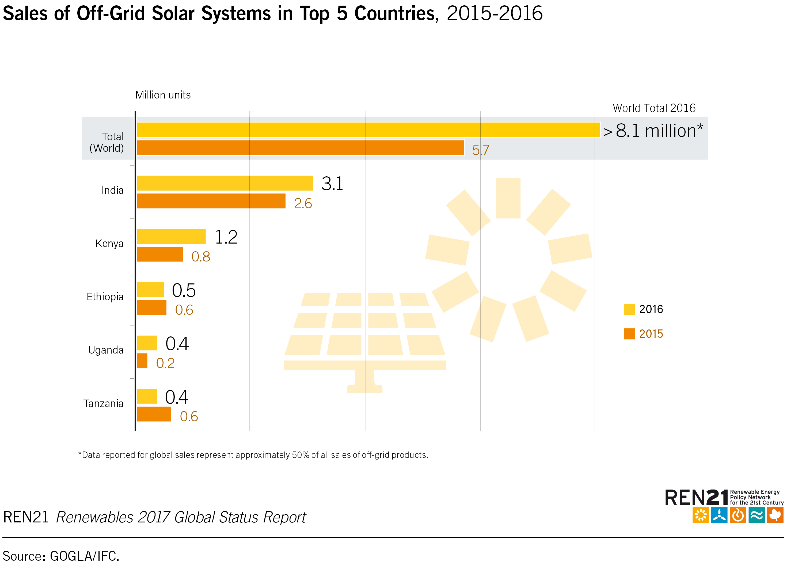
Distributed Renewable Energy for Energy Access
Sales of off-grid solar systems reach 8.1 million units worldwide
Sales were highest in sub-Saharan Africa, in particular in East Africa
Notes:
Across the distributed solar industry, sales in four of the top five countries (India, Kenya, Ethiopia, Uganda and Tanzania) increased in the first half of 2016 compared with the second half of 2015.
Sales were highest in sub-Saharan Africa, although sales in that region decreased for the first half of 2016 compared to the second half of 2015.

Slide 25
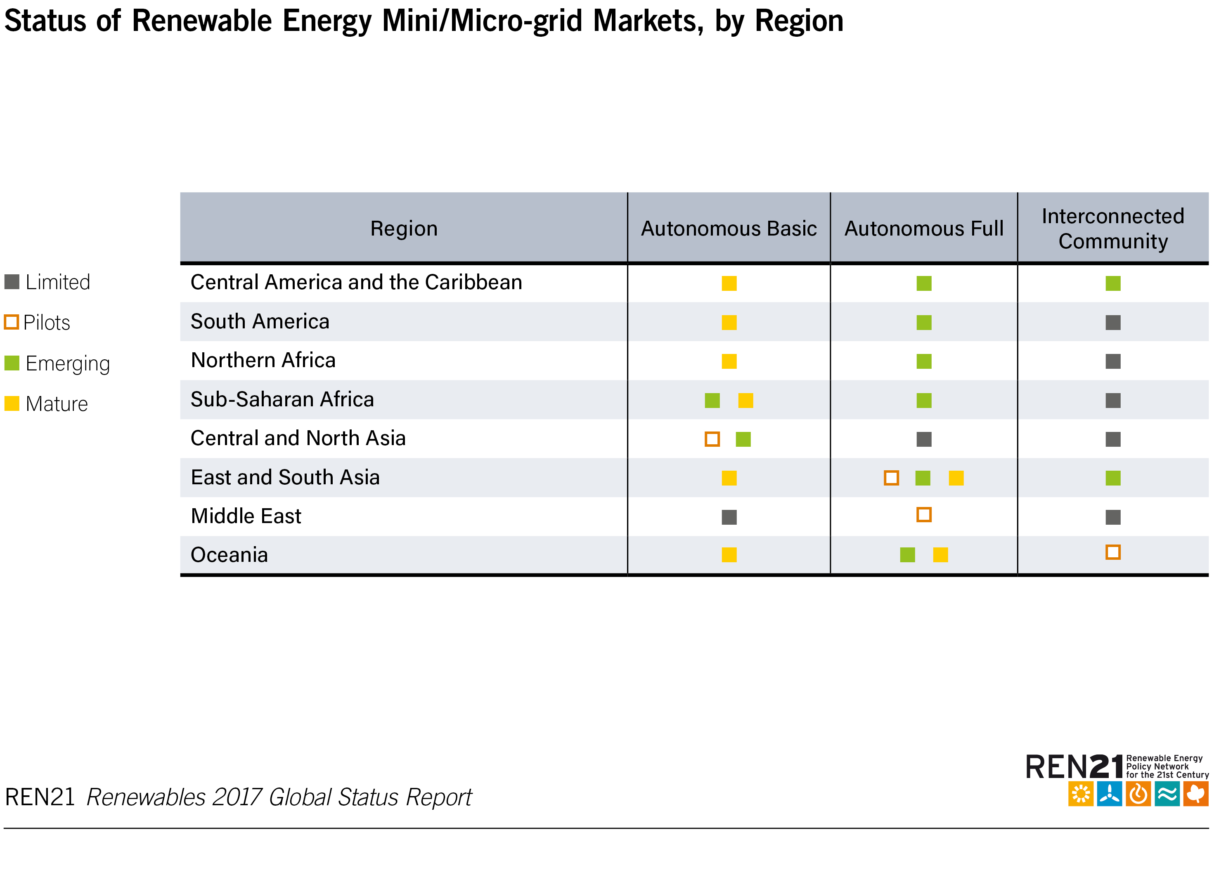
Distributed Renewable Energy for Energy Access
Deployment of mini-grids accelerated in 2016
Market now exceeds USD 200 billion annually
Notes:
The deployment of renewable mini-grids accelerated in 2016 as well, and this market now exceeds USD 200 billion annually.
Renewable mini/micro-grids are either emerging or mature in markets on almost every continent.
Mini-grid projects are being implemented with an increasing interest in interconnection, both to centralised grids and/or to other mini-grids.

Slide 26
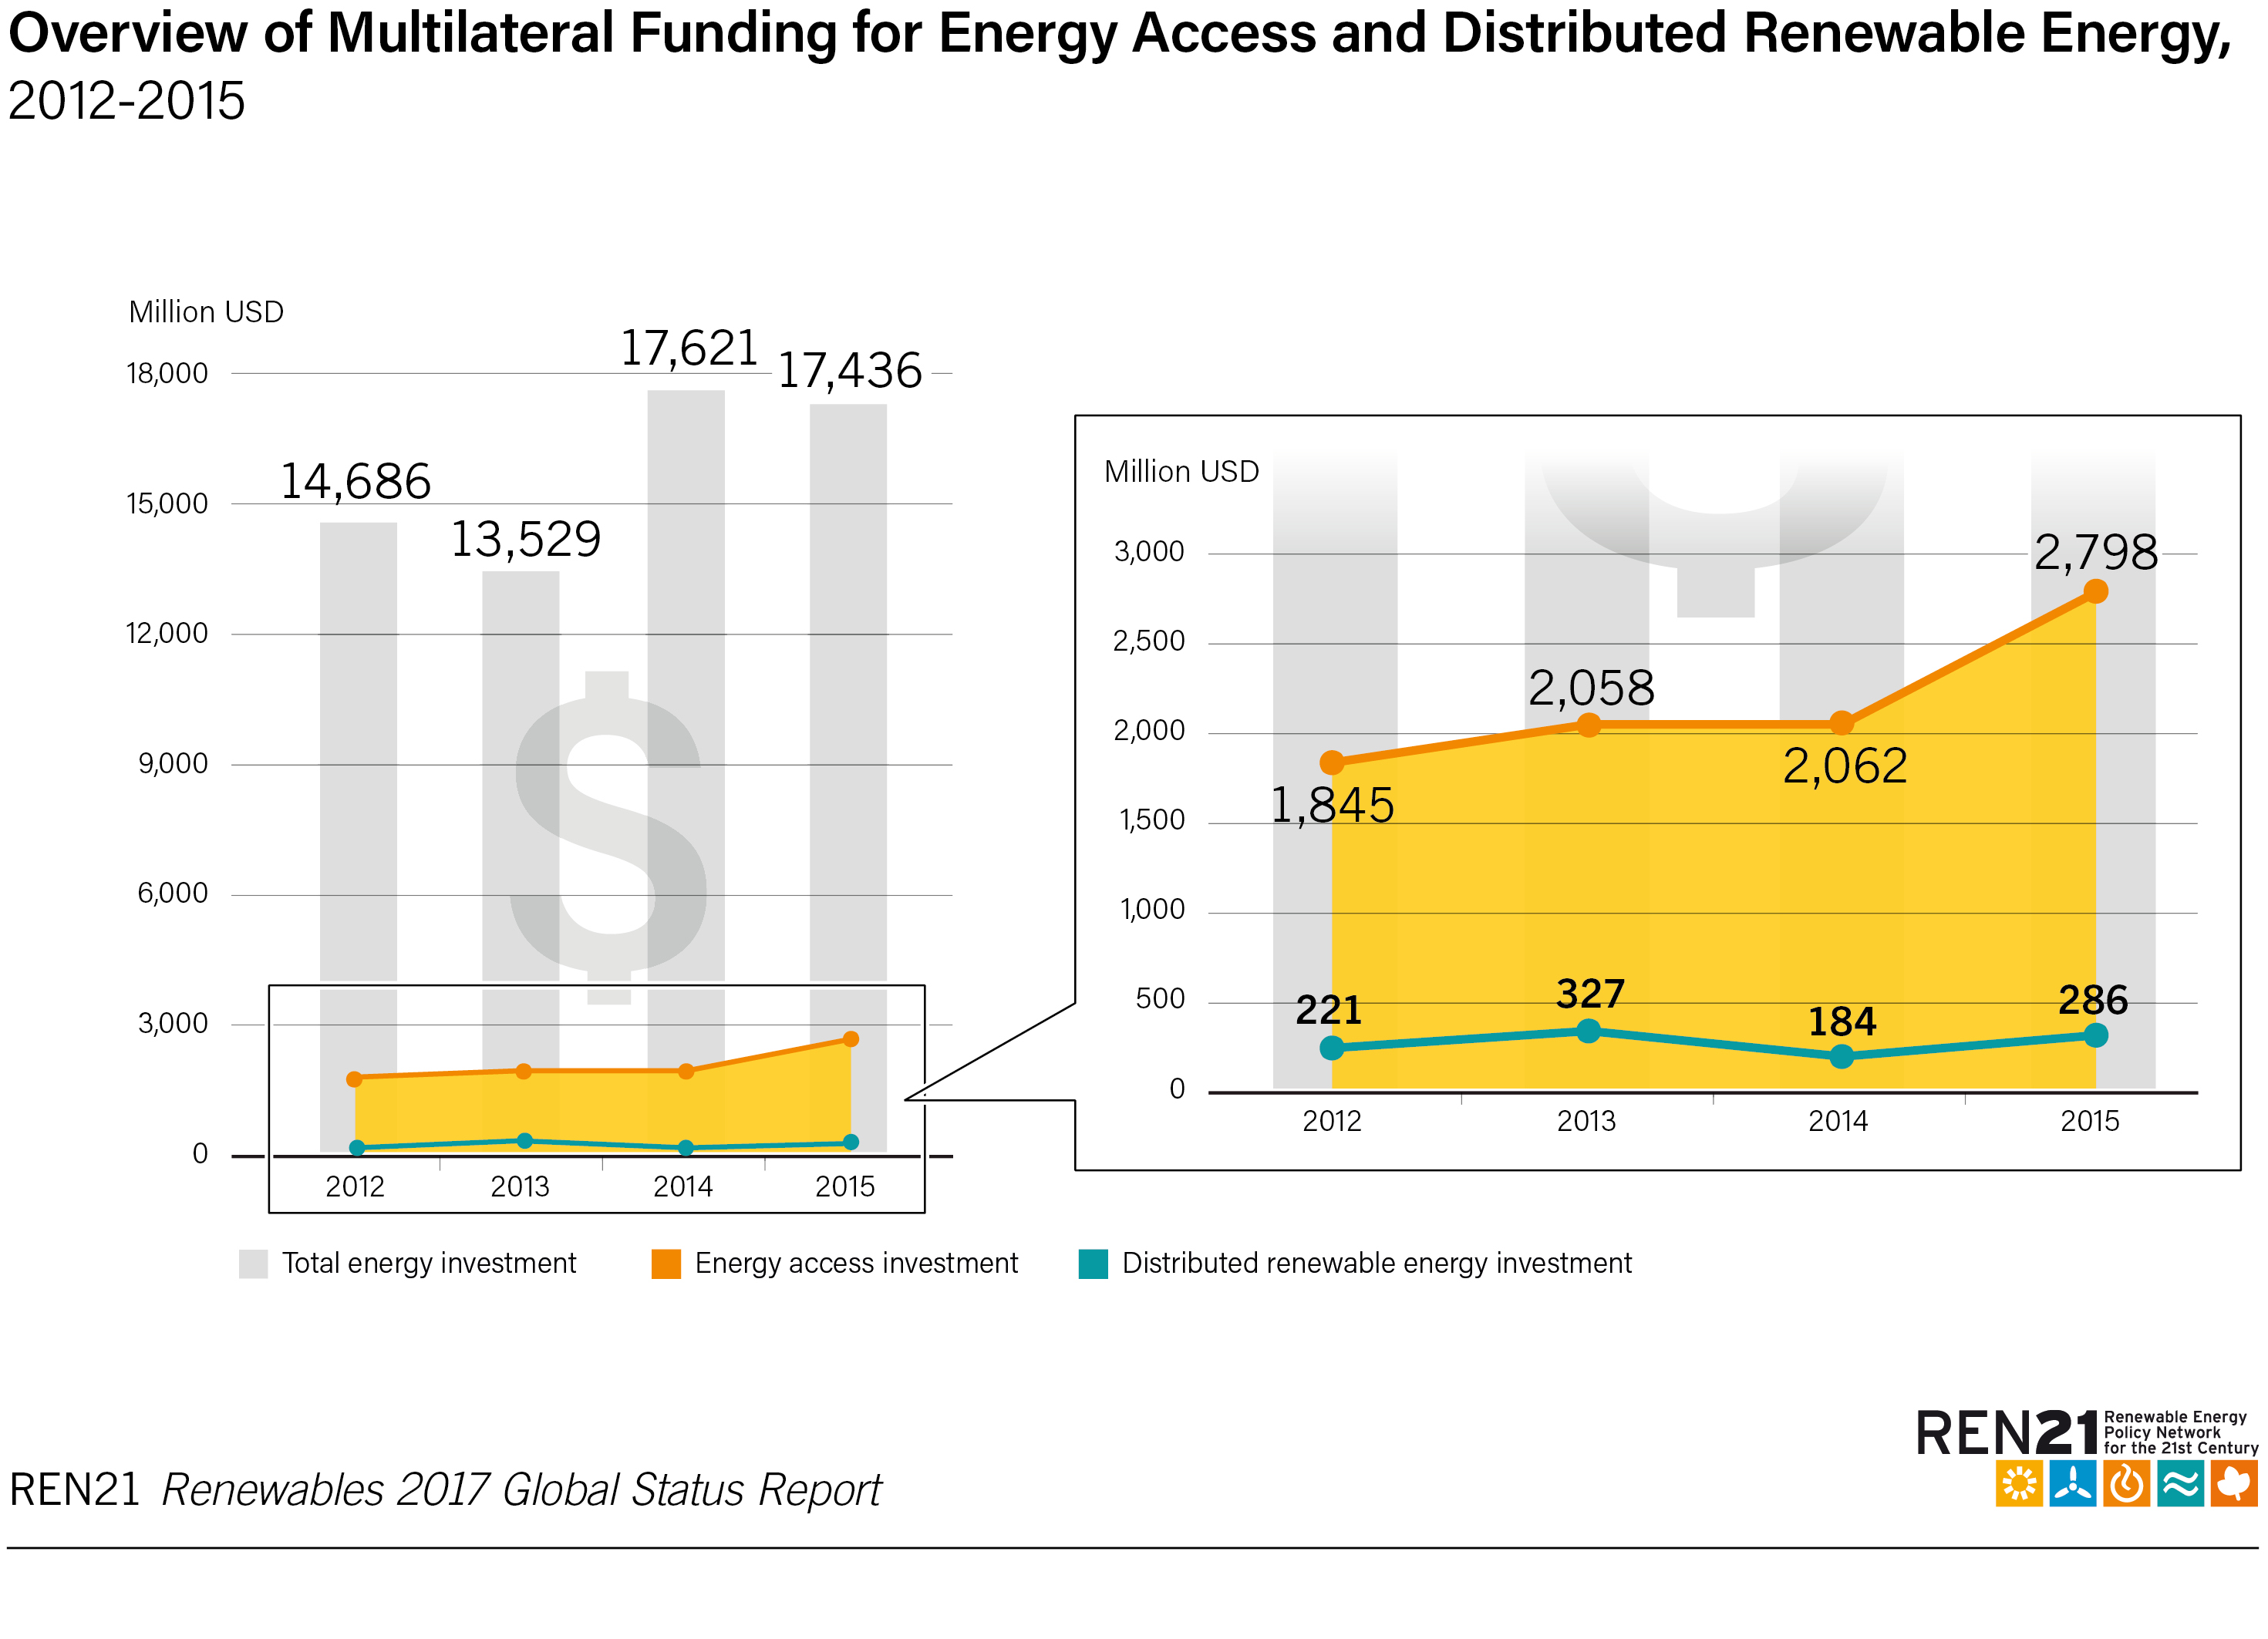
Distributed Renewable Energy for Energy Access
Funding from multilateral organisations and bilateral donors account for 55% of energy access investments
Notes:
To achieve the objective of universal access to energy by 2030, the Sustainable Energy for All (SEforALL) platform recommends an annual investment of USD 50 billion.
Current levels (around USD 13 billion in 2013, focused mostly on electricity) are far from this target.
Funding from multilateral organisations and bilateral donors continued to be the main source of financing for energy access investments (accounting for 55% of all such investments in 2013).
Although public international finance for climate change and clean energy systems - one of many channels through which DRE is financed - reached about USD 14.1 billion between 2003 and 2015, only 3% or USD 475 million was allocated to DRE-specific activities.
Debt financing, equity and to some extent grants are the main financing vehicles in the DRE sector.

Slide 27
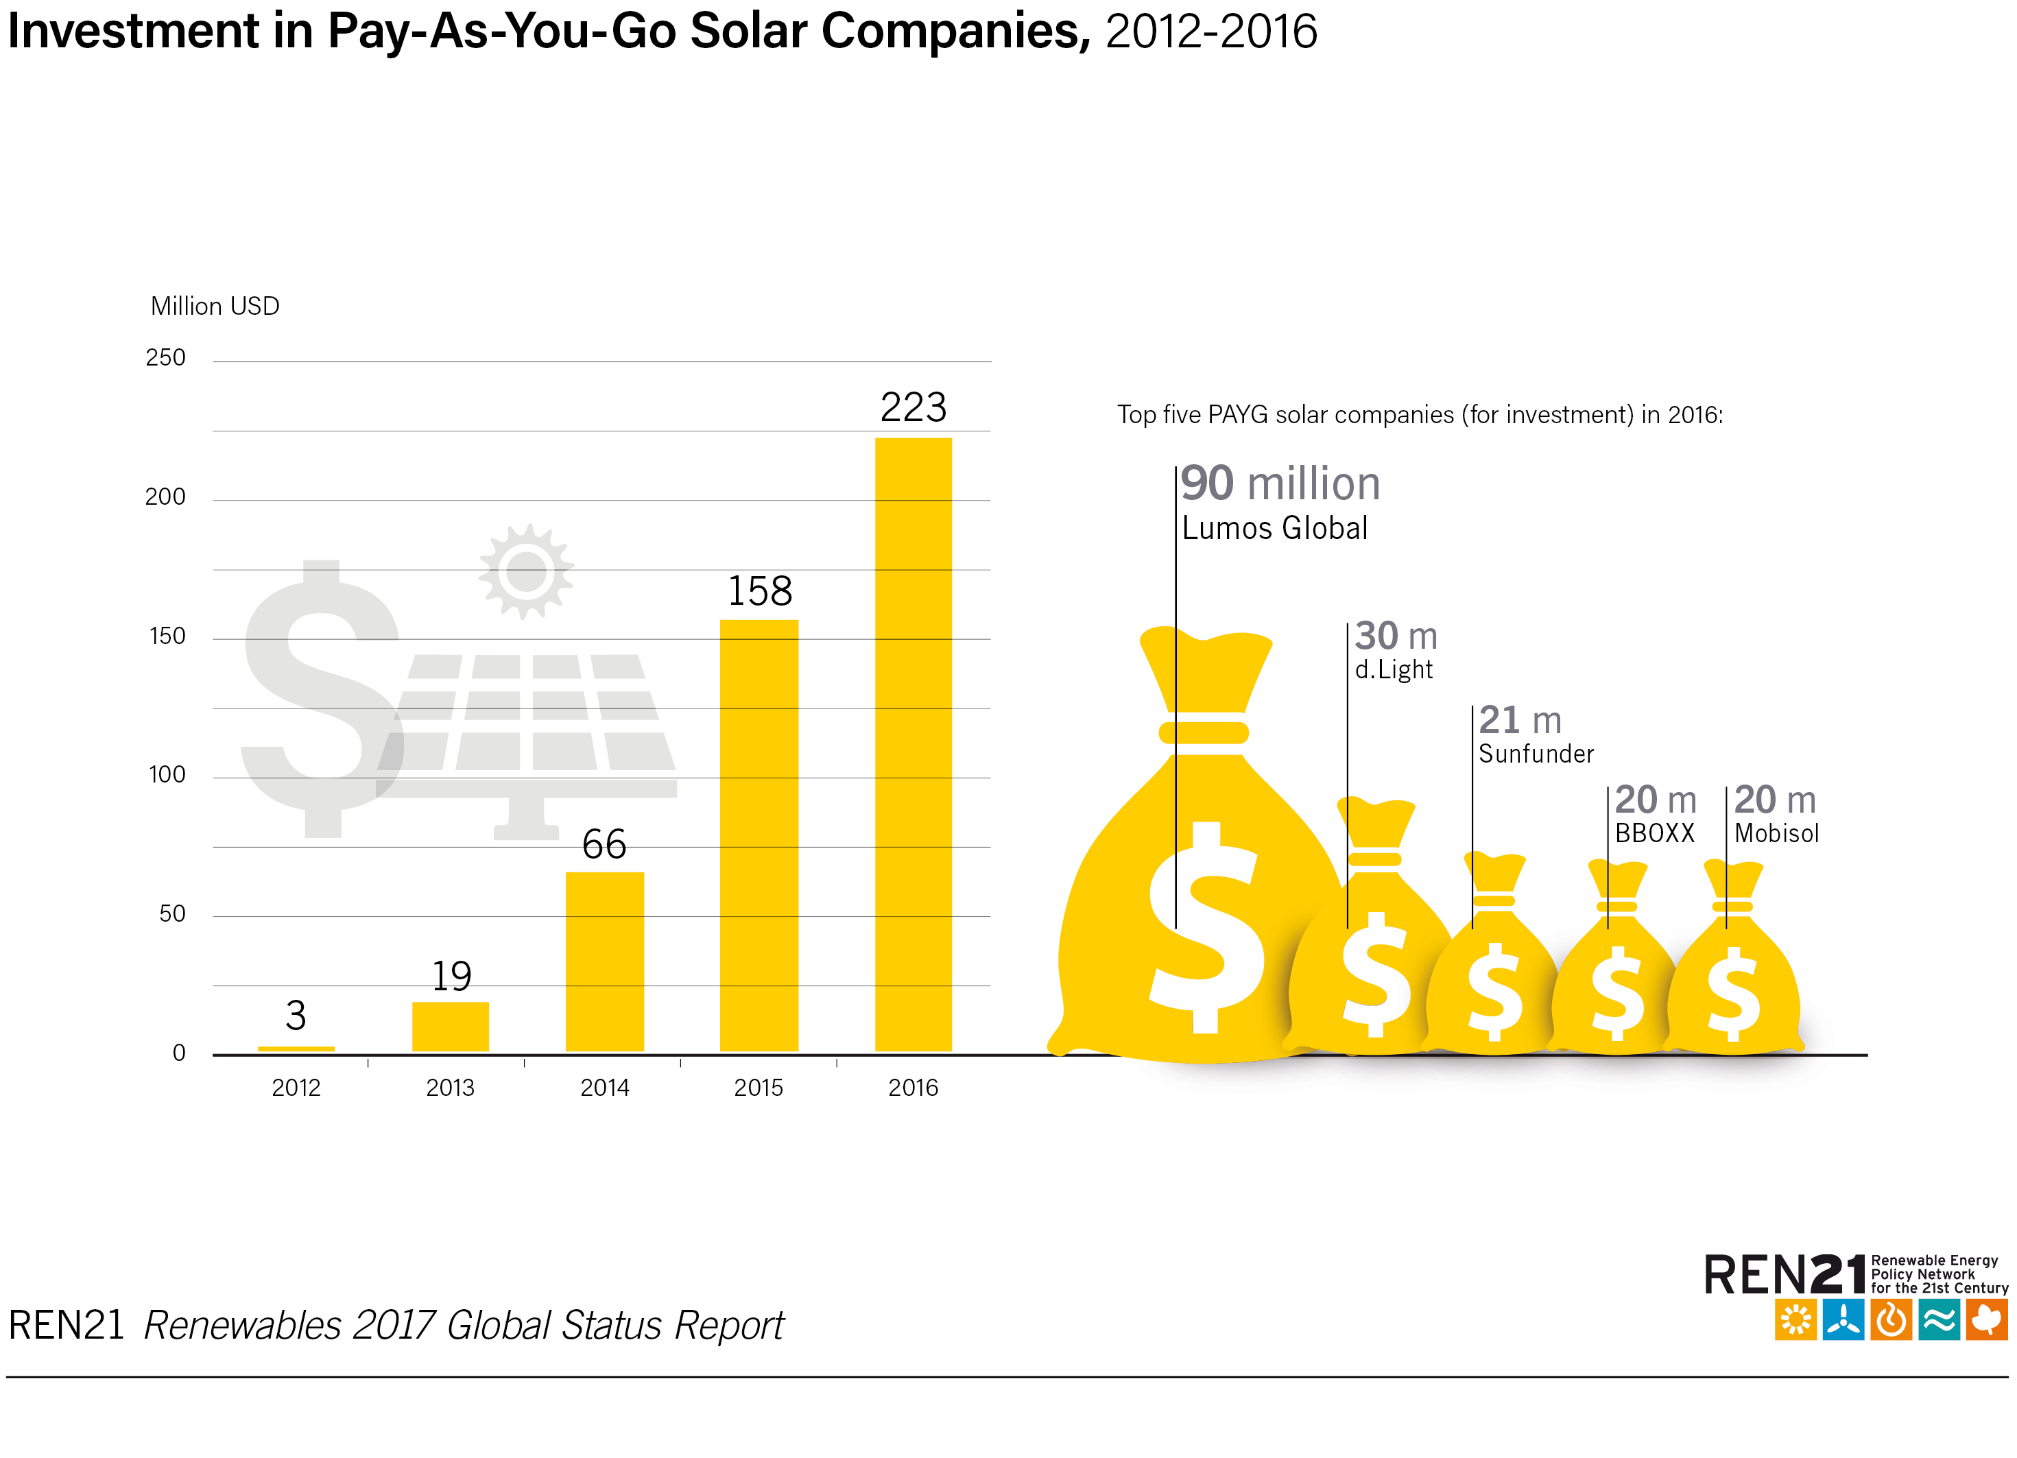
Distributed Renewable Energy for Energy Access
USD 223 million raised by PAYG solar PV companies, an increase of about 40% from 2015
Notes:
Investment in off-grid solar PV continued to grow in 2016, dominated mainly by investments in PAYG companies.
In 2016, some USD 223 million was raised by PAYG solar PV companies, an increase of about 40% from 2015.

Slide 28
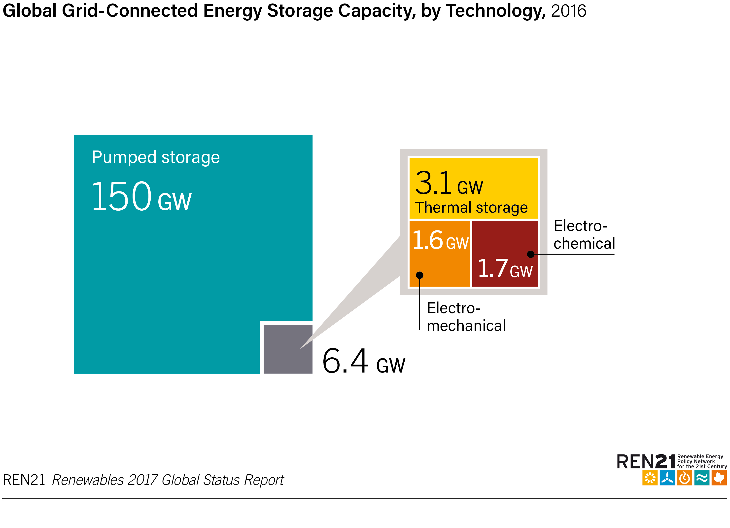
Enabling Technologies and Energy Systems Integration
Global grid-connected and stationary energy storage capacity in 2016 totalled an estimated 156 GW
Notes:
Global grid-connected and stationary energy storage capacity in 2016 totalled an estimated 156 GW, including 6.4 GW of new advanced storage.
Pumped storage hydropower accounting for the vast majority.
More than 6 GW of pumped storage capacity was commissioned in 2016, for a year-end total of approximately 150 GW.

Slide 29
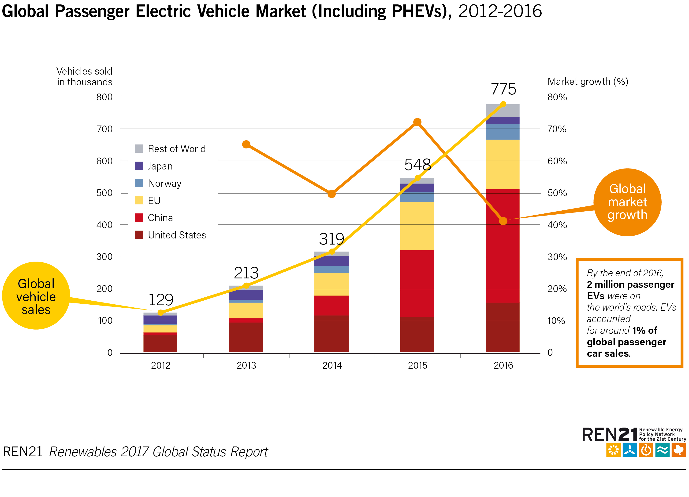
Enabling Technologies and Energy Systems Integration
Global sales of EVs reached 775,000 units
More than 2 million passenger EVs were on the world's roads by year's end (1% of the light vehicle market)
So far, little linking of renewable Energy and electric mobility
Notes:
Global Deployment of EVs for road transport, and particularly passenger vehicles, has grown rapidly in recent years.
In 2016, global sales reached an estimated 775,000 units, and more than 2 million passenger EVs were on the world's roads by year's end.
The EV passenger car market (including PHEVs) accounted for around 1% of global passenger car sales in 2016.
The top five countries for total passenger EV deployment in 2016 were China, the United States, Japan, Norway and the Netherlands; together, they accounted for 78% of the year's global sales.
China and the United States are the market leaders in unit sales, while Norway is well ahead of all other countries in terms of market penetration.

Slide 30
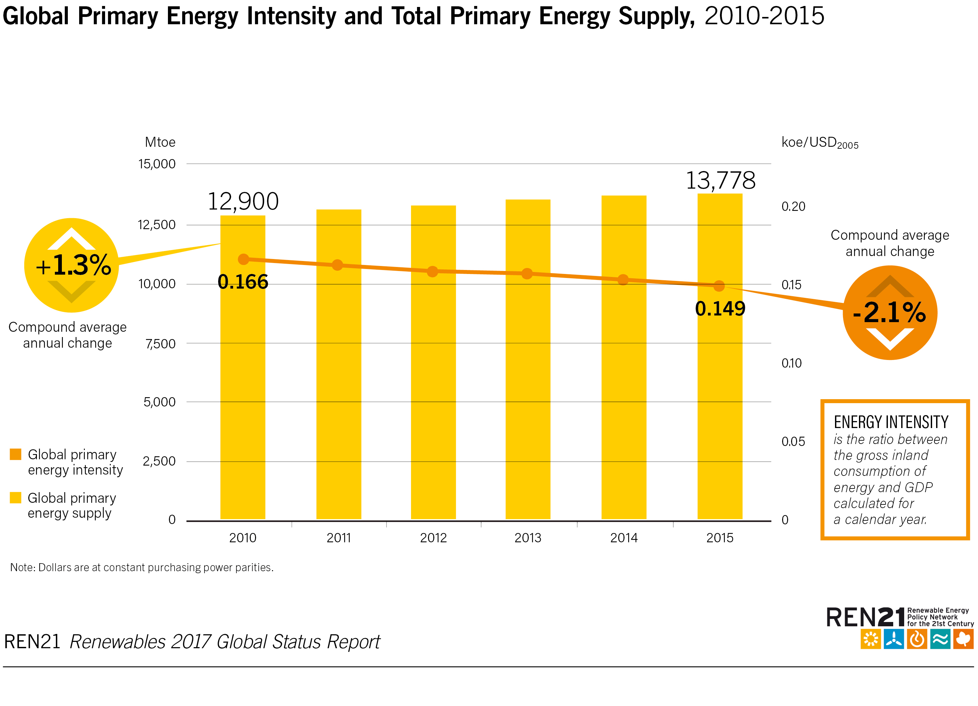
Energy Efficiency
From 2010
to 2015, energy
intensity declined
by an average
annual rate of
2.1%
Notes:
In 2015, global primary energy intensity improved by 2.6%.
That is the average rate that needs to be achieved between 2010 and 2030 to meet the Sustainable Development Goal 7 target of doubling the rate of improvement in energy efficiency.
However, between 2010 and 2015, energy intensity declined by only 10.2% overall - an average annual rate of 2.1%.
Over the same period, TPES grew by 1.3% per year, amounting to a total increase of 6.8%.

Slide 31

Conclusions
Global renewable energy transition advancing with record capacity additions and rapidly falling costs – more capacity installed for less money
2016 was the third year in a row where decoupling of economic growth and energy-related CO₂ emissions occurred
However, progress not fast enough to reach Paris Agreement goals
Better-integrated sectoral planning
Smarter, more flexible systems integrating variable renewables
More use of enabling technologies
Notes:
This year has shown that a global energy transition is well under way.
There were record new additions of installed renewable energy capacity and rapidly falling costs, particularly for solar PV and wind power.
There was decoupling of economic growth and energy-related carbon dioxide (CO₂) emissions for the third year running.
There are innovative and more sustainable ways of meeting our energy needs - through better-integrated sectoral planning, the adoption of new business models, and more use of enabling technologies.
These developments are accelerating the paradigm shift away from a world run on fossil fuels. However, the share of renewables in total final energy consumption is not growing as quickly as it needs to be.
Climate commitments can only be reached if the majority of remaining fossil fuel reserves are kept in the ground, and both renewable energy and energy efficiency will have to be scaled-up dramatically.
To accelerate the transition to a healthier, more-secure and climate-safe future, we therefore need to build a smarter, more flexible system that maximises the use of variable sources of renewable energy, and accommodates both centralised as well as decentralised and community-based generation.

Slide 33
Nationally Determined Commitments
( The Paris Agreement)
Tuvalu :
100% RE based electricity generation by 2020
Increase energy efficiency o Funafuti by 30%
Tonga
70% of electricity generation from renewable sources by 2030
Improve Energy efficiency through reduction of electricity Line losses to 9 percent by 2020 (from a baseline of 18 percent in 2010)
Samoa
100% Renewable energy target for electricity generation through to the year 2025.
Fiji
30 % reduction in emissions : 10% through energy efficiency rest fro RE ( 100% electricity from RE resources by 2030- conditional)
Vanuatu
100% RE based electricity by 2030
Solomon Islands
30% emission reductions ( conditional)
PNG
100% RE by 2030

Slide 34
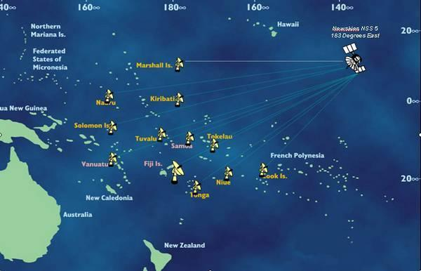
The USP
Striving to develop a well-trained cadre of professionals for the Pacific region and beyond
12 Member Countries, 14 Campuses, ~27,000 students spread over 30 million sq.km
The overarching themes of the University’s activities are Human Security and Sustainable Development.

Slide 35
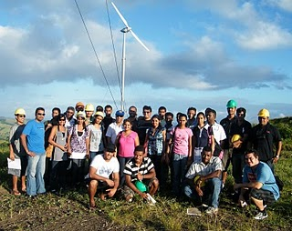
Renewable Energy Programmes @USP
PG Programmes:
PG Diploma in Physics(Renewable Energy) : 10-15 /year
Masters in Renewable Energy
(Engineering/Physics): 4-5 /year
Ph.D. in Renewable Energy
(Engineering/Physics): 3 in progress
UG Progarmmes:
Undergraduate courses in Renewable Energy ( 150 students)
Accredited Engineering programme : RE courses
Vocational Training : ASU/USP VOCTEC Project (30 trainers/200 technicians)

Slide 36
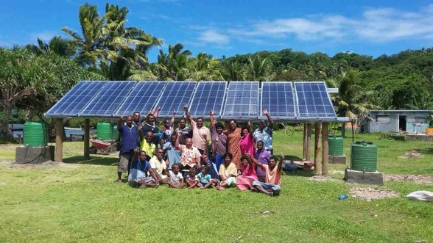
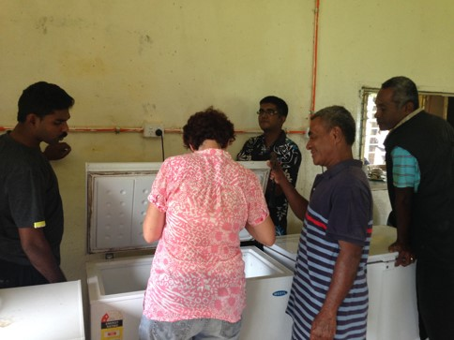


USP Projects : Community impacts - Energy for Sustainable Development
Solar water distillation
Solar PV powered Refrigeration Systems
Solar water pumping
Solar lighting

Slide 37
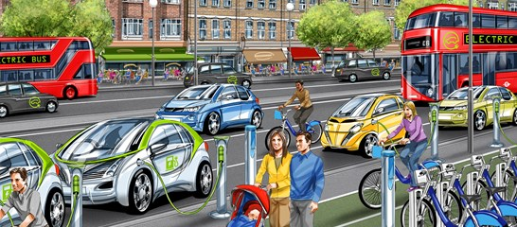
The future : exciting times ahead!
Smart b/c world will go all-electric appliance-machines-transport supplied by WWS ( Wind, Water and Sunlight) . Utilities will have more business + need more transmission
Mark Jacobson
wsp-pb

Slide 38
Thank You For Your Attention

