Slide 1




4 June 2018
REN21 Secretariat
gsr@ren21.net

Slide 2
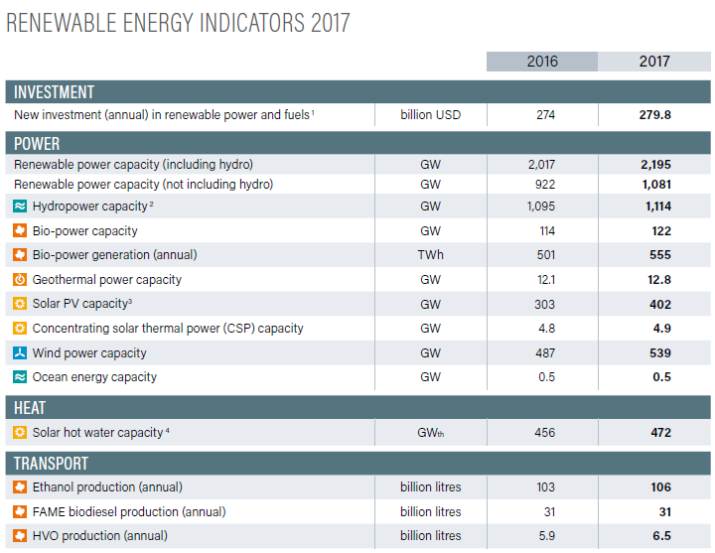
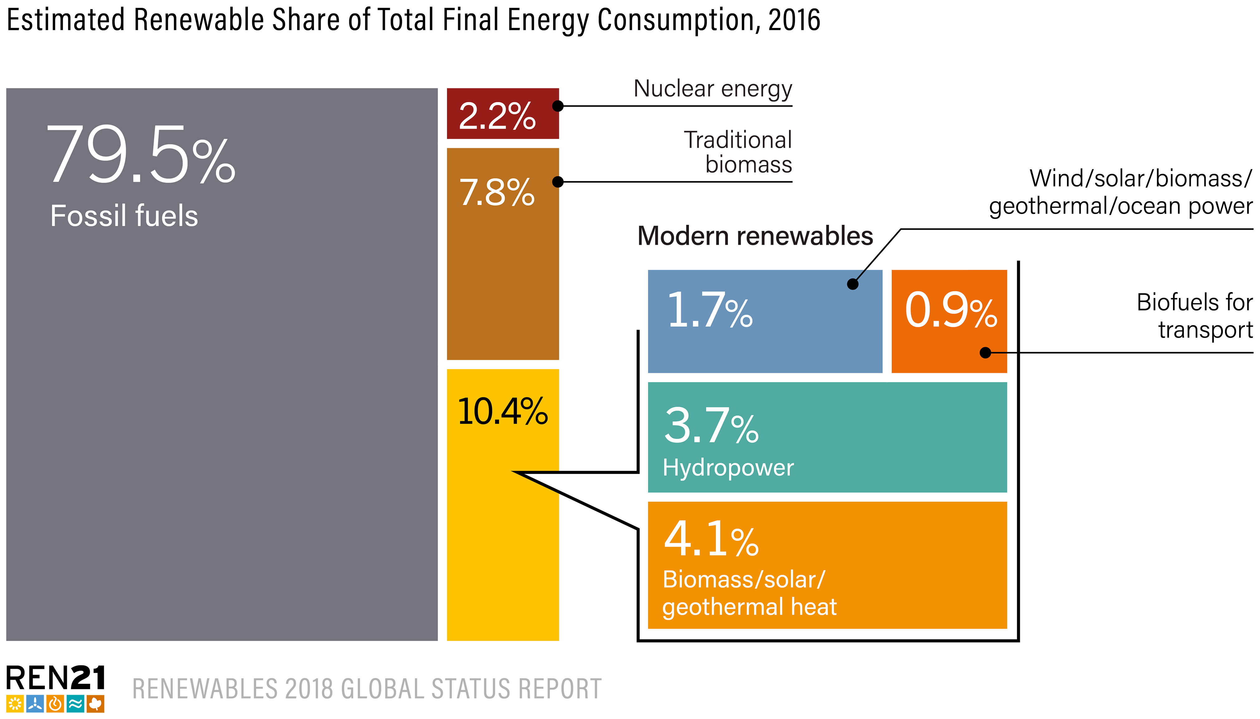
Another Extraordinary Year for Renewable Energy
Total global capacity:
up almost 9% compared to 2016, 2,195 GW at year’s end (1,081 GW not incl. hydro)
Share in newly installed renewable power capacity:
  Solar PV: 55%
  Wind: 29%
  Hydropower: 11%
  Bio-power: 4.6%
Notes:
2017 was another great year for renewable energy:
Total global renewable capacity was up almost 9% compared to 2016, to more than 2,195 GW at year’s end.
This development was mainly driven by solar PV and wind:
Solar PV represented more than 55% of newly installed renewable power capacity in 2017, wind 29%, hydro X and bio-power X.

Slide 3
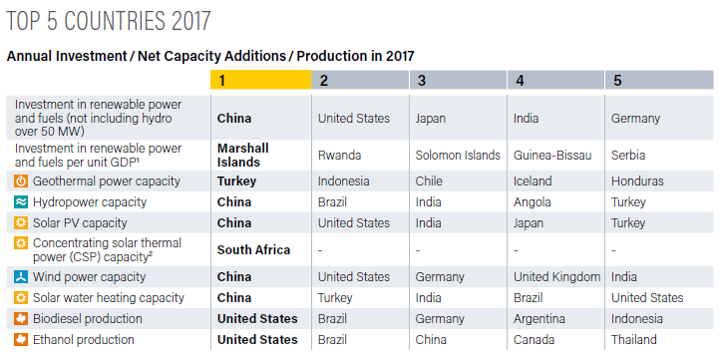
Renewable Energy “Champions”
Notes:
The Global Status Report provides an overview of renewable energy champions in different areas.
Let’s look at annual investment/capacity additions - In absolute number, the top countries for investment in RE power and fuels were: China, the US, Japan, India and Germany.
However, when you look at investment relative to GDP, you get a completely different list of countries. The countries now are: the Marshall Islands, Rwanda, Solomon Islands, Guinea-Bissau and Serbia, which clearly highlights the rapid advancement of renewable energy in developing countries.

Slide 4
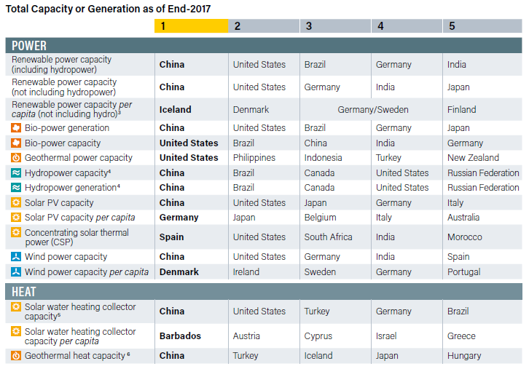
Renewable Energy “Champions”
Notes:
Now lets look at the “Champions” when it comes to total RE capacity installed. In absolute figures including hydro, this list reads: China, US, Brazil, Germany, and India.
When looking at total RE capacity per capita (without hydro) the list reads as follows: Iceland, Denmark, Germany/Sweden and Finland – 5 European countries in the pole position.
Similarly in the heating sector, the list of countries changes entirely when looking at solar water heating collector capacity and per capita, with the 5 leading countries being Barbados, Austria, Cyprus, Israel, and Greece.

Slide 5
Renewable Energy in Total Final Energy Consumption
As of 2016, renewable energy provided an estimated 18.2% of global final energy consumption
  10.4% was provided by modern renewables
  (+0.2% relative to 2015)
  7.8% was provided by traditional biomass
  (-2.4% relative to 2015)
Notes:
As of 2016, renewable energy provided an estimated 18.2% of global final energy consumption, down from 19.3% in 2015.
Of this total share, modern renewables (not including traditional biomass) represented 10.4% in 2016, 0.2% more than in 2015. Hydropower accounted for an estimated 3.7% of total final energy consumption, other renewable power sources comprised 1.7%, renewable heat energy accounted for approximately 4.1%, and transport biofuels provided about 0.9%.
Traditional biomass, used primarily for cooking and heating in remote and rural areas of developing countries, accounted for about 7.8%, -2.4% than in 2015.

Slide 6
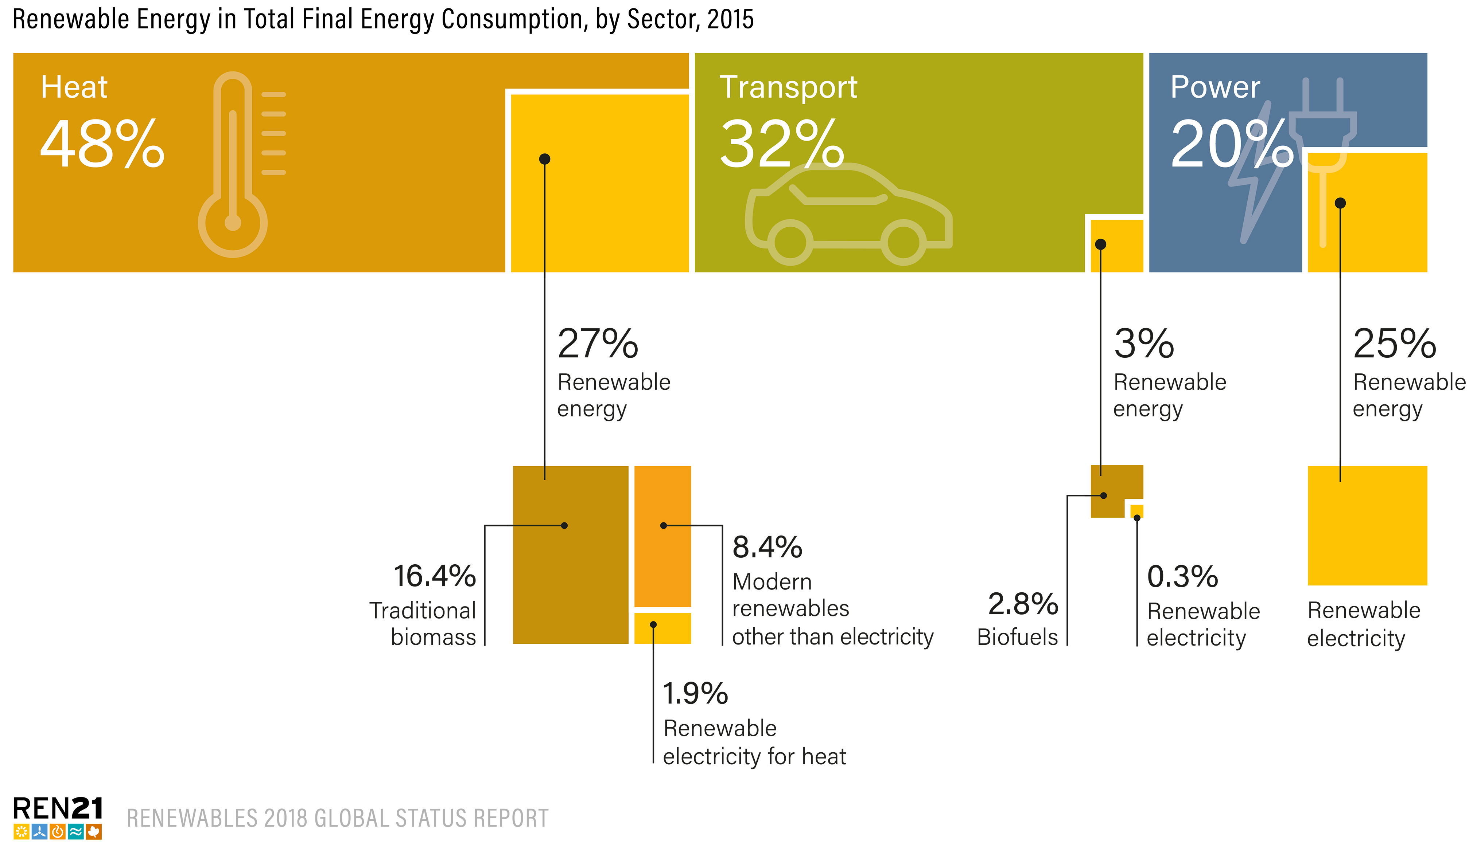
Renewable Energy in TFEC by Sector
Notes:
Despite these developments, renewables and the broader energy sector face several challenges, such as uneven growth across sectors.
Progress in the renewable heating and cooling and transport sectors continues to be relatively slow when compared to the power sector, despite the number of initiatives that exist to boost the role of renewables and the electrification of heating and transport.
However, the lack of advancement and attention to these sectors does not reflect relative importance: as of 2015, heating and cooling accounted for 48% of TFEC, followed by transport (32%) and electricity consumption (20%).
Heat consumption remains heavily fossil fuel-based, with only 10.3% of the heat used worldwide produced from modern renewables and renewable electricity in 2015. The largest share of renewable heating is associated with the traditional use of biomass which accounts for 16.4% of global heat demand.
As for transport, the vast majority of global energy needs within the sector are still met by oil, with small proportions met by biofuels (2.8%) and electricity (1.3%, of which 0.3% is renewable).

Slide 7
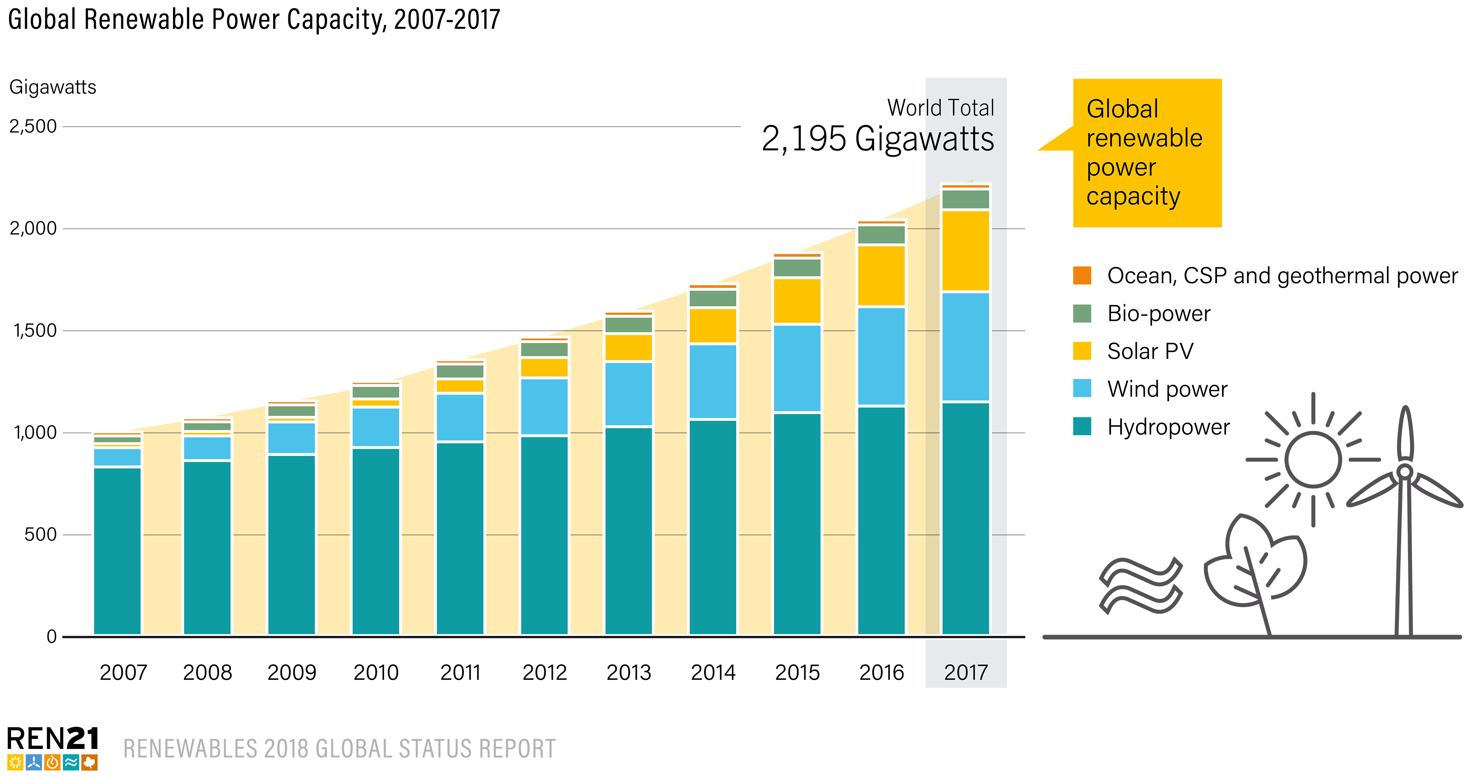
Global Renewable Power Capacity
Notes:
Renewable power generating capacity saw its largest annual increase ever in 2017, with an estimated 178 GW installed worldwide, raising total capacity by almost 9% over 2016.
Solar PV led the way, nearly double those of wind power (in second place), and adding more net capacity than coal, natural gas and nuclear power combined in 2017.
Total renewable power capacity more than doubled in the decade 2007-2017, and the capacity of non-hydropower renewables increased more than six-fold.

Slide 8
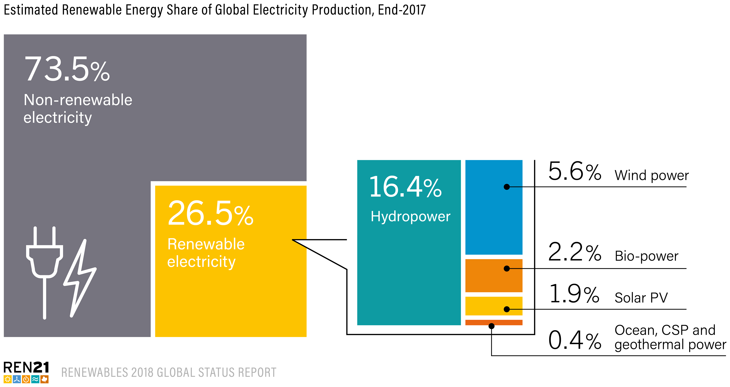
Power Sector
In 2017, renewables accounted for: 70% of net additions to global power generation capacity
Providing 26.5% of global electricity demand
Progress in the power sector shows that the transition to renewable energy is possible!
Notes:
- Taken together, renewables accounted for an estimated 70% of net additions to global power generation capacity in 2017. And provided 26% of global electricity demand.
- It is safe to say that the global energy transition is well underway in the power sector which shows that it is possible
Again, much of this progress is due to falling costs of solar PV and wind, made possible by technological innovations, changes in markets, effective policies and new business models.

Slide 9
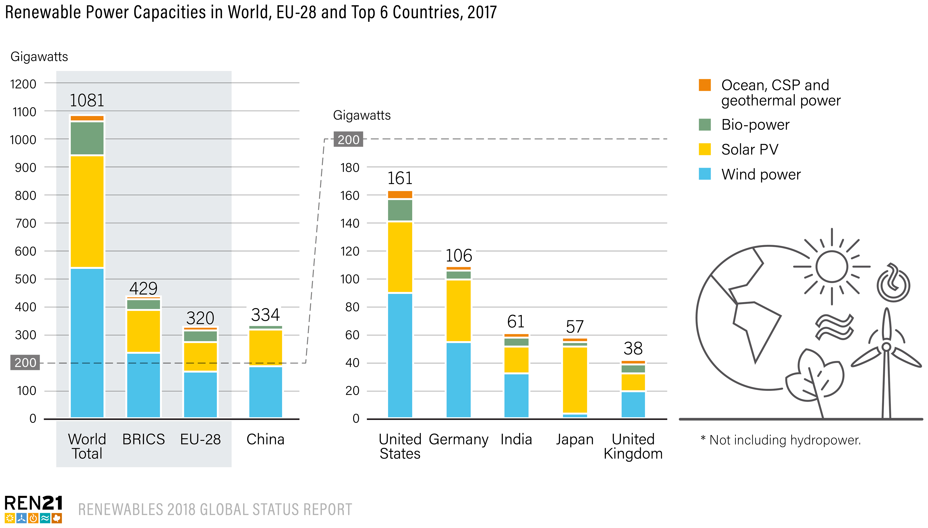
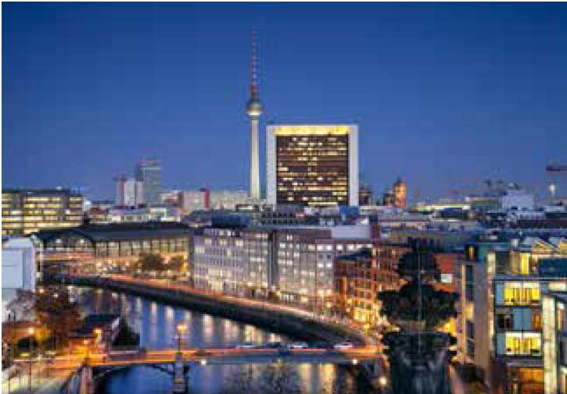
Renewable Power Capacities in the World
By the end of 2017, China alone was home to nearly 30% of the world’s renewable power capacity (approx. 647 GW)
Notes:
The top country for total installed renewable power capacity at the end of 2017 was China, followed distantly by the United States, Brazil, Germany and India, which moved ahead of Canada.
China alone was home to nearly 30% of the world’s renewable power capacity – totalling approximately 647 GW, including about 313 GW of hydropower.
Considering only non-hydropower capacity, the top countries were China, the United States and Germany, followed by India, Japan and the United Kingdom. The world’s top countries for non-hydro renewable power capacity per inhabitant were Iceland (more than 2.1 kilowatts (kW) per inhabitant), Denmark (nearly 1.6 kW), Germany and Sweden (both approaching 1.3 kW).

Slide 10
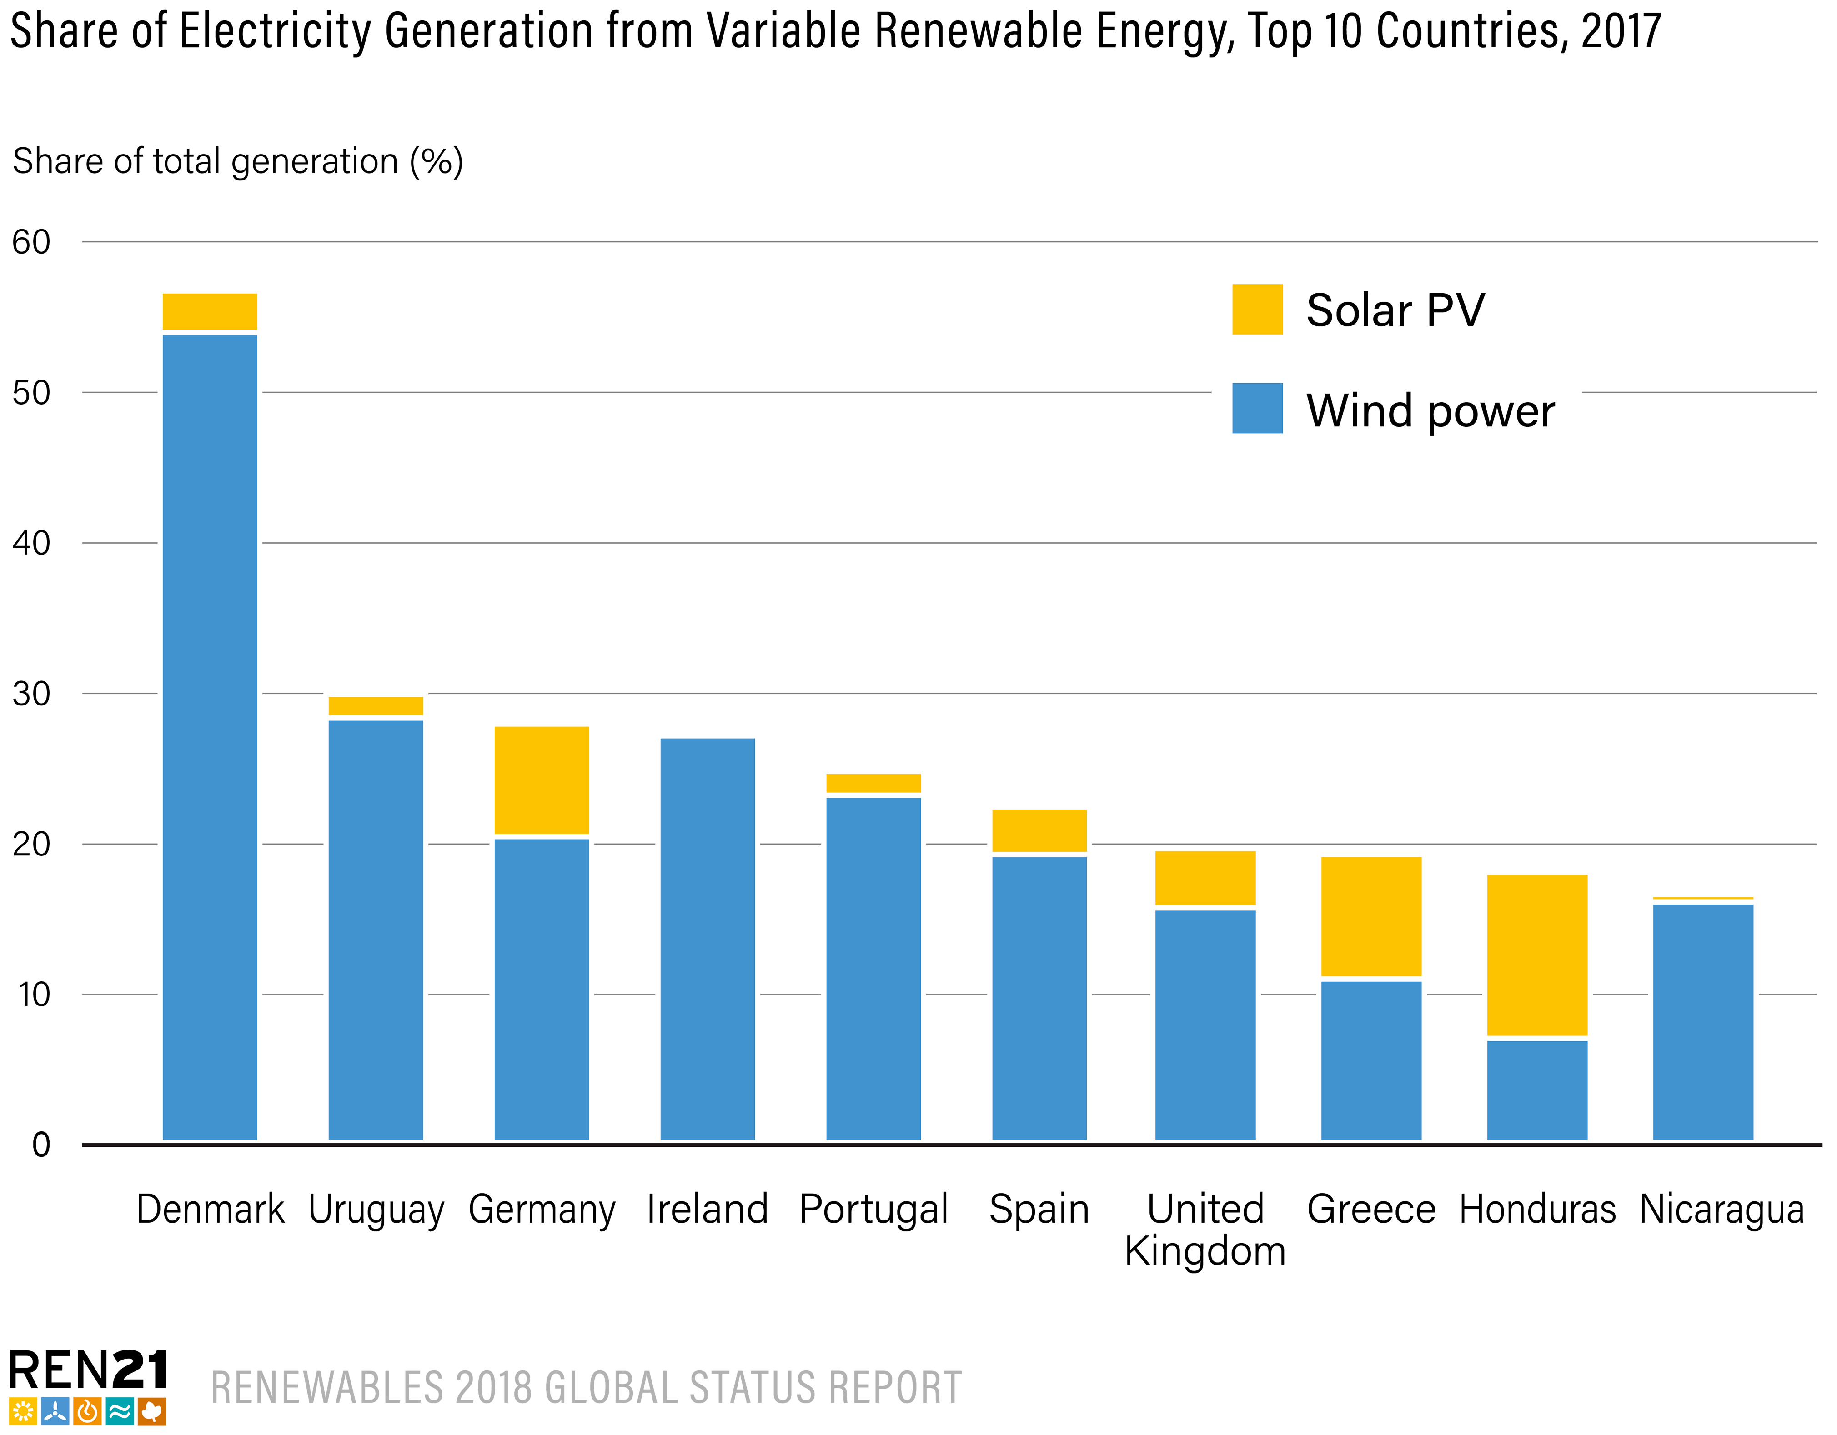
High Shares of Variable Renewable Power on the Grid
Notes:
Several countries are successfully integrating increasingly larger shares of variable solar PV and wind power into electricity systems by improving regulations and market design to reward flexibility, and by improving transmission and interconnection so as to broaden balancing areas.
In some cases, countries also are investing in energy storage capacity (mostly pumped storage).
Countries leading the way in VRE penetration include Denmark (nearly 53%), Uruguay (28%) and Germany (26%); Ireland, Portugal and Spain also have VRE penetration levels above 20%.

Slide 11
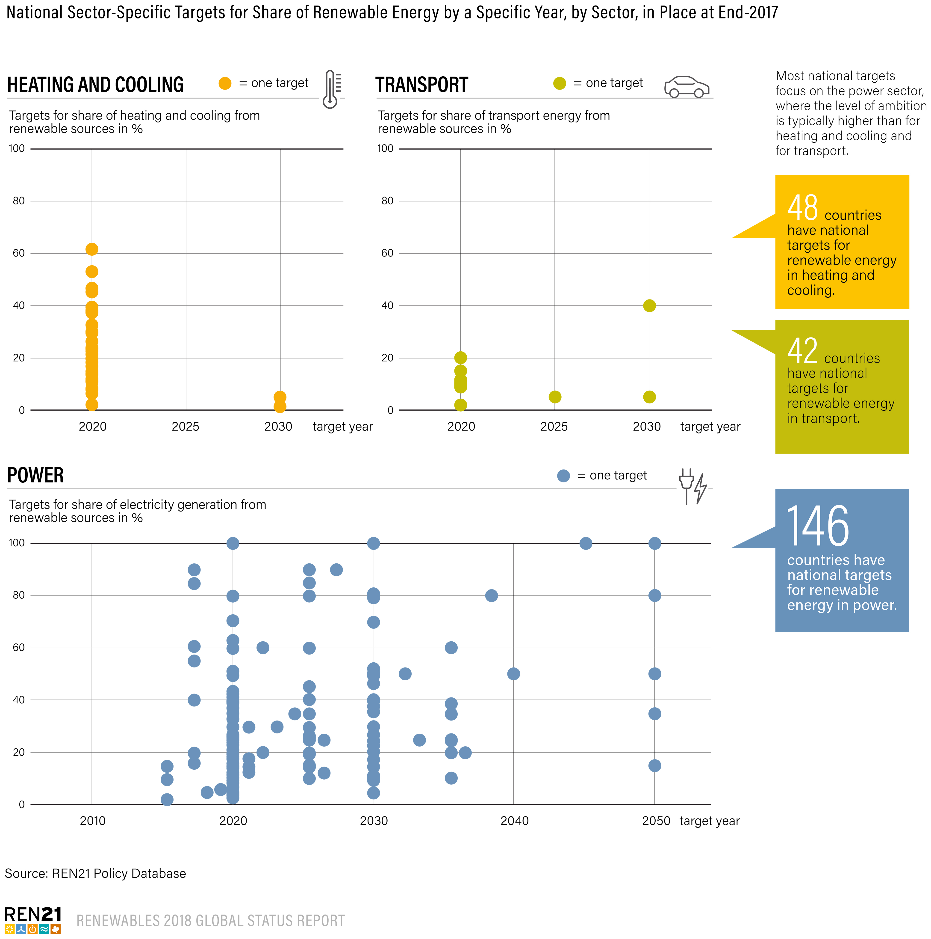
Renewable Energy Targets
179 countries had renewable energy targets
48 countries
had renewable heating and cooling targets
42 countries
had renewable transport targets
146 countries had renewable power targets
Notes:
As of year-end 2017, 179 countries had implemented renewable energy targets at the national or state/provincial level, up from 176 the year before
48 countries had renewable heating and cooling targets
42 countries had renewable transport targets
146 countries had renewable power targets

Slide 12
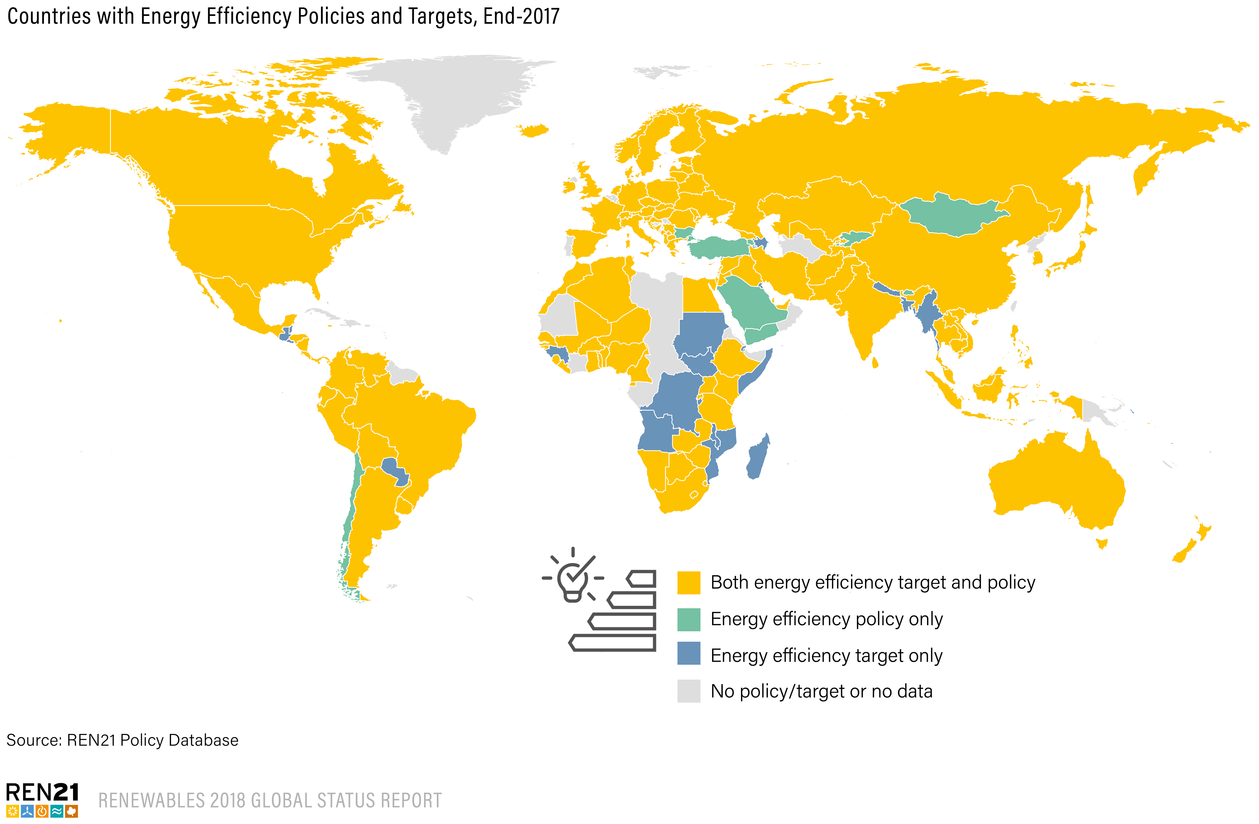
Heating and Cooling
By end-2017, at least 145 countries had enacted some kind of energy efficiency policy
At least 157 countries had enacted one or more energy efficiency target
Mandatory and voluntary energy codes for buildings exist in more than 60 countries worldwide
Notes:
The buildings sector, unlike other sectors, often sees a close alignment between policies for renewable energy and energy efficiency
By end-2017, at least 145 countries had enacted some kind of energy efficiency policy, and at least 157 countries had enacted one or more energy efficiency target.
Building energy codes are one of the most common policy tools used to promote renewable energy and energy efficiency in the sector.
Mandatory and voluntary energy codes for buildings exist in more than 60 countries worldwide
Specific mechanisms to increase renewable energy use for industrial processes are not commonplace, but some examples exist

Slide 13
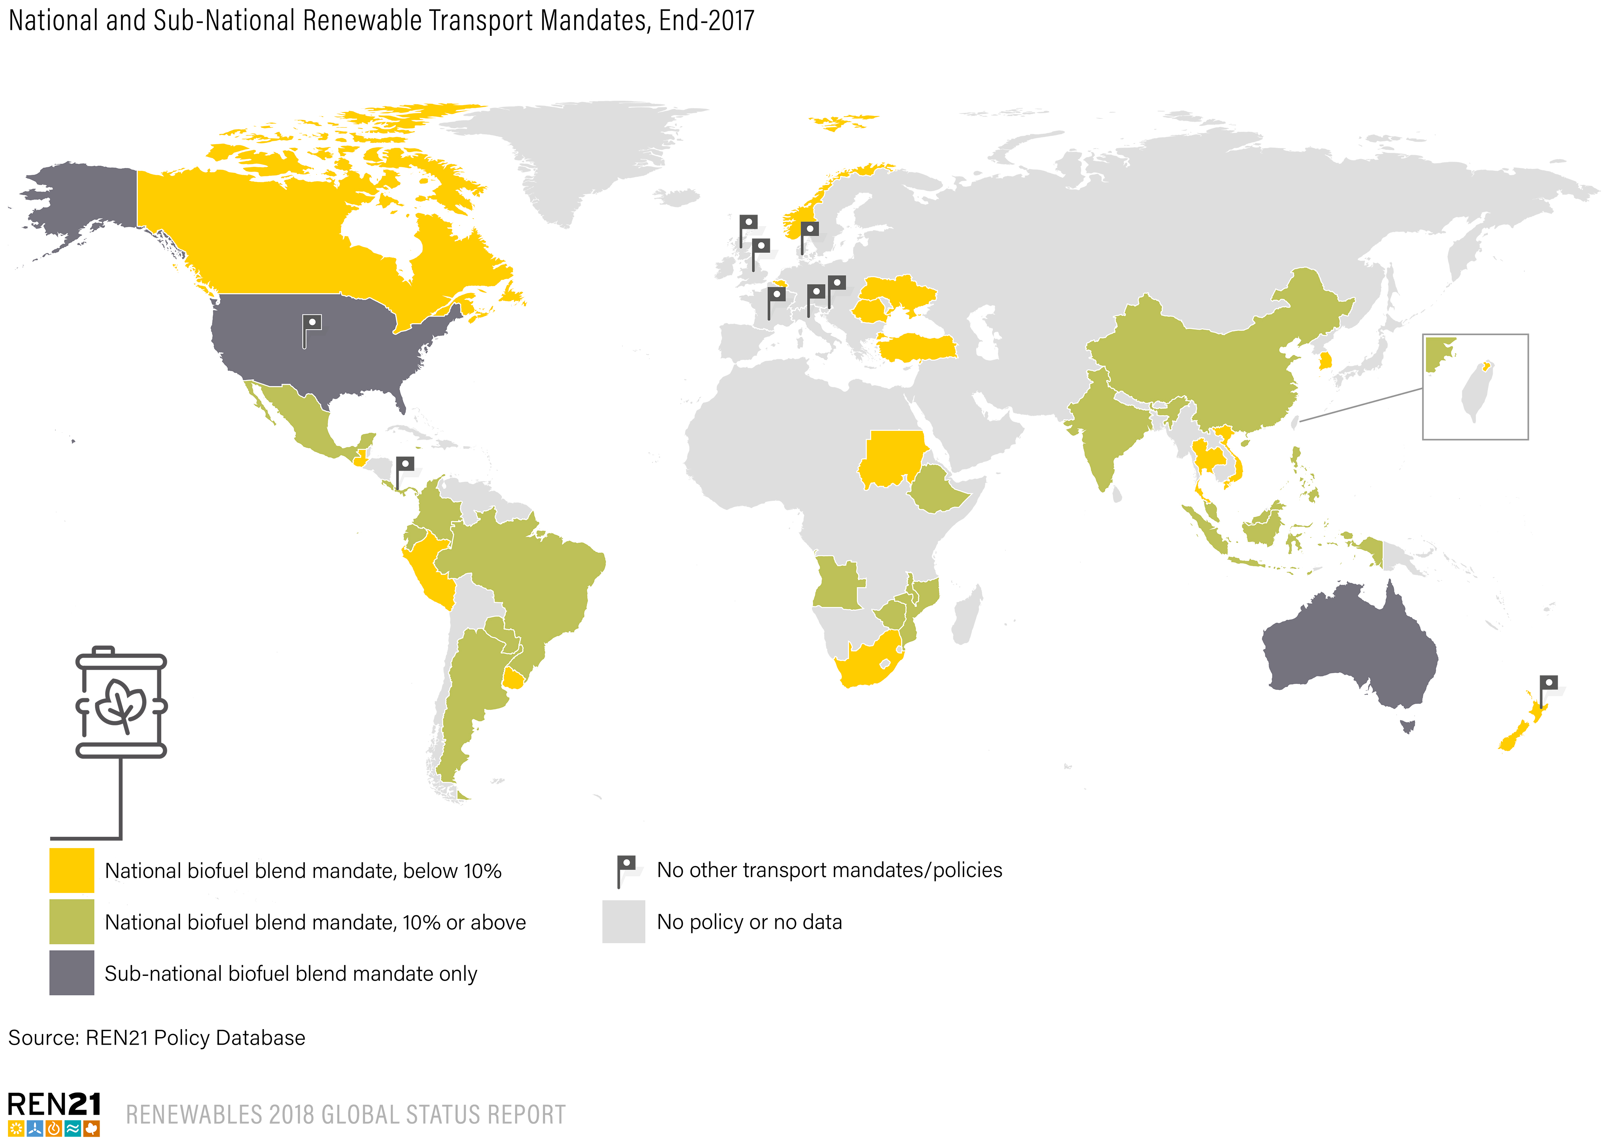

Transport
New or revised ethanol and biodiesel blend mandates were enacted in 2017
Biofuel promotion policies began including specific requirements for the use of next-generation cellulosic biofuels
Fiscal incentives for biofuel production and grants for the development of second-generation biofuels
Other jurisdictions have set goals or incentives for electric or fuel-efficient vehicles
Notes:
Liquid biofuels remain the primary renewable energy in the transport sector
Therefore, as in past years, in 2017 national and sub-national governments continued to require specific shares of biodiesel or ethanol to be blended into transport fuels (70 countries with biofuel mandates)
New or revised biodiesel mandates also were enacted during 2017, although to a lesser extent than those for ethanol.
However, concerns remain about the sustainability of some biofuels. Therefore, more commonly, biofuel promotion policies have begun to include specific requirements for the use of next-generation cellulosic biofuels (advanced biofuels)
Fiscal incentives for biofuel production as well as grants for the development of second-generation biofuels remain a fixture of many transport fuel support schemes
Other jurisdictions have set goals or incentives for electric or fuel-efficient vehicles. More policy announcements were made in 2017 than in any previous year, and the level of ambition has continued to increase. As of October 2017, at least 60 countries as well as 40 cities or regions had targets and/or plans for electric mobility

Slide 14
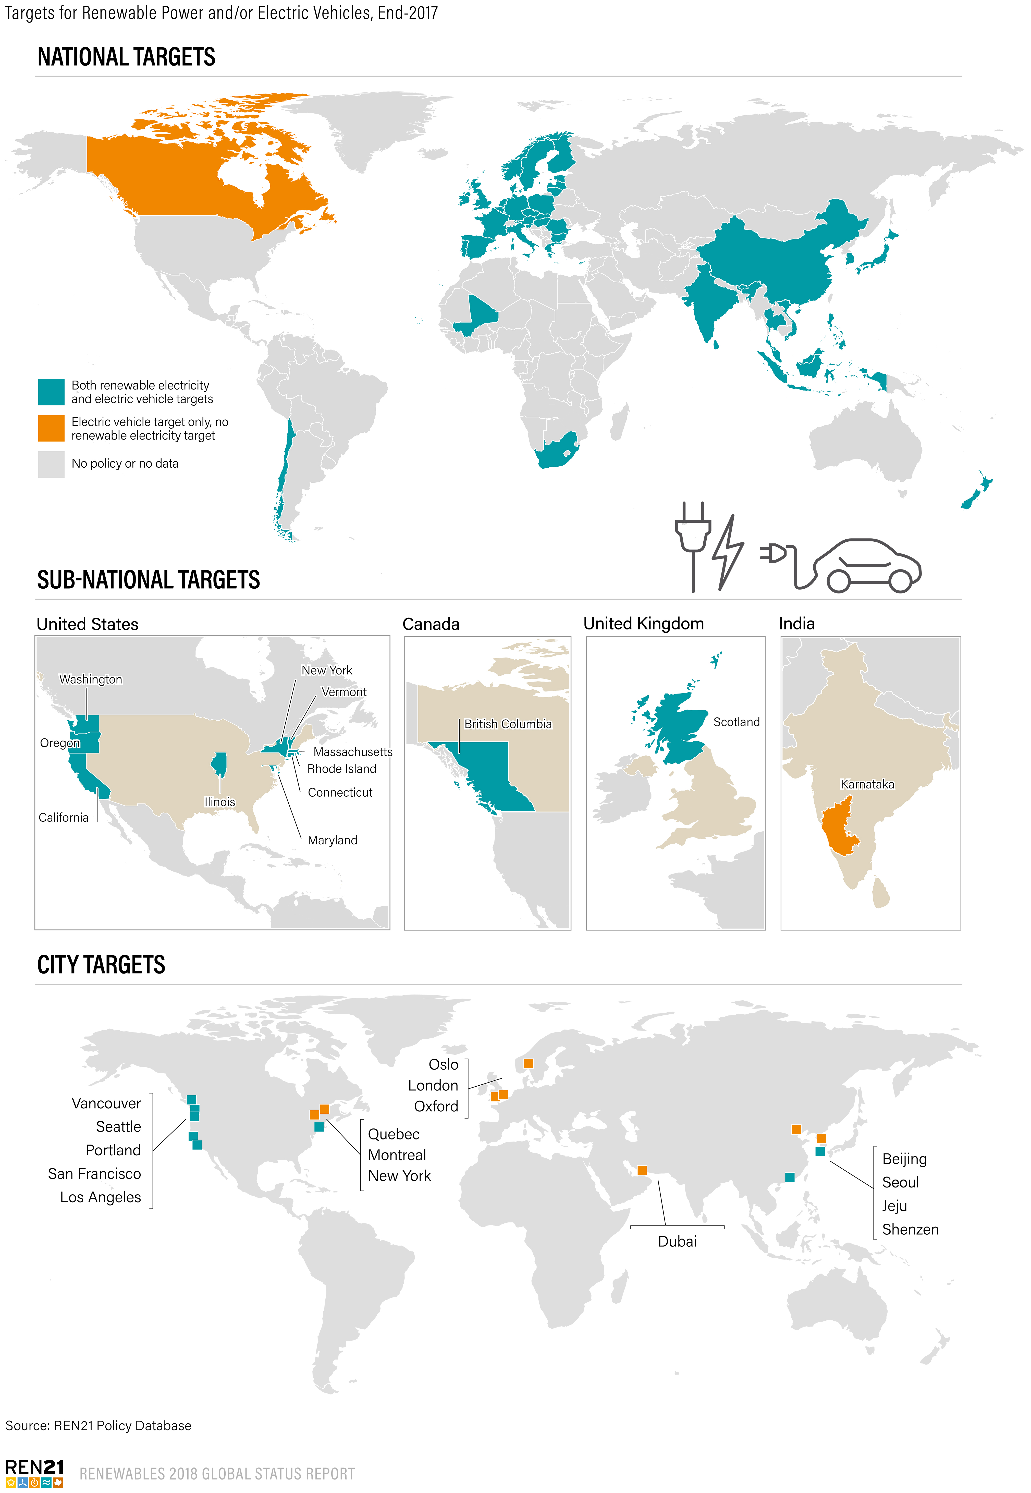
Sector Coupling: Targets for RE and EVs
Limited examples of policies that encourage/mandate the use of renewable energy in EVs (Austria and Germany)
Countries with targets for both EVs and renewable energy in power may encourage the use of renewable deployment in transport
Governments also are supporting EVs through public procurement
Notes:
Although numerous measures have been adopted in recent years to scale up the use of electric vehicles, few efforts have been made to directly link renewable electricity production and EV use or to ensure that EVs work to support the integration of renewable energy into energy supplies.
Limited examples of policies that encourage or mandate the use of renewable energy in EVs: Austria offers a purchase price premium for EVs charged with 100% renewable electricity, and in 2017 Germany established an EUR 300 million (USD 370 million) tendering programme providing grants for the deployment of EV charging infrastructure that sources electricity from renewables.
However, countries with targets for both EVs and renewable energy in power may encourage the use of renewable deployment for transport
Governments also are supporting EVs through public procurement.

Slide 15
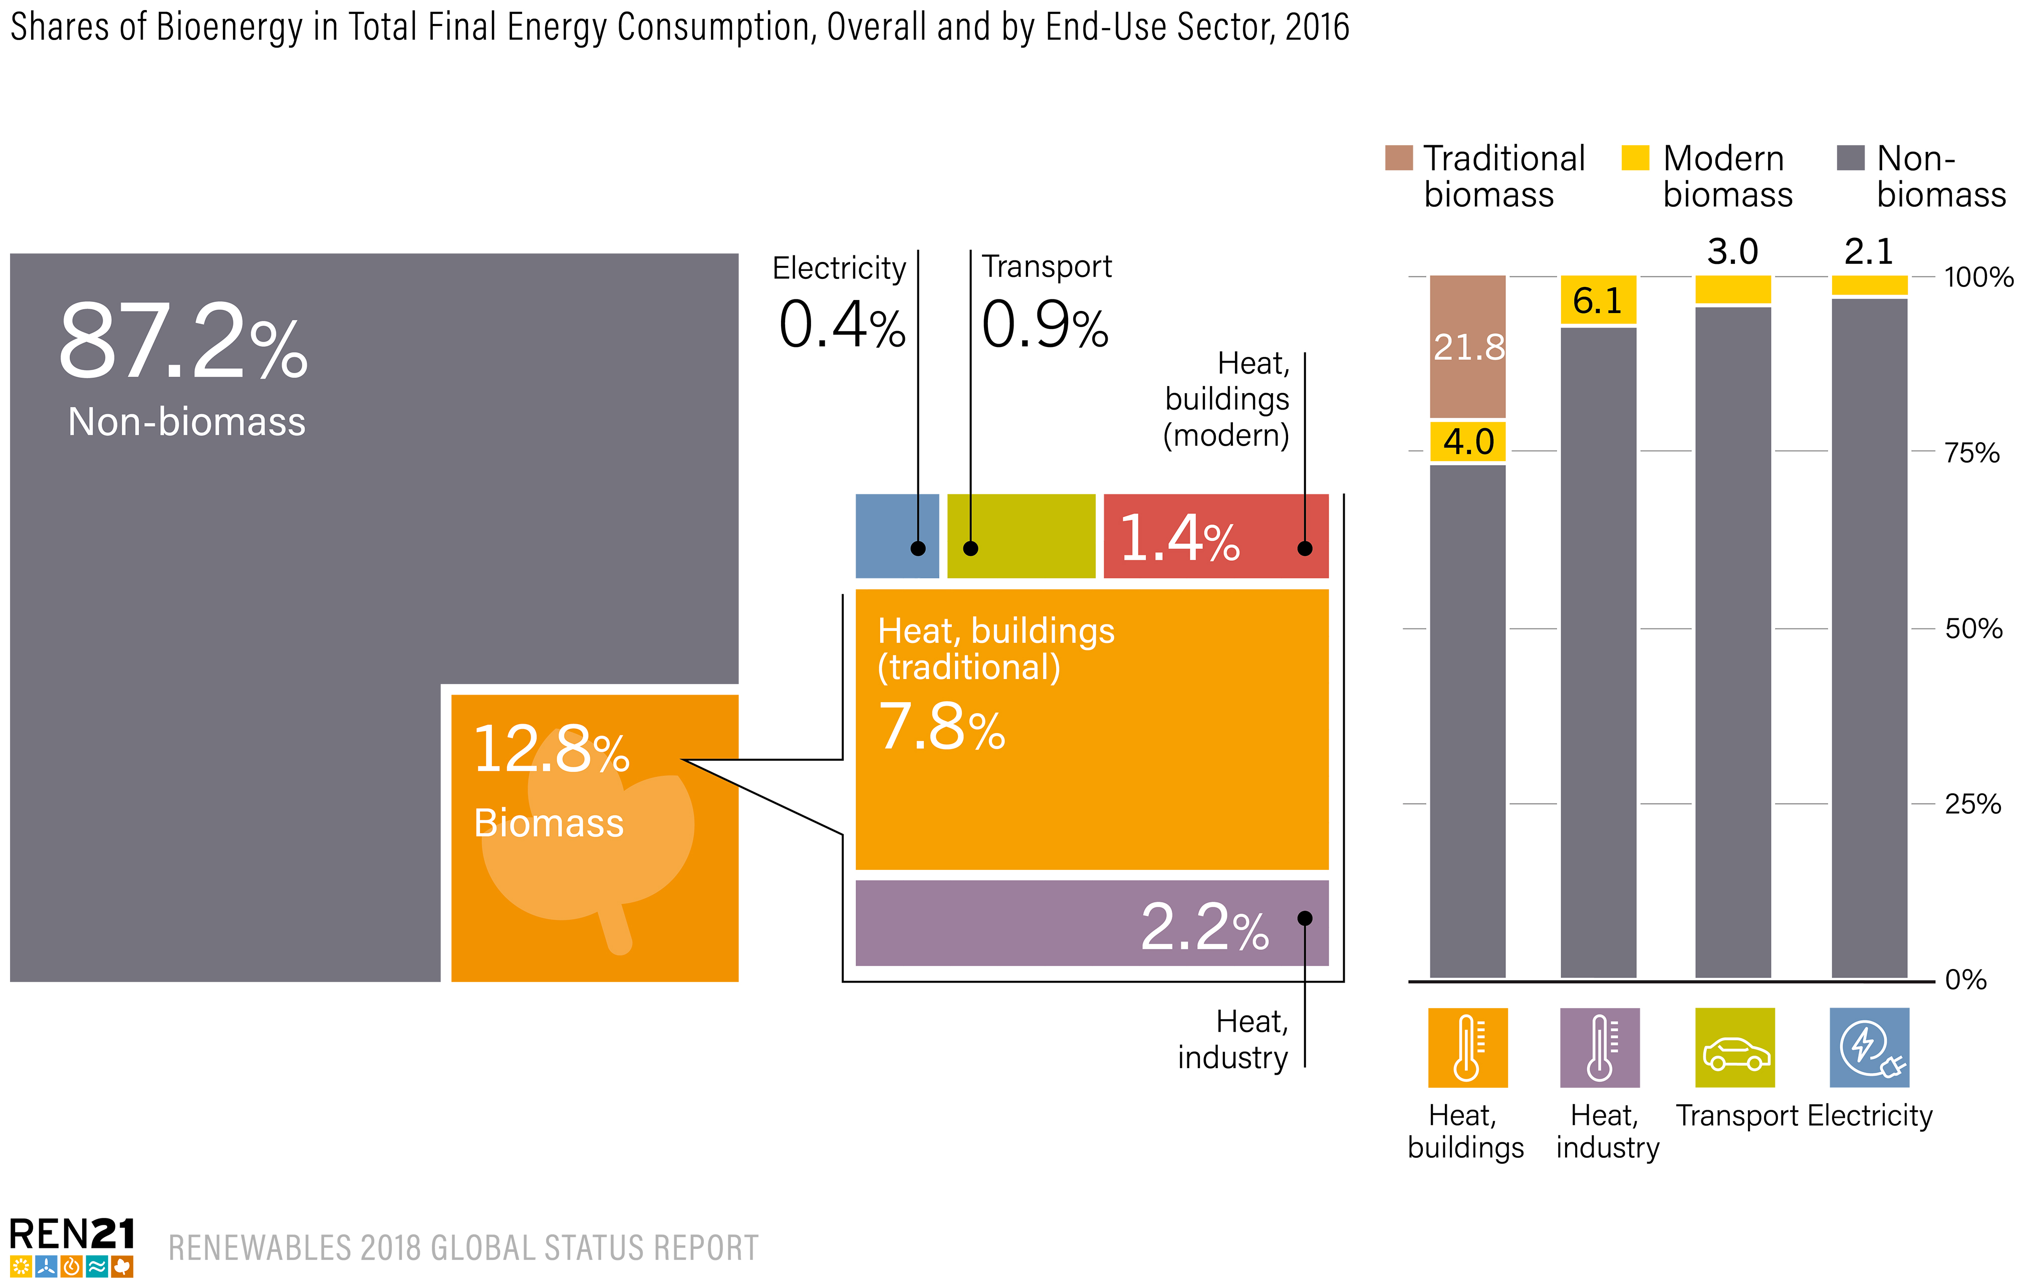
Bioenergy
Biomass accounted for 12.8% of total final energy consumption in 2016
Traditional biomass in TFEC declining:
9.2% in 2005 to estimated 7.8% in 2016
Modern bioenergy contributed 5% to final energy consumption
Notes:
The contribution of bioenergy to final energy demand for heat in buildings and industry far outweighs its use for electricity and transport combined.
In 2016, biomass accounted for 12.8% of total final energy consumption, down 9% from the previous year (14.1%).
Traditional biomass continues to make up the majority of biomass consumption but it has been declining gradually for several years, from 9.2% of TFEC in 2005 to an estimated 7.8% of TFEC in 2016
Modern bioenergy contributed 5%

Slide 16
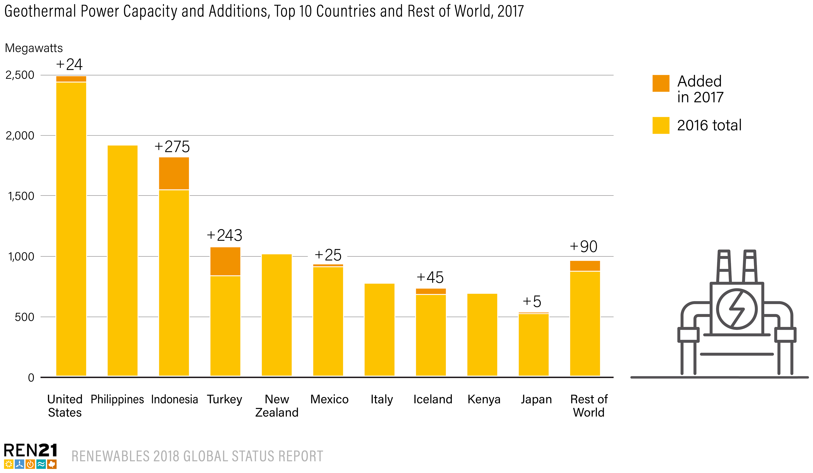
Geothermal Power and Heat
The United States is the global leader for installed geothermal power capacity, but expansion remains slow
Total capacity was around 2.5 GWnet at year’s end, and geothermal power generated about 16 TWh during the year, accounting for 0.4% of US net generation
Notes:
The countries with the largest amounts of geothermal power generating capacity at the end of 2017 were the United States, the Philippines, Indonesia, Turkey, New Zealand, Mexico, Italy, Iceland, Kenya and Japan.
The United States is the global leader for installed geothermal power capacity, but expansion remains slow
Total capacity was around 2.5 GWnet at year’s end, and geothermal power generated about 16 TWh during the year, accounting for 0.4% of US net generation

Slide 17
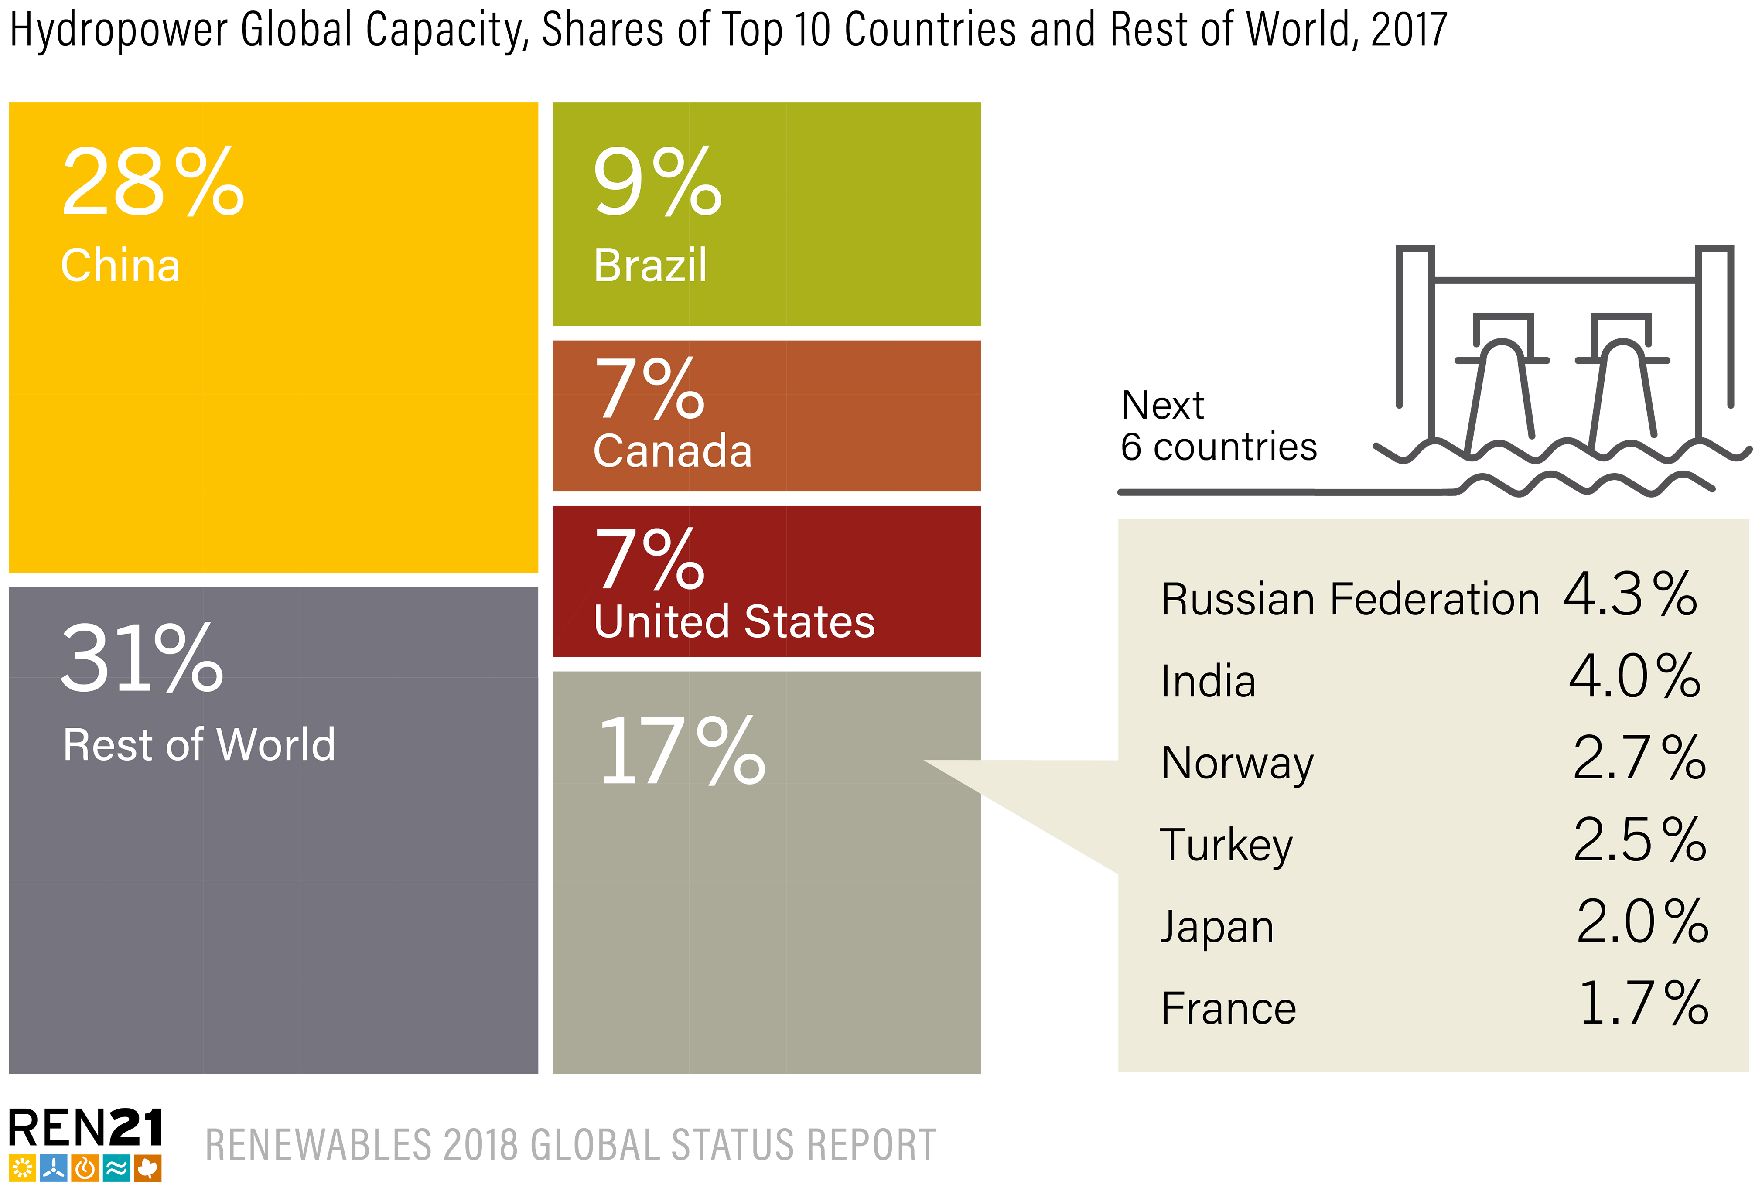
Hydropower
In 2017, total global hydropower capacity increased to approximately 1,114 GW
Generation from hydropower was an estimated 4,185 TWh worldwide, up about 2% from 2016
The leading countries for cumulative capacity remained the same: China, Brazil, Canada, the US, the Russian Federation, India and Norway
Notes:
In 2017, total global hydropower capacity increased to approximately 1,114 GW.
The leading countries for cumulative capacity – China, Brazil, Canada, the United States, the Russian Federation, India
and Norway – remained the same as in the past several years

Slide 18
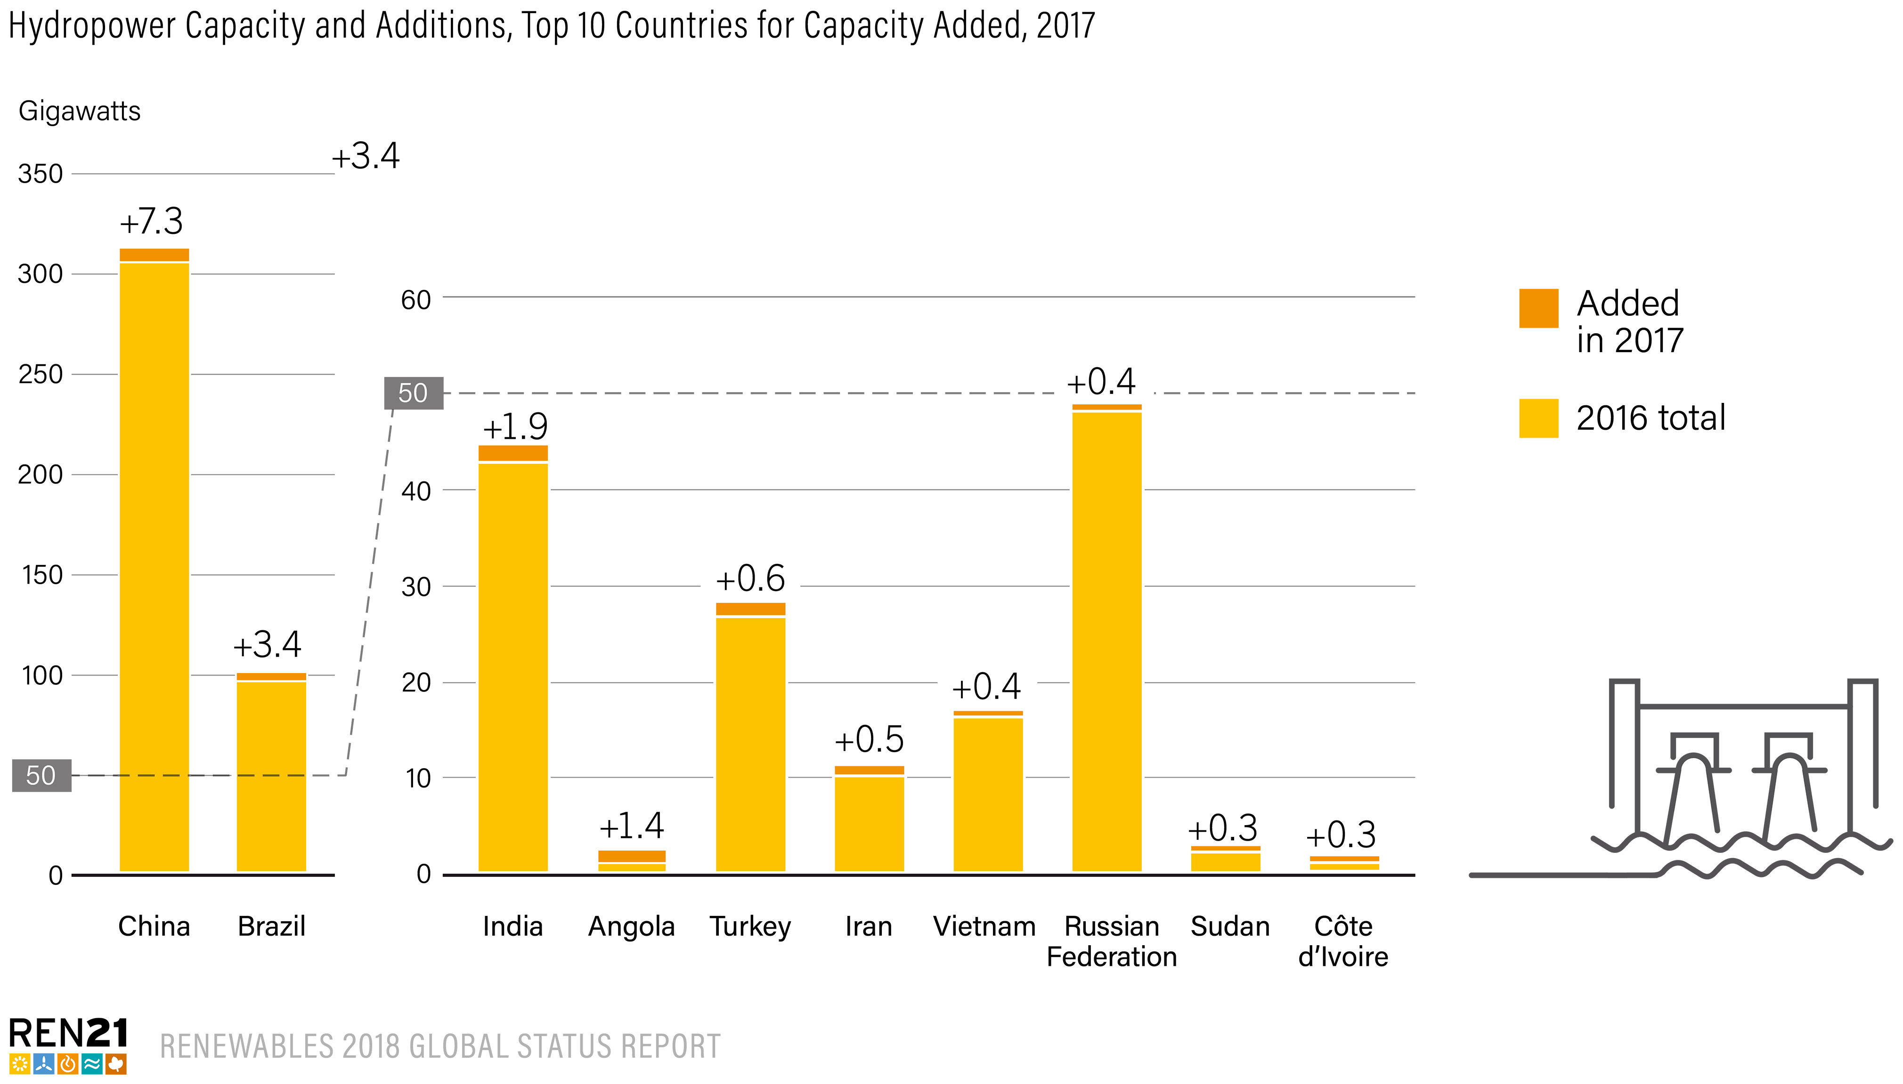
Hydropower
19 GW of new hydropower capacity was commissioned in 2017
While significant, this was the smallest annual increment over the past 5 years
Most capacity added by China, followed by Brazil
Notes:
At least 19 GW of new hydropower capacity was commissioned in 2017
While significant, this is the smallest annual increment seen over the last five years.
The country adding most capacity remained China, followed by Brazil, India, Angola, Turkey, Iran, Vietnam, the Russia Federation, Sudan and Cote d’Ivoire.
Growing penetration of variable renewable energy (VRE) is increasing interest in additional electricity storage capacity.
Pumped storage hydropower is the dominant source of largescale energy storage, accounting for an estimated 96% of global energy storage capacity
Global pumped storage capacity rose by more than 3 GW in 2017, for a year-end total of an estimated 153 GW

Slide 19
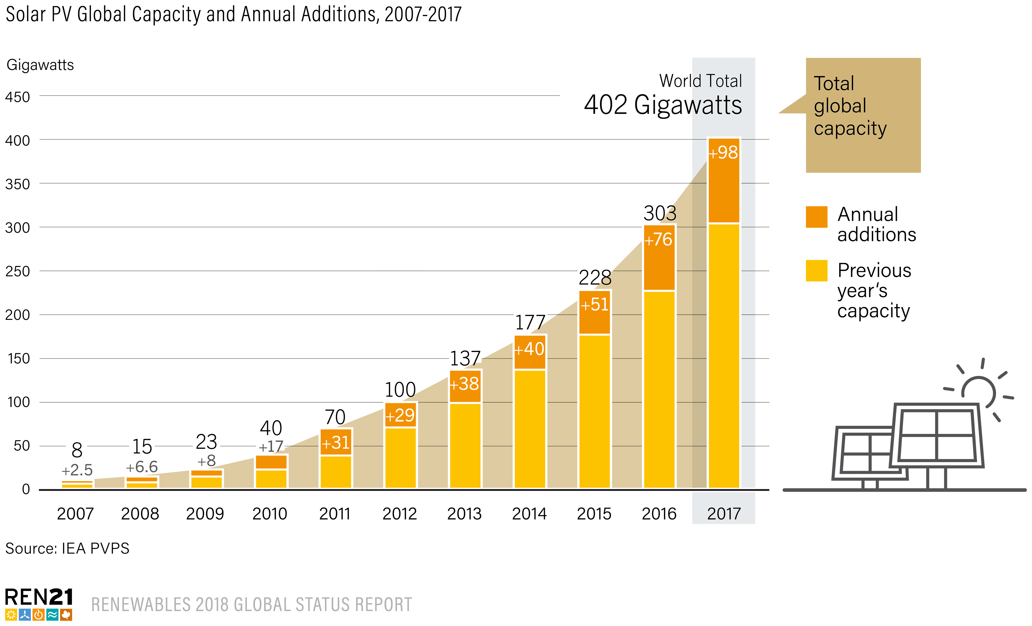
Solar PV
98 GW of solar PV capacity added in 2017
Global total increased 33% to 402 GW (equivalent of 40,000 PV panels every hour)
More solar PV was installed than the net capacity additions of fossil fuels and nuclear power combined
Notes:
As mentioned already, in 2017, solar PV was the driving force
Solar PV had another landmark year in 2017.
At least 98 GW (in direct current) of solar PV capacity was added worldwide - equivalent to the installation of more than 40,000 solar panels every hour.
By year's end, global solar PV capacity totalled at least 402 GW (+33% increase) = more than the net capacity additions of fossil fuels and nuclear power combined

Slide 20
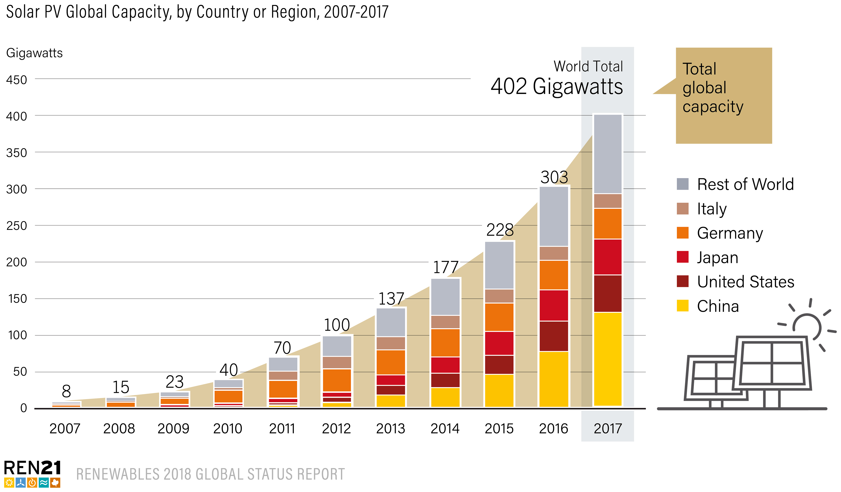
Solar PV
By the end of 2017, every continent had installed at least 1 GW
At least 29 countries had 1 GW or more of capacity
The size and number of large projects continued to grow during 2017
By year’s end, at least 196 solar PV plants of 50 MW and larger were operating in at least 28 countries
Notes:
By the end of 2017, every continent had installed at least 1 GW and at least 29 countries had 1 GW or more of capacity
The size and number of large projects continued to grow during 2017
By year’s end, at least 196 solar PV plants of 50 MW and larger were operating in at least 28 countries

Slide 21
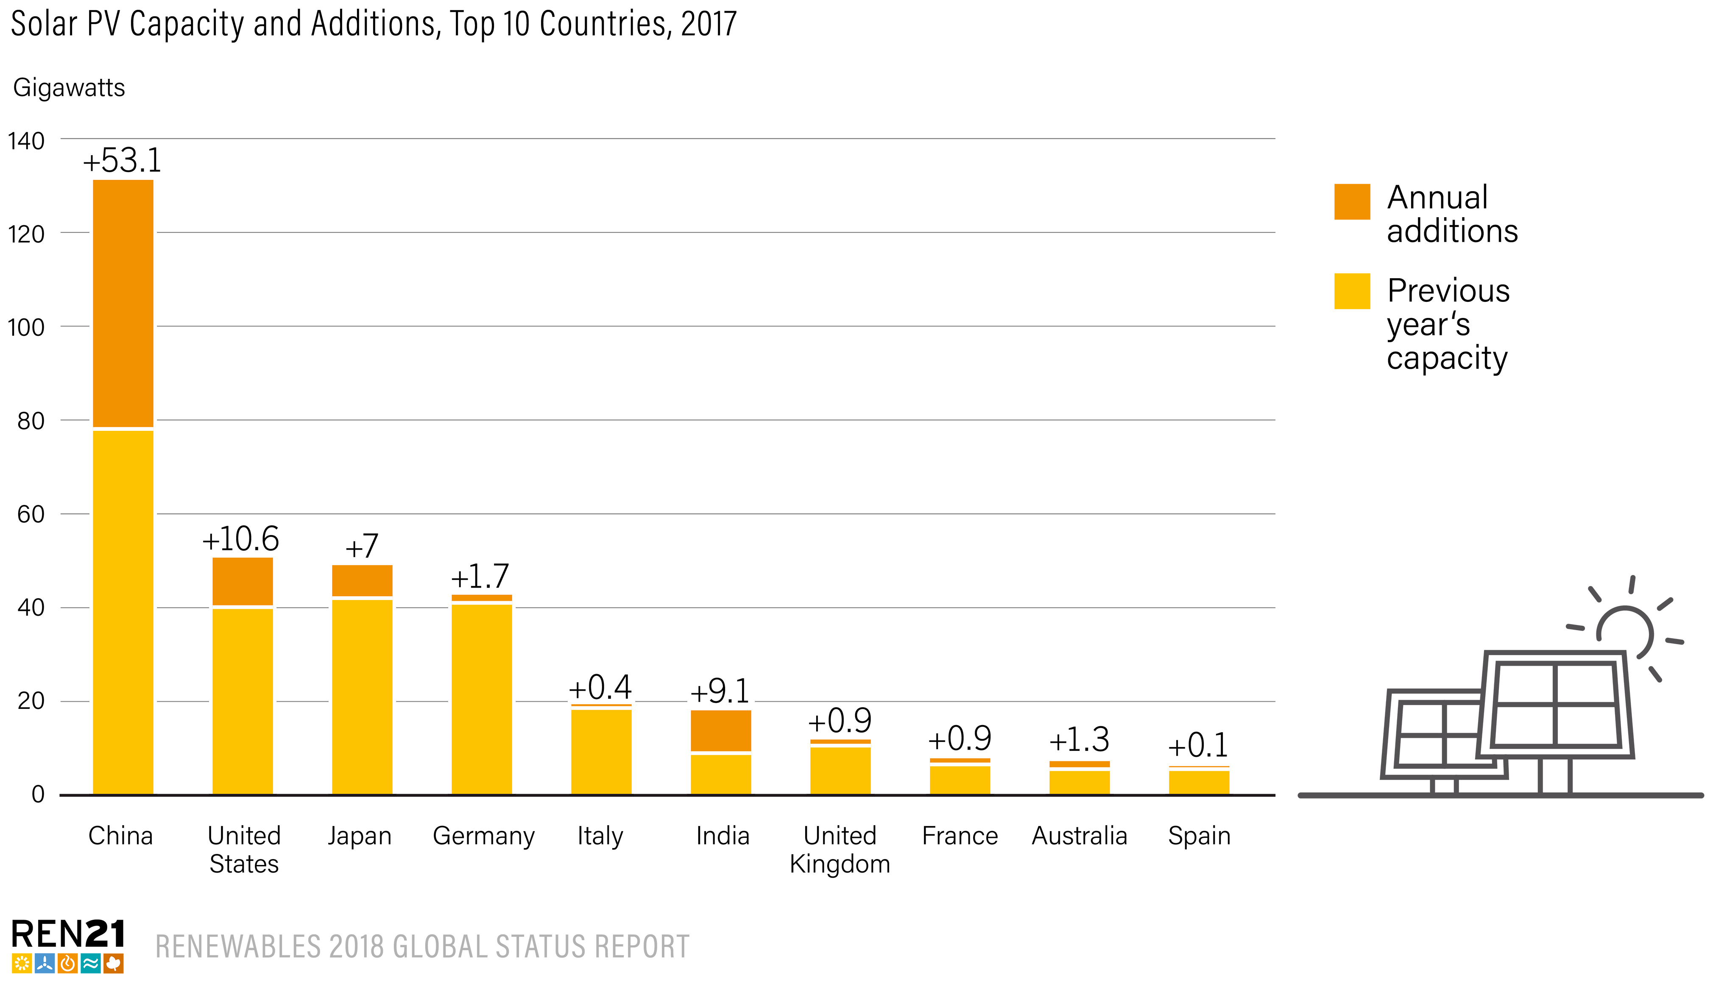
Solar PV
China added
53.1 GW in 2017, more than was added worldwide in 2015, increasing its total solar PV capacity to 131.1 GW
China reached its 2020 target for solar installations in 2017
The United States remained a distant second, adding 10.6 GW for a total of 51 GW
Notes:
The significant market increase in solar PV was due primarily to China, where new installations were up more than 50%.
China added 53.1 GW of solar PV in 2017, more than was added worldwide in 2015 (51 GW).
By year’s end, total solar PV capacity in China approached 131.1 GW, surpassing the government’s minimum target for 2020 (105 GW) which had been announced in 2016.
The United States remained a distant second, adding 10.6 GW for a total of 51 GW

Slide 22
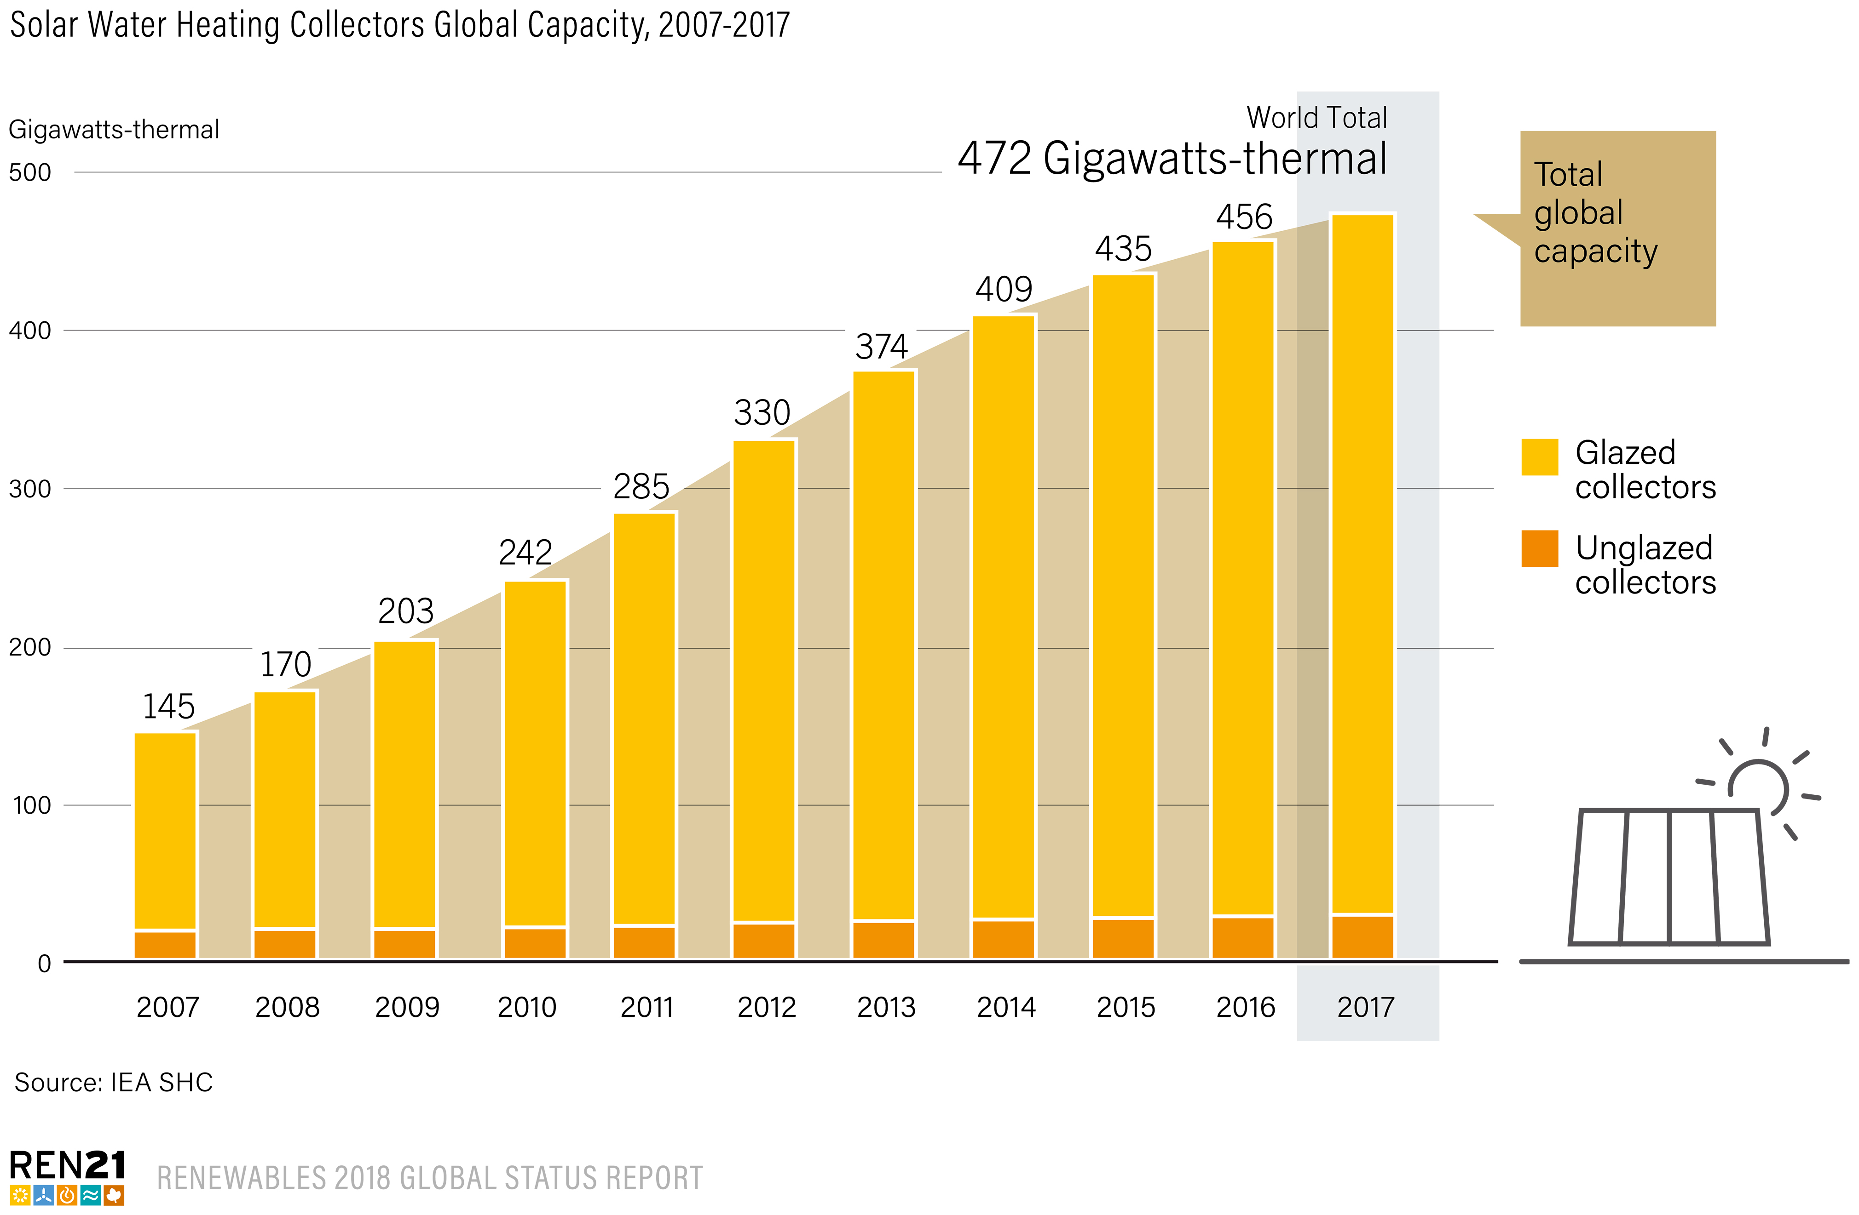
Solar Thermal Heating and Cooling
Globally, 35 GWth of capacity of glazed (flat plate and vacuum tube technology) and unglazed collectors was newly commissioned in 2017
The total global capacity was an estimated 472 GWth by year-end
Gross additions for the year were down 3%, from
36.2 GWth in 2016
Notes:
Globally, 35 GWth of capacity of glazed (flat plate and vacuum tube technology) and unglazed collectors was newly commissioned in 2017
The total global capacity was an estimated 472 GWth by year’s end
Gross additions for the year were down 3%, from 36.2 GWth in 2016
The contraction was due primarily to increasing competition with other renewable energy technologies in the residential sector

Slide 23
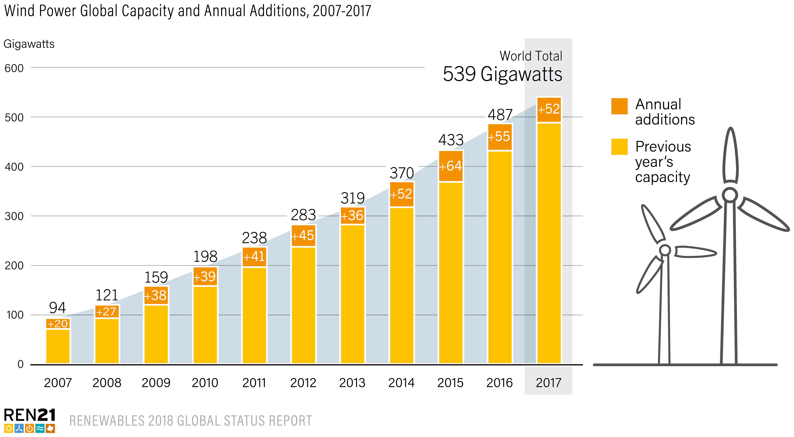
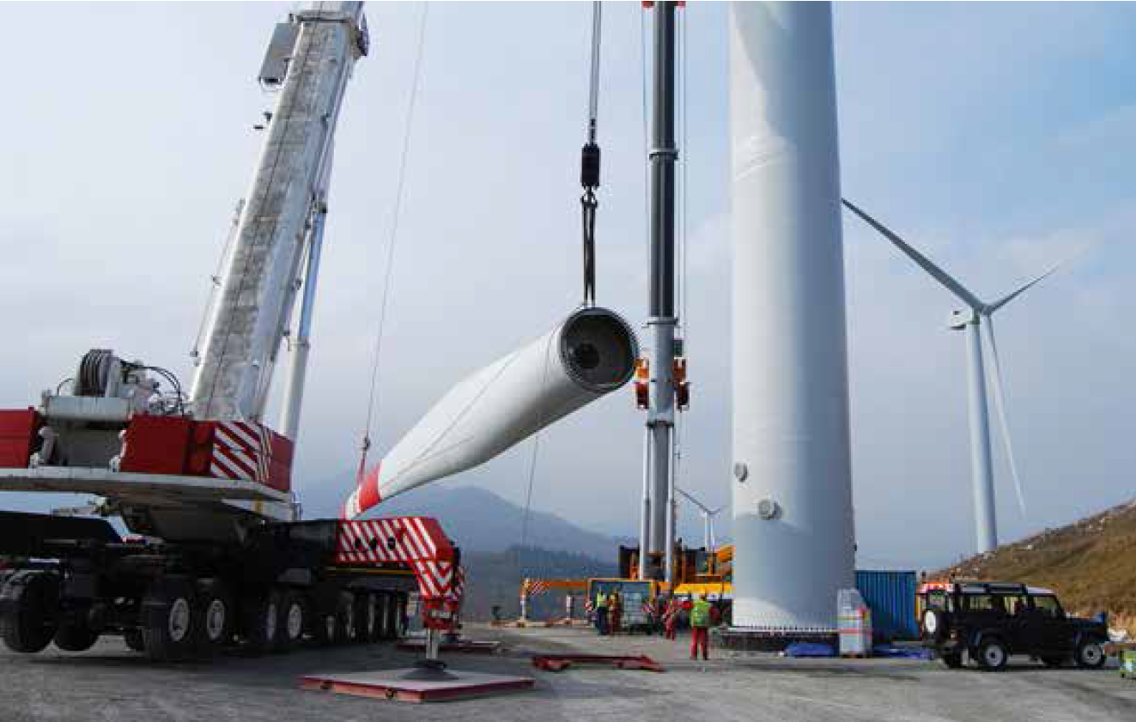
Wind Power
52 GW of wind power capacity added in 2017
The global total increased by 11% to 539 GW
Notes:
- Although wind had a relatively modest year compared to 2015 and 2016, it still saw its third strongest 12-month period, with more than 52 GW added globally in 2017, increasing the global total about 11% to some 539 GW.

Slide 24
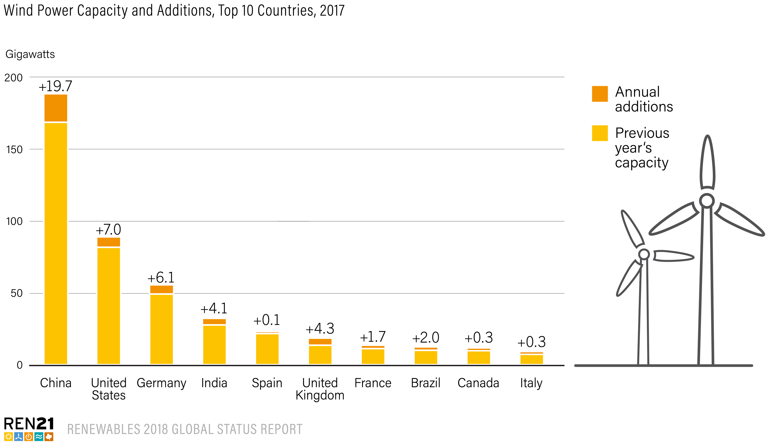
Wind Power
China retained its lead position for wind power as well, adding nearly 19.7 GW and reaching a total of 188.4 GW
It was followed distantly by the United States, Germany, the United Kingdom and India
Notes:
A significant decline in the Chinese market was responsible for most of the wind market contraction in 2017
China retained its lead for new installations, followed distantly by the United States and Germany.

Slide 25
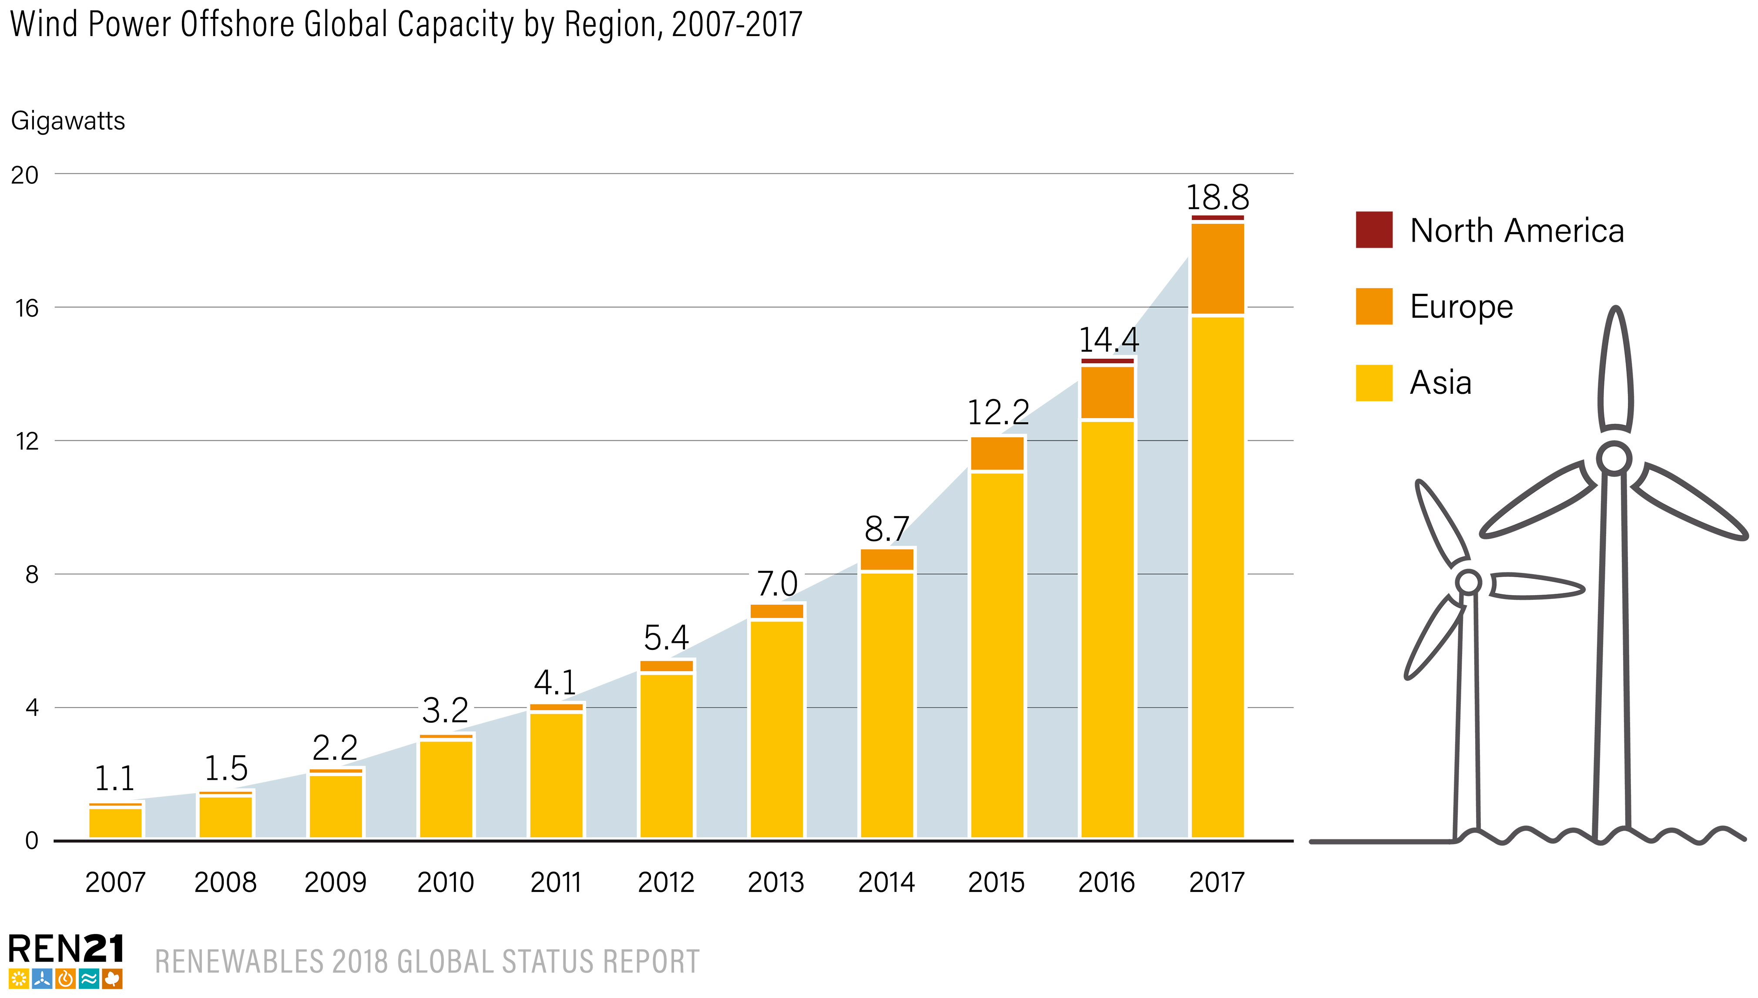
Wind Power
There was an increase of 30% in global offshore capacity
A total of 17 countries had offshore wind capacity by the end of 2017
The United Kingdom maintained its lead for total capacity, with
6.8 GW at year’s end, followed by Germany (5.4 GW), China
(2.8 GW), Denmark (1.3 GW) and the Netherlands (1.1 GW)
Europe was home to about 84% of global offshore capacity (down from 88% in 2016), with Asia accounting for nearly all the rest
Notes:
Although onshore wind power continues to account for the vast majority (more than 96%) of global installed capacity, total world offshore capacity increased by 30%, to 18.8 GW.
A total of 17 countries (11 in Europe) had offshore wind capacity by the end of 2017, although 4 of these had only demonstration projects.
The United Kingdom maintained its lead for total capacity, with 6.8 GW at year’s end, followed by Germany (5.4 GW), China (2.8 GW), Denmark (1.3 GW) and the Netherlands (1.1 GW).
Europe was home to about 84% of global offshore capacity (down from 88% in 2016), with Asia accounting for nearly all the rest.

Slide 26
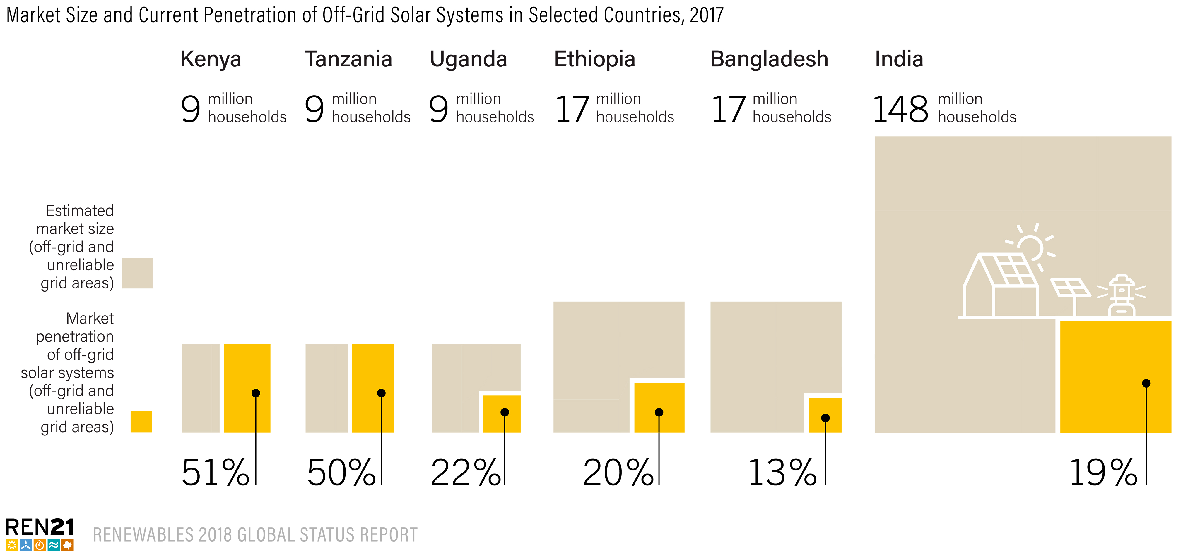
Distributed Renewables for Energy Access (DREA)
13% of the population in Bangladesh gained access to electricity through off-grid solar systems
51% of the off-grid population of Kenya is served by DREA systems
In 2017, an increasing number of national governments demonstrated their interest in DREA systems by enhancing the enabling environment
Notes:
In places where the electric grid does not reach or is unreliable, DREA technologies provide cost-effective options for generating electrical and mechanical power, heating water and space, cooking and baking, and enabling various productive uses.
For example, about 13% of the population of Bangladesh gained access to electricity through off-grid solar systems, while 51% of the off-grid population of Kenya is served by DREA systems.
In 2017, an increasing number of national governments demonstrated their interest in DREA systems by enhancing the enabling environment

Slide 27
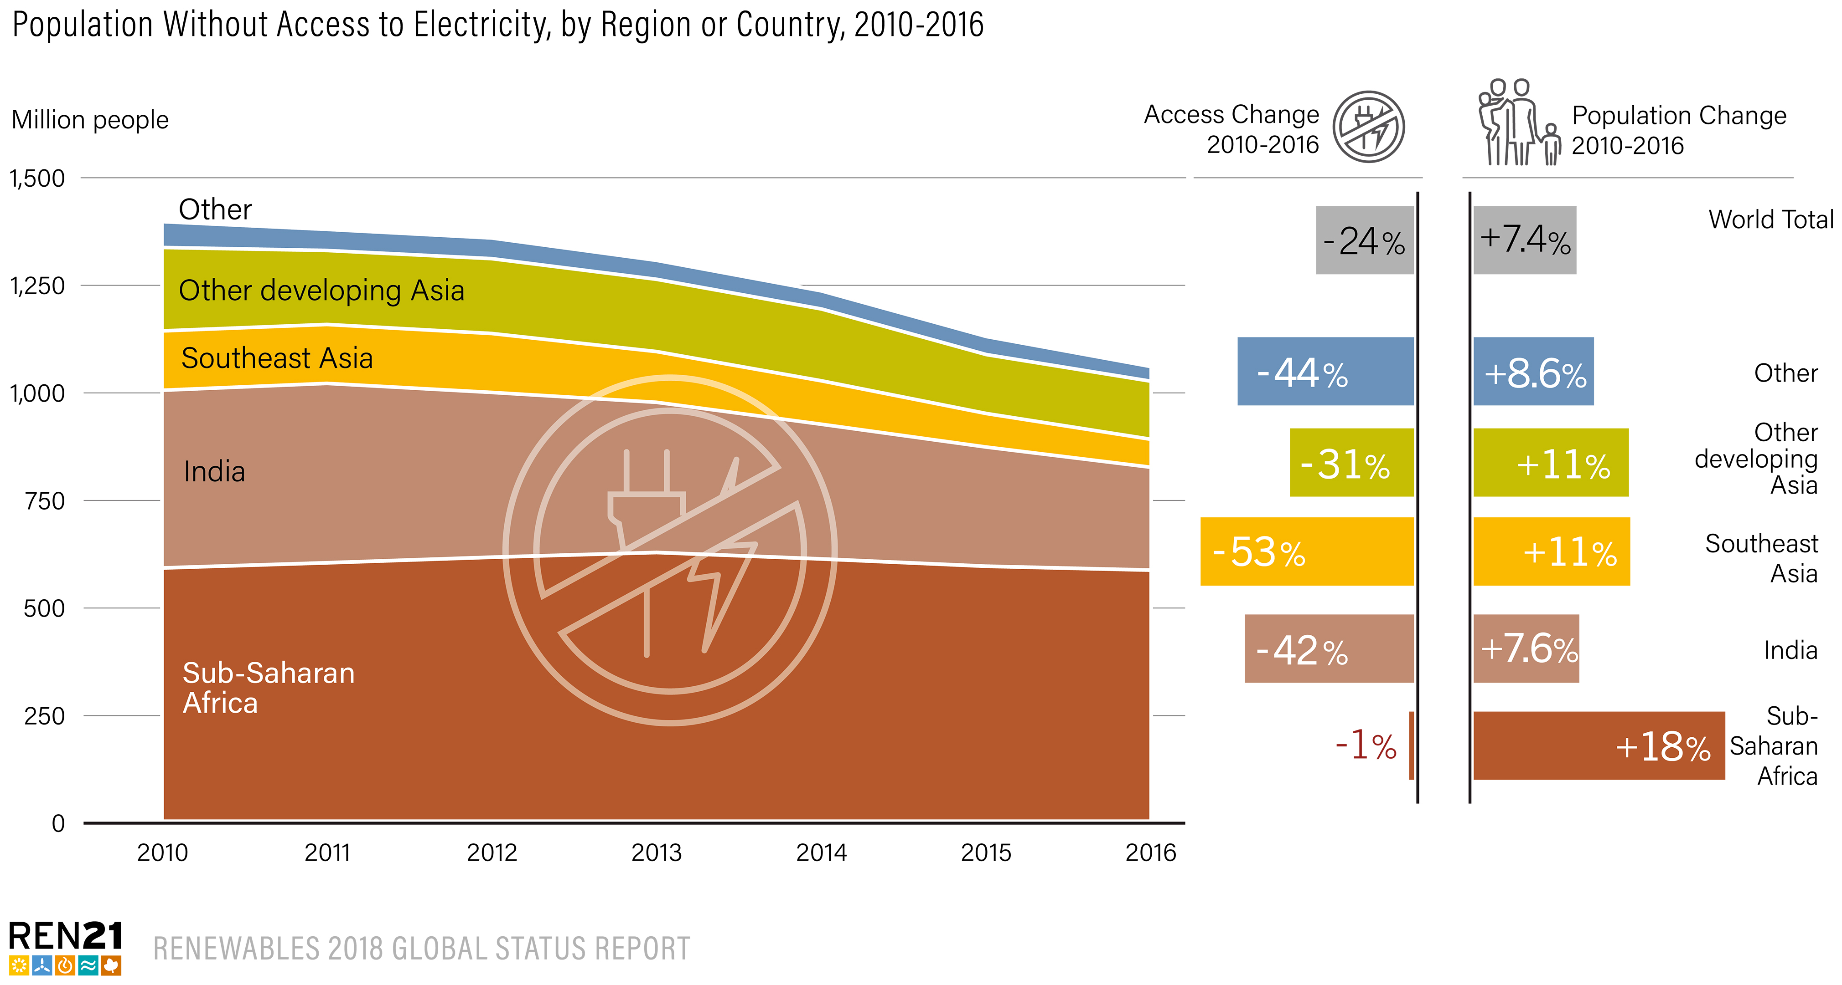
Distributed Renewables for Energy Access
In 2016: 14% of the global population lived without electricity – approx.
1.06 billion people (majority in SSA and Asia-Pacific regions)
DREA systems were serving ~300 million people by end-2016
Notes:
Approximately 1.06 billion people (about 14% of the global population) lived without electricity in 2016, about 125 million fewer people than in 2014.
The vast majority of people without access to electricity and clean cooking are in sub-Saharan Africa and the Asia-Pacific region, and most of them live in rural areas.
Distributed renewables for energy access (DREA) systems that play a very important role in improving energy access and were serving an estimated 300 million people by the end of 2016.

Slide 28
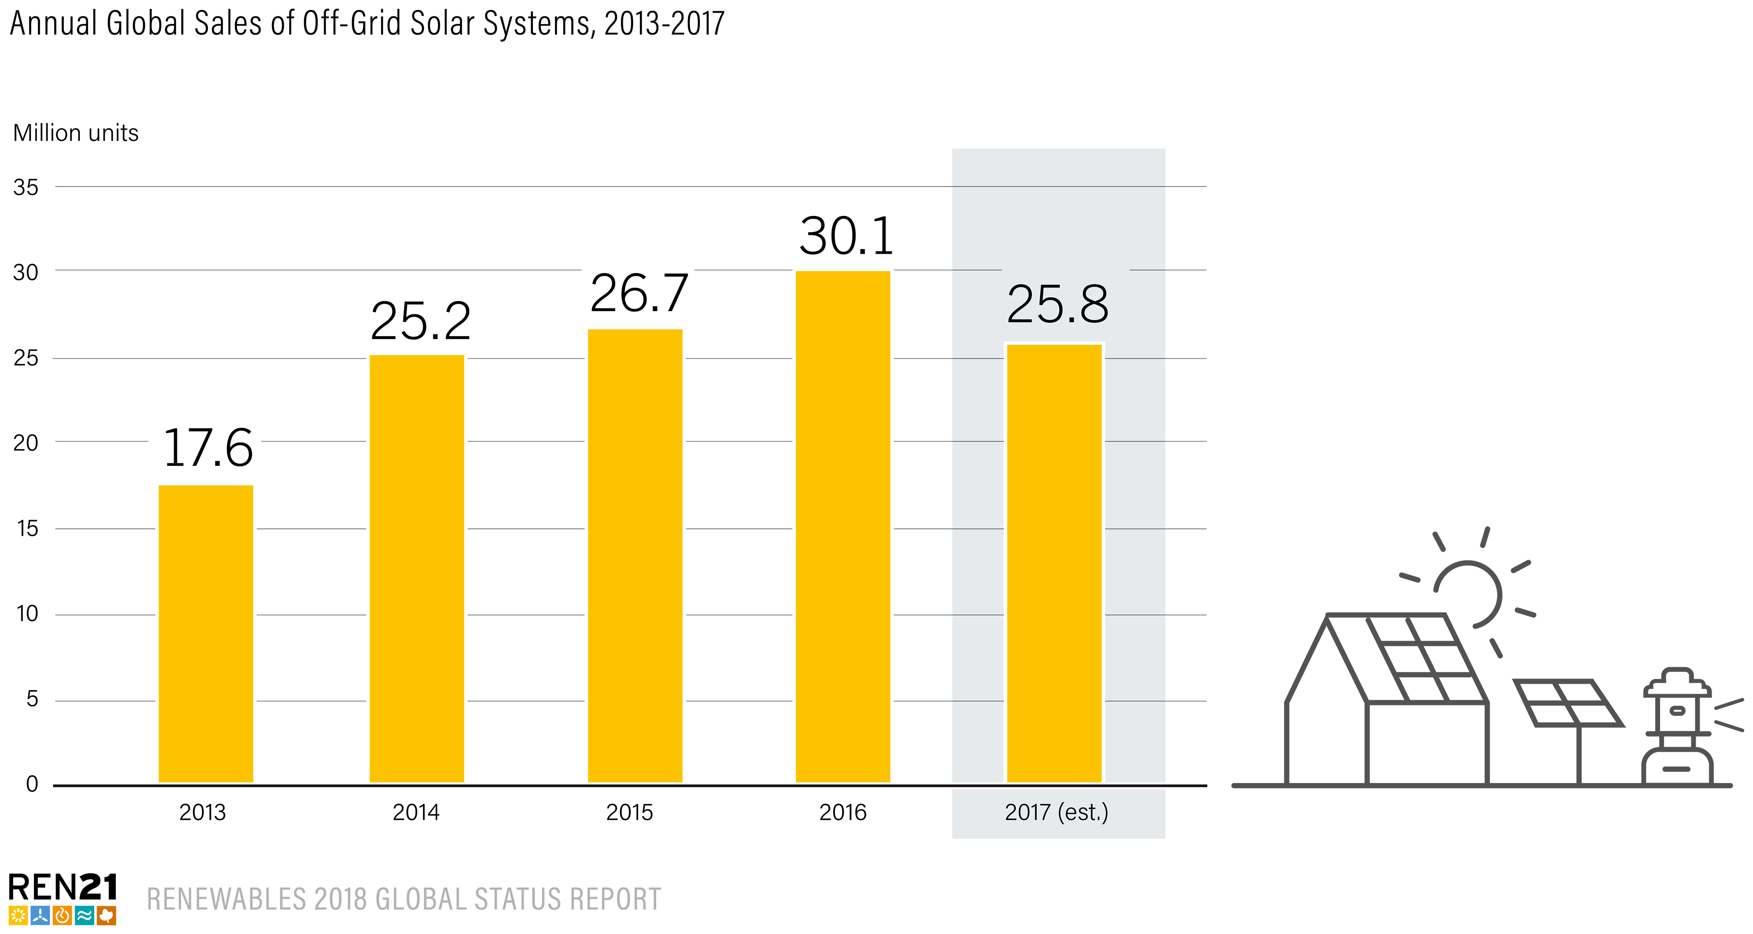
Distributed Renewables for Energy Access
Off-grid solar devices (solar lanterns and solar home systems) experienced 60% annual growth rates between 2010-2017
25.8 million off-grid solar systems (est.) were sold in 2017, a 14% decrease from 2016 sales
130 million off-grid solar systems sold cumulatively by end-2017, providing electricity access to about
360 million people worldwide
Notes:
Off-grid solar devices such as solar lanterns and solar home systems experienced 60% annual growth rates between 2010 and 2017
An estimated 25.8 million off-grid solar systems were sold, a 14% decrease from sales reported in 2016
Some 130 million quality-assured off-grid solar systems had been sold cumulatively by the end of 2017, providing electricity access to about 360 million people worldwide.

Slide 29
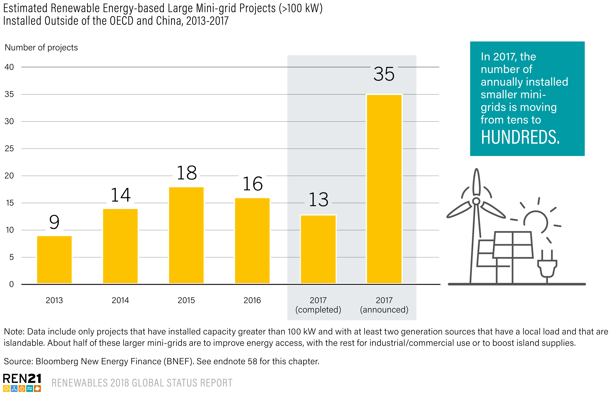
Distributed Renewables for Energy Access
In 2017, an estimated 13 renewable energy-based large mini-grid projects (>100 kW) were implemented in countries outside of the OECD and China, primarily in Africa and Southeast Asia
> 35 new mini-grid projects were announced in 2017
Notes:
In 2017, an estimated 13 renewable energy-based large mini-grid projects (with installed capacity greater than 100 kW) were implemented in countries outside of the Organisation for Economic Co-operation and Development (OECD) and China, primarily in Africa and Southeast Asia, half of which were designed specifically to provide electricity access.
The pipeline for 2018 suggests that the market may more than double, with about 35 new mini-grid projects announced in 2017, although many smaller mini-grids are not included in these estimates.

Slide 30
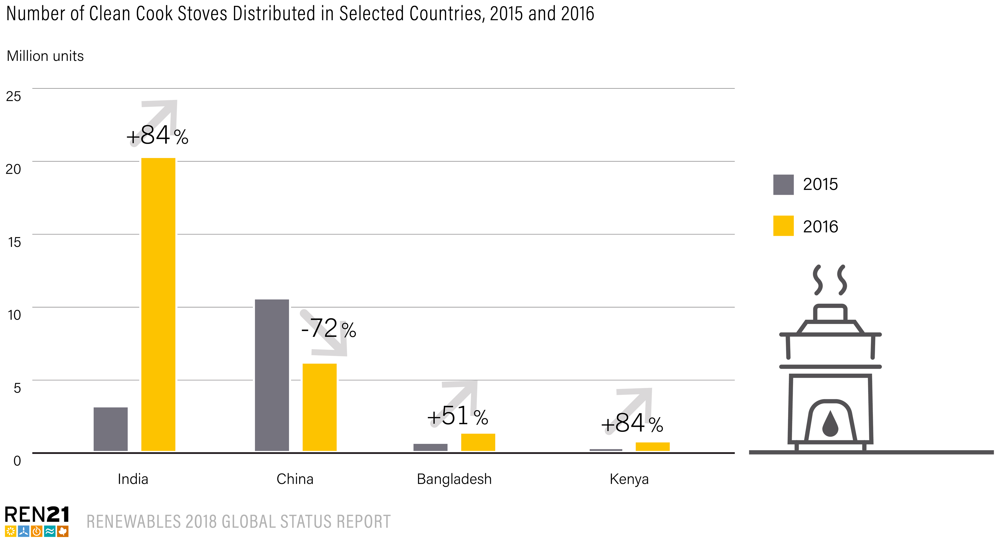
Distributed Renewables for Energy Access
Clean cook stoves made up 83% (30.8 million) of the 37 million cook stoves distributed in 2016
The number of clean cook stoves distributed more than tripled in 2016 compared to 2015
India became the main market for clean cook stoves with 20.3 million distributed (two-thirds of the total globally)
China continued to be a major market, with 6.2 million clean stoves distributed in 2016, while Bangladesh, Ghana and Kenya all matched or exceeded their 2015 numbers
Notes:
The market for clean cooking solutions continued to thrive in 2016, with cleani cook stoves making up 83% (30.8 million) of the 37 million cook stoves distributed.
The number of clean cook stoves distributed more than tripled in 2016 compared to 2015, highlighting the positive momentum in the sector
In 2016, building on the momentum of its Pradhan Mantri Ujjwala Yojana cooking gas programme, India became the main market for clean cook stoves, with 20.3 million distributed.71 China continued to be a major market, with 6.2 million clean stoves distributed in 2016, while Bangladesh, Ghana and Kenya all matched or exceeded their 2015 numbers

Slide 31
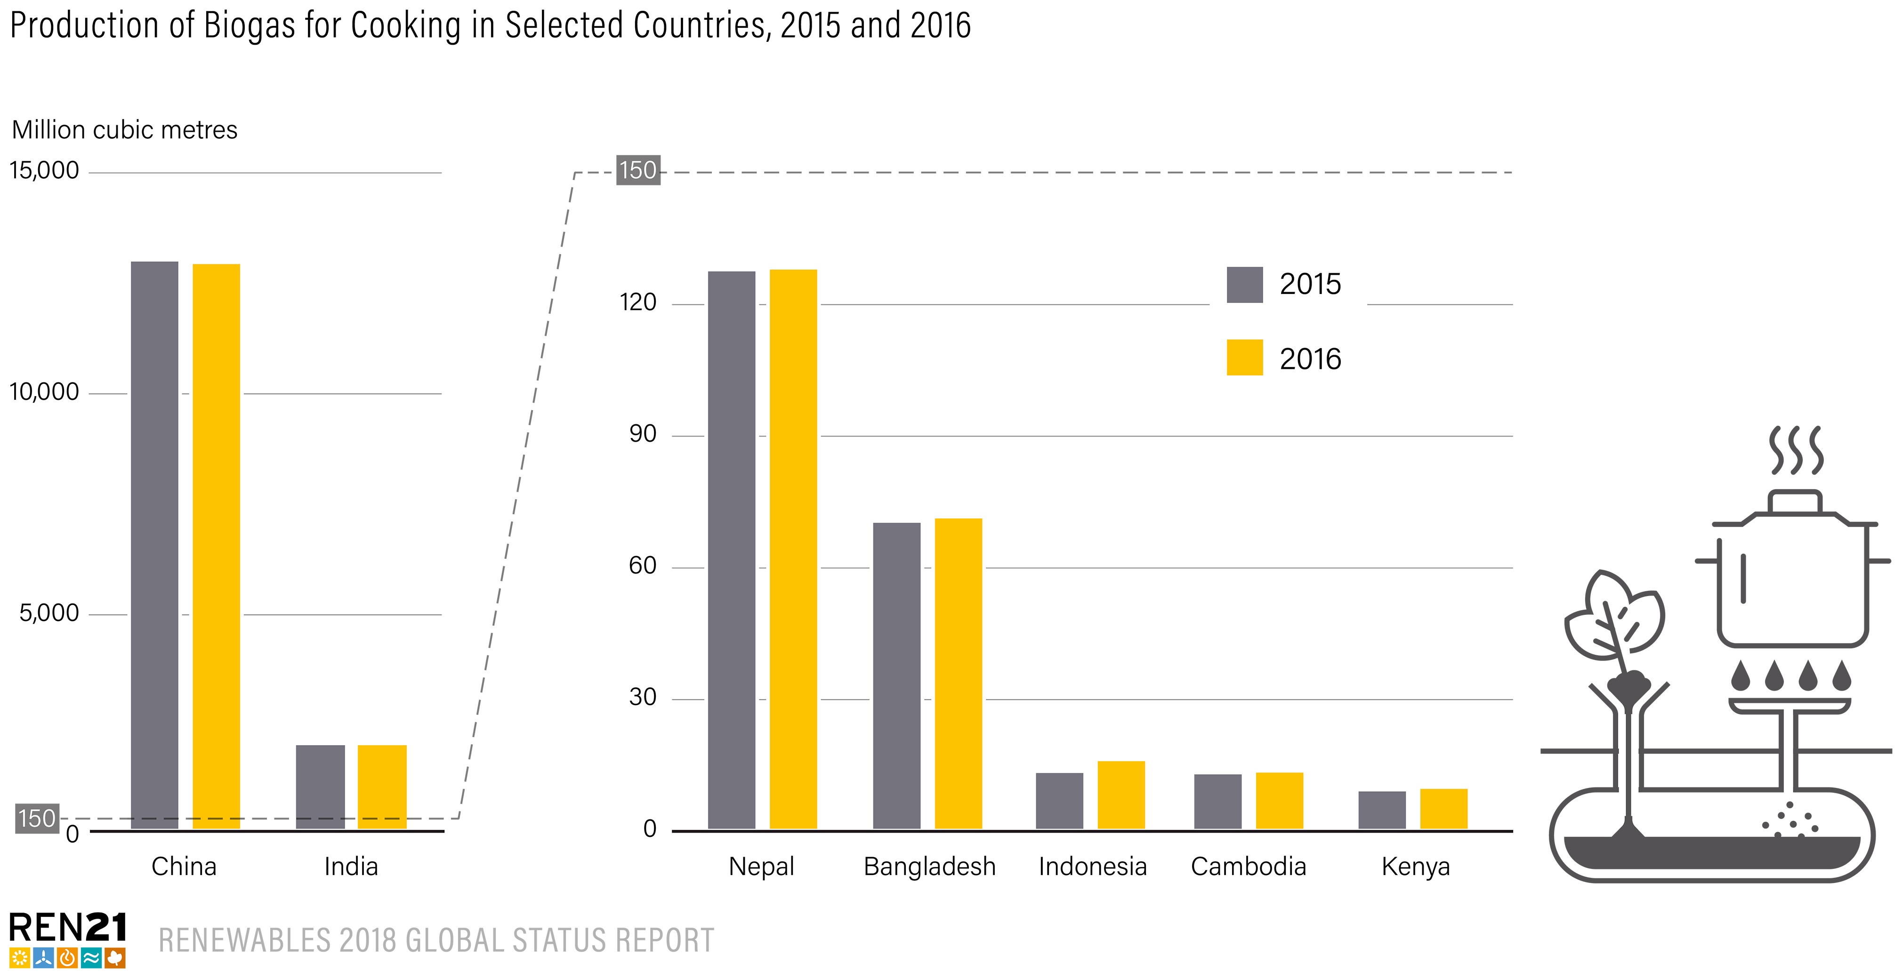
Distributed Renewables for Energy Access
> 50 million biogas cook stoves had been installed as of year-end 2016; 126 million people using biogas for cooking (112 million in China and 10 million in India)
China: 13 million m³ of biogas production from biogas digester installations for cooking; and India: 2 million m³
The use of biogas for cooking continued to grow in South-Central and South-Eastern Asian countries (Bangladesh, Cambodia, Indonesia and Nepal), and also in SSA (Ethiopia, Kenya and Tanzania)
Notes:
Globally, a cumulative total of more than 50 million biogas cook stoves had been installed as of year-end 2016, with about 126 million people using biogas for cooking, mainly in China (112 million) and India (10 million)
China accounted for 13 million cubic metres of biogas production from biogas digester installations for cooking in 2016, and India accounted for 2 million cubic metres.
The use of biogas for cooking continued to grow in South-Central and South-Eastern Asian countries such as Bangladesh, Cambodia, Indonesia and Nepal, and also in sub-Saharan Africa, namely in Ethiopia, Kenya and Tanzania

Slide 32
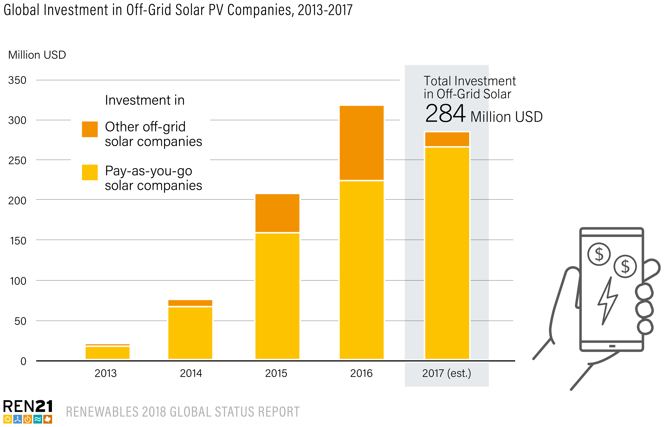
Distributed Renewables for Energy Access
DREA systems attracted some USD 922 million in investment between 2012-2017, with a large portion of this for
solar PV
In 2017, off-grid solar companies raised
USD 284 million, a decrease of 10% from the USD 317 million raised in 2016
PAYG companies attracted nearly all of the investment, raising about USD 263 million in capital (+19% from 2016)
Notes:
DREA systems attracted some USD 922 million in investment between 2012 and 2017, with a large portion of this for solar PV.
In 2017, off-grid solar companies raised USD 284 million, a decrease of 10% from the USD 317 million raised in 2016.
PAYG companies attracted nearly all of the investment, raising about USD 263 million in capital (+19% from 2016)

Slide 33
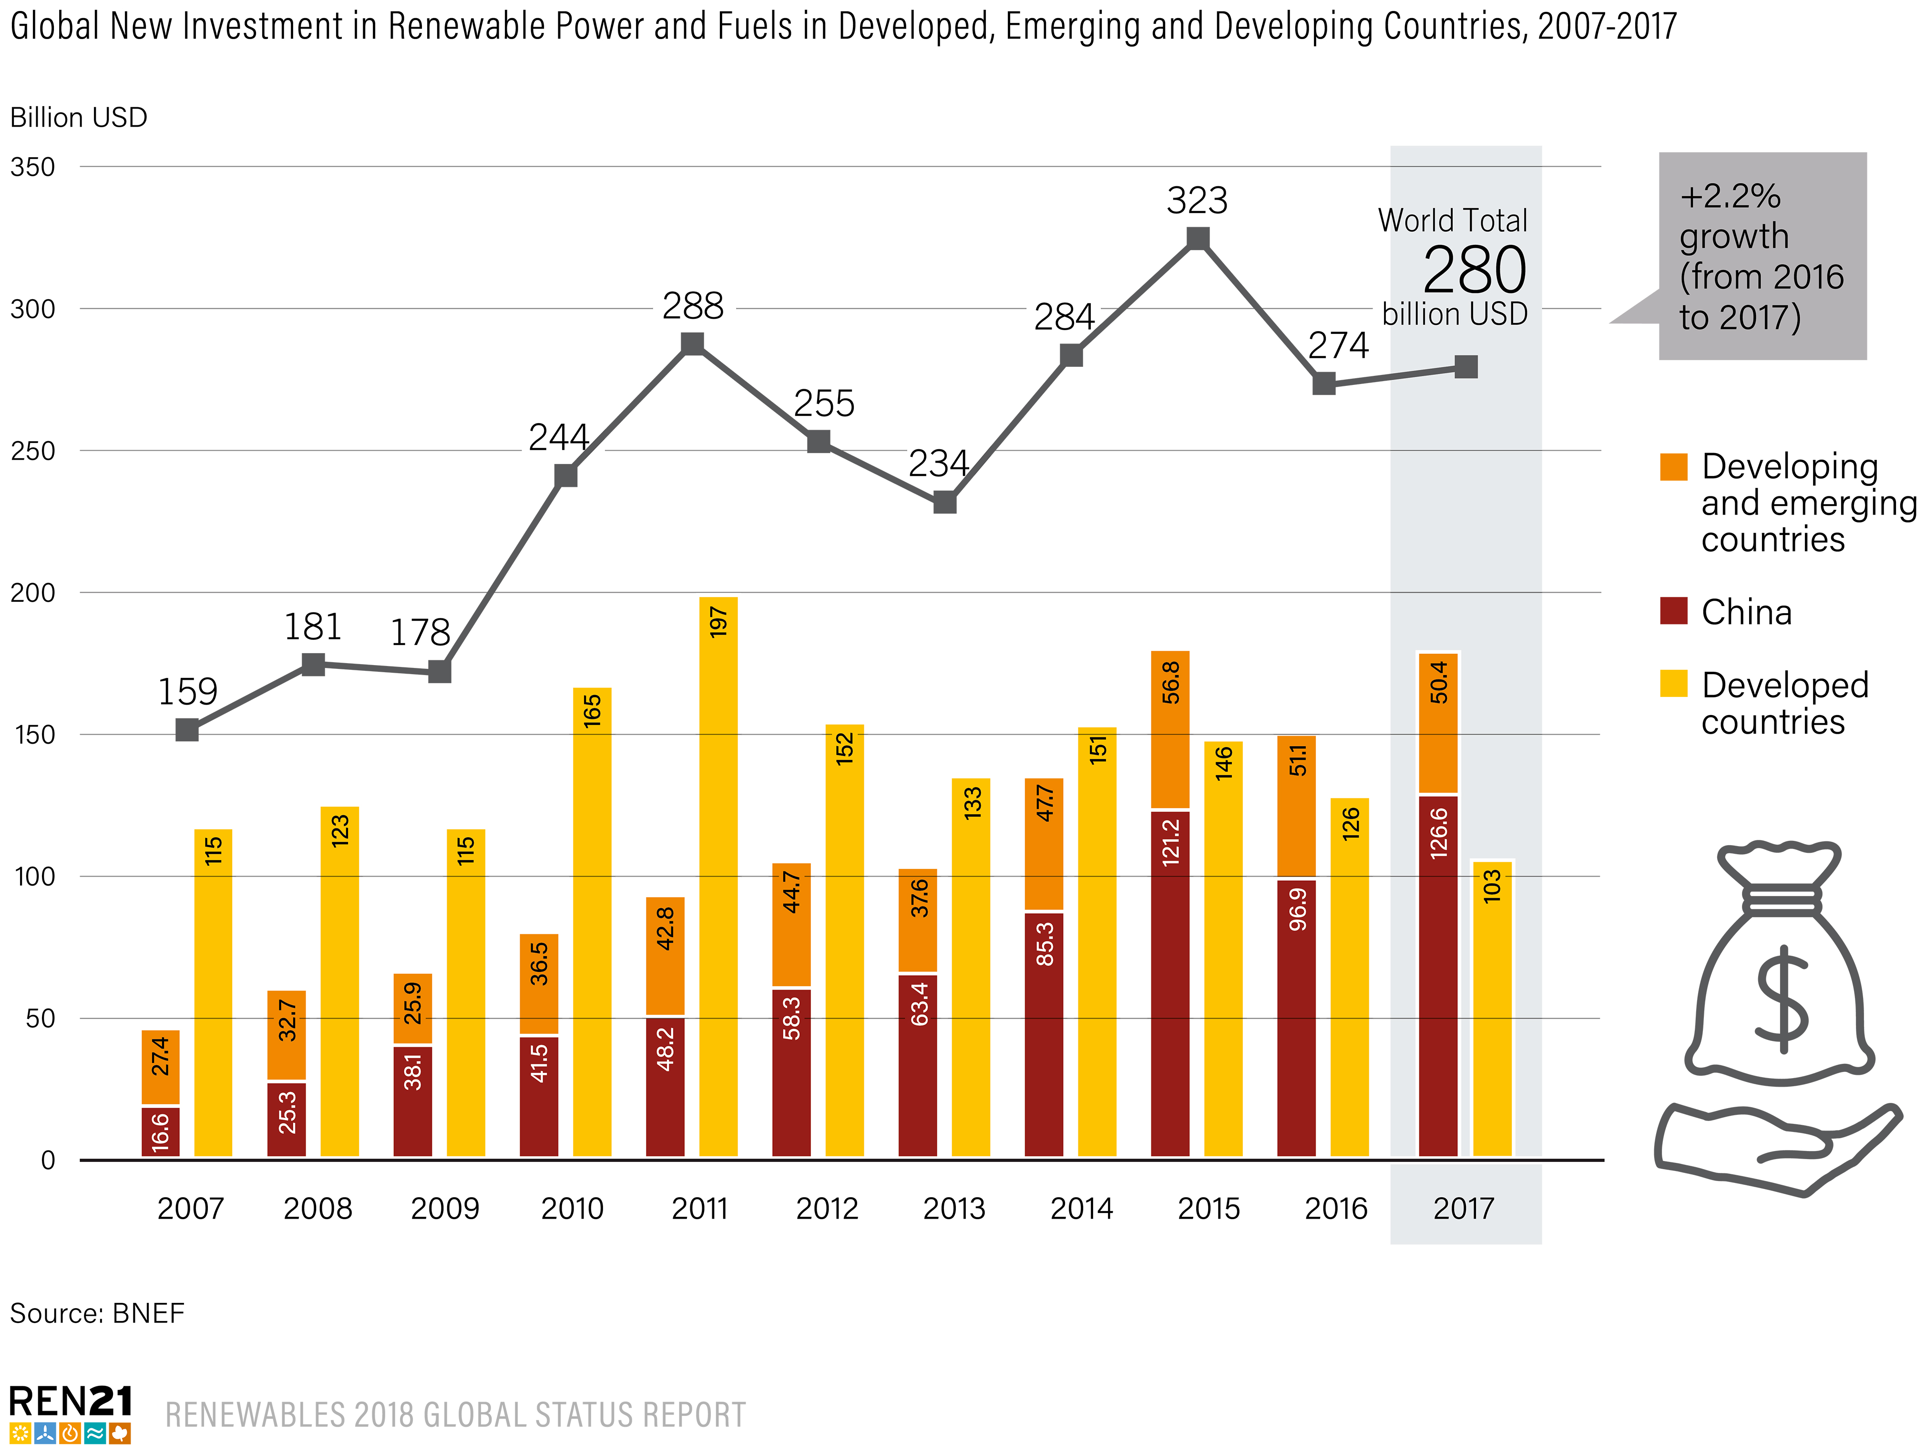
Global Investment in Renewable Energy
Global new investment in renewable power and fuels in 2017: USD 279.8 billion (+2.2%) (USD 319.8 billion incl. large hydropower)
Investment in new renewable power capacity was roughly three times that in new fossil fuel capacity
Notes:
Global new investment in renewable power and fuels (not incl. hydropower projects >50 MW) was close to USD 280 billion in 2017 (as estimated by Bloomberg New Energy Finance).
This represents a 2% increase in investment in relation to 2016 which means that, although costs keep going down for renewable energies (particularly for solar PV and wind), investment in renewable power is increasing
In fact, investment in renewable power capacity in 2017 was three times higher than investment in new fossil fuel capacity.

Slide 34
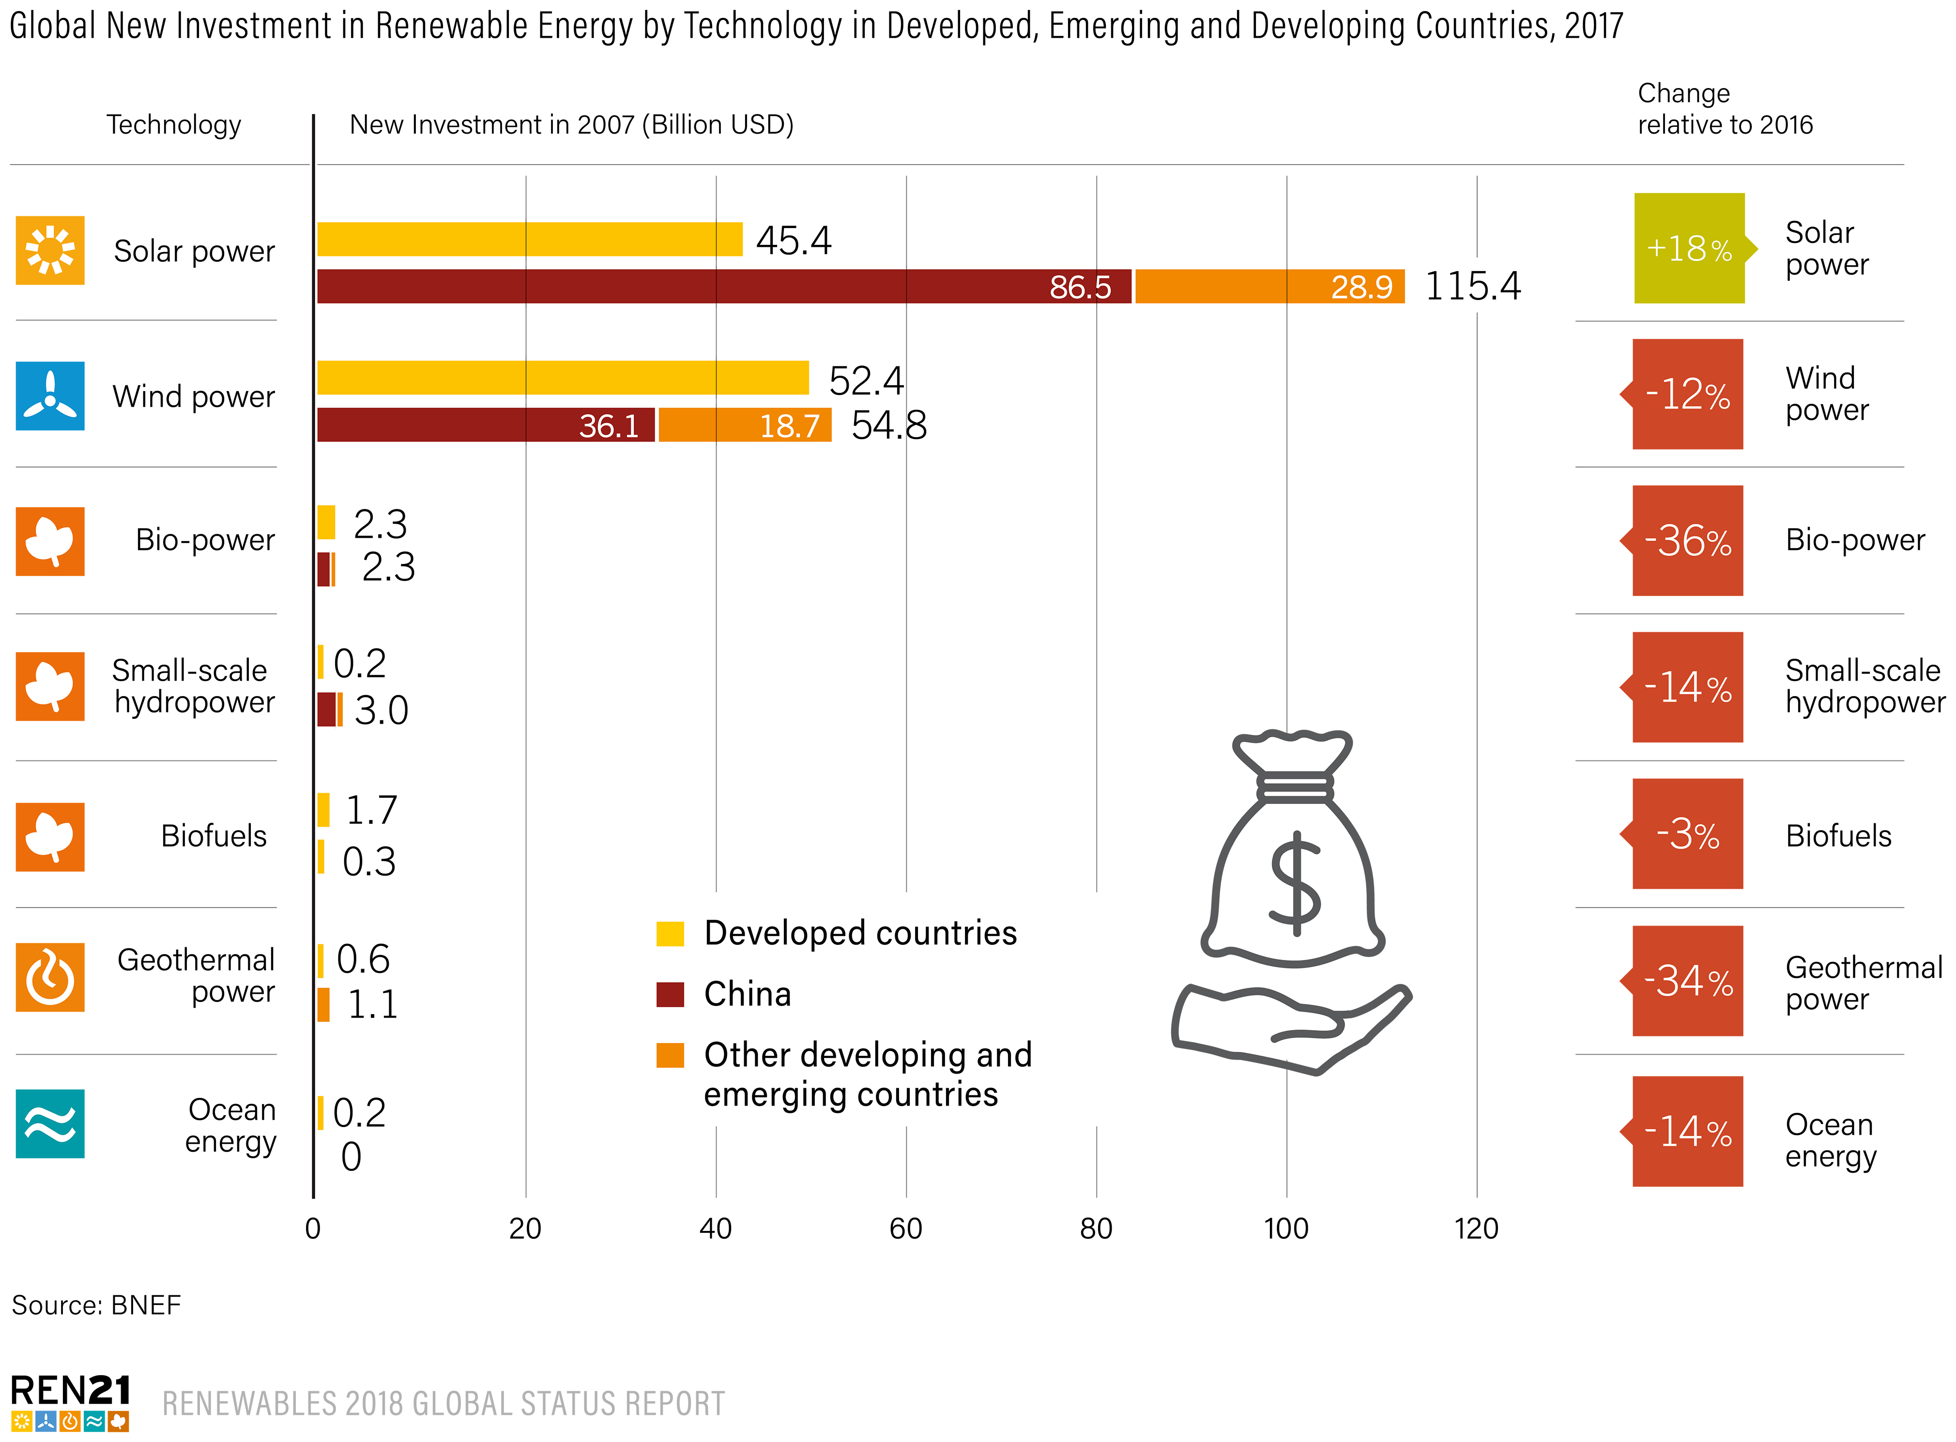
Global Investment in Renewable Energy
Nearly all of the investment in 2017 was in solar PV (57%) and wind power (38%)
Solar PV was the only technology to witness an increase in new investment (+18% compared to 2016)
Investment in all other technologies was down in 2017 relative to 2016
Notes:
New investment in renewable energy in 2017 continued to be dominated by solar PV and wind power, accounting for roughly 57% and 38%, respectively.
The costs of these rapidly growing technologies have fallen so quickly that renewable energy capacity installations in 2017 exceeded those in 2016 despite lower absolute investment, as each dollar represents more capacity on the ground.
Solar power was the only technology to witness an increase in 2017, with new investment up 18% relative to 2016, to USD 161 billion.
Investment in all other technologies was down in 2017.
The most substantial declines in dollar value were seen in wind power (down 12% to USD 107 billion), in biomass/waste-to-energy (down 36% to USD 4.7 billion) and in geothermal power (down 34% to USD 1.6 billion)
Investment in biofuels declined 3% to USD 2.0 billion.

Slide 35
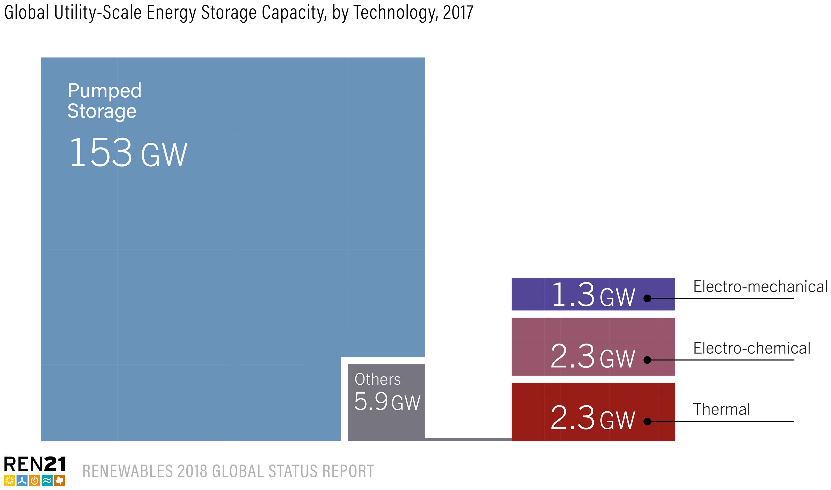

Energy Systems Integration and Enabling Technologies
Markets for energy storage continued to expand in 2017
Global stationary and grid-connected energy storage capacity: 159 GW (est.), with pumped storage accounting for the vast majority
> 3 GW of pumped storage capacity was commissioned (approx. 153 GW by year-end)
Pumped storage is followed distantly by thermal storage (molten salt storage at CSP plants: 82%), then by battery (electro-chemical) and electro-mechanical storage
Notes:
The markets for energy storage continued to expand in 2017. (Data are limited for energy storage in all sectors and particularly for the transport and thermal sectors.)
Global stationary and grid-connected energy storage capacity totalled an estimated 159 GW, with pumped storage accounting for the vast majority.
During 2017, more than 3 GW of pumped storage capacity was commissioned, for a year-end total of approximately 153 GW.
Pumped storage is followed distantly by thermal storage (about 82% of which is molten salt storage at CSP plants), then by battery (electro-chemical) and electro-mechanical storage.

Slide 36
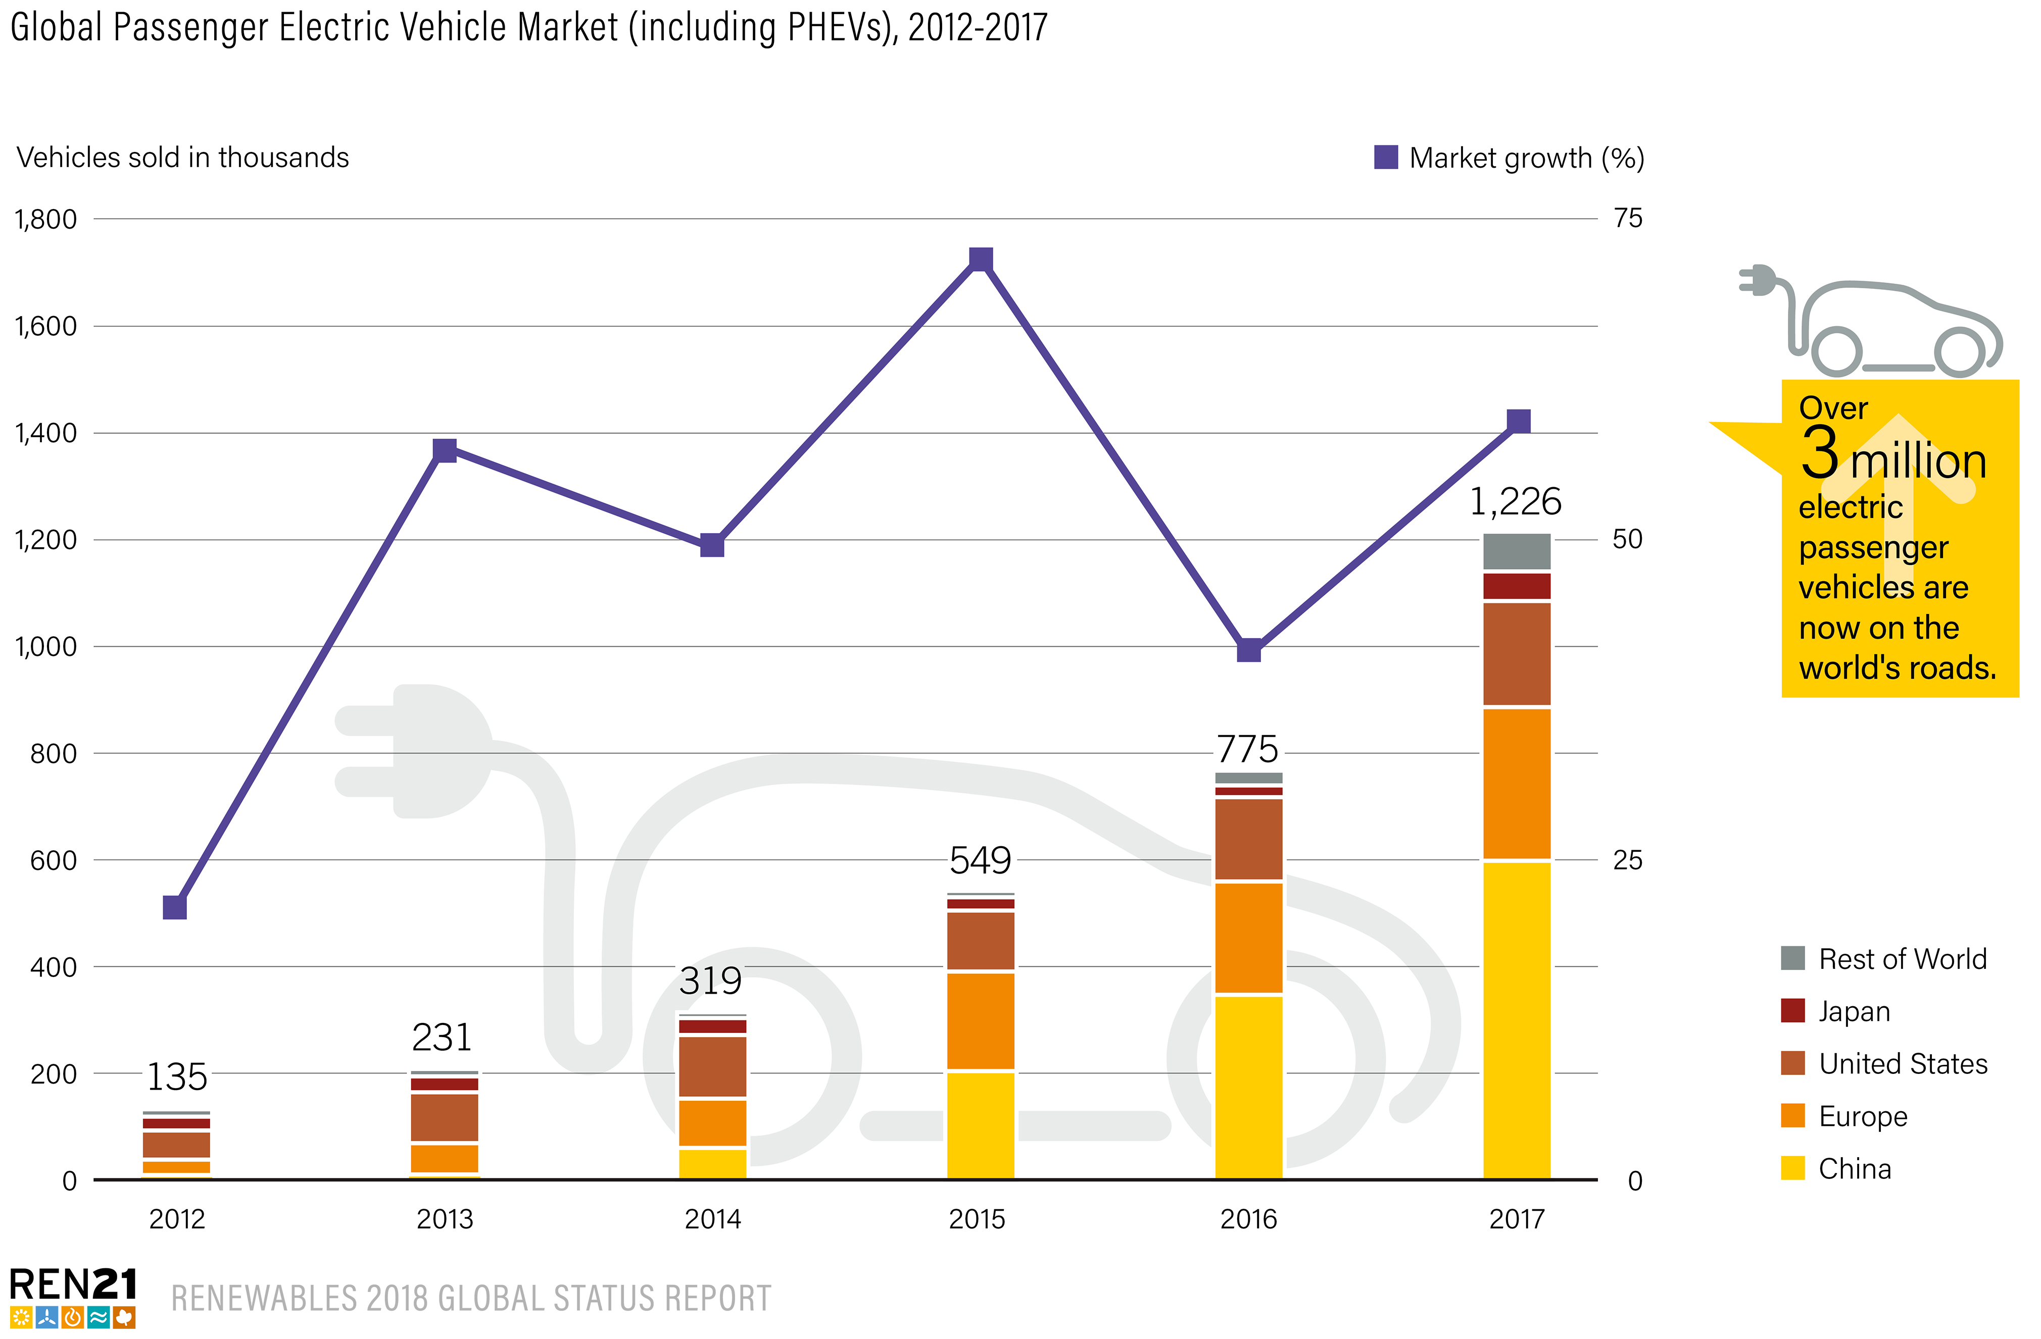
Energy Systems Integration and Enabling Technologies
Electrification trend in 2017
Global sales of electric passenger cars (including PHEVs) reached an estimated 1.2 million units, up about 58% over 2016
> 3 million electric passenger vehicles on the road (+70% relative to 2016, but still only representing 1% of light vehicle market)
Potential to create a new market for RE and facilitate integration of VRE
Notes:
Electrification of the transport sector expanded significantly during 2017, enabling greater integration of renewable energy in the form of electricity for trains, light rail and trams as well as for two-, three- and four-wheeled EVs and heavy-duty vehicles.
In 2017, global sales of electric passenger cars (including PHEVs) reached an estimated 1.2 million units, up about 58% over 2016
EVs on the road passed the 3 million mark in 2017 (+70%), even though annual sales are still only a very small proportion of the global market (1%)
Potential to create a new market for renewable energy and facilitate the integration of higher shares of VRE

Slide 37
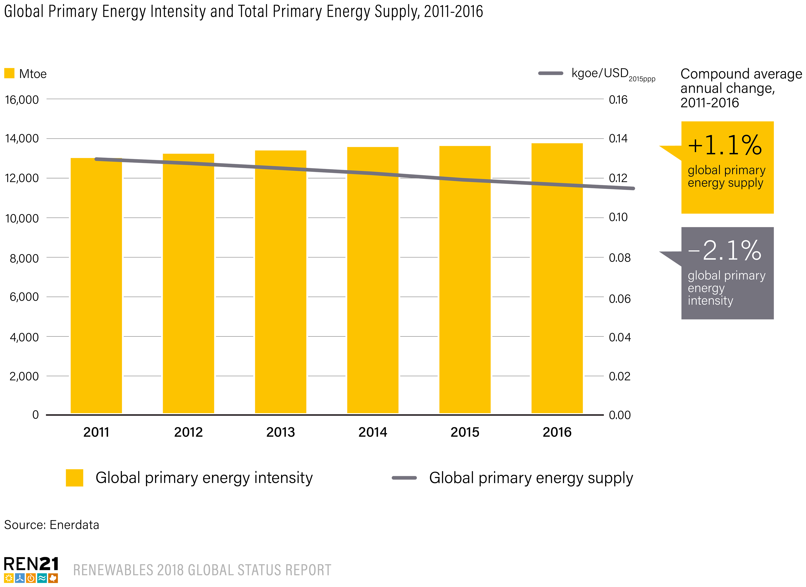
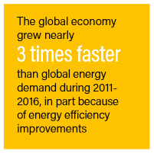
Energy Efficiency
Between 2011-2016, primary energy intensity decreased by 10% (average annual contraction of 2.1%)
This moderated the growth in primary energy consumption, which grew 5.7% (average annual growth of 1.1%)
In 2016, global GDP grew 3% and energy demand only 1.1%
Notes:
Between 2011 and 2016, primary energy intensity decreased by about 10%, an average annual contraction of 2.1%.
This greatly moderated the growth in primary energy consumption, which grew by 5.7% over the same period (average annual growth of 1.1%).
In 2016, global gross domestic product (GDP) grew 3%, whereas energy demand increased only 1.1%

Slide 38
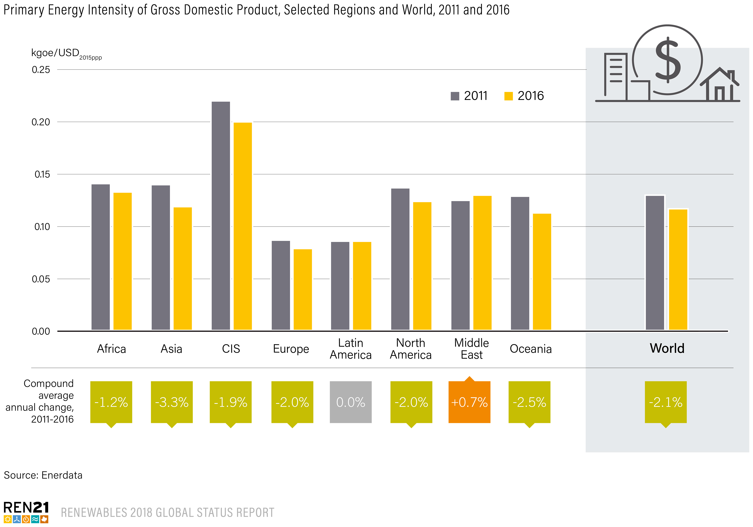
Energy Efficiency
Annual changes in energy intensities vary widely at the regional level
Between 2011-2016:
Asia and Oceania had the largest reductions (average annual declines of 3.3% and 2.5%, respectively)
Latin America’s energy intensity remained flat
The Middle East was the only region that saw an overall increase (3.1% decline in 2016)
Notes:
At the regional level, annual changes in energy intensities vary widely.
Asia and Oceania experienced the largest reductions in energy intensity between 2011 and 2016, with average annual declines of 3.3% and 2.5%, respectively.
Latin America’s energy intensity remained flat over this period, while the Middle East was the only region that saw an overall increase, albeit ending the period with a decline of 3.1% in 2016.
At least 25 countries appear to have reached their peak energy demand and have since maintained lower demand, despite continued economic growth. (Total energy demand across all OECD countries peaked in 2007.)

Slide 39
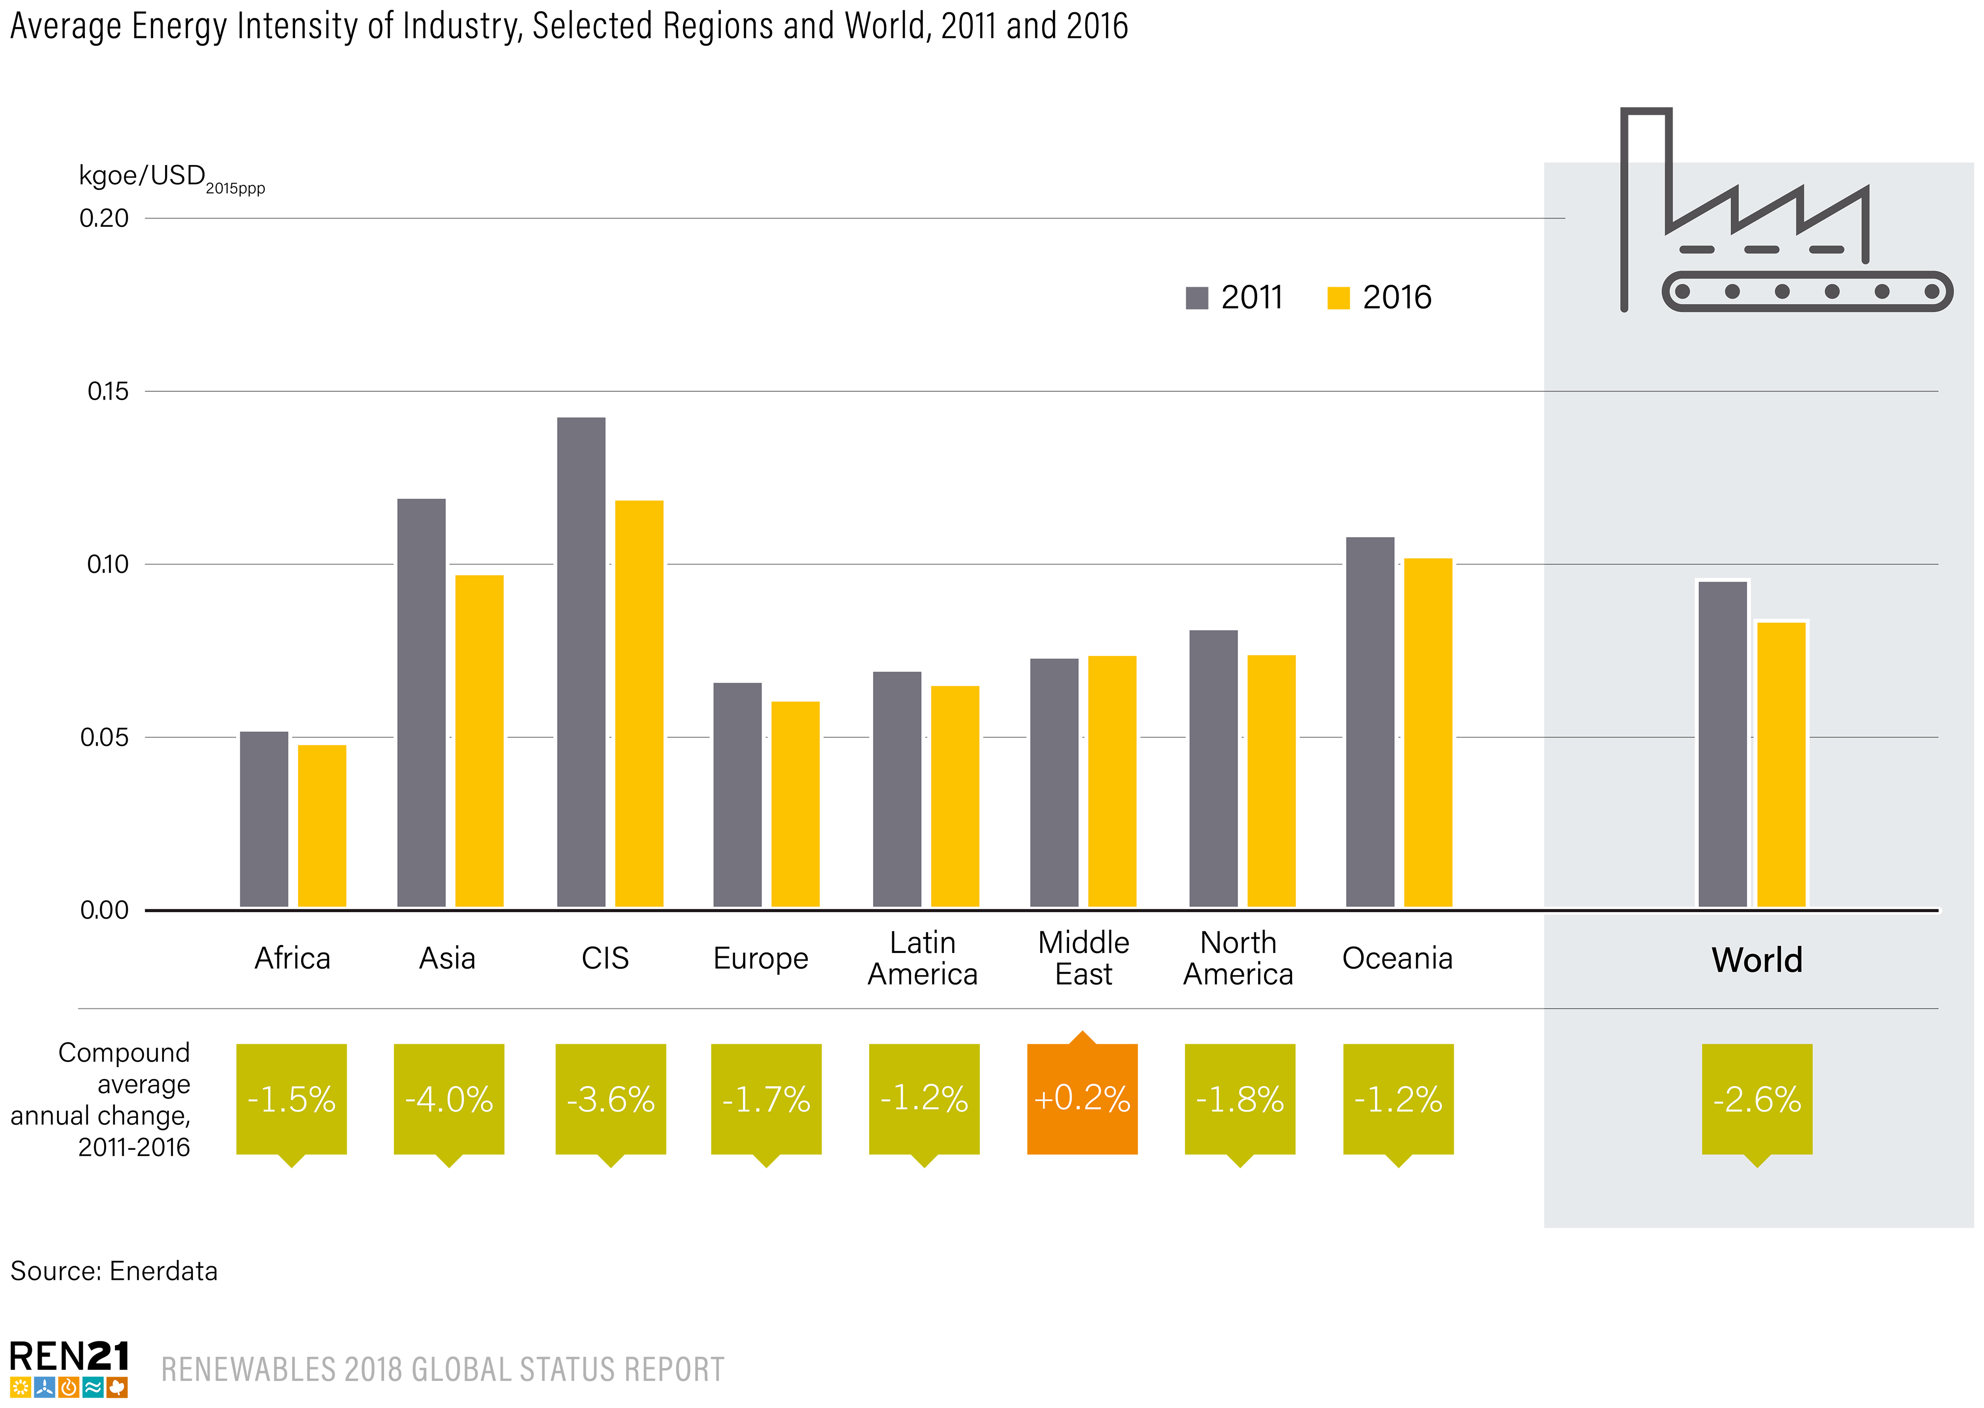
Energy Efficiency
Energy intensity in industry decreased by an average annual rate of 2.6%
between 2011-2016
Regions with the most marked decreases in energy intensity:
  Asia (average annual decline of 4%) and the Commonwealth of Independent States (3.6%)
  Only the Middle East did not show notable improvement in energy intensity for the period
Notes:
The global average energy intensity of industry contracted between 2011 and 2016, at an average annual rate of 2.6%.
The regions with the most marked decreases in energy intensity were Asia (average annual decline of 4%) and the Commonwealth of Independent States (3.6%).
Only the Middle East did not show notable improvement in energy intensity for the period.

Slide 40
Future is All ( Renewable)Electric

Slide 41


Future is All Electric
logout.palaunet.com

Slide 42
Solar at Gate ( ICAO/UNDP/GEF Project)
Pilot Project in Jamaica
Replaces jet fuel based Auxiliary Power Units ( APU) and/or Diesel Power Units( GPU) for powering on-board systems and heating/cooling of parked aircrafts
Reduces aviation related carbon emissions
100 kW_{p} system
Offsets 522 tonnes of CO₂ annually.
Should be replicated by all SIDs including Fiji

Slide 43
Fiji Demand Scenario
EVs introduced in 2030

Slide 44
Generation Scenario
Decreasing RE share

Slide 45
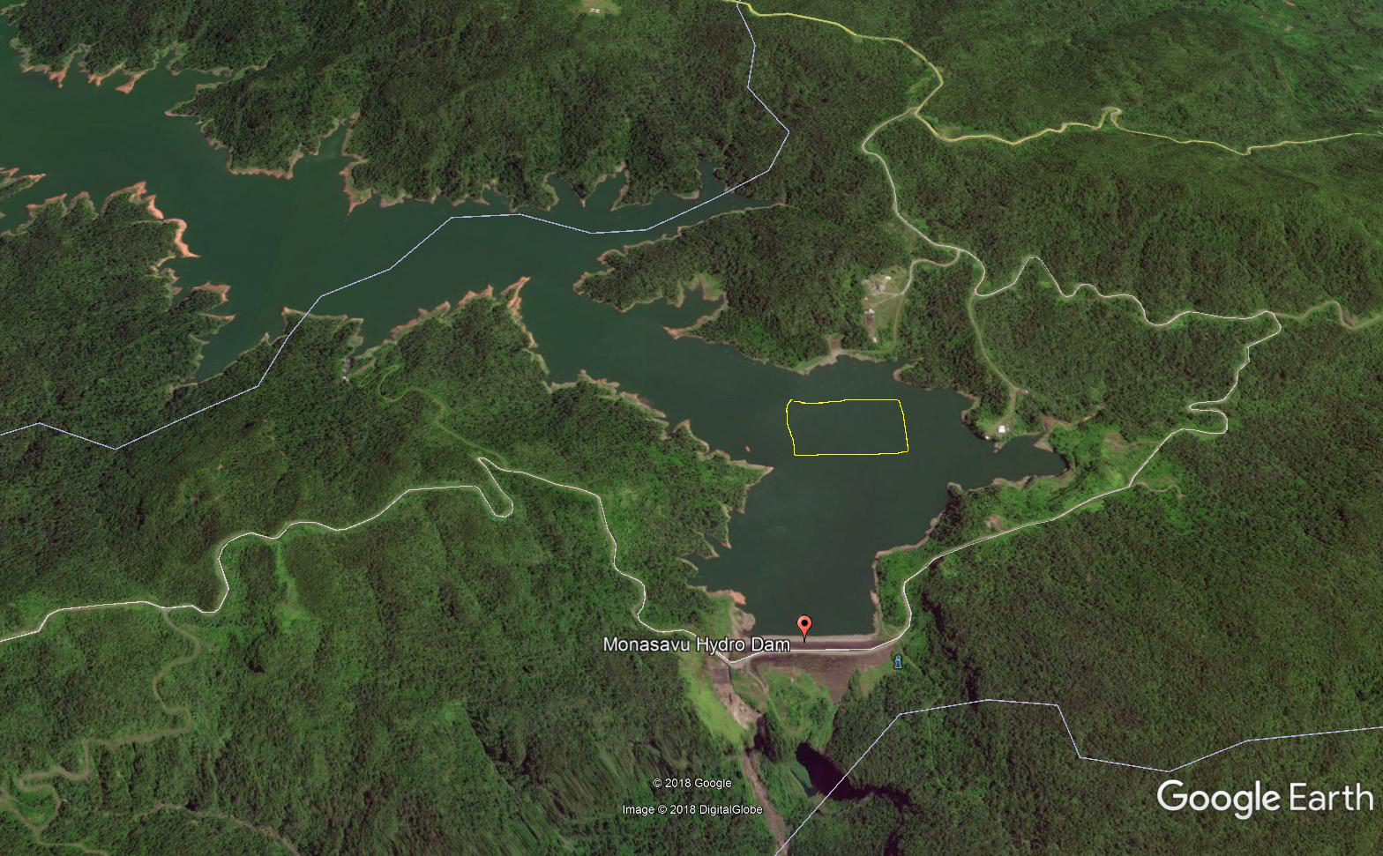
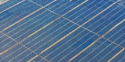
Hydropower and Solar PV
A 7.5 MW floating solar (FPV) farm at Monasavu reservoir covering 0.06 sq km
Can produce about 10.5 GWh of electricity annually
Helps in the land issue for PV installations
Saves water for peak demand and nighttime.
PV efficiency increases due to cooler temperatures.

Slide 46




Workshop on High Penetration Variable Renewables in the Pacific:
Small grids and Off-grid
Where: Colombo Theatres, UNSW Sydney
Cost: Free, but registration required
Registration: Please contact Dr Anna Bruce at a.bruce@unsw.edu.au
Program
Introduction to the Workshop, Iain MacGill, CEEM UNSW
Overview of Status and Challenges for RE in the Pacific, Atul Raturi, USP
Roadmaps for VRE Upscaling - challenges & issues, IT Power Australia
Panel Presentations from regional stakeholders including:
Pacific Island utilities
Project developers, consultants
Donors and financiers
Panel Q&A and Discussion – opportunities, priorities for research and collaboration
Conclusions - key themes and issues emerging from the workshop, future work
___________________

Slide 47
Thank You

Slide 48
logout.palaunet.com

