Slide 1
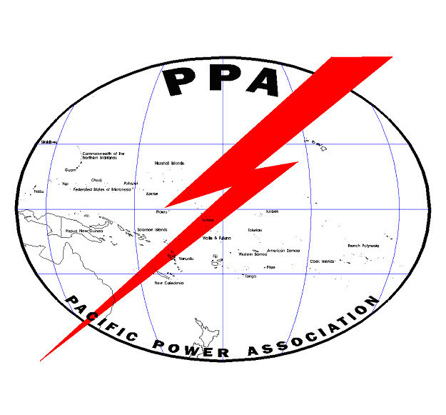
Adding Energy Storage
to the Grid

Slide 2
How can adding storage help a utlilty
Allows up to 100% solar, wave, tidal or wind generation
Can allow diesel engines to operate continuously at top fuel efficiency
Can improve voltage regulation at the far ends of the grid
Very rapid response to load changes

Slide 3
Where to install storage
Not a critical issue, with remote monitoring and control, storage can be distributed and placed almost anywhere on the grid.

Slide 4
Major Types of Energy Storage
Mechanical (flywheels)
Pumped water storage
Compressed air
Heat storage
Capacitors
Flow batteries
Static Batteries

Slide 5
Flywheel Storage

Slide 6
Spinning at over 16,000 RPM and weighing over 1.5 tons, the flywheel is brought to speed by the motor using surplus electricity and energy is taken out by tapping that high kinetic energy using the generator to make electricity when needed to fill in gaps in generation

Slide 7
20 MW Flywheel Energy Storage Facility in the USA (100 kW per unit)

Slide 8
Advantages
Very fast response time for load changes
Disadvantages
High cost
Best to manage rapid variations from solar, not good for long term (multi day) storage
No experience with small utility storage
High maintenance

Slide 9
Pumped Water Storage

Slide 10
NEDO Solar and Pumped Hydro Project in Laos

Slide 11
Laos 100 kW Solar With Pumped Storage

Slide 12
Advantages
If topography is good, can be relatively cheap and reliable storage
Well tested technology
Disadvantages
Perfect topography is rare
Land issues both for the pond and for the delivery pipe
Relatively high losses

Slide 13
Compressed Air Energy Storage

Slide 14
Advantages
Can provide long term storage
Uses commercial mechanical technology
Disadvantages
Hard to find a suitable underground chamber
Relatively high losses
Complex and expensive
High maintenance
Little real world experience
Not a good match for small utilities

Slide 15
Thermal Energy Storage
Stores heat in a special salt or in water and runs a low temperature turbine to generate electricity
Only suitable for thermal type solar generators (power tower and concentrating collector systems) which are very unlikely to be used in the Pacific

Slide 16
Capacitor Storage
Advantages
Very fast response
long life
Charge rapidly
Disadvantages
Very expensive
Suitable mainly for rapid delivery of energy to offset solar variations, not practical for long term storage

Slide 17
Flow Batteries

Slide 18
Advantages
Very long life of components
Good conversion efficiency
Disadvantages
Still under development
More expensive than Li-ion units
Typically operate at high temperatures
Generally not cost effective for small utilities

Slide 19
Static Batteries
Commercially available batteries for small utility scale storage
Lead-Acid
Lithium-ion

Slide 20
Small Li-ion Batteries - Niue (For Power Stabilization Only)

Slide 21
Large Li-ion Battery Bank (2MWh storage) Iririki Island, Port Vila, Vanuatu

Slide 22
Advantages of Li-ion batteries
Much lighter than lead-acid
Longer life than lead-acid
Not sensitive to deep discharging
Disadvantages
Still more costly per kWh than lead-acid batteries
Potential fire hazard

Slide 23
Sealed Lead Acid Batteries

Slide 24
Advantages of sealed lead-acid units
Can be stacked or mounted in any position
No maintenance
Shipping while charged is ok
Readily available
Disadvantages of sealed units
More expensive
Must not be overcharged
No maintenance possible
Very heavy
Must be kept at full charge if in storage more than two months

Slide 25
Open Cell Lead-Acid Battery

Slide 26
Advantages of open cell lead-acid batteries
Cheapest per kWh storage
Not sensitive to overcharging
Readily available
Longer life than sealed batteries
Can be shipped cheaply ‘dry’ then filled with electrolyte on site
More forgiving of abuse than sealed batteries
Equalization charging is practical to reduce sulphation
Spares can be stored ‘dry charged’ for years without degradation
Usually have transparent cases so the ‘guts’ are visible

Slide 27
Disadvantages
Require adding distilled water about twice a year
Shipping charged batteries is very expensive
Very heavy
Must be transported upright

Slide 28
What is the main disadvantage of all energy storage technologies?
Loss of 15% to over 40% of grid energy in the conversion to stored energy and back to delivered energy
TANSTAAFL

Slide 29
DISCUSSION

