Slide 1
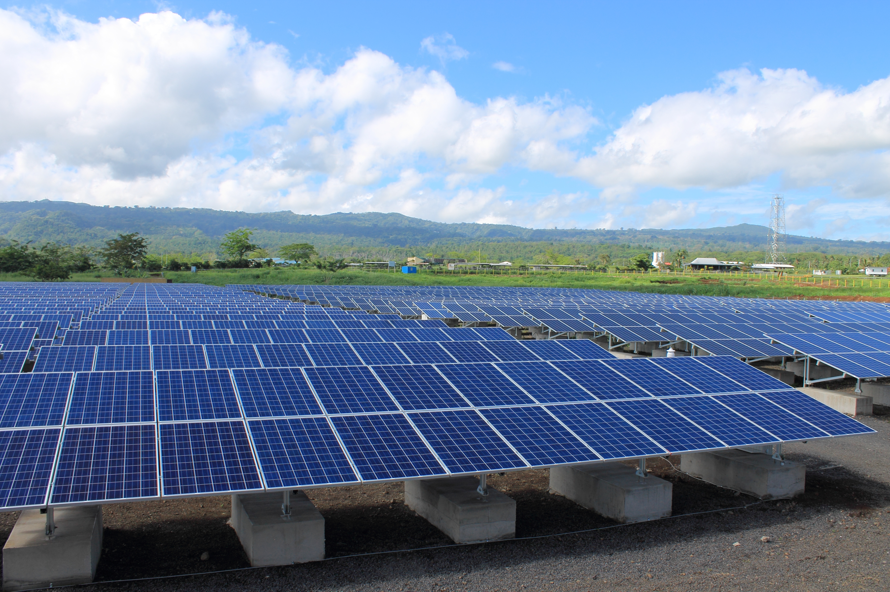
SUSTAINABLE ENERGY INDUSTRY DEVELOPMENT PROJECT (SEIDP)
Donor: The World Bank
Funding: USD 5.66million
Additional Funding: USD 1million (Australian Government)
Technical Advisory Group Presentation to the PPA Board
PPA Annual Conference 2017, Apia, SAMOA

Slide 2
Overview
Background
Funding
Objectives & Project Components
Progress & Work plan next 12 months
Utility participation
Questions

Slide 3
Background
2014 PPA & Sustainable Energy Industry Association of the Pacific Islands (SEIAPI) project proposal
Aim to provide support to Pacific Island Countries (PICs) to help ensure the long-term sustainability and success of the increasing number of RE installations
Project approved by World Bank Sept 2015
Project duration: 5 years (Sept 2015 - Aug 2020)

Slide 4
Funding
Total project cost: US$5.66m
Financing:
  Small Islands Developing States Initiative (SIDSDOCK) grant US$3.47m
  Scaling Up Renewable Energy Program (SREP) grant US$1.92m
  Government of Japan under GFDRR grant US$0.27m

Slide 5
Additional Funding
Additional financing of US$1.0m from Australian Government Feb 2016
Variable Renewable Energy Grid Integration and Planning Studies in 4-5 PICs /Assessment of the needs for Supervisory control and data acquisition (SCADA) and Energy Management System (EMS)
  Federated States of Micronesia
  RMI
  Samoa
  Tonga
  Tuvalu
Support for regulatory framework changes under discussion?? Confirm with WB
Value Of Lost Load (VoLL) study under discussion

Slide 6
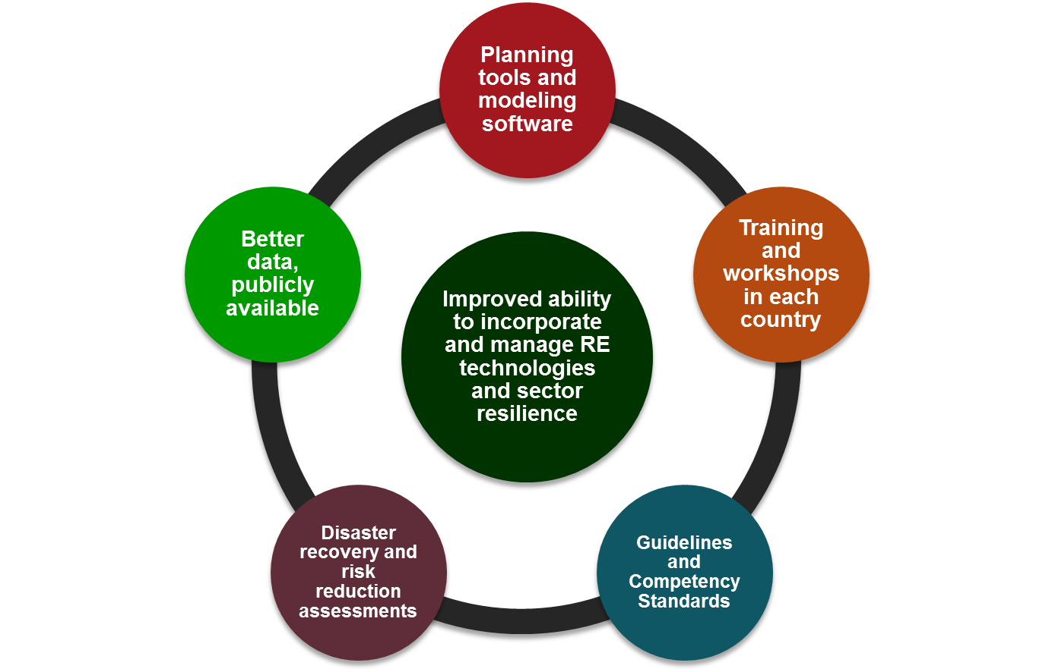
Project Objectives

Slide 7
Component 1
Energy Sector Management Assistance Program (ESMAP)
Phase 1: Being implemented by ESMAP
  Solar resource maps available online & copies at the conference
  Wind resource maps will be available by the end of the year
Phase 2: Ground-based data collection (2017-19)
  High resolution data from 8 solar stations & 4 wind stations
Phase 3: Validated resource maps – by August 2020

Slide 8
Component 2
Modelling software for RE integration and capacity building
Online power benchmarking platform;
RE/EE guidelines and competency standards
Training/workshops
TNA & Career development initiatives study
Assistance with mainstreaming gender equity/equality in the power sector
Disaster-recovery and risk-reduction activities for power utilities

Slide 9
Component 3
Building PPA’s capacity for
  overall project coordination,
  management and monitoring including technical operation,
  procurement,
  financial management,
  environmental and social management,
  gender action plan implementation,
  monitoring and evaluation, and
  reporting.

Slide 10
Project Implementation Status Update
Comp 1 :
  Wind & Solar resource mapping bid to be issued in late August;
  ToR for consultant to validate data & prepare resource maps being drafted;
Comp 2:
  Electrical Engineer recruited to provide technical advice & lead the power system modelling & benchmarking activities;
  Power system modelling software – PowerFactory procured & training for PPA has been completed.
    Training for utilities scheduled for September
  ToR for consultant to develop online benchmarking platform being developed;
  Renewable Energy & Energy Efficiency Guidelines, Competency Standards and Training evaluation of proposals underway. Aim to award contract in September
  TNA & Career development initiatives – consultant has completed the study

Slide 11
TNA & Career Development Initiatives Study
Four major training topics resulted and were prioritized:
1. O&M of large scale solar
2. Energy storage for large scale solar
3. Adding private solar generation into the grid
4. Implementing SCADA for multiple generators

Slide 12
Project Implementation Status Update
Comp 3:
  Project Implementation Officer & Procurement Advisor recruited.
  PPA website upgrade completed.
  Training for PPA staff on procurement, finance & administration.

Slide 13
Work plan 2017/2018

Slide 14
Utility Participation
Encourage active participation of member utilities to provide support & advice to the project including but not limited to:
Identifying sites, installation, monitoring, data collection & data validation;
Participating in training workshops & courses to be identified;
Providing required information/data to PPA to help with project implementation & activities;

