Slide 1
Challenges for Renewable Energy Integration in the Pacific Islands Grids Herb Wade
Notes:
Excellencies, delegates, ladies and gentlemen
There are many good studies for Africa, but these are not comprehensive and access to them is a challenge
The fact that we start with Africa is a two-edged sword. We need to develop our methodology and we need to test and refine the methodology. The insights for Africa will be used to refine the methodology further and it will benefit the following studies.
We are on an extremely tight timeline for such an ambitious undertaking.

Slide 2
Why are There Challenges?
Actually there are no serious challenges integrating most renewable energy generators into a grid as they just represent a different type of ordinary generating plant
Hydro
Geothermal
Biomass
Biofuel
Biogas

Slide 3
The problem is the variability of some sources
Variable inputs are provided by
Solar
Wind
Wave
Tidal

Slide 4
But the main problem is not just variability
Problem with rates of change of power output
Engines have to keep up with the change
Fastest changes are with wind in stormy weather
Solar can change 80% in a few seconds
Wave more slowly
Tidal, very slow
And predictable

Slide 5
Integrating Solar
Because solar only is available at high levels between about 0900 and 1500, the load at that time is the only one that is relevant with regards to solar design and integration unless there is substantial storage installed.
Generally, use the noon-time load as the guiding parameter because that is when the solar is the strongest and there is the greatest possible change of output if clouds come by.

Slide 6
What solar enthusiasts want you to think solar input is like
A clear day in the desert…………..

Slide 7
Solar generation in real life
A “clear” day in the Pacific…………

Slide 8
And a partly cloudy day in Tuvalu……

Slide 9
Also of concern is the pattern of the load…..

Slide 10
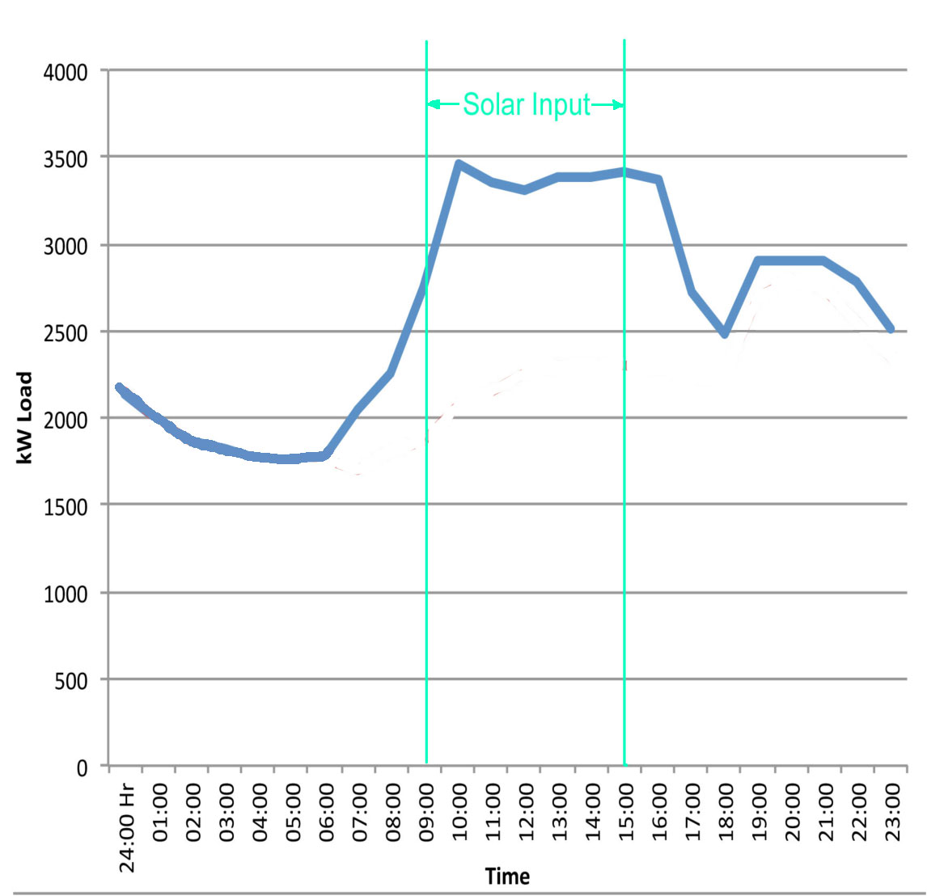
Noon time peak load – urban grid
Good for grid-connected solar input
Typical of larger urban utilities
Solar helps offset the peak
Often peak is air conditioning which is also dependent on solar input

Slide 11
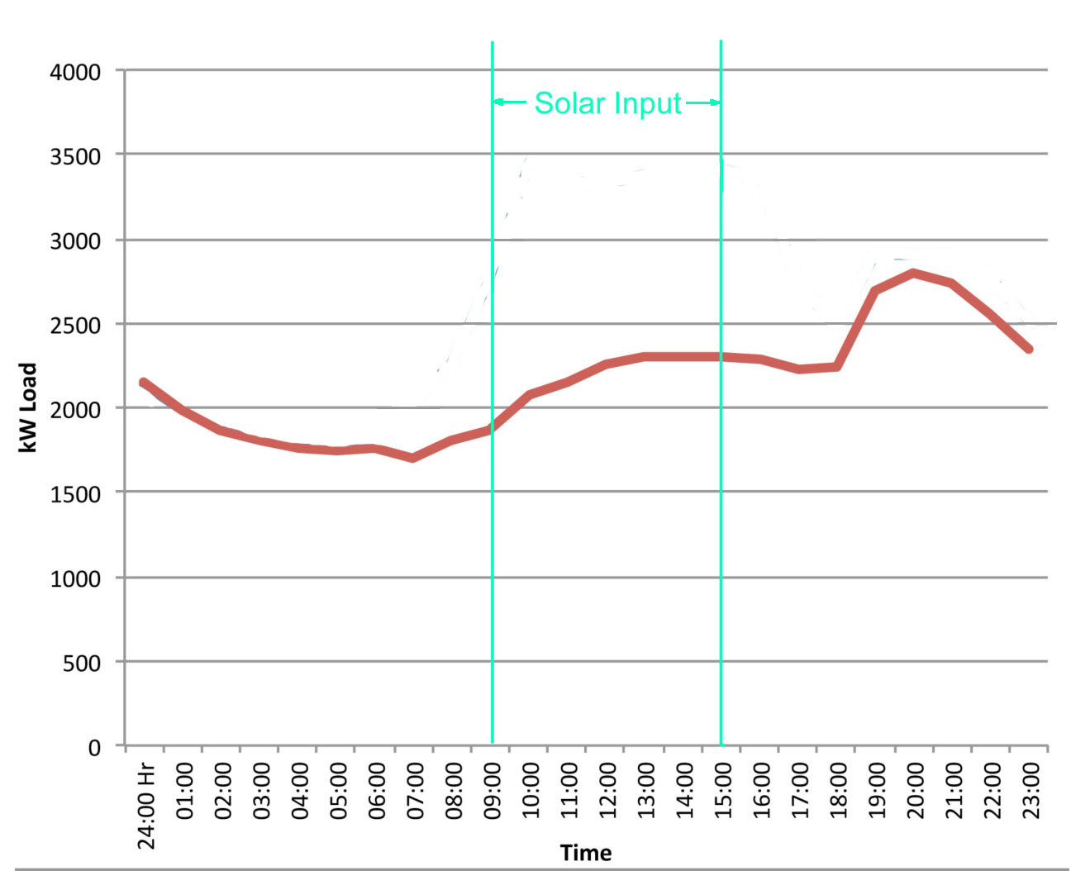
Evening Peak – non-urban grid
Not so good for grid connected solar
Typical of small utilities with no major urban base
Can only provide a small benefit because the solar does not arrive when the load needs it

Slide 12
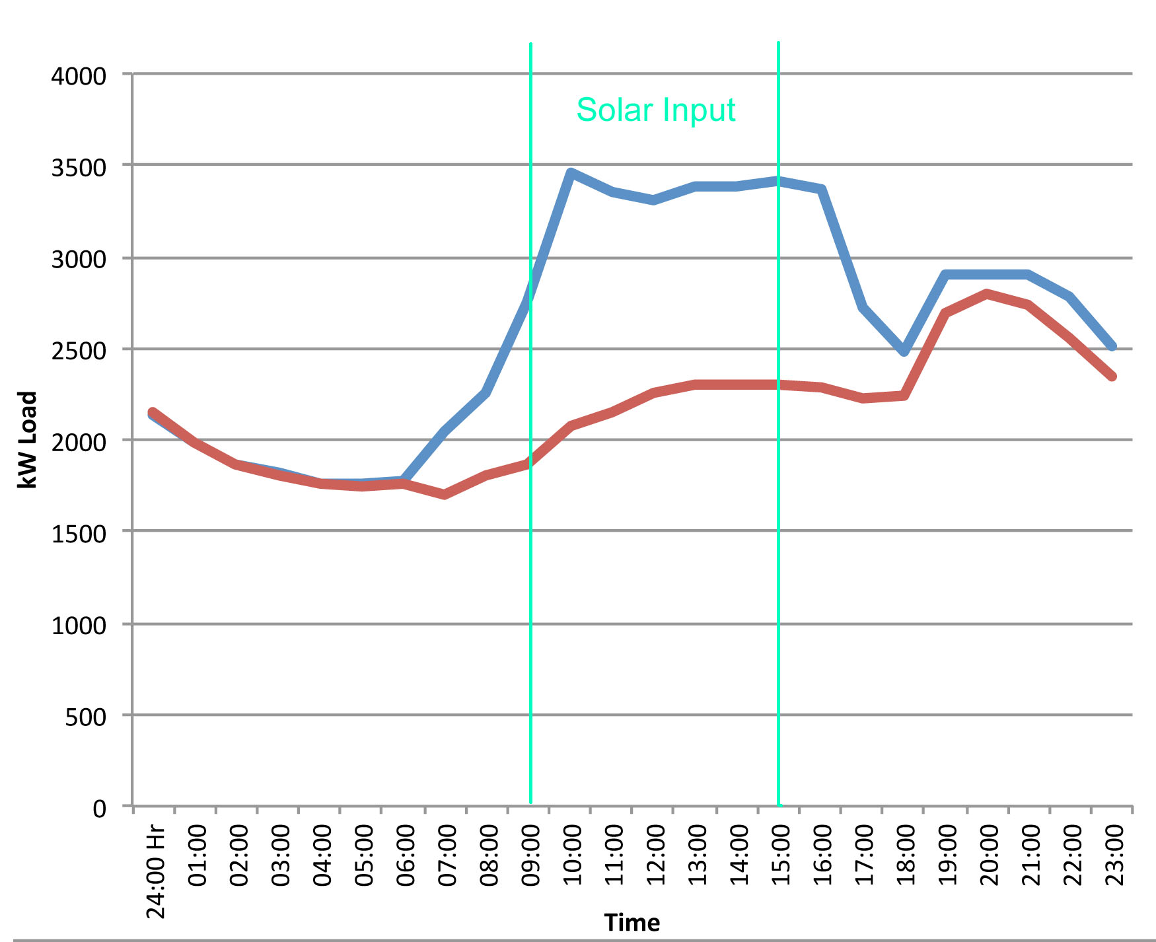
Rule of Thumb for Solar
Once you see the noon-time peak for solar reaches 20% of the noon-time load, there need to be concerns though instability may not occur until 50% or more if the solar is widely dispersed..
Don’t forget noon time peaks are usually related to A/C use so Saturdays and Sundays may have a much lower noon-time load. Blue graph = weekday load and red graph = Sunday load which is typical of non-urban loads because the government and many business offices are closed and their A/C is off

Slide 13
Increasing penetration
What happens when you go over the limit?
It is much like a very large load going on and off when a cloud goes by
So to make it possible to go higher, split the solar generation into several parts and spread it around the island so it all does not change at the same time.

Slide 14
Single large solar installation for Rarotonga

Slide 15
Dispersed small arrays for Rarotonga

Slide 16
Then what
40% penetration of the noon load or even somewhat more can probably be achieved without significant problem with dispersed solar but to go much higher, energy storage and controls to help slow down and/or lower the extent of variations may be needed.
Storage Options include
Pumped storage (existing hydro is interesting)
Batteries (the most common but rather expensive approach)
Flywheels (not a major contender)
Compressed air (requires special conditions not found in most of the Pacific)

Slide 17
How to predict what can reasonably be accepted?
By using a dynamic model of the grid and trying different types of solar inputs in the model and different loading conditions to see the predicted results
Model must be validated for the type of grid in use (mostly diesel in the Pacific)

