Slide 1
PPA Gender Network

Slide 2
INTRODUCTION
The PPA benchmarking report released in June 2017 showed that:
the number of females employed as a proportion of total staffing in the Pacific power utilities has decreased to 21.3% in the 2015 FY, as compared with 23.1% in 2014.
In technical positions, there are only 4% women
Among senior staff there are 69.4% male and 30.6% female.
Utilities face two major challenges: aging infrastructure, and an aging workforce.
PPA’s focus on gender is part of its commitment to help utilities build a strong, qualified workforce for the future – with access to the best talent on the market.
Notes:
INTRODUCTION
PPA’s focus on gender equality began with looking at what the data shows. The benchmarking report released in June 2017 showed that:
the number of females employed as a proportion of total staffing in the Pacific power utilities has decreased to 21.3% in the 2015 FY, as compared with 23.1% in 2014.
In technical positions, there are only 4% women
Among senior staff there are 69.4% male and 30.6% female.
At the same time, most utilities face two major challenges: aging infrastructure, and an aging workforce. Recruitment of qualified personnel – particularly in technical roles – is often a struggle.
Women represent an untapped labor pool and additional source of talent. To date they have been underrepresented in the sector, but this can change for the better.
PPA’s focus on gender is part of its commitment to help utilities build a strong, qualified workforce for the future – with access to the best talent on the market.

Slide 3
PROJECT UPDATE
World Bank gender consultant presented at 2017 PPA conference
Research pointed towards the need throughout the sector – from management to trainees.
PPA worked with its members to select and appoint Gender Champions – 2 men and 2 women from utilities across the region - who exemplify leadership on gender issues.
June 2018, Gender Champion meeting in Suva.
Notes:
Work done to date:
At the 2017 PPA conference, a World Bank gender consultant helped to kickstart a discussion with the CEOs to identify opportunities to create a gender work program.
Part of this research pointed towards the need throughout the sector – from management to trainees – for a better understanding of why gender is relevant in the workplace, and what practical approaches could be taken to increase opportunities for women.
To this end, PPA worked with its members to select and appoint Gender Champions – 2 men and 2 women from utilities across the region - who exemplify leadership on gender issues.
Each gender champion has a unique story and perspective on how gender issues have been relevant to their careers, whether as a mentor of young women or as a female engineer navigating a traditionally male dominated field. These stories help to ‘humanize’ the issues and place them in a content people can understand and relate to.

Slide 4
Gender Champions Consultation:
Gender Champions met in Fiji to prepare content for a gender web portal and develop the project workplan.
Gender Portal aims to provide resources and support PPA’s member utilities.
Web portal provides a virtual learning community for sharing data, best practices, training and policy resources.
The Gender Champions’ Role: Peer supporters, role models and leaders both internally within the regional workforce, and externally in engagement with key partners including schools and the wider community.
Notes:
· Fiji Meeting for Gender Champions:
In June this year, the Gender Champions met in Fiji to record video interviews, help prepare content for a gender web portal, and generate some ideas for a workplan.
· PPA’s Gender Portal aims to provide resources to encourage PPA’s member utilities to increase their employment of women, and to support policies and initiatives focused on broader workforce development. The overall goal is to assist members utilities’ efforts to continue making the workplace more attractive, accessible and welcoming to talented candidates – regardless of gender or background.
· The website provides a virtual learning community for sharing data, best practices, and training and policy resources. It will be updated regularly.
· Some initial ideas on a work program are available on this site under the tab ‘Gender and the PPA’ – status and opportunities. If you are interested, please visit. PPA and the Gender Champions would be grateful for your feedback and views on the direction we should take this work.
· The Gender Champions’ role: As PPA’s work on gender progresses, the Gender Champions will act as peer supporters, role models and leaders both internally within the regional workforce, and externally in engagement with key partners including schools and the wider community.

Slide 5
PPA Gender Portal
https://www.ppa.org.fj/gender-portal/ppa-gender-champions-profiles

Slide 6
PPA 2018 Goal:
Survey
Perceptions, attitudes, experiences and beliefs around women’s employment, recruitment channels and workforce development issues.
Responses to feed into development of a work program that PPA can roll out to support its members.
Survey Link
https://www.surveymonkey.co.uk/r/B3XJZQQ
Notes:
Goals·
Survey: the gender champions have a tablet-based survey and will be circulating at the conference with the goal of trying to capture as many responses as possible. This is a 5-minute, 25 question survey focused on perceptions, attitudes, experiences and beliefs around women’s employment but also to map out recruitment channels and other workforce development issues.
· The goal is to use the responses to feed into development of a work program that PPA can roll out to support its members.
· Gender champions are also at the conference to learn more from informally from PPA members about best practices, key challenges faced and ideas for supporting efforts going forward to build an engaged, motivated workforce that is inclusive of women.

Slide 7
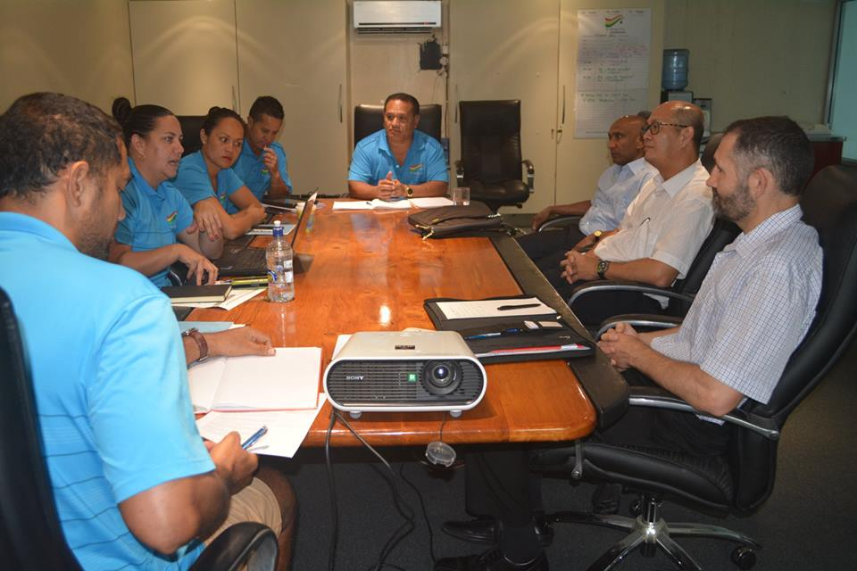
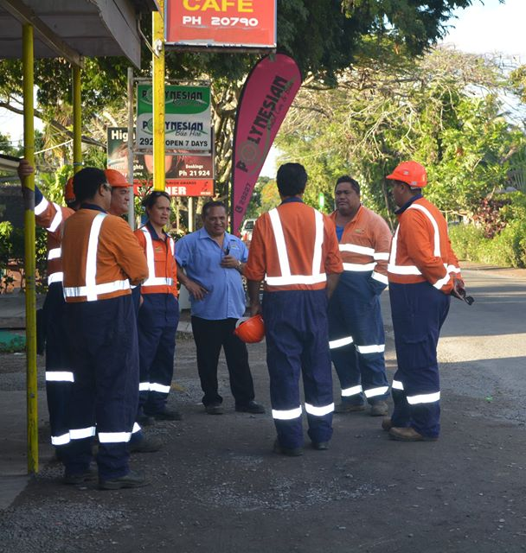
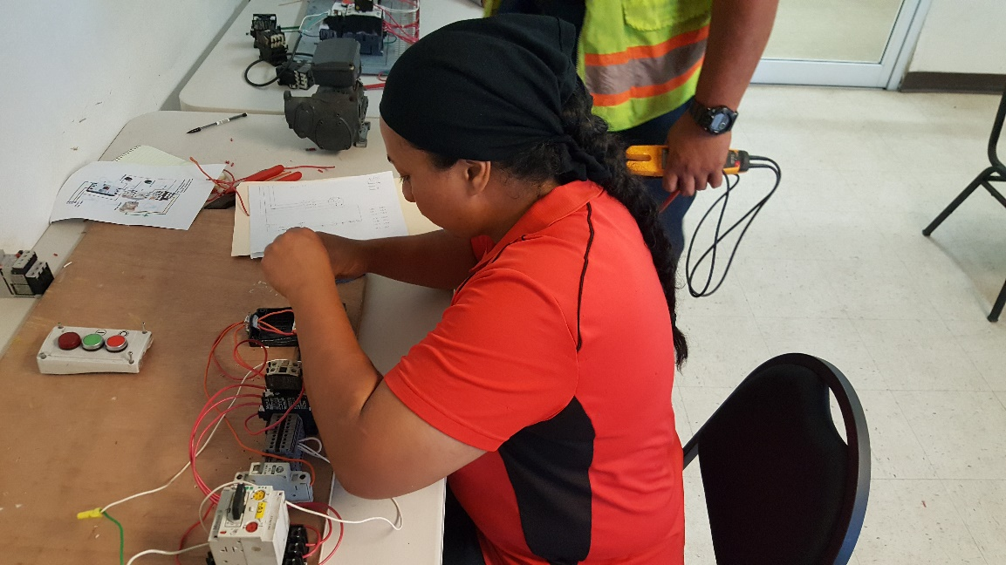
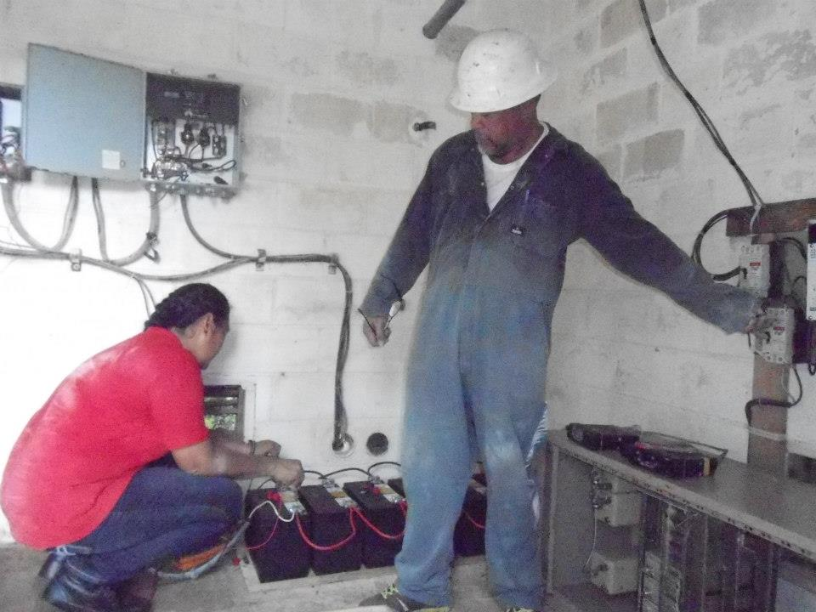
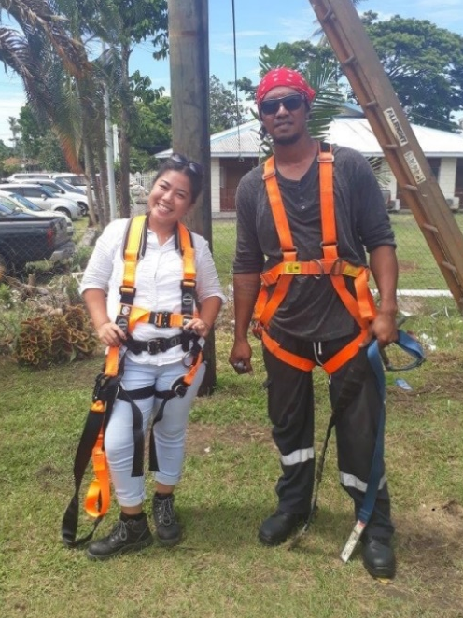

Slide 8
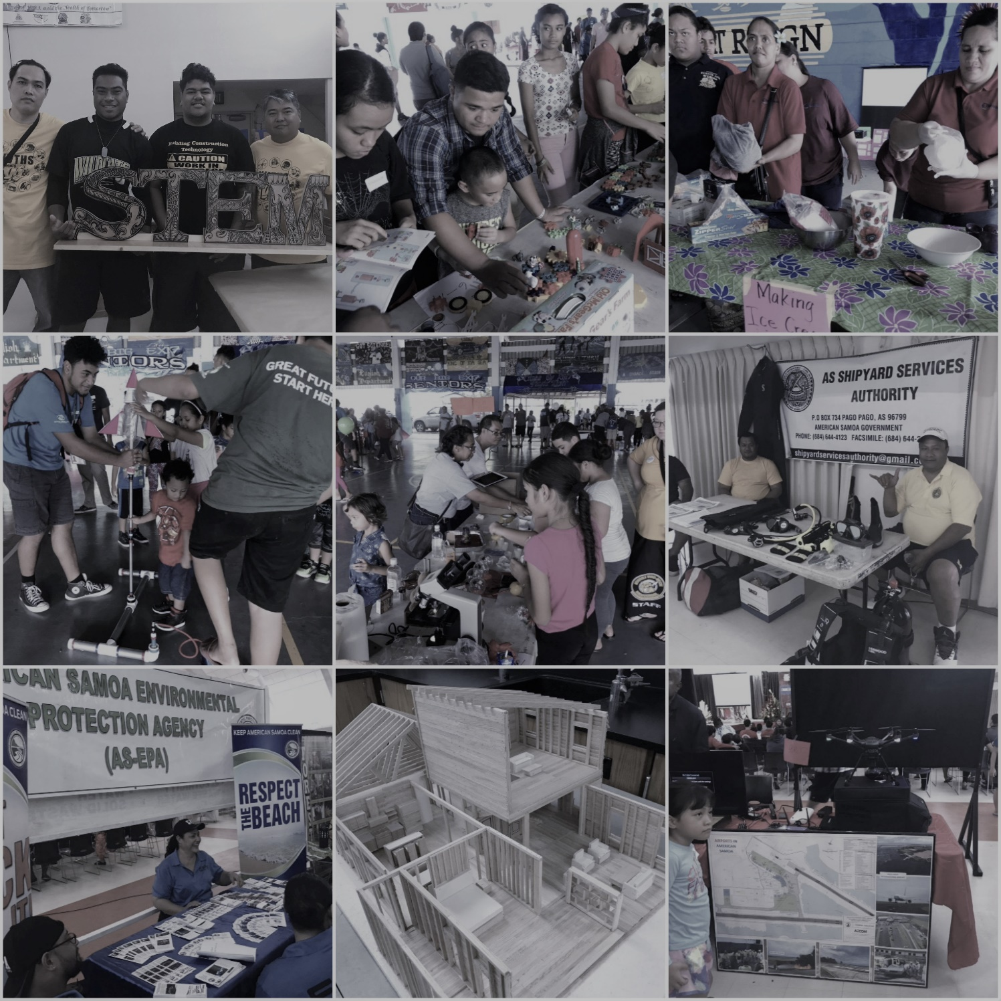
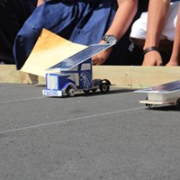

Slide 9
