Slide 1
Yap Renewable Energy Development Project
PPA Conference Palau 2018
Dean Haley – 28 July 2018

Slide 2
About Entura
One of the world's most experienced specialist power and water consulting firms
Part of the Hydro Tasmania group - backed by more than 100 years of creating energy and maintaining power and water assets
Services covering every aspect of major power and water projects, from strategy, planning, design and construction through to operation, maintenance, risk management and training
Over 200 staff; expanding business opportunities nationally and internationally
Broad range of clients across the Asia-Pacific region including:
all levels of government
electricity and water utilities
developers
funding agencies (World Bank, ADB)

Slide 3
solutions across the whole lifecycle
Notes:
We partner with clients to deliver practical and commercially sound solutions across the whole lifecycle of power and water assets, helping them to manage risks and achieve valuable outcomes

Slide 4
Hybrid renewables
As the world increasingly embraces renewable electricity generation, and transitions away from costly or emissions-intensive technologies, the need is growing for hybrid renewable energy assets that combine multiple forms of generation and storage.
Our services include:
renewable energy roadmaps, conception and master planning
feasibility studies and concept designs
power systems and grid connection studies
due diligence assessments
tender and bid responses
planning and environmental approvals
front-end engineering design including power systems modelling, integration design and control design and interface specification
detailed designs, technical specification, procurement and factory testing
control code and HMI (operator screen) design and preparation
owner’s engineer role
project management of site works including construction, installation, pre-commissioning, unit commissioning, system integration commissioning and initial operation
asset management plans
operator training
remote system support
web dashboards and app development for mobile devices

Slide 5
Renewables are our future
Yap State Renewable Energy Transition in Partnership with ADB and FSM

Slide 6
Presenter - Dean HAley
Renewable Energy Engineer with Entura
Entura were awarded the Design and Construction Supervision (DSC) contract on 29th April 2014
My role in this project was YREDP Team Leader
Implementing Agency – Yap State Public Service Corporation (YSPSC)
Faustino Yangmog – General Manager
Victor Nabeyan – Assistant General Manager and PMU Project Manager
Vincent Bouet – YSPSC Chief Engineer
Funding Agency - ADB
Energy Specialist - Mike Trainor

Slide 7
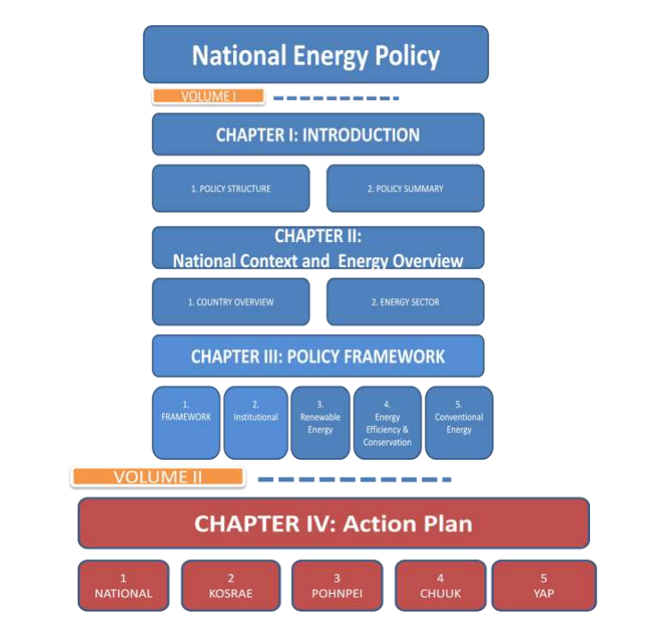
National Energy Policy

Slide 8
Yap State Energy Action Plan
The National Vision statement for Energy is
To improve the life and livelihood of all FSM citizens with affordable, reliable and environmentally sound energy.
The National Objective for Energy is
To promote the sustainable socio-economic development of FSM through the provision and utilization of cost-effective, safe, reliable and sustainable energy services.
Yap State’s Energy Action Plans
To become less dependent on imported sources of energy by having an increased share of renewable energy sources
30% of energy coming from renewable sources by 2020
50% improvement in energy efficiency by 2020
50% of energy coming from renewable sources by 2030

Slide 10
The Entura Team

Slide 11
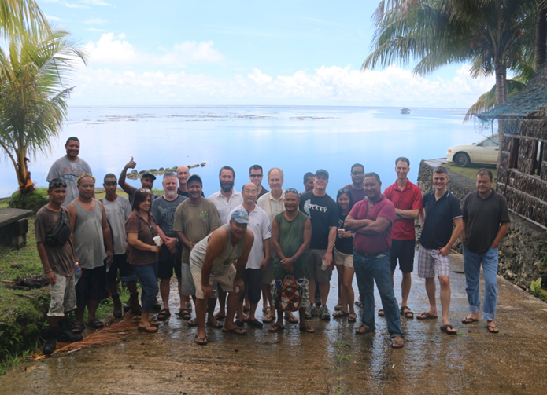
Working Collaboratively with yspsc

Slide 12
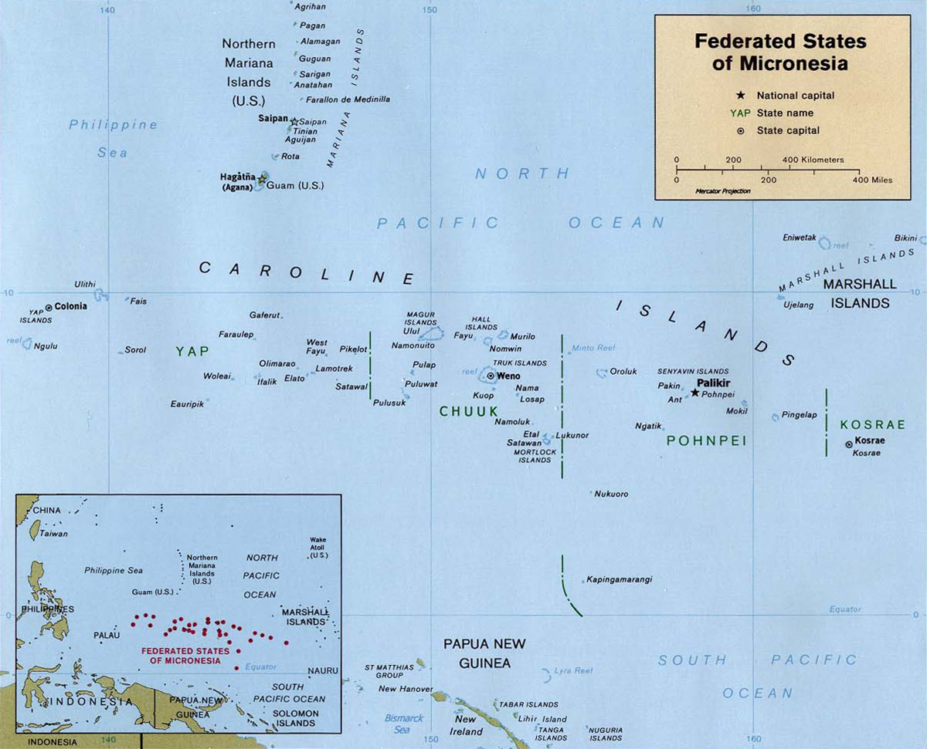
Yap located in the caroline islands

Slide 13
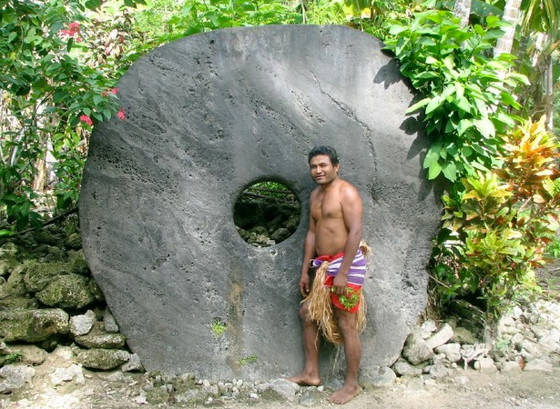
Yap - A Traditional Island capable of modern transition

Slide 14
A Modern fully Integrated Hybrid RE Power System

Slide 15
Scope Of Works
Wind resource and energy estimate feasibility confirmation
Power System Studies
Confirm and Develop Power System Architecture
Procurement Planning
Preparation of both Technical and Commercial Bidding Documentation
Bidding process including bid evaluation
Owners Engineer during detailed design
Social safeguards planning and implementation monitoring
Environmental safeguards planning and implementation monitoring
Construction Supervision
Witness Commissioning and Acceptance

Slide 16
Combining Resources to reduce variability
Combining resources to reduce variability.
Solar and wind resources are often negatively correlated: Solar power peaks in the summer, whereas wind tends to peak in the winter. On the other hand, solar power peaks during the day, while winds tend to be stronger in the afternoon and at night. These correlations make it possible to mix wind and solar resources to yield a combined power output that mimics the demand curve, a phenomenon called natural balancing
Wind and solar energy is a fast-growing share of the global energy mix. But integrating them into power-system operations requires significant adaptations to compensate for their variability. Solutions include increasing the amount of flexible generation within the system, combining, and dispersing variable resources to smooth aggregate output, expanding the transmission network, using smart technology to control supply and demand, and storing electricity.

Slide 17
Power System Studies – Grid Stability
To estimate the future high renewable penetration power system performance, four worst-case scenarios were conducted and studied:
Wind farm trip with a single diesel online
Wind farm trip with two diesels online
Colonia feeder trip with a single diesel online
Colonia feeder trip with two diesels online
These simulation scenarios showed that the system frequency and voltage will venture outside their normal operating limits during critical events.
Installation of high speed diesel engines will provide Yap power system with fault ride through capability during the critical events with minimal or no loss of customer load.

Slide 18
RE Integration
Wind and solar energy is a fast-growing share of the global energy mix. But integrating them into power-system operations requires significant adaptations to compensate for their variability. Solutions include increasing the amount of flexible generation within the system, combining, and dispersing variable resources to smooth aggregate output, expanding the transmission network, using smart technology to control supply and demand, and storing electricity.

Slide 19
Automated Integration and Control System
The control systems of today’s smart power-distribution grids have evolved significantly. Such systems improve system reliability by reducing the frequency and duration of outages. They also optimize asset utilization and increase power quality. But the scale of automation and the ultimate configuration of the system need to be considered carefully with each client. The decision to proceed must be based on a sound economic evaluation; it cannot simply echo the mantra of automation.

Slide 20
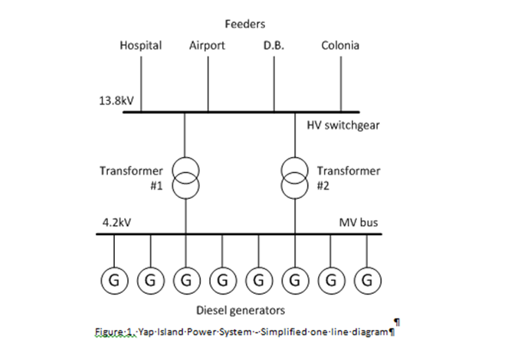
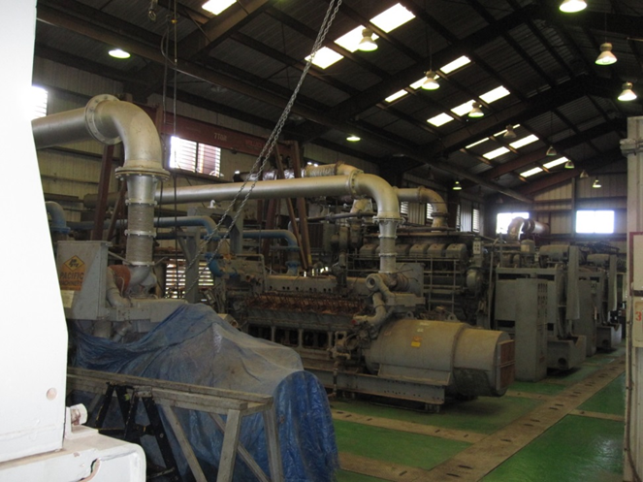
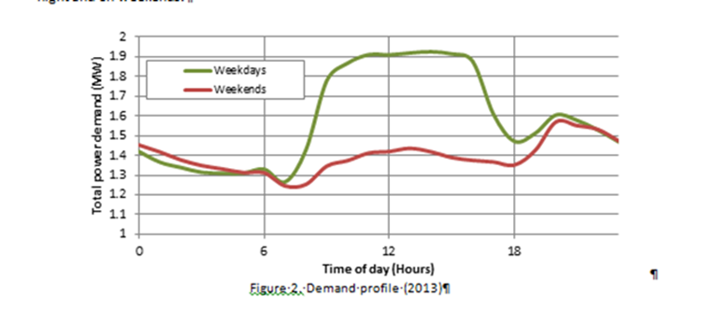
Original Power House

Slide 21
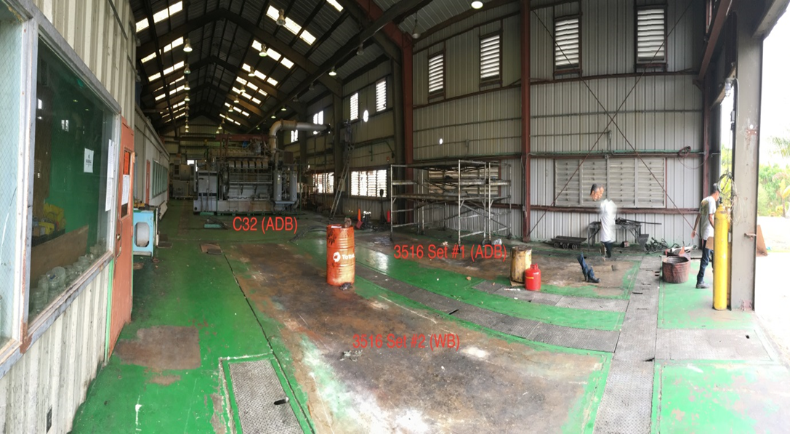
Removal of Redundant Diesel Generators

Slide 22
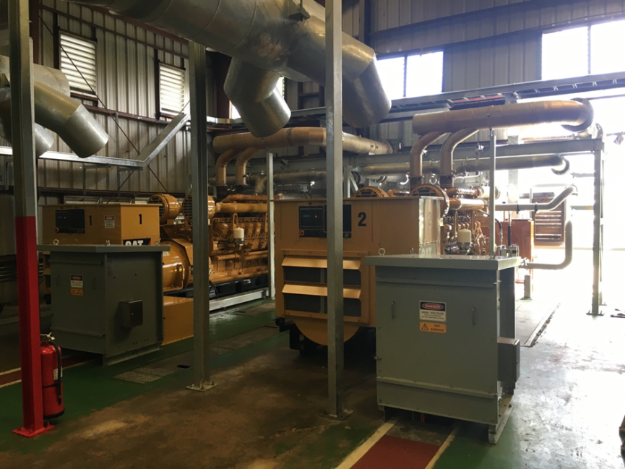
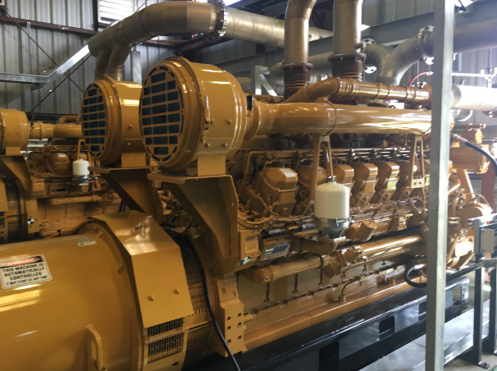
Replace With New High Speed Diesel Generators
2 * 1650kw Cat 3615C Diesel Gensets

Slide 23
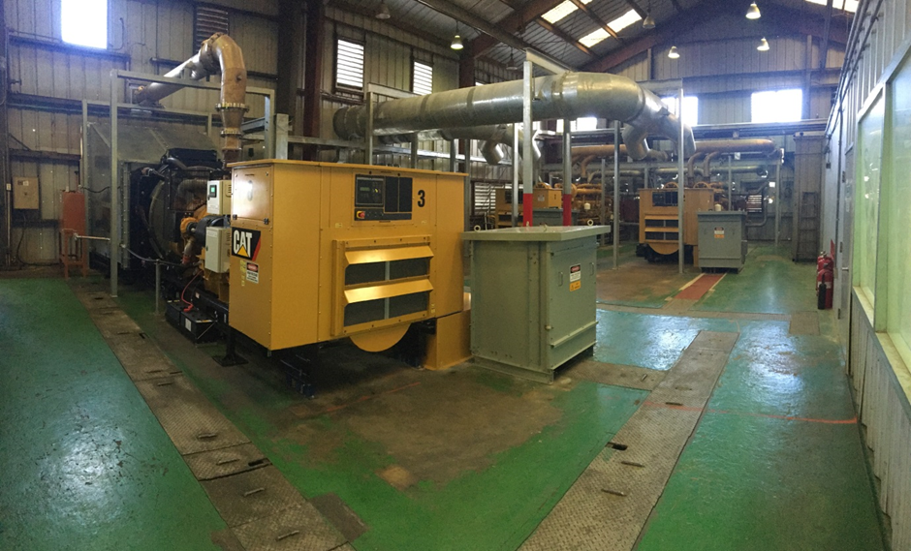
High speed Diesels
1 * 800 kw Cat Diesel genset

Slide 24
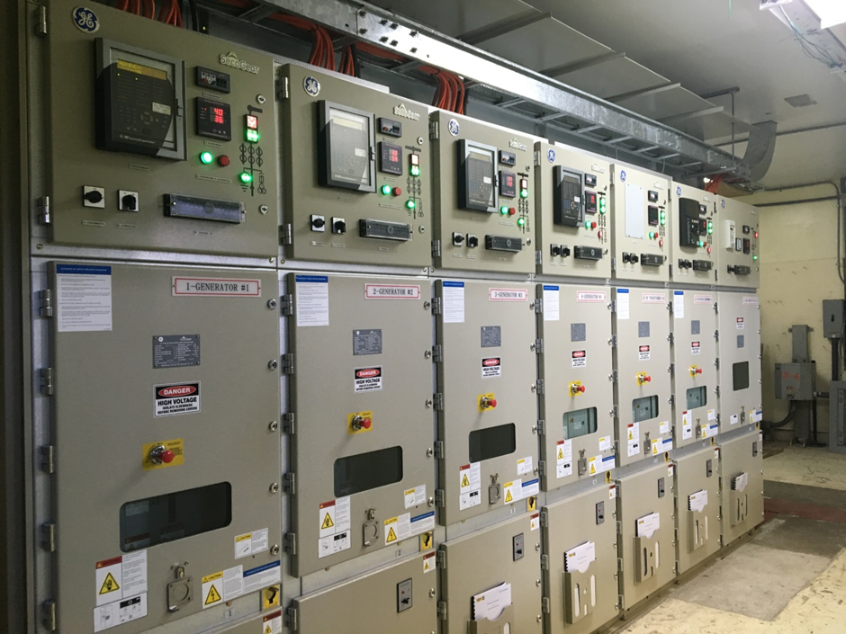
Replace redundant Switchgear with New MV Switchgear

Slide 25
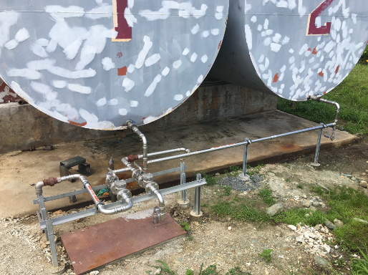
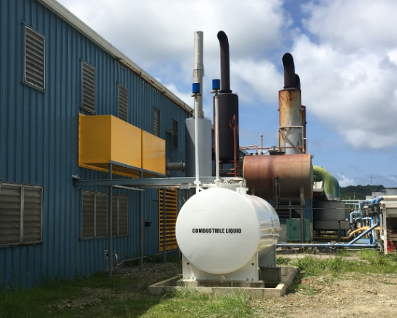
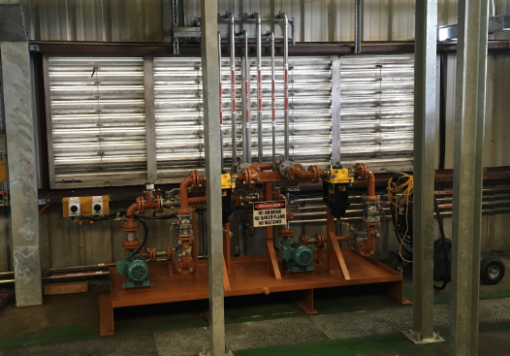
Upgrade to the fuel Storage and Transfer System including Installation of New Day Tanks

Slide 26
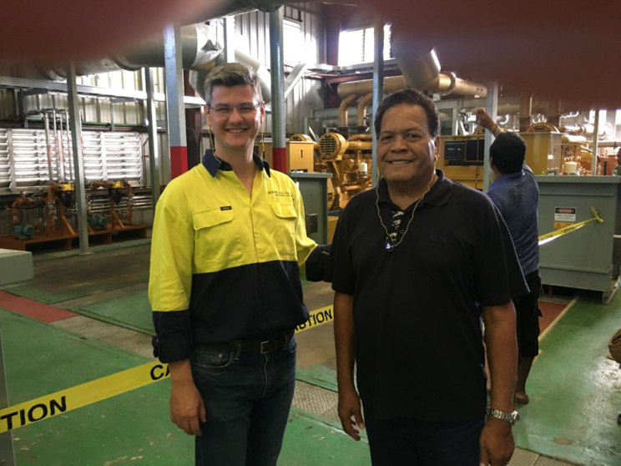
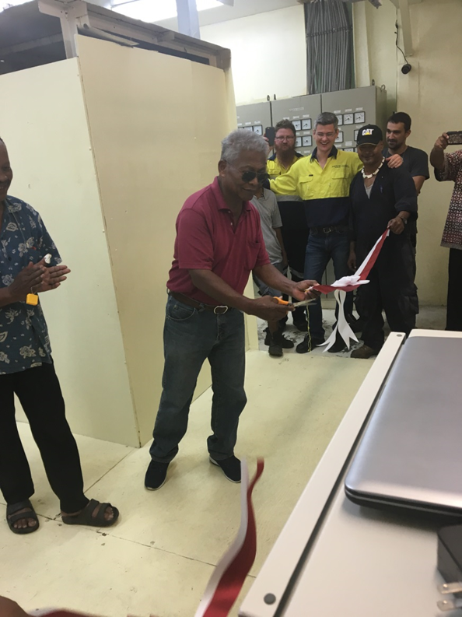
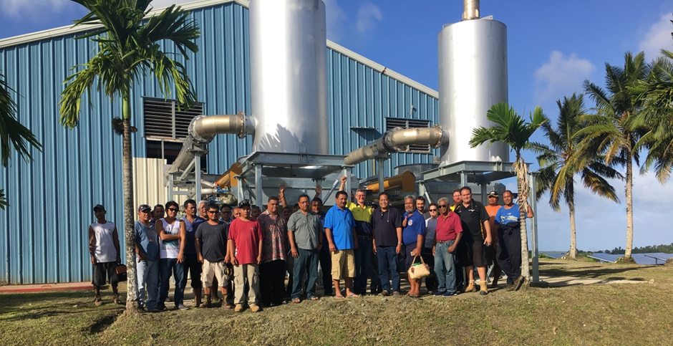
Power House Commissioning

Slide 27
Community consultation

Slide 28
Wind Power
3 * 275 kW Vergnet wind turbine generators
Key features
Guy wired tilt down tower for typhoon survival
Tilt down allows for ease of construction, operation and maintenance
Smaller crane size required than for typical monopole wind turbine towers.

Slide 29
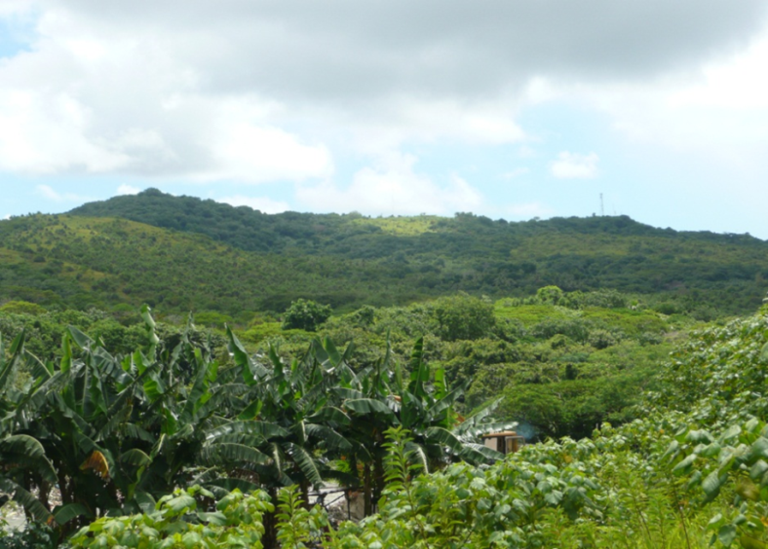
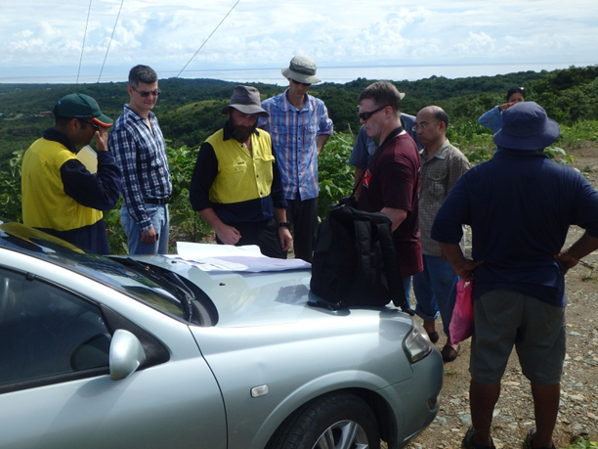
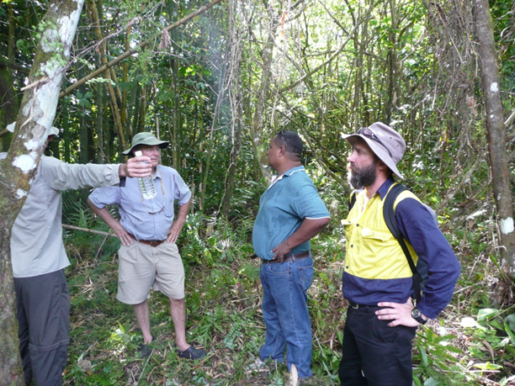
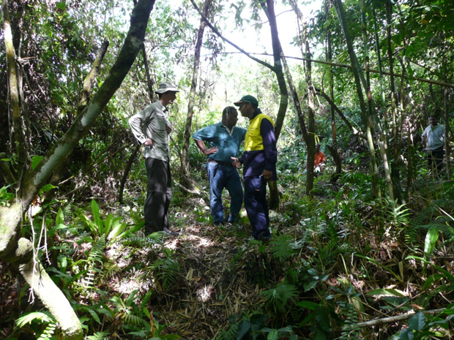
Wind turbine Site identification and identification of constraints

Slide 30
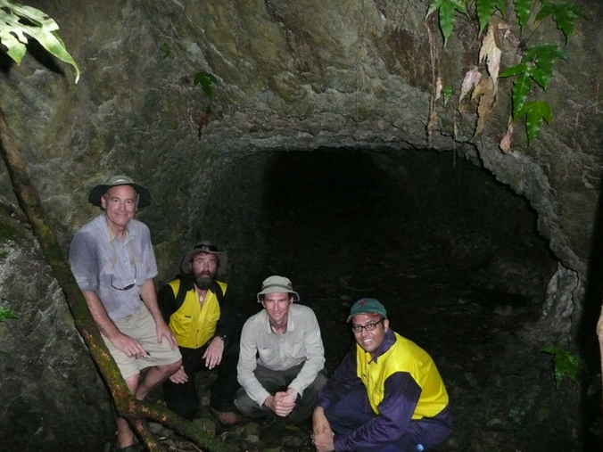
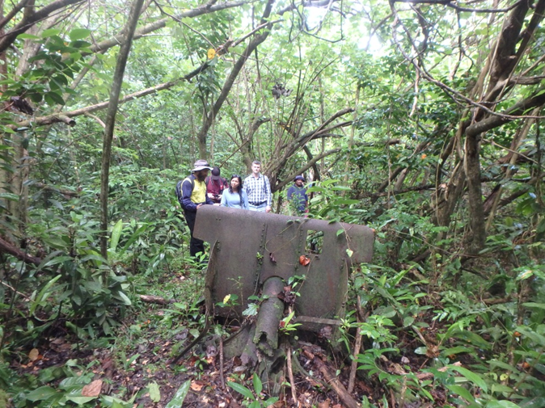
Identification and Protection of Historical Sites for preservation & Environmental Safeguards

Slide 31
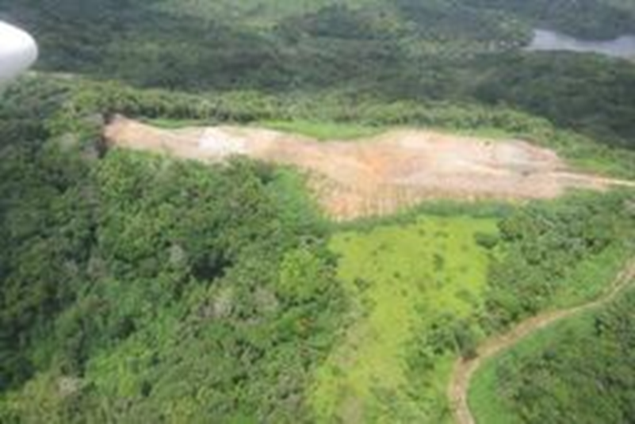
Windfarm Site Clearance

Slide 32
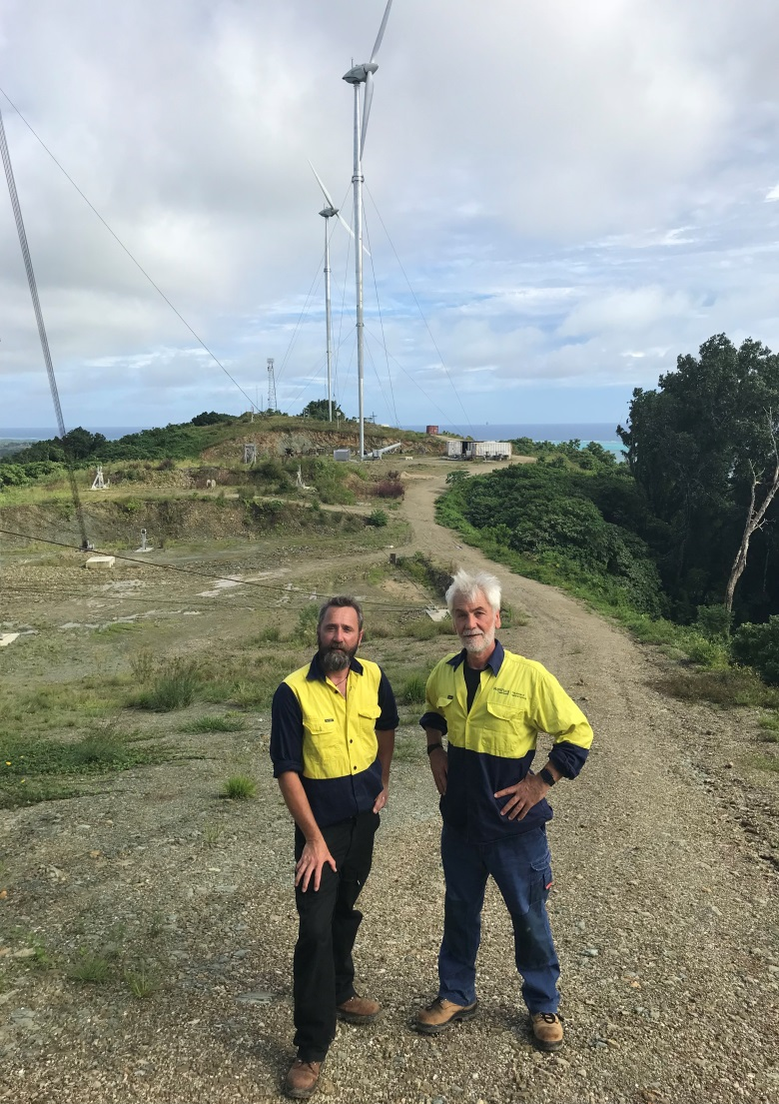
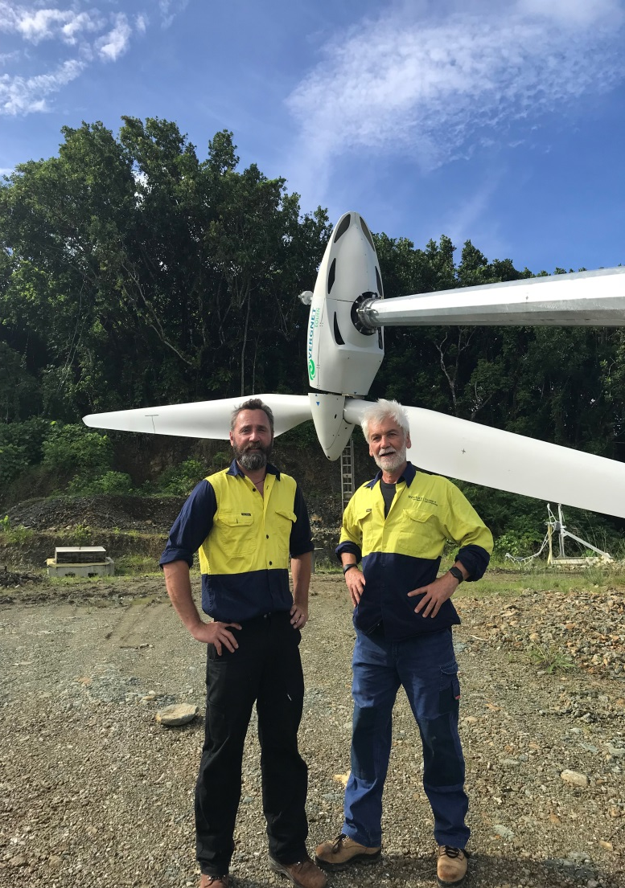

Slide 33
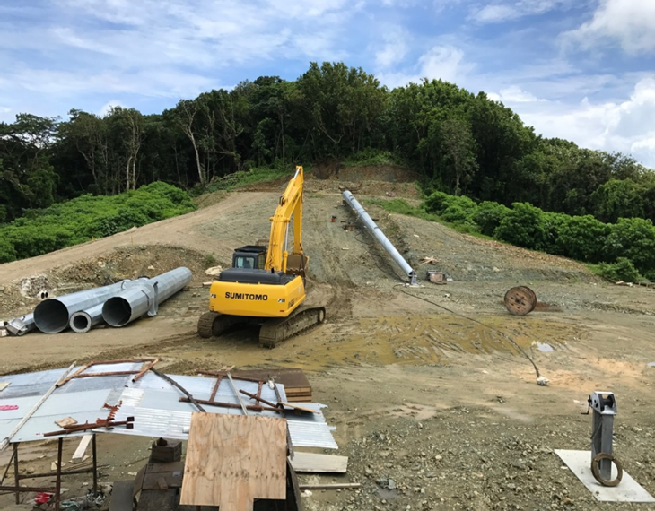
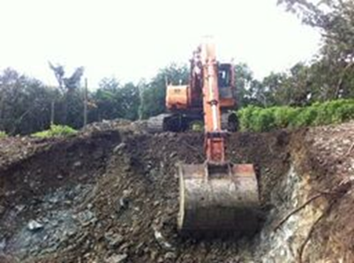
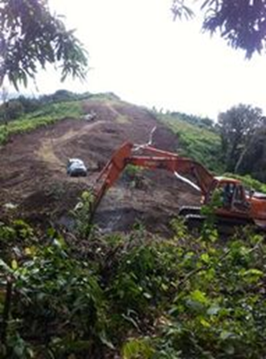
Windfarm Construction

Slide 34
Solar PV
 | Existing PEC Solar to be integrated New Grid Connected Solar PV Total Solar PV | 200 kWp 308.5 kWp 508.5 kWp
1 | Sports Complex | 194.5 kWp
2 | Public Safety Building | 25 kWp
3 | Early Childhood Education Building | 50 kWp
4 | Water Treatment Plant | 13 kWp
5 | Public Works Building | 26 kWp

Slide 35
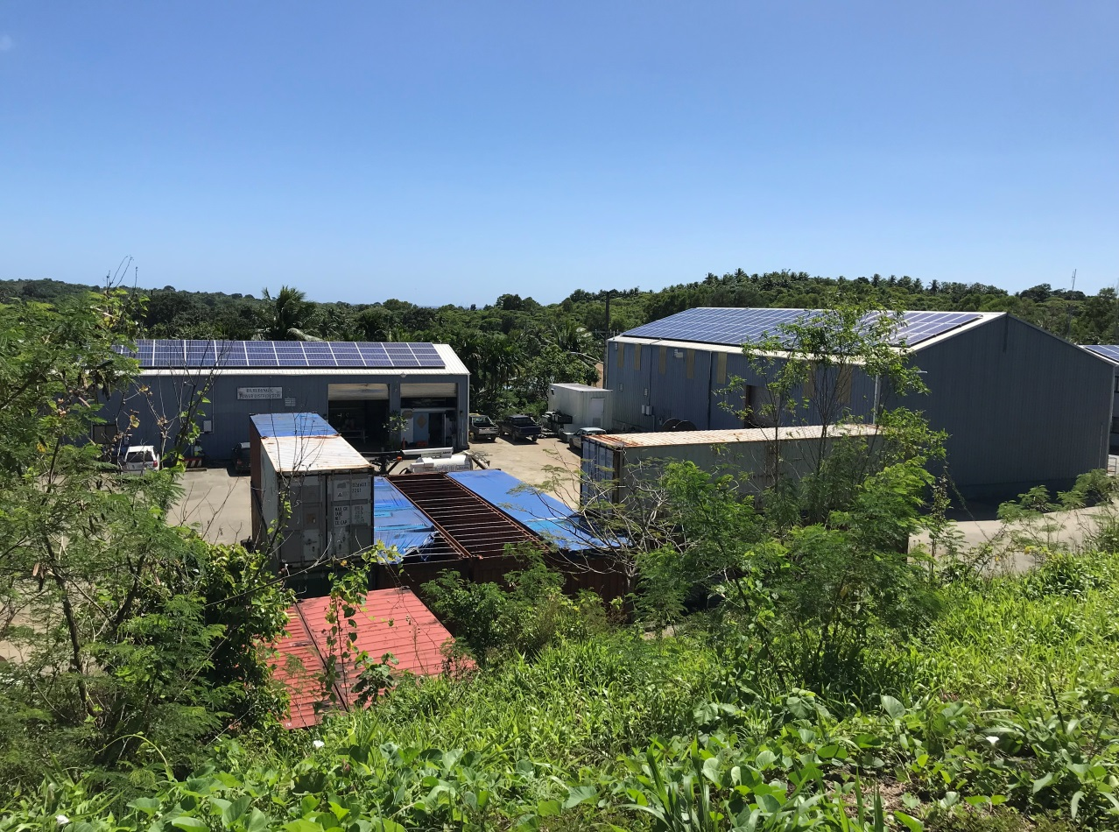
Existing PEC Solar 200 kw

Slide 36
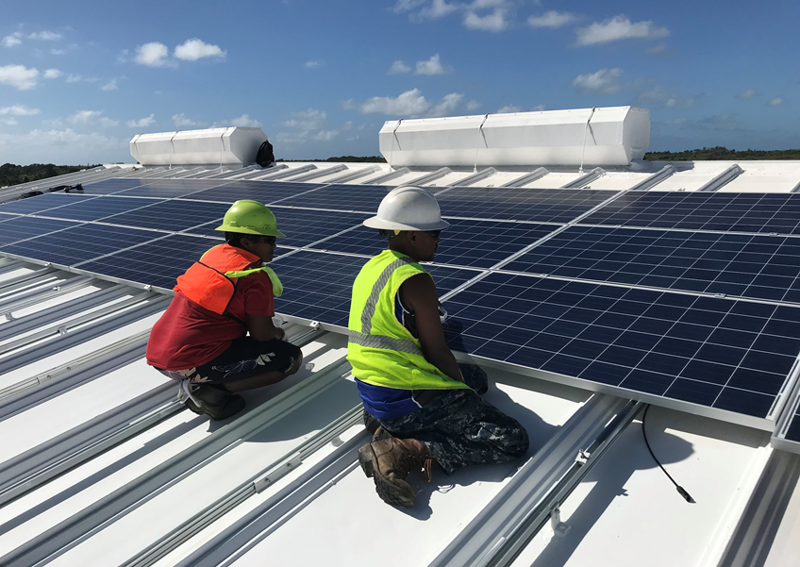
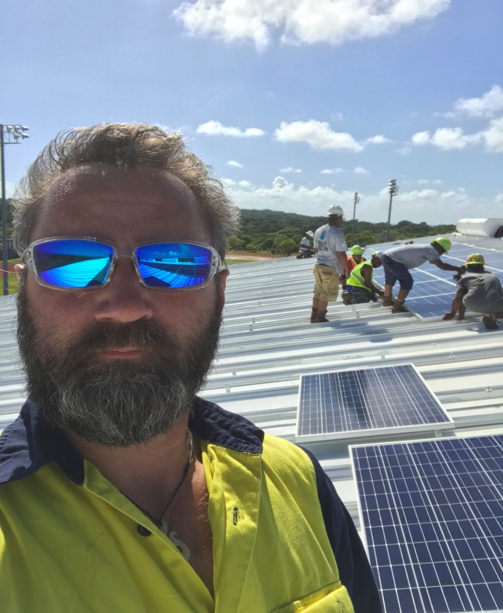
Sports Complex 194.5KW

Slide 37
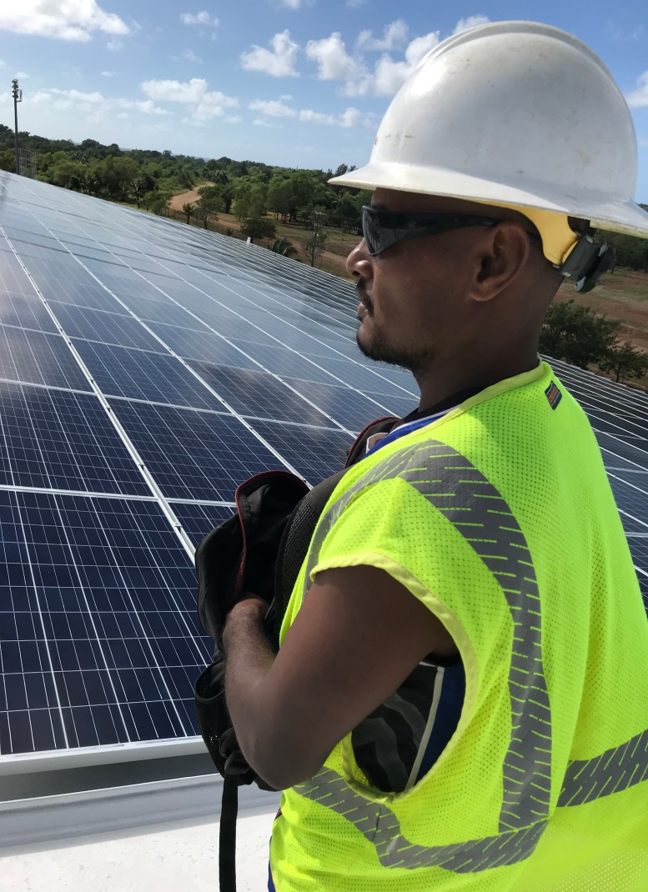
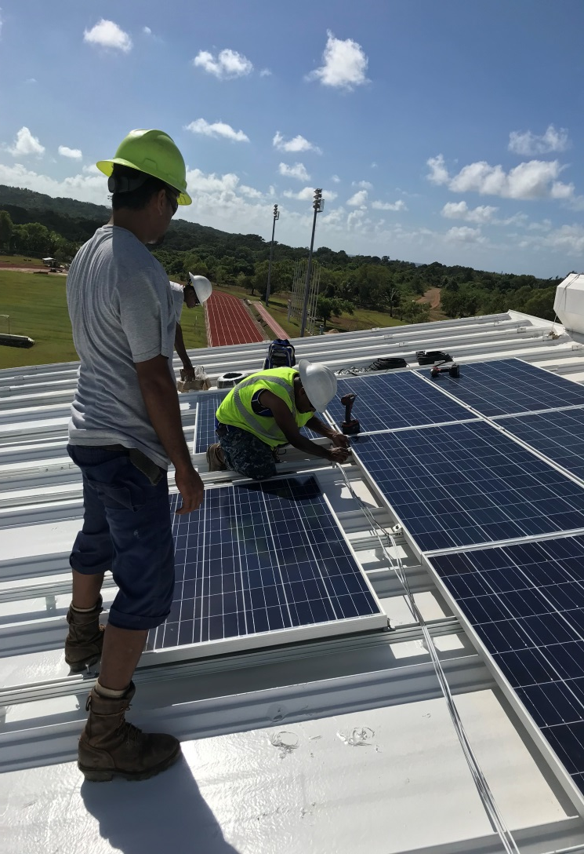
Solar Installation by YSPSC

Slide 38
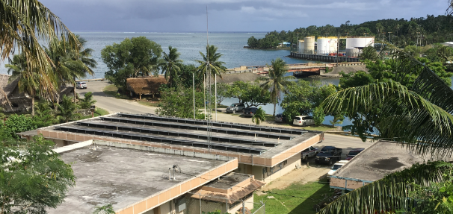
Public Safety Building 25kW

Slide 39
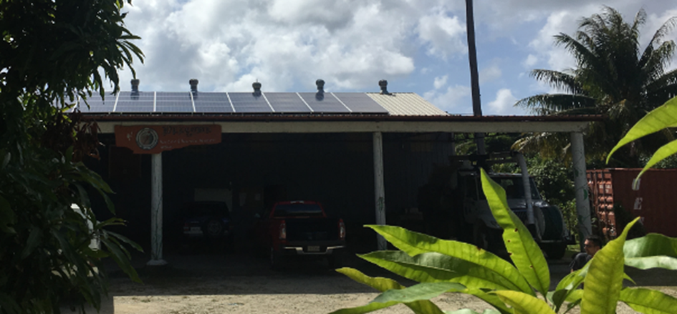
Water Treatment Plant 13 KW

Slide 40
Civil Engineering and Maintenance Building 26 kW

Slide 41
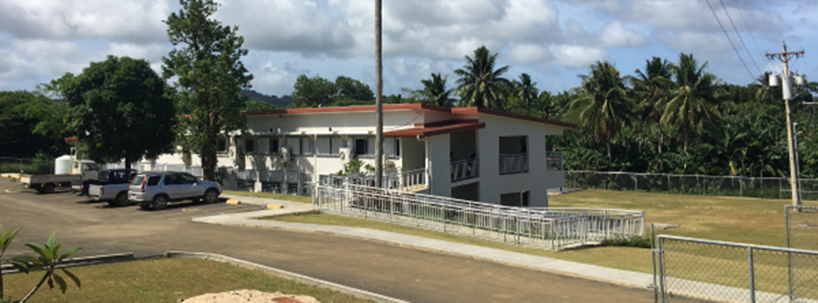
Early childhood centre 50 kW

Slide 42
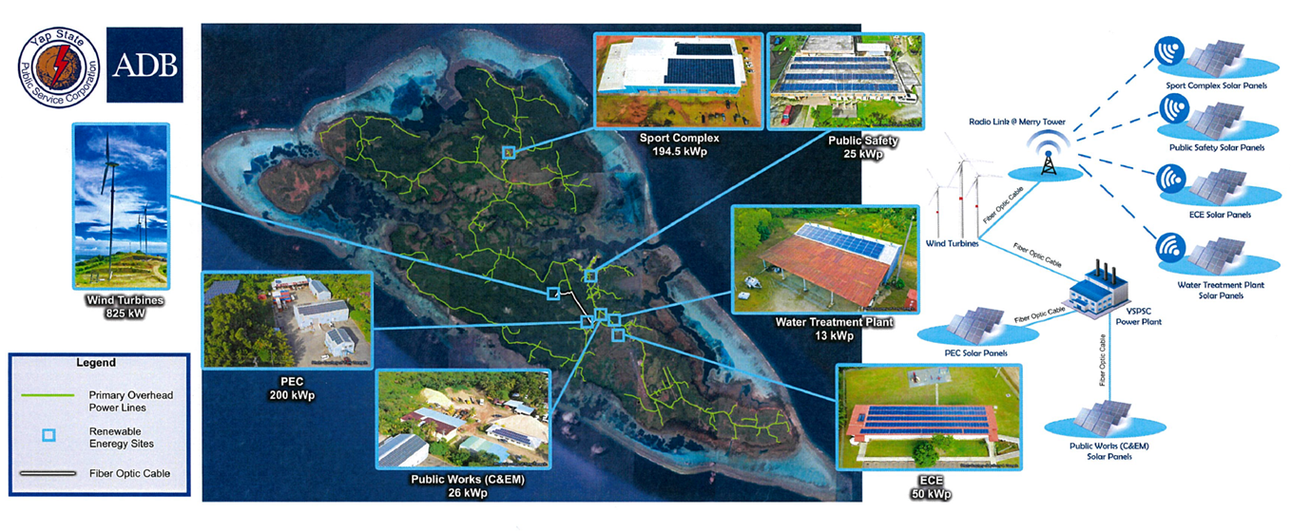
Island Wide Communications Network

Slide 43
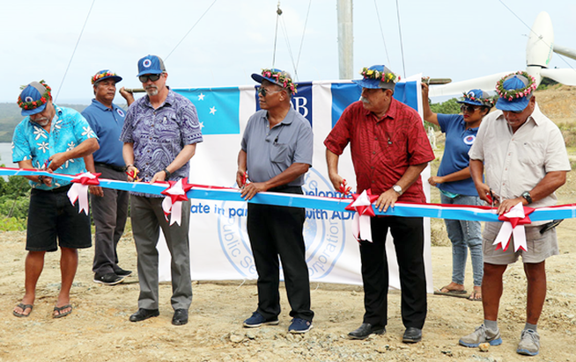
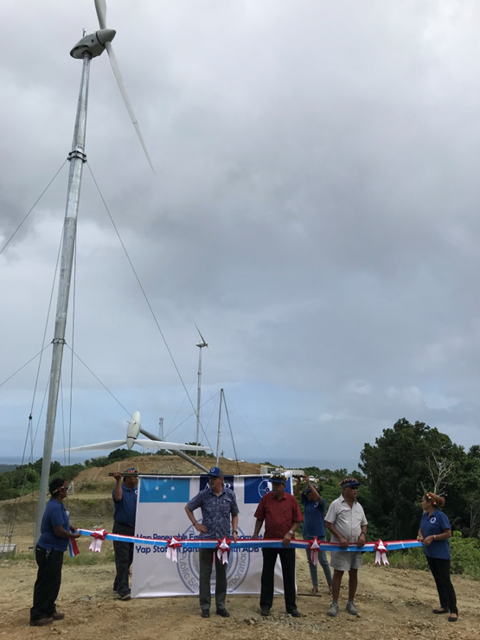
Opening Ceremony
Left to Right – Hon. Ted Rutun (Yap Legislature Speaker), Jim Lynch (Deputy Director General, Pacific Department, ADB), Hon. Tony Ganngiyan (Yap Governor), HE Peter Christian (FSM President), James Gilmar (Chairman, YSPSC Board of Directors).

Slide 44
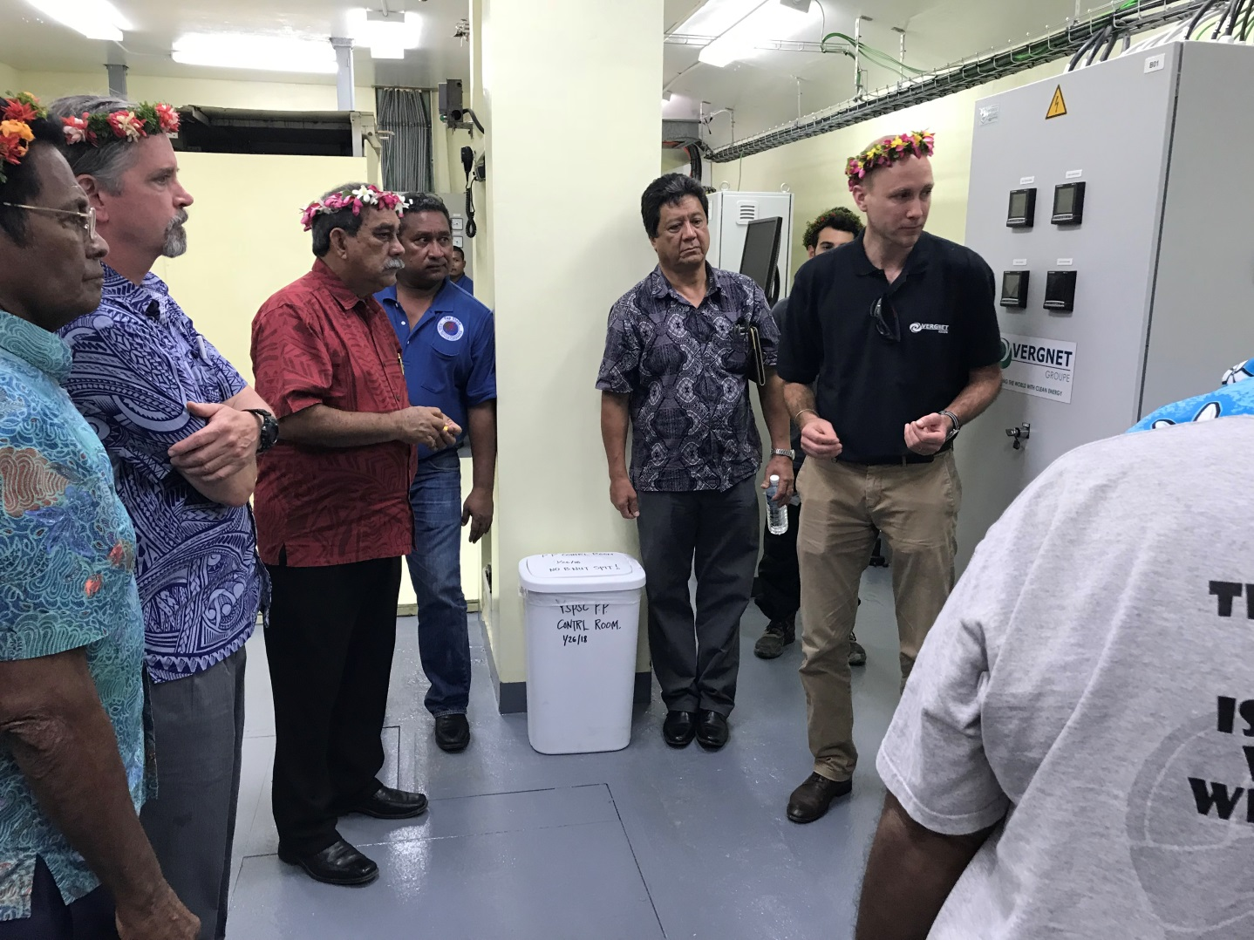
Integration And Control

Slide 45
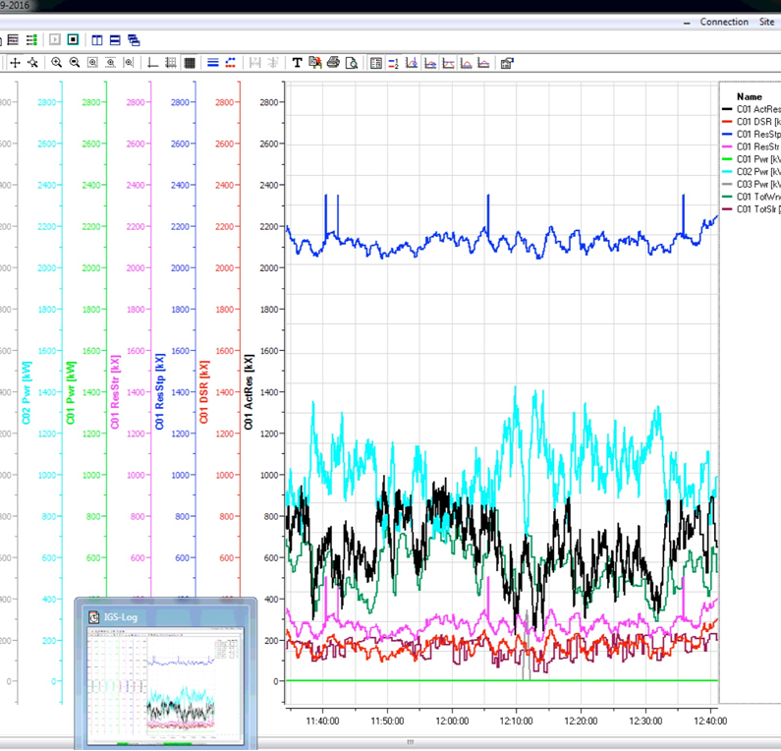
Current performance – 1 hr period

Slide 46
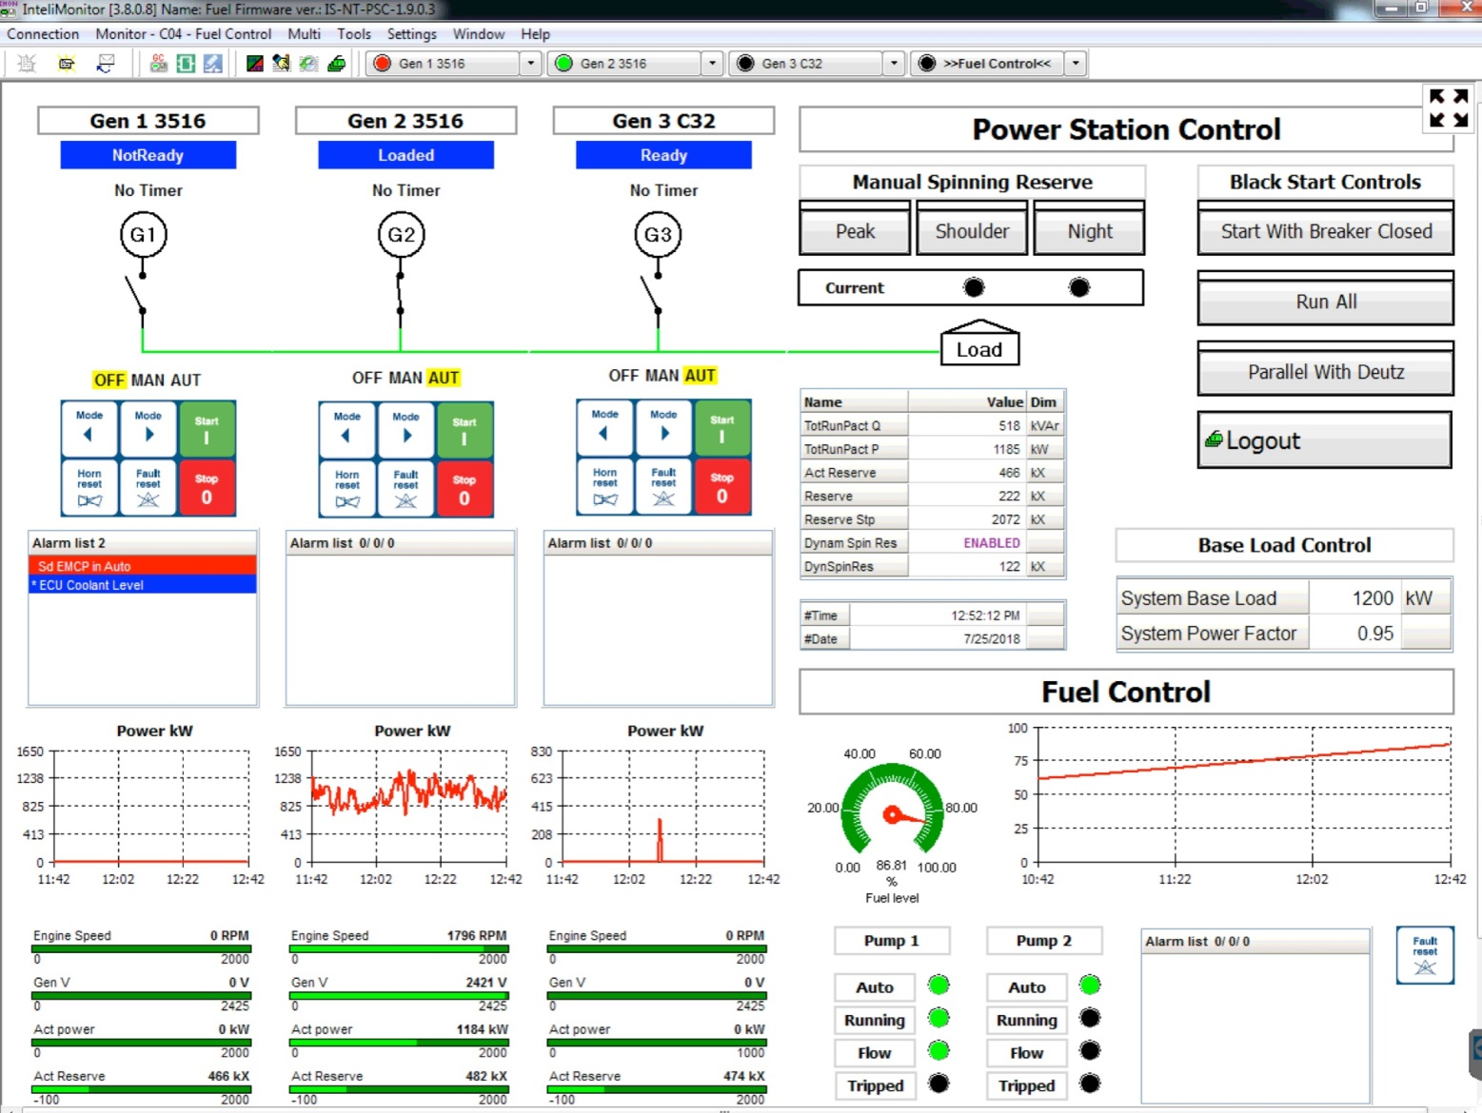
Operation

Slide 47
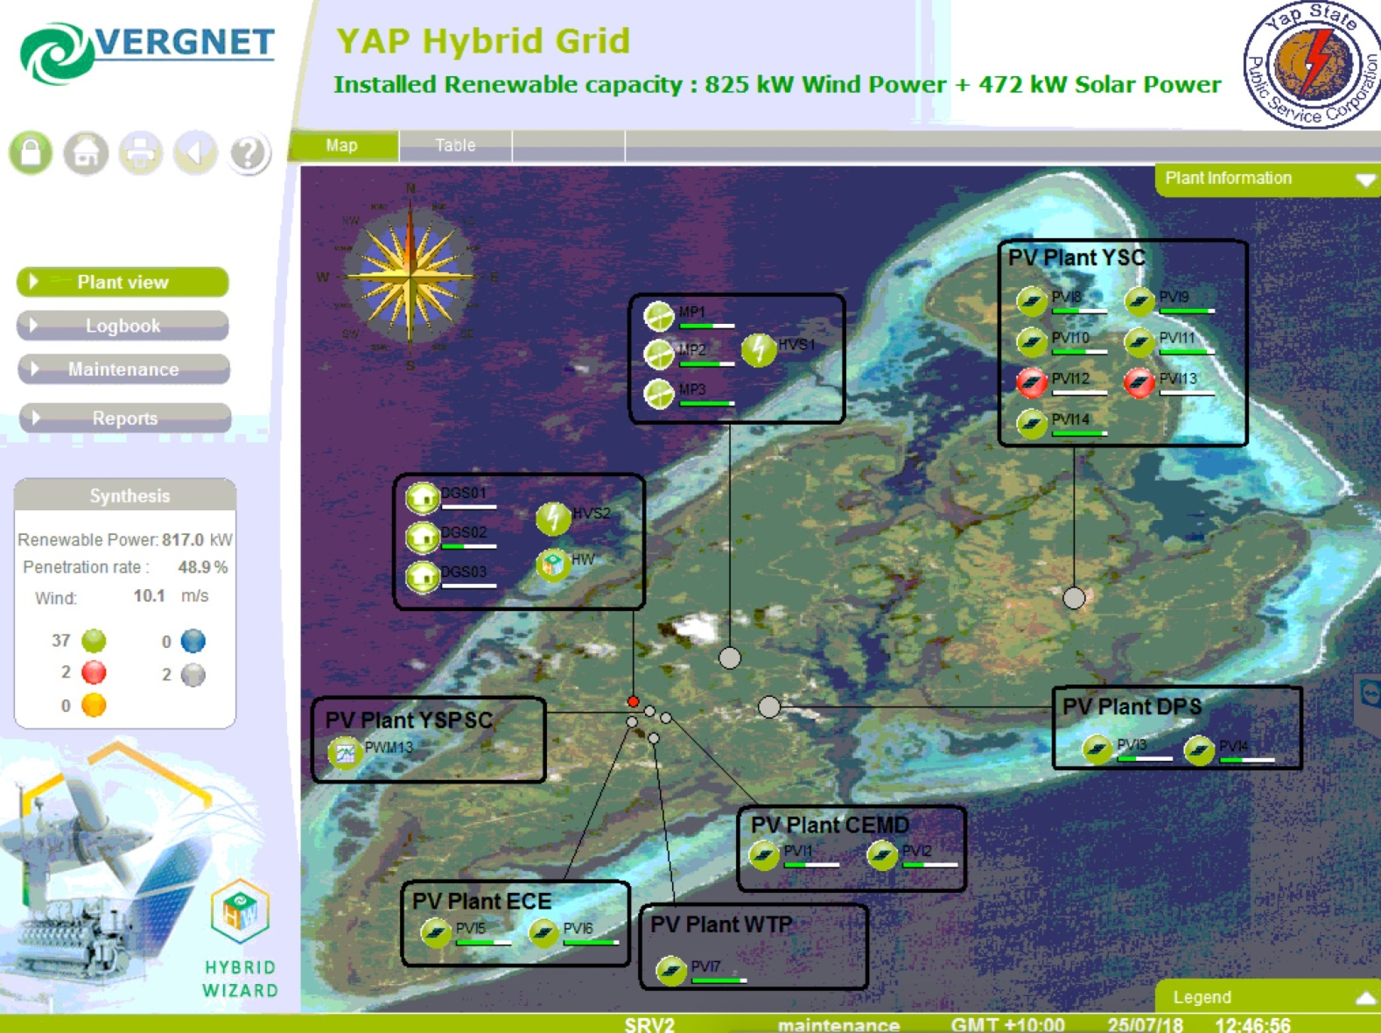
Hybrid Grid

Slide 48
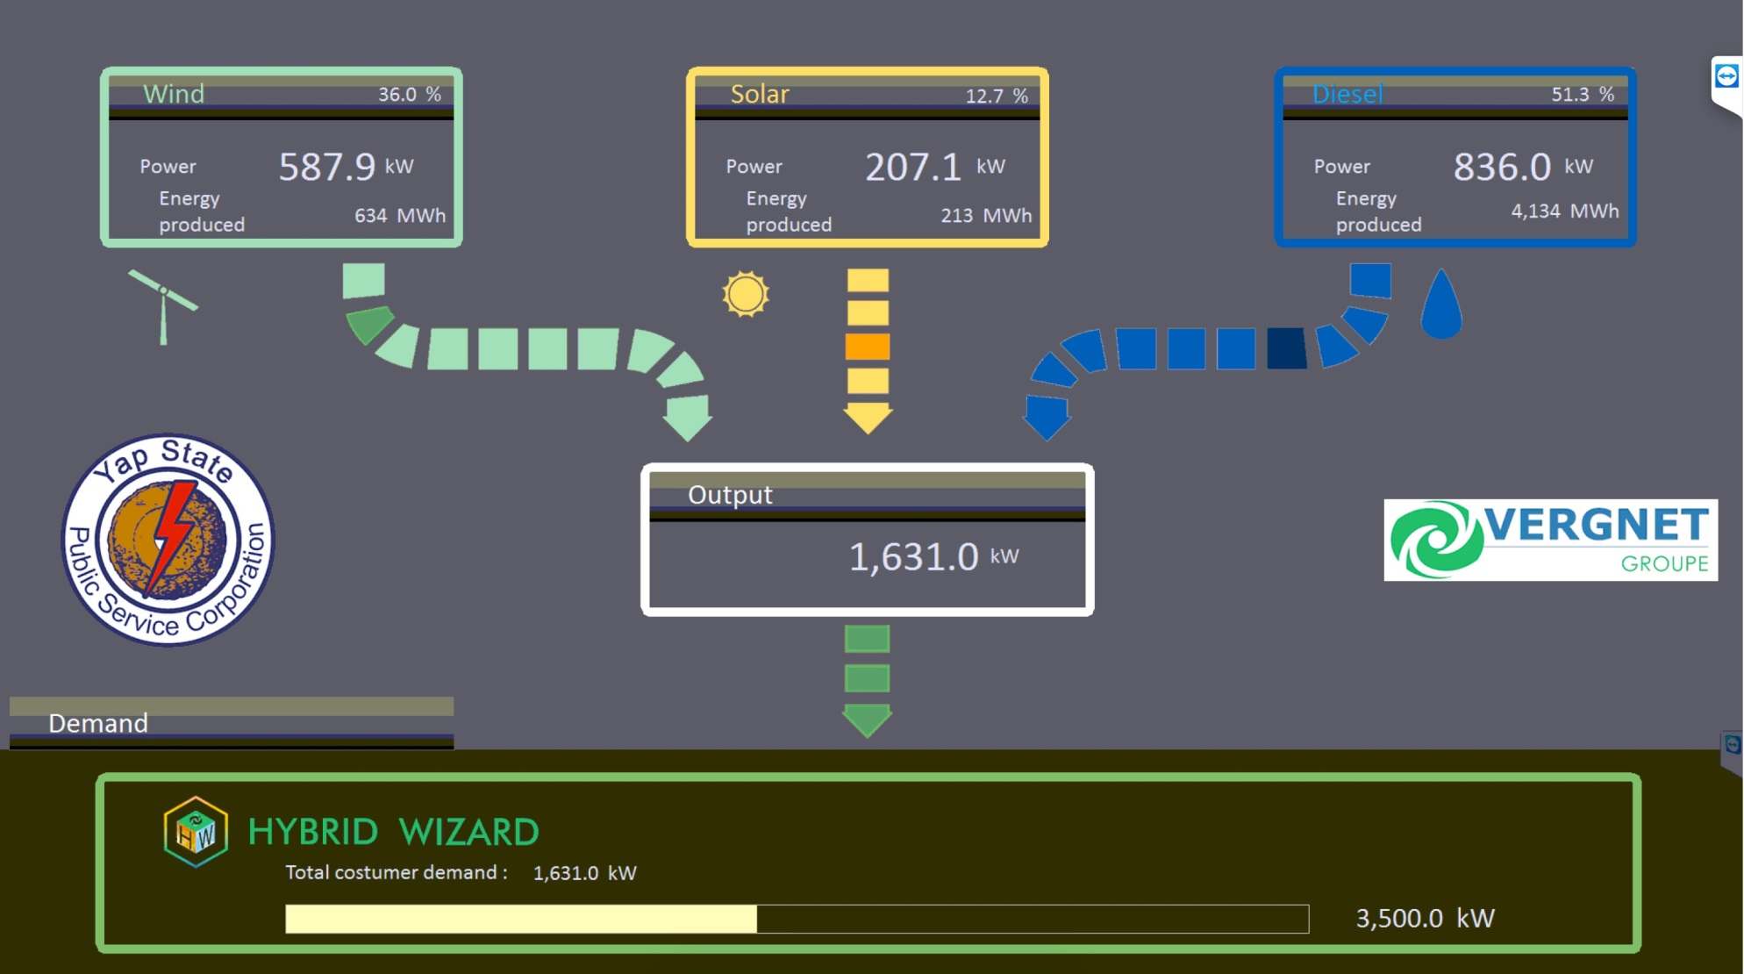

Slide 49
Achievements to date
Since the commissioning, no outage has been attributed to the introduction of the renewable energy facilities, Wind & Solar.
The reliability was not impacted.
The weather conditions were not favourable to produce important renewable energy. A few windy conditions, with a lot of variability of RE have shown that the supervision and control system is performing as expected, curtailing RE if necessary to keep stability and diesel generator(s) under minimum load.
The Dynamic Spinning Reserve plays its role and we can observe the small peak generator coming on line when necessary.
The system reached 60% of RE penetration without any energy storage.
Under particular conditions, the small peak generator connects & disconnects quite often, thus we look forward to the introduction of an Energy Storage System.
The full RE potential will be observed during the trade winds season. At present, the rainy season shows limited RE production in very few occasions.

Slide 50
Diesel Displacement
Average diesel displacement:
So far, the wind farm has produced 602 MWh
MP1 318.4 MWh
MP2 135.1 MWh
MP3 148.5 MWh
The solar farms (ABD project only, PEC excluded) have produced 264.167 MWh since their installation.
Approximate Diesel Displacement so far:
866167 kWh / 14 = 61,869 US Gall. @ $USD3.9/ gallon - $USD241,3000
Diesel displacement in non-wind period ie Solar only:
264167 kWh / 14 = 18,869 US Gall

Slide 51
Ingredients For Success
Commitment from National and State Governments
Capable and Competent Executing Agency
Executive management
Operational management
Operators
Community Engagement
Renewable readiness
Acceptance, Resilience and Preparation for Disruption

Slide 52
Contacts
Dean Haley – Senior Project Manager
E: dean.haleyl@entura.com.au
P: +61 (0)407 515 447

