Slide 1
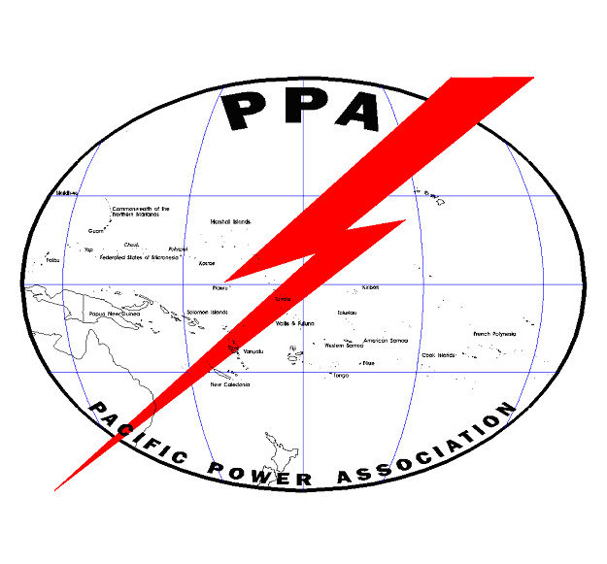
Grid Connected PV Overview

Slide 2
Solar on the Grid Experience
Over 30 years of commercial experience
Over 1000 GW of solar panel capacity is estimated to be installed and connected to the grid in the world with most of the capacity in Europe, Japan, USA, Australia, India and China.
Over 50 MW of grid connected solar is installed or committed in the Pacific Islands

Slide 3
Variability of solar input
Output from the solar installation that rapidly varies is caused by the passage of clouds over the solar generators. If generation is by a large array, the cloud will simultaneously reduce the solar generation of all the solar panels.
If generation is dispersed over a wide area, the cloud will only affect a few panels at a time and overall solar generation will change more slowly and with lower variation.

Slide 4
Grid stability issues with
grid-connected solar
Grid stability issues are mostly determined by the speed and depth of power demand changes.
If the engines that are on line cannot keep up with the load changes, the system may trip off line or there may be voltage or frequency variations that exceed system standards

Slide 5
Clear day solar input to the grid

Slide 6
Solar radiation measured on clear and partly cloudy days

Slide 7
Day to day solar variation

Slide 8
Rules of thumb exist for the allowable percentage of solar generation to maintain grid stability. They vary according to the distribution of the solar generation

Slide 9
With one large solar farm and little other solar, about 20% of the noon time load can come from solar without stability issues

Slide 10
With two or three widely separated large solar farms of roughly equal size (more than 5 km separation) 30% to 40% of the noon time load can generally come from solar without stability issues

Slide 11
Solar Array Distribution on Tarawa
Bonriki 500 kWp
Bikenibeu = 400kWp
Betio/Bairiki 548 kWp

Slide 12
With a large number of small scale solar installations spread over the entire load area, over 50% of the noon time load can usually come from solar without stability issues though there should be significant spinning reserve on line.

Slide 13
Why are many dispersed generators less likely to cause stability problems than a few large solar arrays?

Slide 14
Simply because the shadow of the clouds hit panels in different locations at different times. The more dispersed the locations of panels feeding the grid, the less effect there will be on the overall output from the solar.

Slide 15
Planning for increased solar generation on the grid

Slide 16
Because of the problems associated with solar variability when solar is concentrated in a few areas, planning a number of dispersed arrays rather than a few very large arrays that are close together is preferable.
Also smaller arrays may allow using the existing grid system and avoid the construction of new transmission lines from the solar array

Slide 17
Also consider mixing roof top installations on government buildings (e.g. schools, warehouses, etc.) with larger ground mounted arrays.
Encourage (but control) small scale private solar that feeds into the grid

Slide 18
Types of Grid Connected Solar
Solar Thermal Generation
Uses concentrated sunlight to generate heat that is used to generate electricity

Slide 19
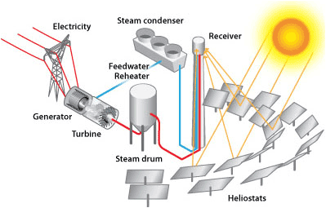
Power Tower Array

Slide 21
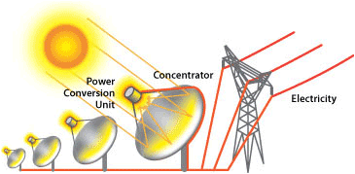
Tracking Parabolic Concentrator Unit

Slide 23
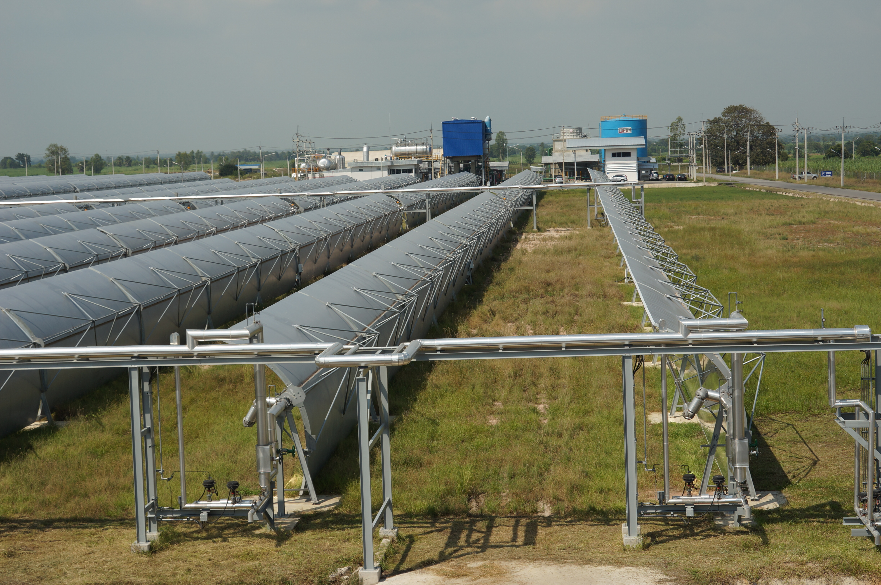
Semi-tracking parabolic
Solar concentrator array

Slide 24
Solar thermal generation is not appropriate for utilities in the Pacific because:
There is zero heat output when a cloud comes across the sun and partly cloudy conditions are the norm in the Pacific
Very high tech with complicated heat transfer systems and sun tracking required
Cost more than other options

Slide 25
Photovoltaics

Slide 26
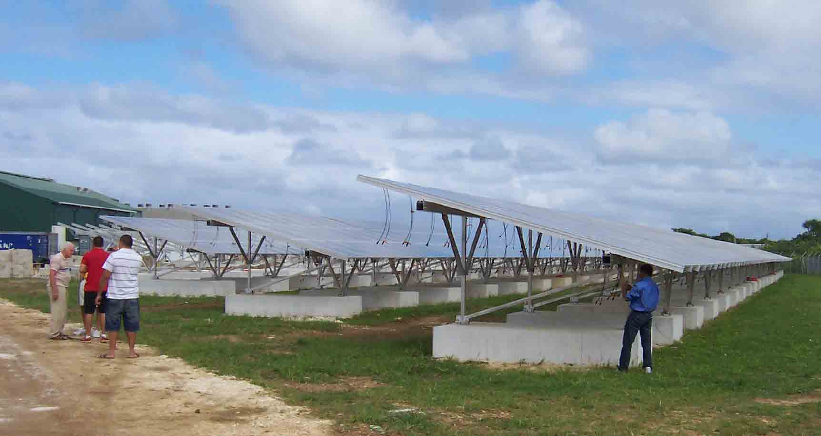
Large Solar Photovoltaic Array

Slide 27
School Roof Installation

Slide 28
Rooftop installation at power plant

Slide 29
Utility Owned Large Arrays
Advantages of installing a few large arrays
Construction management is simplified. All components are installed in just a few locations
Ease of management and maintenance. Everything is easily accessed and system O&M management is simplified

Slide 30
May be lower in per kW cost – but also may be more costly due to added land costs.
Generally easier to get finance for a large array than for multiple small arrays
Large PV arrays look impressive and provide for good PR to government and customers

Slide 31
Disadvantages of a few large arrays close together
More difficult to maintain grid stability on partly cloudy days
Higher environmental cost due to large land areas cleared for solar arrays
Have a sharp noon time peak

Slide 32
IPP Provided Solar
Independent Power Producers may install solar arrays and sell the power (using a PPA or Power Purchase Agreement) to the utility

Slide 33
Advantages of IPP solar generation
No large capital outlay required by the utility
All land acquisition, financing and construction is typically provided by the IPP as well as all operating and maintenance costs
Predetermined long term cost of energy

Slide 34
Disadvantages of IPP based solar generation
Utility is forced to purchase all the power generated by the IPP or pay a penalty for throttling power at times when having the solar input causes problems
Less flexibility in system design and operating characteristics than for a utility owned system

Slide 35
Lower cost finance may be available to the utility than to the IPP making actual solar power generation cheaper for the utility than for the IPP
The IPP has to make a profit and that becomes part of the power charge and may result in lower profits for the utility or higher costs to the consumer

Slide 36
Advantages of dispersed roof mounted arrays
Few problems with grid stability due to solar variations
The failure of one installation does not seriously reduce the solar input
Can be roof mounted with no land cost
No special transmission lines needed, feed in can be through the existing grid

Slide 37
All installations can be made using identical low power, modular components thereby simplifying spare parts and training requirements
Easier for the power system to absorb a series of small generators than a single large system
Distribution losses are reduced because most if not all of the load is near the site of the generator

Slide 38
Disadvantages of many small roof mounted dispersed arrays
Requires a more complex system for monitoring such as through the cell phone system, the Internet or by using smart meters
Roofs may need to be rehabilitated before installation of panels
More difficult to access panel wiring after installation
May be more difficult to finance

Slide 39
Must deal with many site owners instead of just a few. This problem is minimized if only government owned building roofs are used.
Installers of solar always advise facing panels toward the equator and at a tilt equal to the latitude or 10º which ever is greater. When using roof top solar, there is little control over either the direction the panels are facing or their tilt. Is this a problem?

Slide 40
It is not a problem, it is a benefit!
The output from the combined solar installations that have a random direction and tilt will be much more even over the day than if all panels have the same direction and tilt. This both better matches the daytime load curve and reduces the solar fluctuations over the day. In tropical islands the reduction in output due to tilt or direction that is not optimal is only a few percent

Slide 42
Metering of customers having a roof top solar installation
Options:
One meter that runs backward when solar generates more than the customer uses (cannot be used with prepayment meters)
Two separate meters, one for the solar and one for the total amount used
A smart meter that measures both solar and total use and sends the data to a central location

Slide 43
Two separate meters are recommended
Connect the solar on the grid side of the existing meter and install a new meter that shows the amount of solar electricity sent to the grid
Leaving the existing meter in place measures the total energy used by the customer while the other meter measures the solar that is generated

Slide 44
Subtracting the solar meter reading from the main meter reading gives the net amount owed. If the number is negative, then some sort of credit or payment is usually given for the excess solar electricity that was generated

Slide 45
Connection Arrangement

Slide 46
Benefits of connecting the solar directly to the grid
It allows the utility to have a strong say in the standards and components used in the installation
The utility cannot be held liable for fires or other problems in the building
Data is available both for the solar connected to the grid and for the total usage of customer facilities

Slide 47
With a single meter that runs backward when there is excess solar generation, the end user will not be able to easily tell whether or not the solar is working properly
Without knowledge of total usage it will be difficult to carry out DSM projects
Without knowledge of energy flows in feeders it will be difficult to determine grid losses

Slide 48
What about billing for the power used in the government buildings with rooftop solar?
The utility can pay a monthly fixed fee for “renting” the roof and bill normally for power
Bill for power used but provide a credit based on the power that has been generated during the billing period

Slide 49
Connection of private
roof-top solar

Slide 50
Advantages of connecting
private solar to the grid
Very dispersed generation with overall minimal effect on grid stability
No capital investment or O&M required by the utility
Helps meet national energy goals
Fuel use reduction

Slide 51
Disadvantages of private solar connection
The utility must enforce standards for the installations to assure safety and a proper interface with the grid
Must ensure that existing feeders to the building connection are adequate for the level of generation that will be present at peak power from the solar

Slide 52
The addition of solar to the grid does not reduce the need for diesel capacity
A more complex billing system may be needed
Loss of revenue due to reduced grid power usage of buildings with roof-top solar
The size of private solar should be limited to a size consistent with that of the load in the building affected

Slide 53
Net Metering
At its simplest, net metering means that when there is excess electricity sent to the grid a credit for that many kWh is provided by the utility and that credit can be used for future usage. The credit can be for direct replacement of kWh (e.g. a credit for 100 kWh means that 100 kWh can be used later with no added charge) or it can be a cash credit based on a feed-in tariff that is less than the regular kWh tariff

Slide 54
Why net metering is important for residential solar
The generation provided by the solar is all during the day but most of the use of electricity in a residence is in the evening. Without net metering, there is little incentive for residences to install solar

Slide 55
What about commercial users?
Most commercial users have a substantial daytime load that can be met directly by solar and net metering is therefore less important though still of value to the customer.

Slide 56
What is a “Feed In Tariff”?
It is the amount per kWh paid to customers that generate more solar energy than they use themselves.
To encourage solar, it may be more than the tariff paid per kWh by the customer for electricity from the grid
To be financially fair to both the end user and the utility, the feed in tariff can be set to the per kWh cost that is avoided by the utility because of the solar generation.

Slide 57
Recommended Net Metering Arrangement
Customer pays the regular tariff for electricity taken from the grid
The utility provides a credit to the customer equal to the avoided cost of any surplus power generated by the customer’s solar. The credit cannot be converted to cash only used for the purchase of kWh from the grid.

Slide 58
New Income Streams from Private Solar
Provide finance for solar installations such that customer’s overall monthly bill remains less than the bill before adding solar but provides the utility some profit
Sell a maintenance contract for private solar installations

Slide 59
Increase the tariff for the purchase of power to offset the lower revenue
Charge a modest monthly ‘stand-by power’ fee to end users with solar installations
Get government to cover the added losses as a cost of meeting international GHG standards
A combination of the above

Slide 60
DISCUSSION

