Slide 1
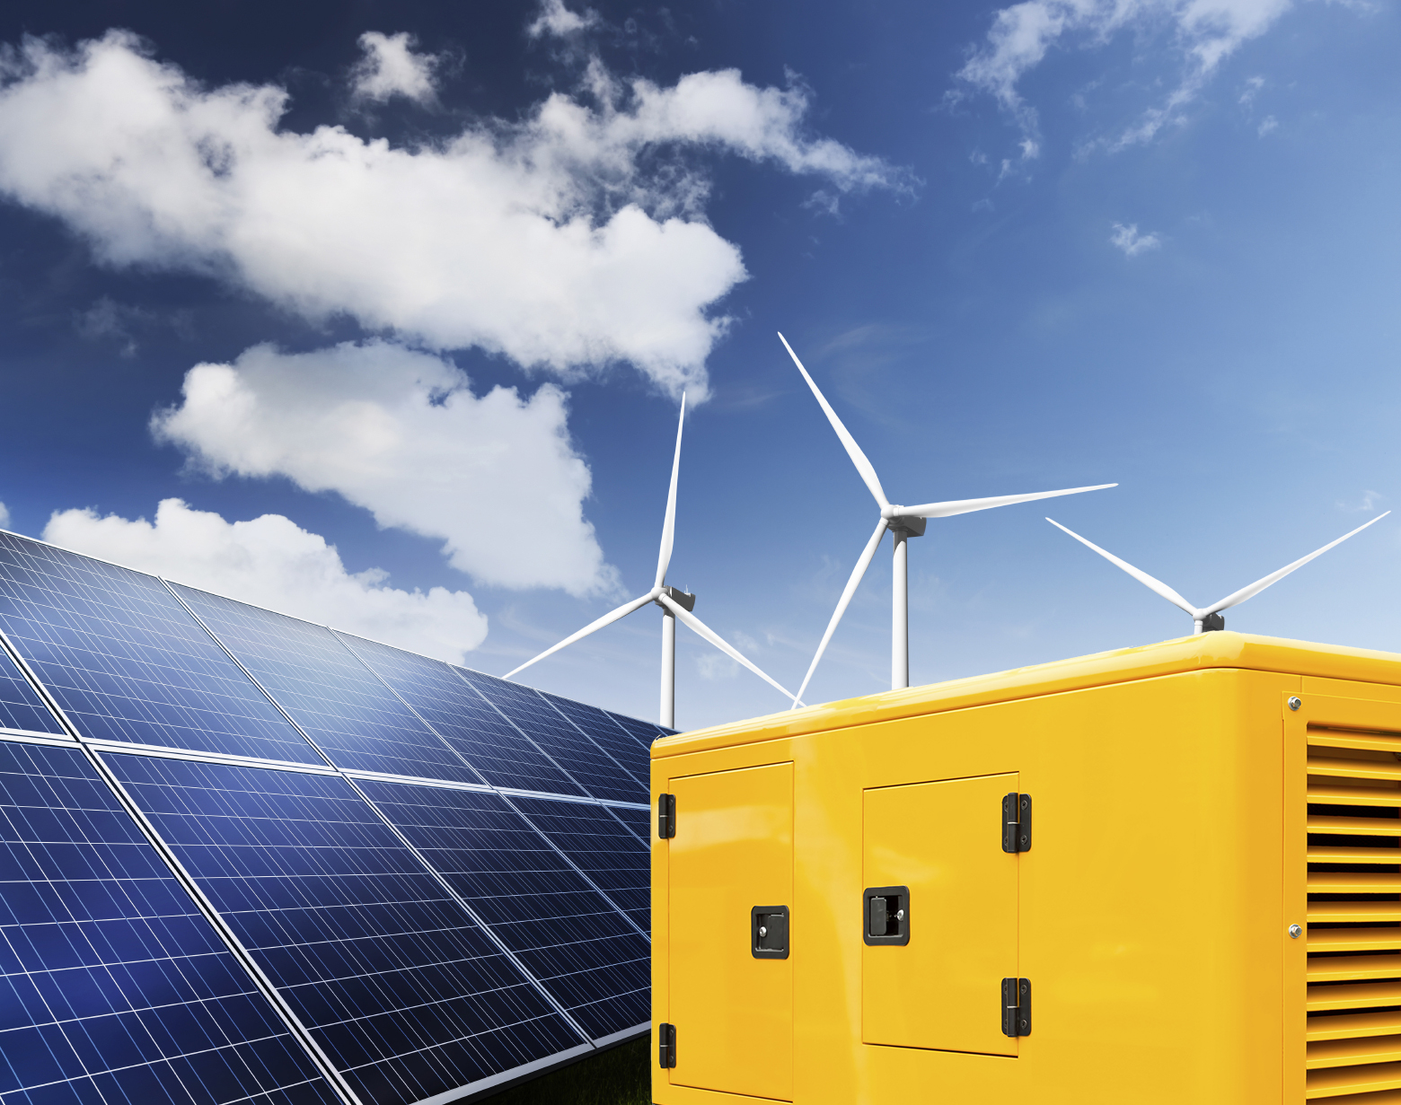
Hybrid Microgrids
Diesel Power and Renewables
Chris Pye

Slide 2
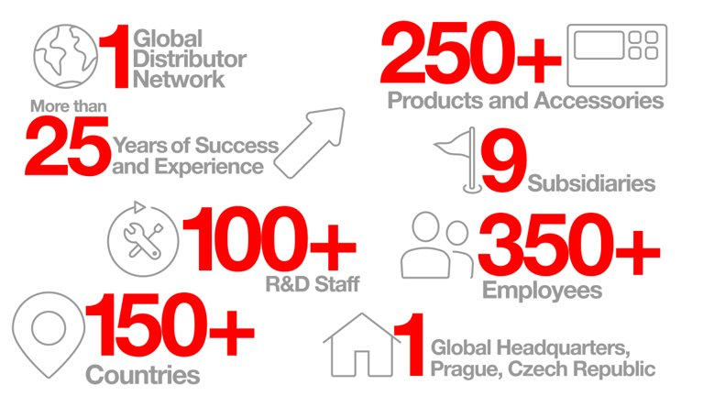

Slide 3
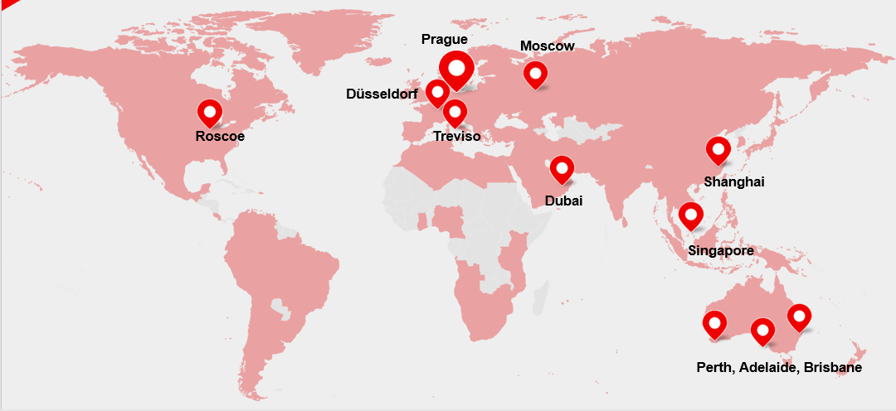
ComAp’s Global Subsidiaries

Slide 4
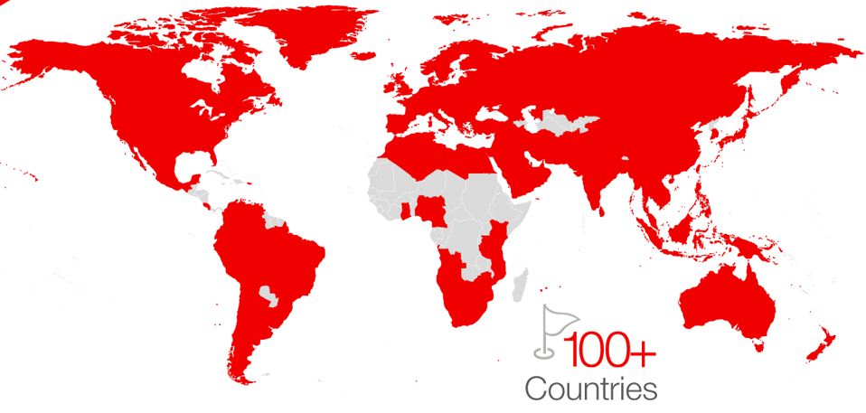
One ComAp
Worldwide distribution network
Notes:
Local presence, customized solutions

Slide 5
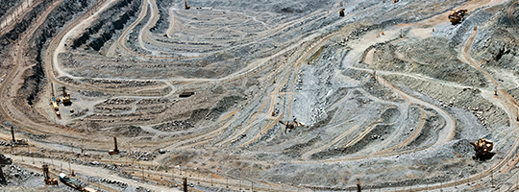


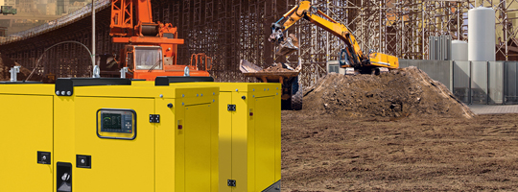
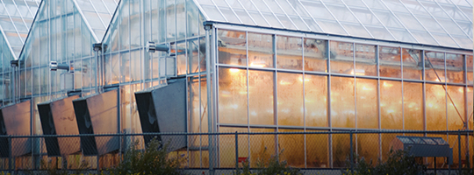
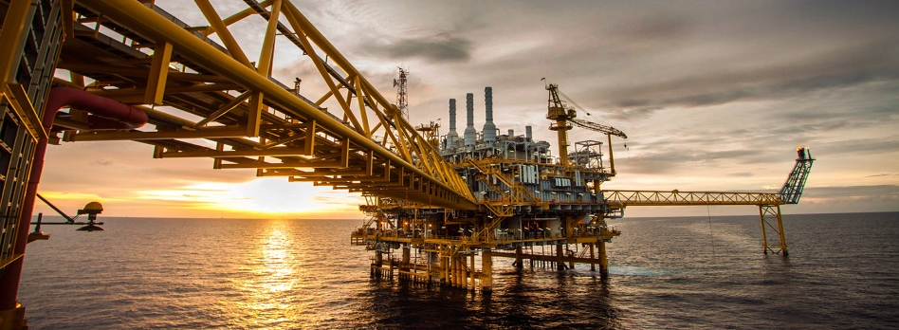
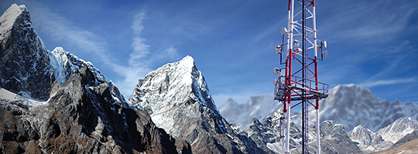

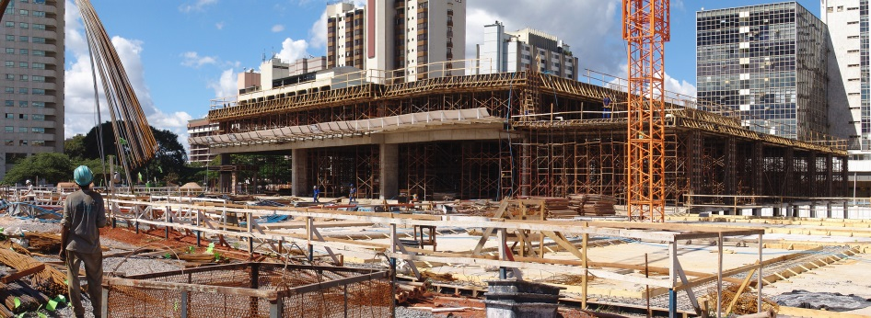
ComAp´s Market Segments
MINING
MARINE
RENEWABLES
RENTAL
AGRICULTURE
OIL AND GAS
COMMERCIAL BUILDINGS
TELECOMMUNICATIONS
CONSTRUCTION

Slide 6
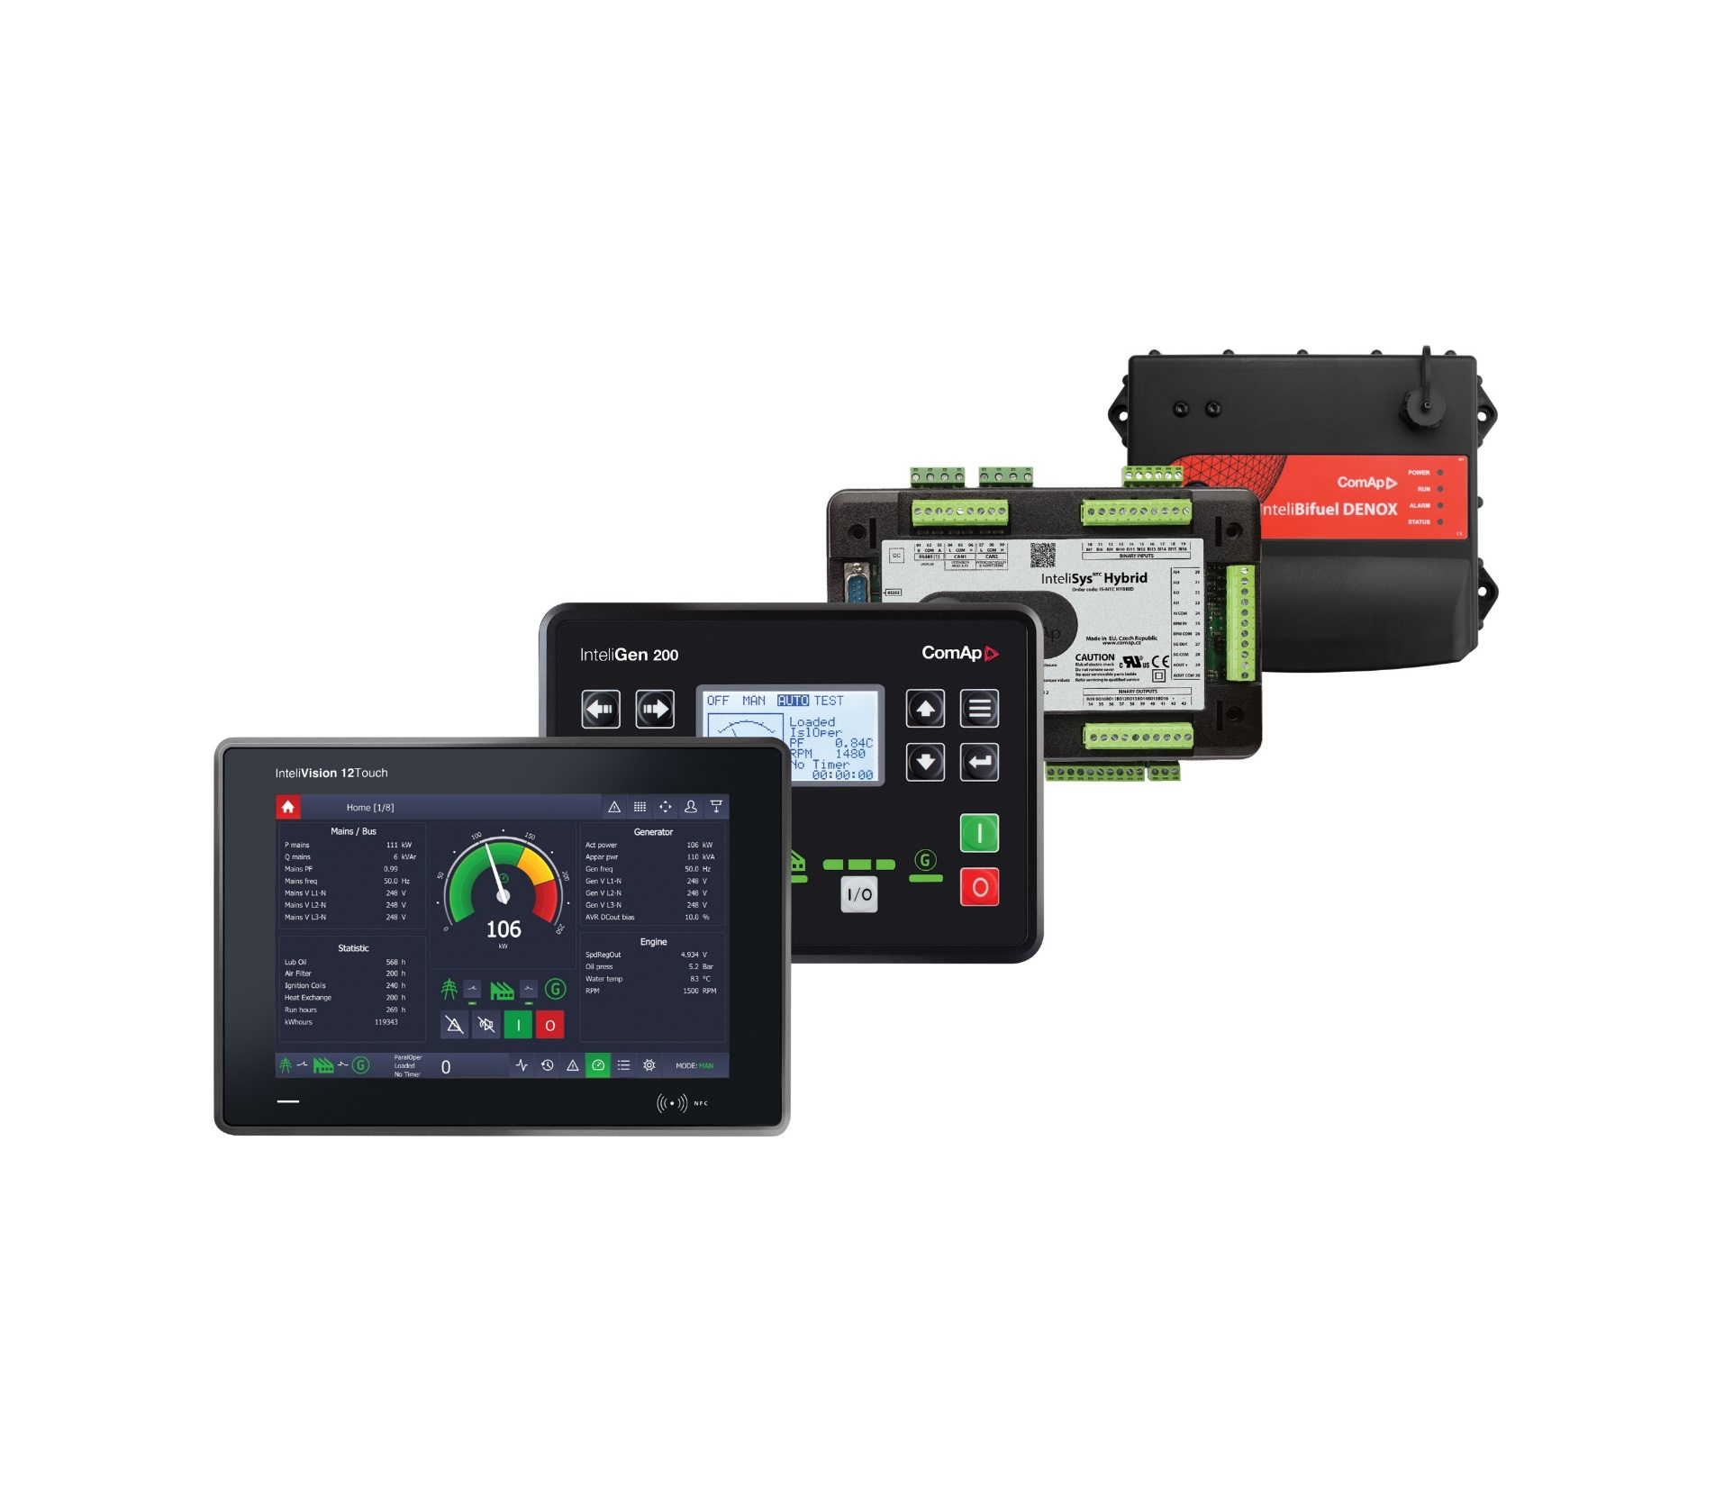
Smart and reliable solutions for every application
Single gen-set applications
Parallel gen-set applications
Complex power generation applications
Mains Protections
Engine driven applications
Advanced drive applications
Bi-fuel applications
Hybrid applications
Telecom applications
Gas applications

Slide 7
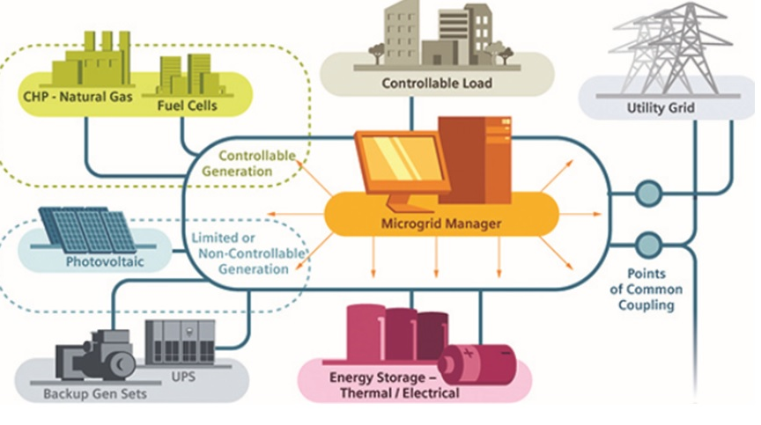
Hybrid Microgrids – the trend of today
Notes:
What is a microgrid?
Why it becomes such a hot topic?
Why the PV-Diesel combination is so popular?
What are the benefits?

Slide 8
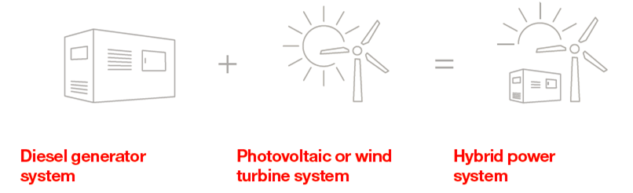
PV-Diesel Hybrid System
Hybrid application combines reciprocating engine/s (genset/s) and a renewable source/s of power
On-grid as well as off-grid applications

Slide 9
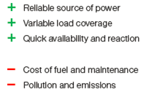
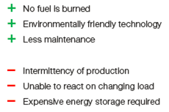
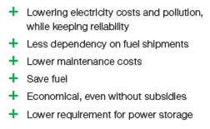
The benefits of a Hybrid System

Slide 10
Microgrids – benefits for all parties?
Utilities & DNOs
  Enable higher penetration of RNW energy resources without the risk of power outages and/or instability.
Aggregators
  New business models, innovative technologies, challenging system integration
End users
  Significant reduction of OPEX
  Lower dependency on the fuel supplier and pricing structure
  Reduced emissions production and air pollution
Investors
  Help the end users to avoid the upfront investment

Slide 11
Challenges
Technical
  Parallel operation of various resources still not an easy option for many
  The demand on control is high only with high penetration (over 60% penetration)
  Stability and reliability of the system is the most challenging issue
Financial
  Territories with diesel subsidies are not motivated to invest
  The upfront investment is often the barrier
  The IPP business model can be a solution, but price dependency on the provider can be a deal breaker
Notes:
The upfront investment is the barrier preventing much faster and wider deployment of hybrids
is suitable, but customers dislike the dependancy on the price from the provider

Slide 12

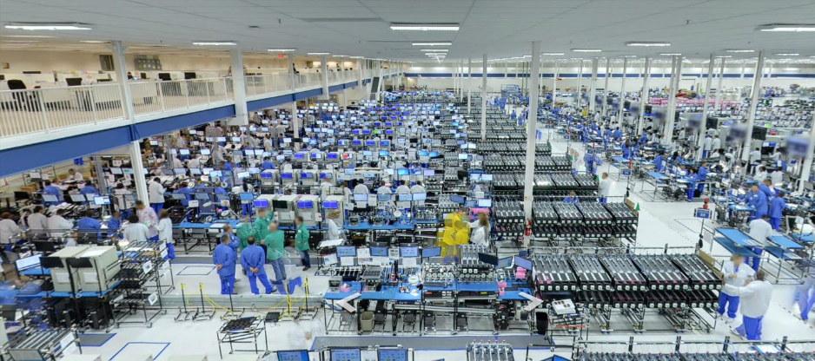

End user landscape
MINING
OIL AND GAS
MILITARY
RENTAL
AGRICULTURE
PRODUCTION
COMMERCIAL BUILDINGS
TELECOMMUNICATIONS
REMOTE RESORTS

Slide 13
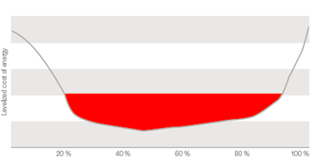
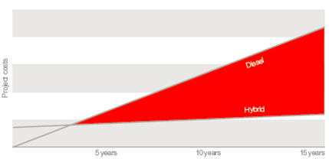



The economy of the system
The highest system profitability is achieved within 40 – 60% of PV penetration
The typical break even point can be as short as 4 years

Slide 14
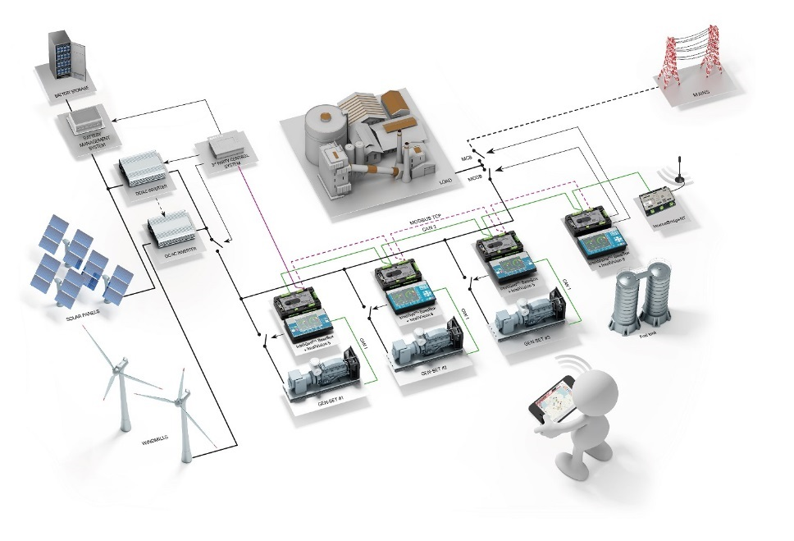
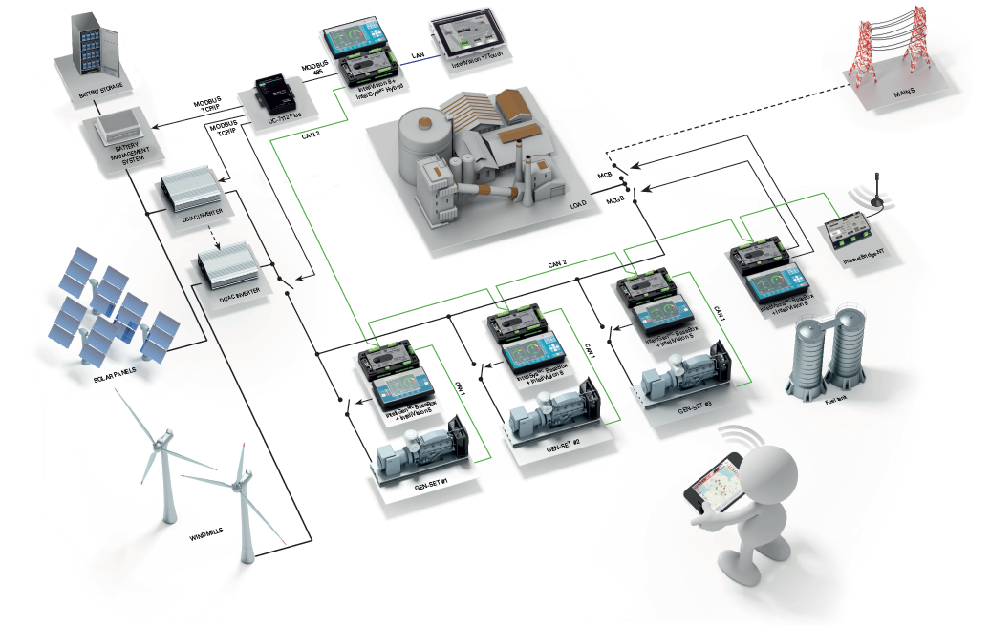
Microgrids/Hybrids – Commercial Offerings
Solution 1 – ComAp slave
Solution 2 – ComAp master
3rd party master controller
ComAp
IS-NTC-Hybrid
ComAp IGS-NT-Hybrid fw
Notes:
Highlight the solution with one genset!

Slide 15
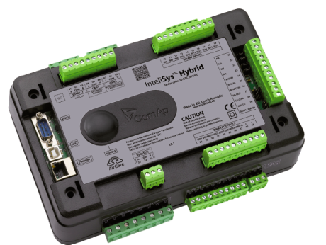
InteliSys NTC Hybrid control system
  Master controller for hybrid applications
  Smooth interface with gen-set controllers over CAN
  Communication with the PV inverters over Modbus (RTU or TCP/IP)
  Predefined interface to a number of well-known inverters
      SMA, ABB, Fronius, Delta, Huawei, KACO
  Extensive statistics of renewable energy production
  Extensive statistics of gen-set(s) energy production
  Prevention of the gen-set(s) underloading
  Reduction of the PV output only when necessary
  Smart power management and load sharing to accommodate maximum RNW energy

Slide 16
Complex hybrid application

Slide 17
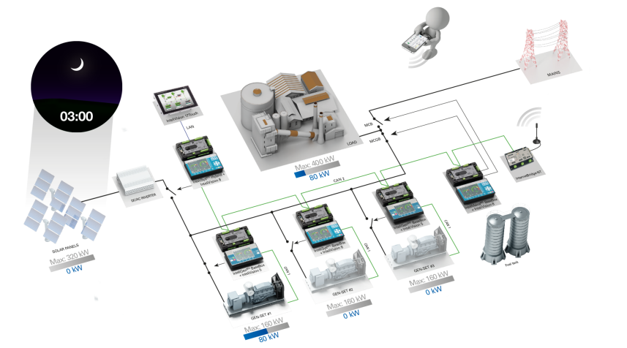
ComAp hybrid power management
  In the case that grid is not available, ComAp controllers will control the site to match the genset output with the load
  This picture represents the low load during the night

Slide 18
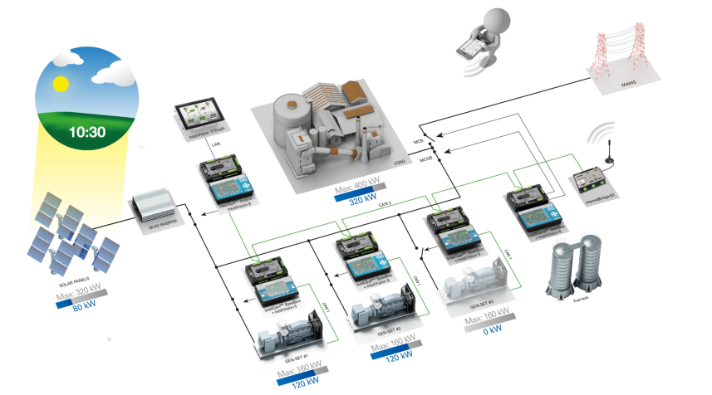
ComAp hybrid power management
  During the morning the PV power plant starts to produce power
  ComAp controllers adjust the output of the gen-sets according to the PV output to match the load

Slide 19

ComAp hybrid power management
  In the middle of the day the PV output reaches the highest output
  In this case the gensets run under-loaded

Slide 20

ComAp hybrid power management
  In standard power management one of the gen-sets would be shut down but in this case this would endanger the reliability of the whole system
  The output of the PV is reduced in order to protect the gen-sets from being under-loaded

Slide 21

ComAp hybrid power management
  When the PV plant is covered by cloud ComAp controllers will automatically load the gen-sets to keep the smooth power delivery

Slide 22
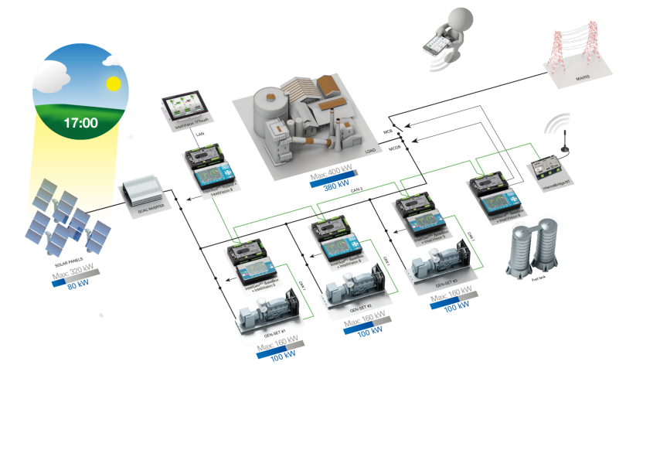
ComAp hybrid power management
  During the afternoon the PV output is decreasing and the load is typically increasing
  The controllers will start, synchronize and load more gensets to cover the load

Slide 23
Energy storage in microgrids
  Different usage
  Storing excess energy
  Offsetting the power output of the renewable energy source
  Offsetting load fluctuations
  Peak shaving
  UPS (Uninterruptible Power Supply)
  Prime power supply
Energy storage options
  Pumped hydroelectric storage
      Favourable environmental conditions necessary
      Time consuming construction
      High investment costs
      + Most cost-effective means of storage for large amounts of energy
      + Renewable Energy
  Flywheel
      + Long lifetime (from 10⁵, up to 10⁷ cycles of use)
      + Little or no maintenance
      + High specific energy and large power output
      Costs
  Super capacitors
      + Very high energy per unit volume
      + Much faster charging than batteries
      + Many more lifecycles than batteries
Notes:
Flywheel = mechanical device to store rotational energy, The amount of energy stored in a flywheel is proportional to the square of its rotational speed

Slide 24
Batteries for microgrids
Li-Ion
      Low capacity
      Lot of control electronics due to the risk of ignition
      Worse performance out of recommended temperature range
      Lower number of cycles
      + Affordability
Lead-Acid
      Low energy-to-weight and energy-to-volume ratio
      Not designed for deep discharge
      Dangerous components
      + Low price
      + High energy-to-power ratio
NMC (Nickel-Manganese-Cobalt)
NCA, LCO, …
LiFePO4 (LFP)
      - High price
      + High safety
      + High number of cycles
      + High discharge currents
      + One big pack – simple and less prone to failure

Slide 25
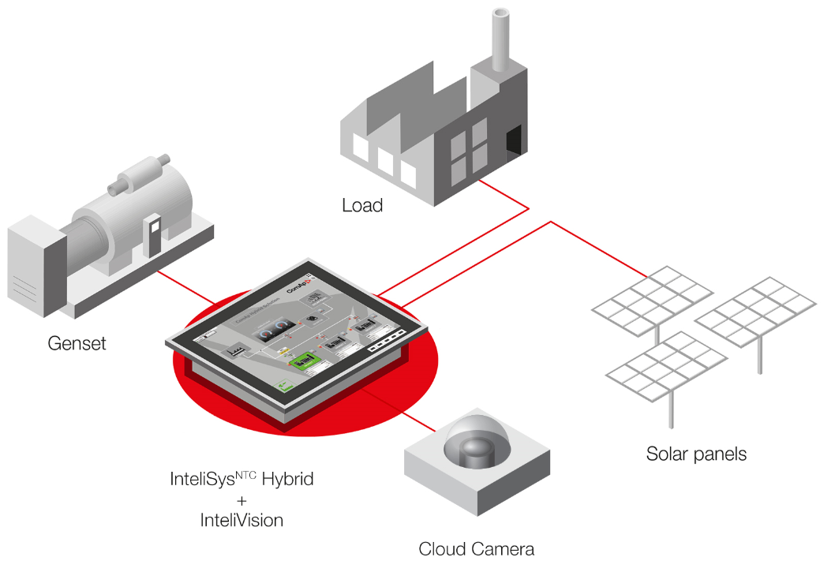
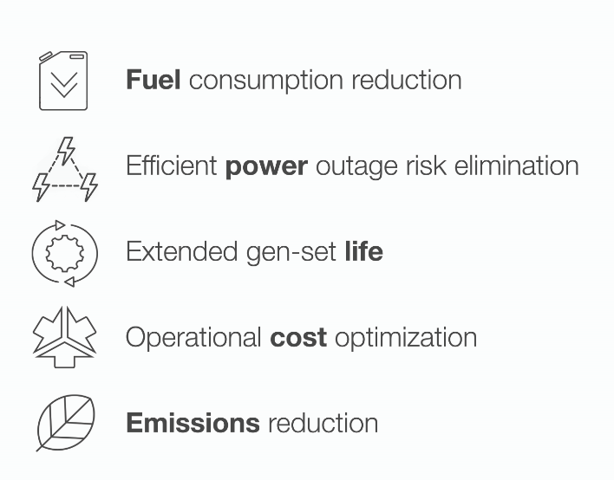
Cloud forecasting system

Slide 26
Reference projects
- Lessons learnt

Slide 27

Peter Island, British Virgin Islands
Four diesel gen-sets (540kW each) and two wind turbines (259kW each)
ComAp provided highly optimized power management for lower load reserve and efficient automatic control of the gen-sets operation to offset wind farm output fluctuations
Fuel consumption costs cut by $500,000 per year

Slide 28
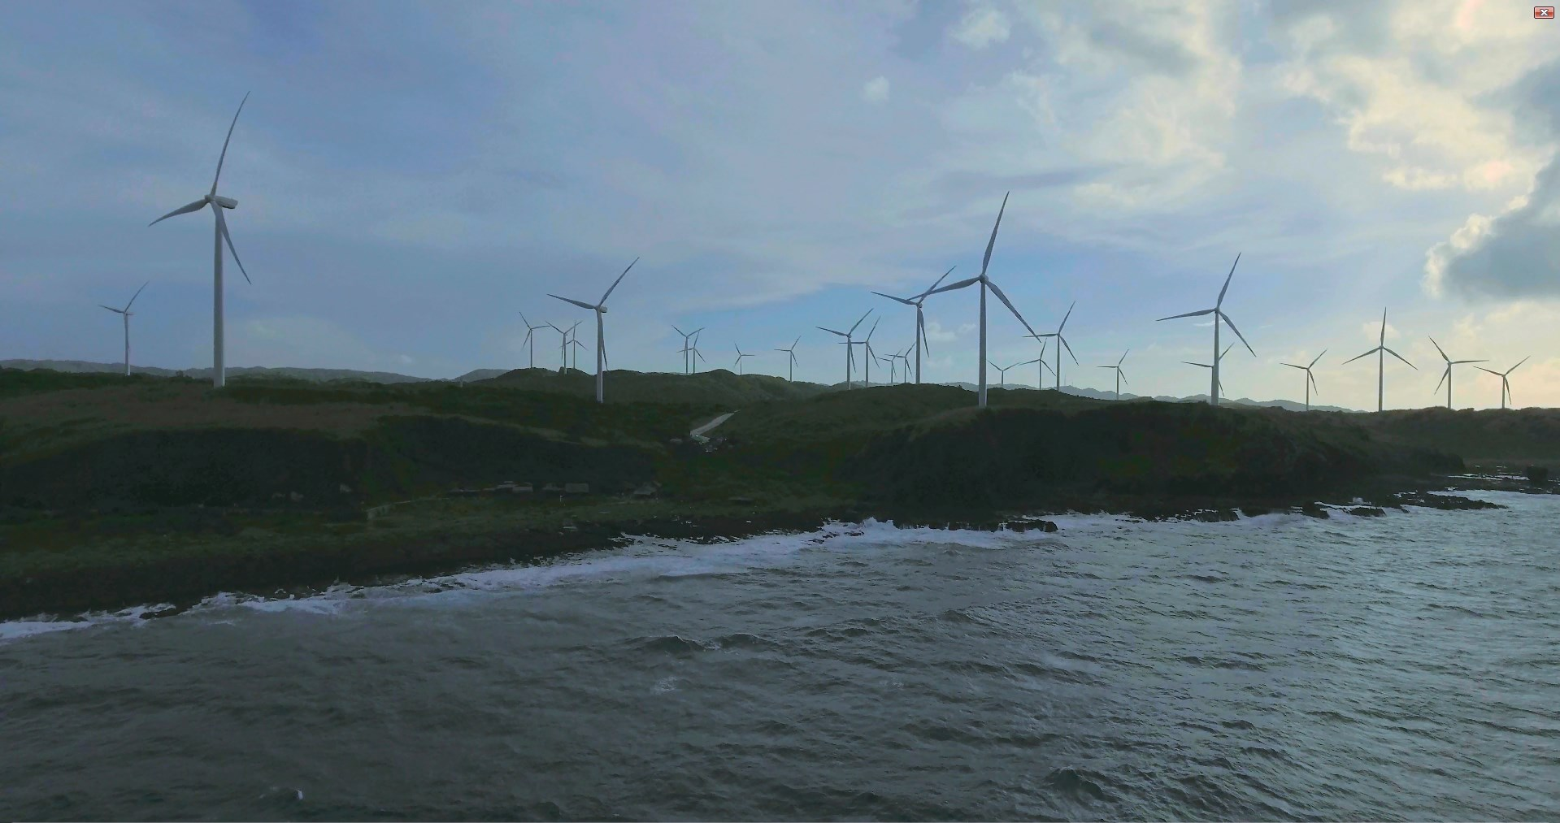
Wind-diesel power plant
Burgos Island, Philippines
Burgos Wind Farm
The largest wind farm in South East Asia; production of 233 GWh/year to provide power for a million households
ComAp installed control system on back-up gensets for emergency power
  Load picked up within 20s; zero spinning reserve required
  Prevention of damage in high speed wind
  Maximized fuel savings and efficiency while keeping high safety standard

Slide 29

Solar-Diesel Hybrid Power Plant
Kiribati
Tarawa Island
Full automation of three 1400 kW low speed diesel generator systems and 500 kWp photovoltaic power plant
The hybrid system saves approximately 227,000 litres of diesel every year
Prevention from around 627 tons of CO₂ from being released into the atmosphere

Slide 30

Wind-Diesel Hybrid Power Plant
Vanuatu
Two 4 MW slow-speed engines along with a 3 MW wind farm
The installed control system has allowed the wind energy penetration to be as high as 70% without any energy storage system

Slide 31

Solar-Diesel Hybrid Power Plant
Rarotonga
Diesel gen-sets (slow speed and high speed sets, total 8.5 MW) and PV power plant (0.65 MW)
ComAp provided smart power management and load sharing between the low speed and high speed diesel gen-sets to optimize the power supply and diesel consumption
Automation of originally manual operation minimized the spinning reserve, improved fuel consumption and lowered the operation costs

Slide 32



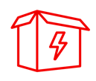
ComAp’s services for hybrid applications
Pre-sales service
Consultancy
Engineering – projects design
System Configuration
Gen-set controllers retrofitting
Commissioning
Training
After-sales support

Slide 33

Save Fuel and Maximize Power System Reliability
That’s smart control

Slide 34

Thank you for your attention
www.comap-control.com
chris.pye@comap.com.au

