Slide 1

Sustainable Energy Industry development Project:
Resource Mapping
PPA Conference
31 July 2017
Isabel Neto
Senior Energy Specialist, World Bank Group
Katherine Baker
Consultant, World Bank Group
Notes:
ESMAP is a multi-donor trust fund administered by The World Bank, with membership and funding contributions from 12 countries;
It is The World Bank’s primary source of funding for energy sector technical assistance, and is active in most client countries;
ESMAP launched an initiative on Renewable Energy Resource Assessment and Mapping in 2013, and has an active portfolio of country projects in over 20 countries covering biomass, small hydro, solar and wind mapping. Geothermal is handled separately. The initiative is led by Oliver Knight, who is based in Washington DC;
This presentation will focus on solar mapping, and will showcase some recent developments and relay some of our lessons learned;

Slide 2
Resource Mapping - Phased Approach
Phase 1: Preliminary resource mapping output based on satellite and global atmospheric and meteorological data
Initial resource estimate at the country level based on a mesoscale model using satellite and re-analysis data; preliminary validation using existing ground-based data.
ESMAP-led, solar maps published completed for PICs June 2017, wind maps to be completed by November 2017
Phase 2: Ground-based data collection
Ground-based measurement campaign using high-quality measurement devices, with real-time data transmission and reporting, for the purpose of validating and improving the mesoscale model and generating reliable benchmarking data.
PPA-led, RFP expected to be published in August 2017
Phase 3: Production of validated resource atlas based on satellite and ground-based data
Preparation of validated resource maps and atlas reports that describe the final outputs, methodology and process, and include provision of the final geographic information system (GIS) data.

Slide 3
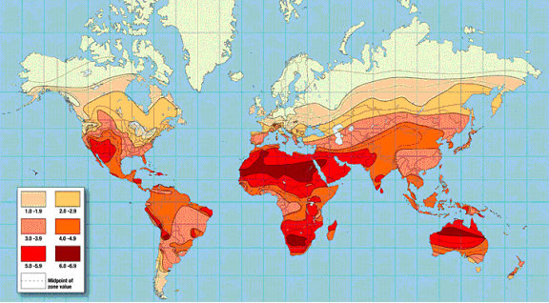
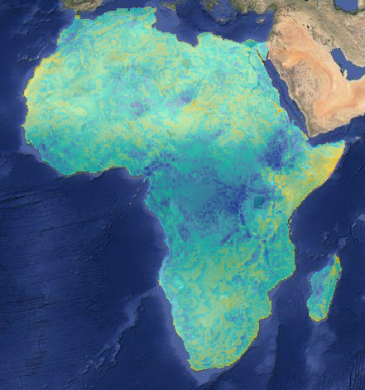
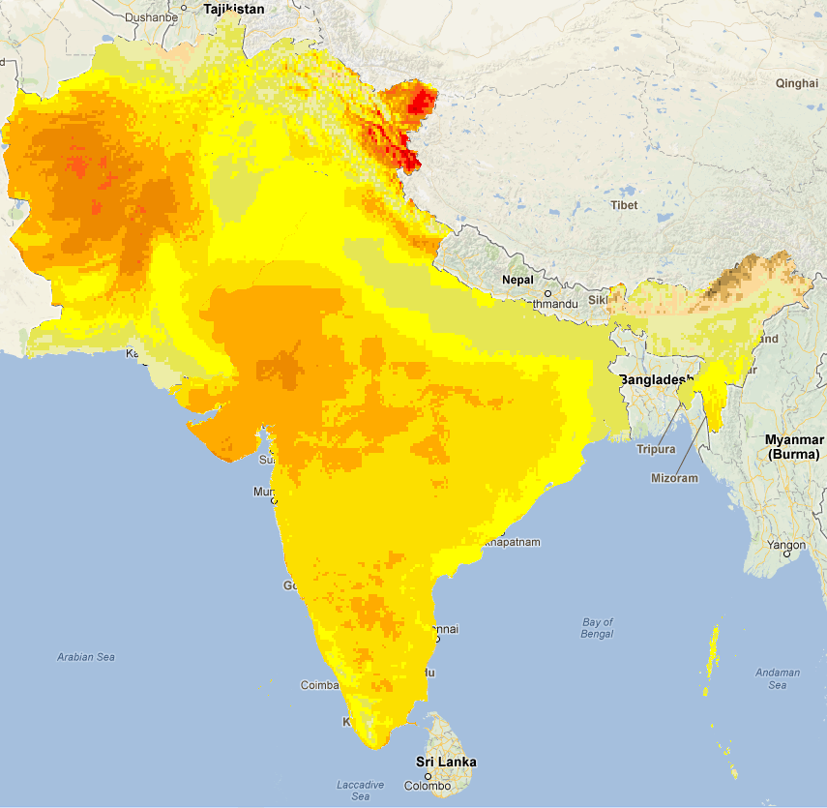
Existing Maps - Proliferation and confusion
Notes:
Solar mapping efforts over the last 10-15 years have been sporadic and mainly country-focused;
Maps were generated using different methodologies so limited consistency and a lot of duplication and overlap;
Most maps did not include or benefit from ground-based measurement campaigns because these were not included in prior efforts.

Slide 4
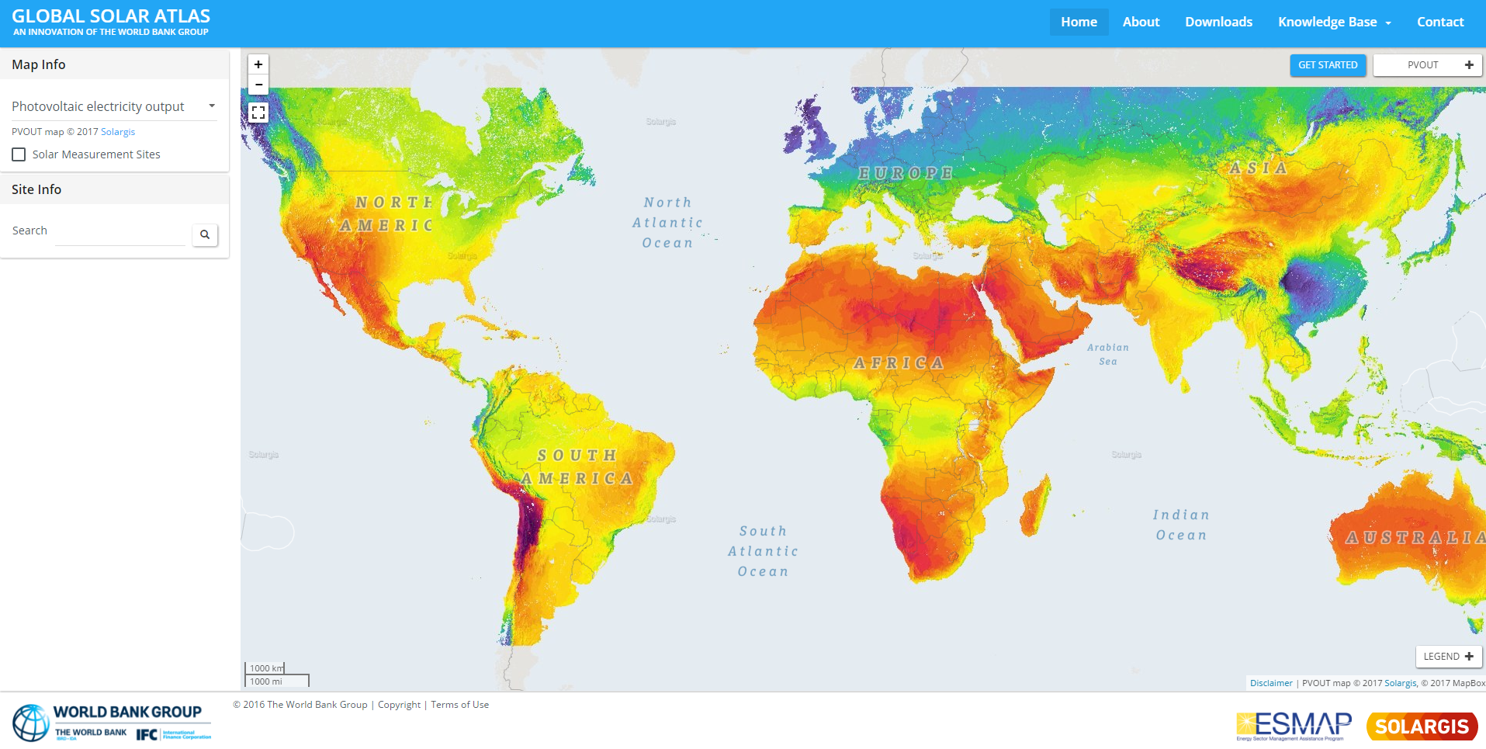
Global Solar Atlas
Launched in January 2017, maps for PICs available since end June 2017
Based on high quality modeled solar data from Solargis
Around 65,000 visitors since launch
Poster maps and GIS layers for all developing countries
http://globalsolaratlas.info
Notes:
Global Solar Atlas is a global web-based tool and a repository for downloadable solar maps and GIS data covering all developing countries;
Uses high quality modeled solar data from Solargis, one of the leading commercial providers of solar resource data, based on 17+ years of satellite and reanalysis data;
Consistent data covering globally, with resolution of 1 km;
Desktop and smartphone accessible.
Global Wind Atlas to be relaunched in November 2017 with updated information and World Bank branding – globalwindatlas.com

Slide 5
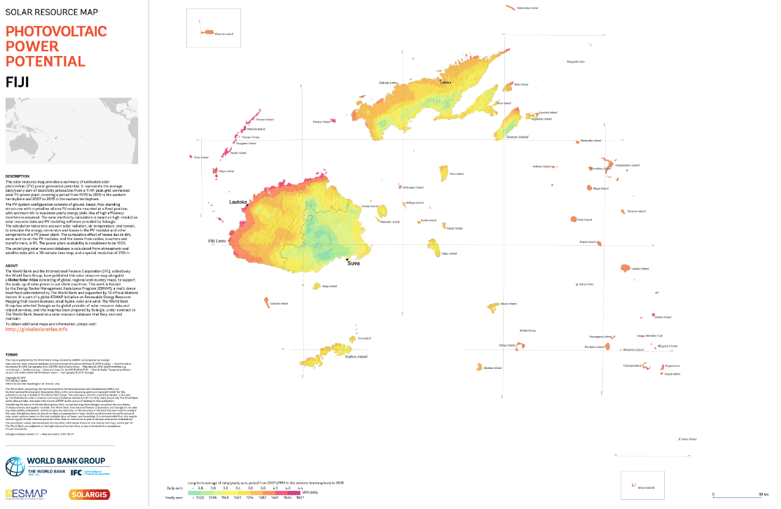
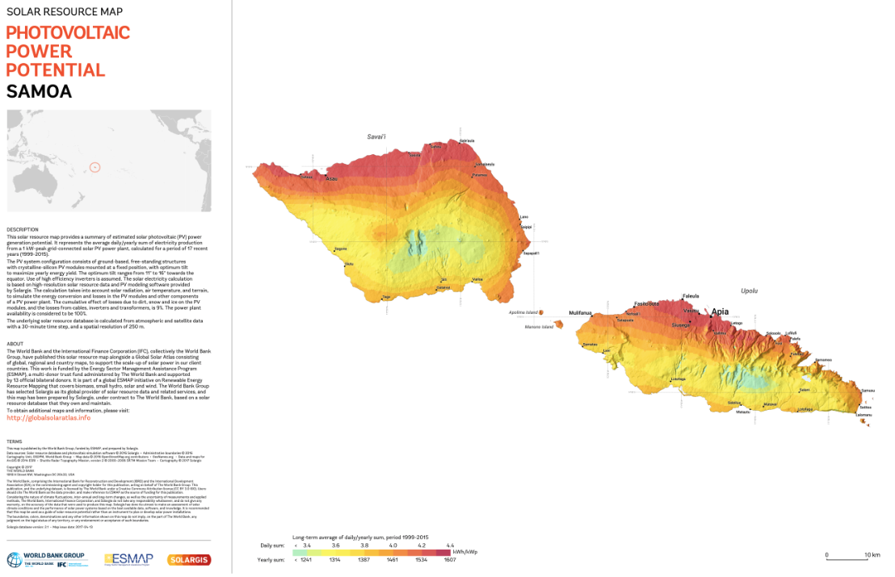
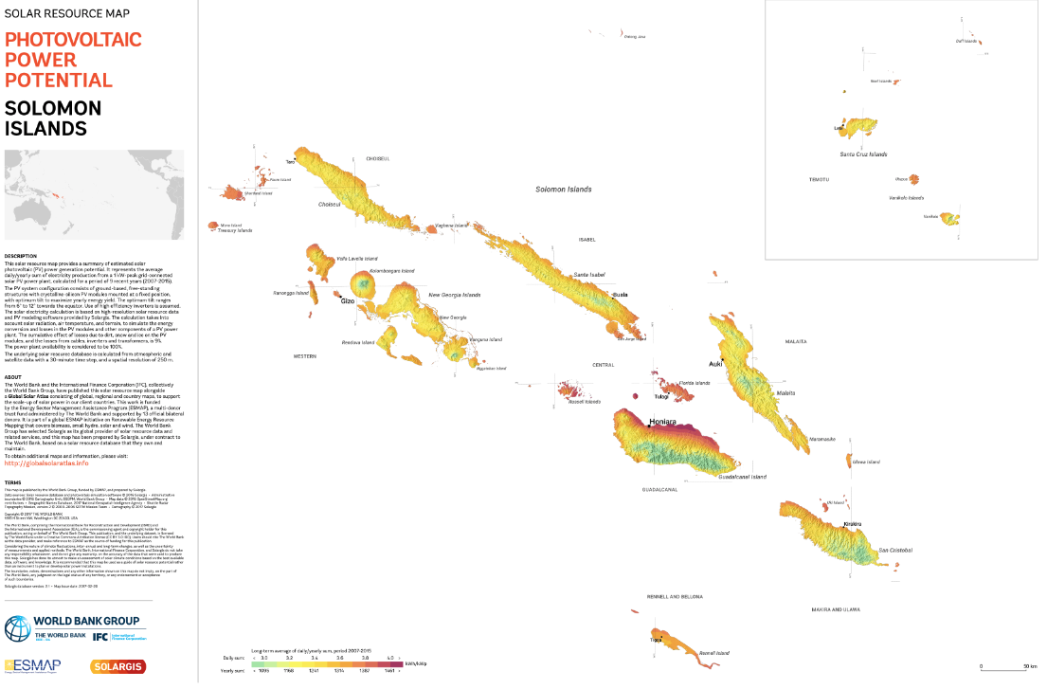
Mapping completed!
Notes:
As a result of the Global Solar Atlas effort commission by ESMAP, mapping for all countries has been completed!
This eliminates the need to commission any more solar maps for countries or regions, as the best data is now in the public domain;
Three maps are available for each country/region:
Global Horizontal Irradiation (GHI, relevant for solar PV);
Direct Normal Irradiation (DNI, relevant for CSP);
PV Power Potential (PVOUT), which is our preferred map format for communicating the useable resource for solar PV.
On the GSA some other data layers are available, including Global Tilted Irradiation (GTI).
Maps are available as high and lower resolution files ready for professional printing, and GIS layers can be downloaded for use in GIS applications.
Poster maps currently available for all PICs and the smaller sized maps will be available by the end of August 2017.

Slide 6
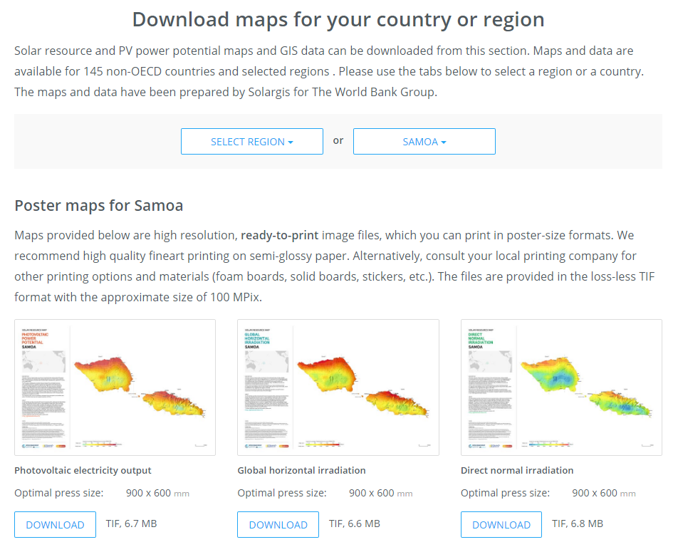
Easy to Use Downloads
Go to: http://globalsolaratlas.info/downloads
Poster maps and GIS layers easy to download
User guide: http://globalsolaratlas.info/knowledge-base/user-guide
FAQ: http://globalsolaratlas.info/knowledge-base/faq
Has anyone used the site already? Feedback?
Notes:
Global Solar Atlas is a global web-based tool and a repository for downloadable solar maps and GIS data covering all developing countries;
Uses high quality modeled solar data from Solargis, one of the leading commercial providers of solar resource data, based on 17+ years of satellite and reanalysis data;
Consistent data covering globally, with resolution of 1 km;
Desktop and smartphone accessible.

Slide 7
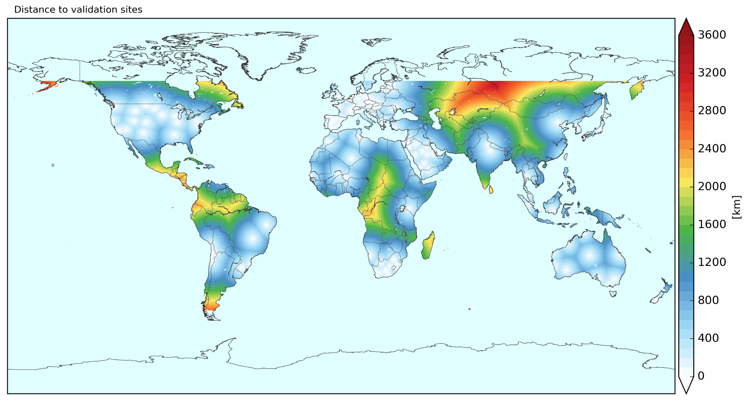
But uncertainties remain
Notes:
Uncertainties in the Solargis data (and from other commercial providers) is higher where there are no high quality ground-based measurements with which to validate the modeling outputs and improve the model performance;
Depending on the location and the availability of ground data it can range between 2%-8%;
The gaps in the measurement ‘network’ or coverage are biggest in developing countries, as one might expect.

Slide 8
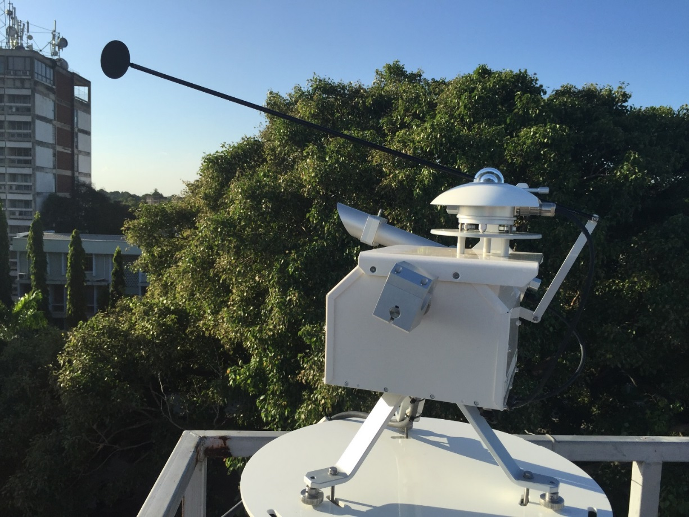
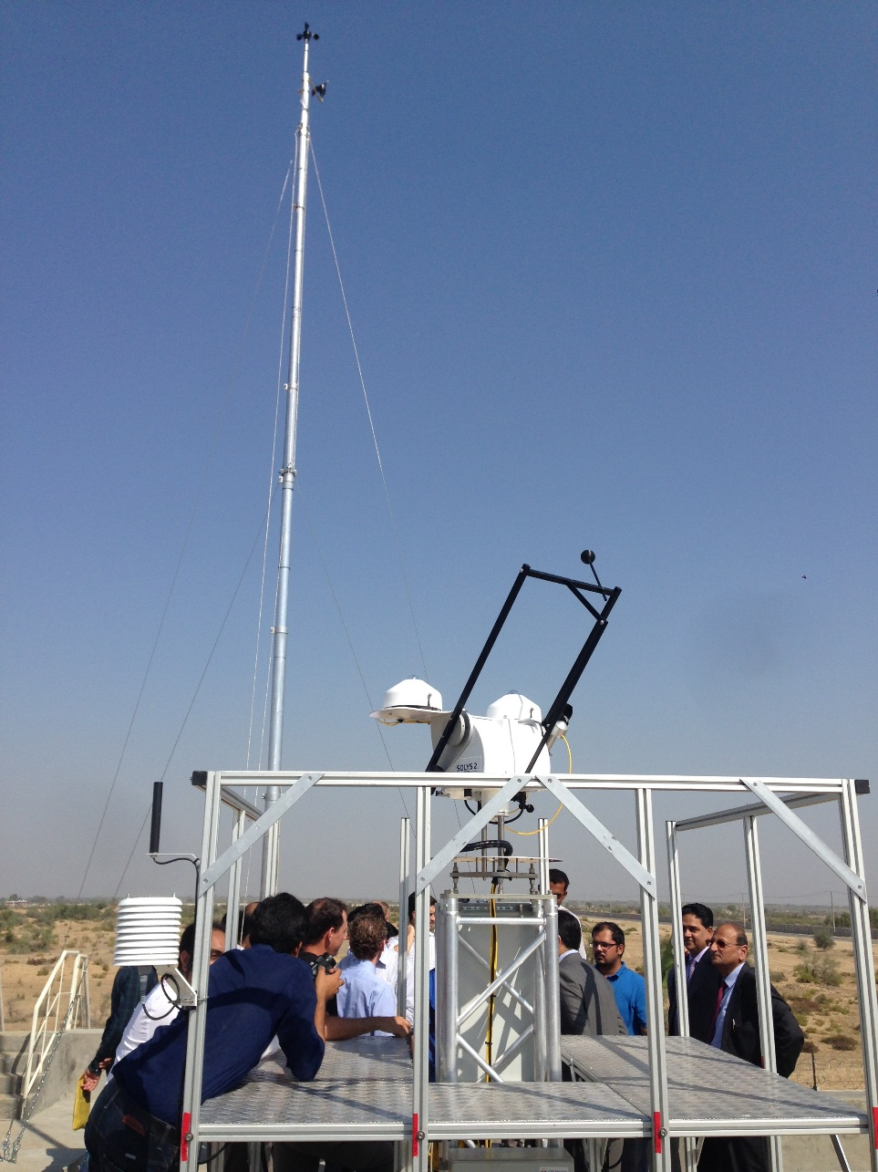
Need to invest in high quality measurement data
Notes:
Uncertainties in the modeled solar resource data can be reduced by carrying out regional or site adaptation and validation of the satellite-based modeled data using ground measurement data from special instruments;
ESMAP has been conducting publicly funded measurement campaigns across various countries since 2015, with completed or live projects in Bangladesh, Malawi, Maldives, Pakistan, Tanzania, Vietnam, Zambia. Additional countries to be added soon, including in East Africa. [See table as annex material if there are specific questions on the portfolio of country projects];
It is crucial that any publicly-funded measurement campaign uses high quality equipment and pays attention to correct installation and maintenance procedures.
PPA is leading the first recipient-executed management of Phase 2 and the RFP for this work will be issued shortly.

Slide 9
Country Project Pipeline
Country | Funding | Source | Biomass | Small Hydro | Solar | Wind
Bangladesh | $500,000 | ESMAP / ASTAE |  |  | ✓ | ✓
Burundi* | - | ESMAP |  |  | ✓
Ethiopia* | $1,600,000 | ESMAP |  |  | ✓ | ✓
Indonesia | $750,000 | ESMAP |  | ✓
Kenya* | - | ESMAP |  |  | ✓
Madagascar | $1,350,000 | ESMAP |  | ✓
Malawi | $710,000 | ESMAP |  |  | ✓
Maldives | $2,415,000 | ESMAP / ASTAE |  |  | ✓ | ✓
Nepal | $1,800,000 | ESMAP |  |  | ✓ | ✓
Pacific Islands (10 countries) | $2,200,000 | SIDS-DOCK |  |  | ✓ | ✓
Pakistan | $4,350,000 | ESMAP / ASTAE | ✓ |  | ✓ | ✓
Papua New Guinea | $1,900,000 | ESMAP / ASTAE |  |  | ✓ | ✓
Rwanda* | - | ESMAP |  |  | ✓
Somalia | $1,000,000 | In-country trust fund |  |  | ✓ | ✓
Sudan* | - | ESMAP |  |  | ✓
Tanzania* | $2,350,000 | ESMAP |  | ✓ | ✓ | ✓
Uganda* | - | ESMAP |  |  | ✓
Vietnam | $1,765,000 | ESMAP | ✓ | ✓ | ✓ | ✓
Zambia | $3,600,000 | ESMAP |  |  | ✓ | ✓
Notes:
Table includes just ESMAP-funded projects coming under the global initiative;
There are other projects that the WB is involved in that are not ESMAP-funded, but where we provide expertise and advice;
The red ticks show countries that were added in the last year, in part through an East Africa regional solar measurement campaign that will start in FY18.

Slide 10
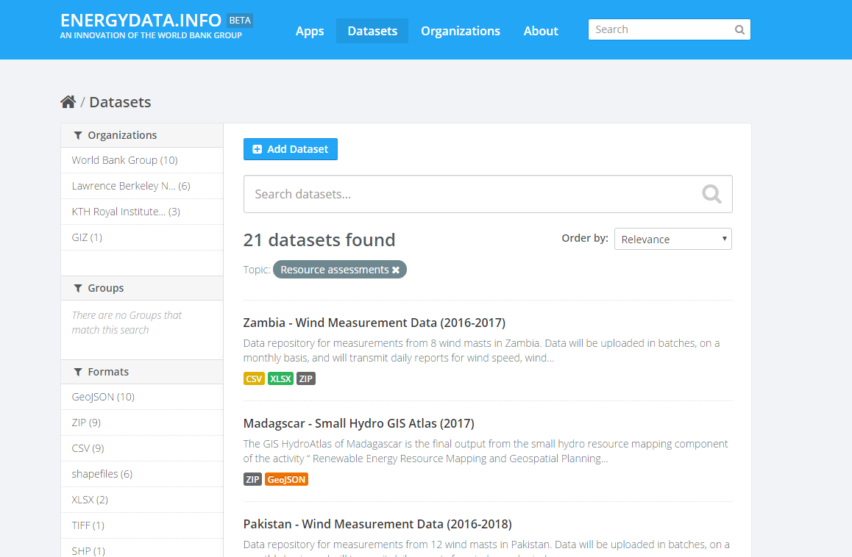
Publishing the Data is essential
https://energydata.info
Notes:
Key to a publicly-funded measurement campaign is for all the data (including meta-data) to be published and easily accessible, for the following reasons;
Transparency: Ensure that publicly-funded measurement data stays in the public domain and is not ‘spontaneously privatized’ or selectively distributed;
Data access: Ensure data can be used by all the other modeling firms, and by project developers directly. Other modeling firms can benefit from the data sets to improve their models and bring better consistency in the data. Developers can use the data to perform site-specific calculations and to validate any modeling data that they are using;
Support other users: There are a range of other users (academia, meteorologists, commercial firms) that are likely to make use of such data.
All data generated under the ESMAP-funded projects is uploaded to our freely-accessible ENERGYDATA.INFO platform, which is also open to clients and development partners who need a way to public energy sector data (including measurements).

Slide 11
















Researching the cost-benefit of measurements
x 10 = US $1m
x 1GW = ? potential economic benefit
Notes:
Research project undertaken over the last six months;
Considered the case where publicly-funded measurement data is available for at least two years;
Measurement data is then incorporated into solar resource models, which is then made available to developers, who factor it into their bid price for electricity in solar auctions;
Research question: What is the economic benefit of this reduced uncertainty spread over 1 GW of solar PV capacity

Slide 12
Lower uncertainties lead to lower cost
Lower Uncertainty
Site adaptation can reduce GHI uncertainty from 8% to 3.5%
Lower Tariff
For the same IRR, tariff can be reduced by 6%
Economic Benefits
For a total of 1 GW installation, reduced cost of electricity can lead to economic benefits of US$89m
Regional Adaptation can reduce the uncertainty from 8% to 5%
Increases the P90 output of the PV plant
Notes:
Assumptions:
Medium capacity factor of 17% (1500 kWh/kWp)
Project IRR of 12%
Capex $1/W
Tariff can go down from 8.3 c to 7.8 c per kWh
Result: Deployment of 10 measurement stations costing up to US$1m can lead to reduced tariff due to lower project risks, resulting in approximately US$89m of lifecycle economic benefit for 1 GW of solar installed.
Conclusion: This is a very high cost-benefit ratio, and shows the value of investing in publicly-funded measurements.

Slide 13
Consolidation is now needed
Requirements for the industry
Use, disseminate and improve the Global Solar Atlas
Invest in public measurement campaigns
Publish data to help improve the models
Things to avoid
Further solar mapping
Use of old resource data and maps
Cut corners when investing in measurements
Future Plans
Enhancements of the Global Solar Atlas
Relaunch improved Global Wind Atlas by end of 2017
Publish guidance on measurement campaigns
Notes:
Assumptions:
Medium capacity factor of 17% (1500 kWh/kWp)
Project IRR of 12%
Capex $1/W
Tariff can go down from 8.3 c to 7.8 c per kWh
Result: Deployment of 10 measurement stations costing up to US$1m can lead to reduced tariff due to lower project risks, resulting in approximately US$89m of lifecycle economic benefit for 1 GW of solar installed.
Conclusion: This is a very high cost-benefit ratio, and shows the value of investing in publicly-funded measurements.

Slide 14
Contact Details
ESMAP website: www.esmap.org/re_mapping
Oliver Knight: oknight@worldbank.org
Leopold Sedogo: lsedogo@worldbank.org

